Slide 1
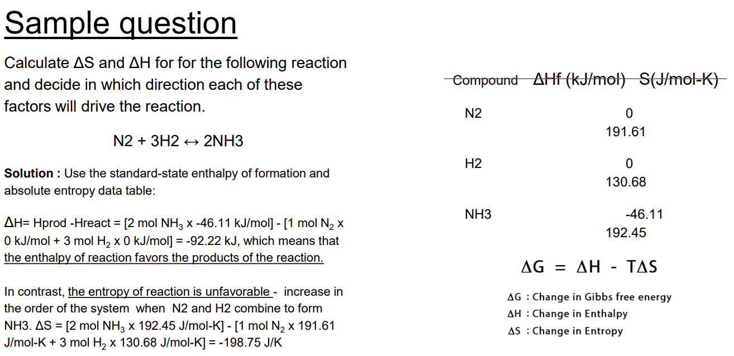

Slide 2
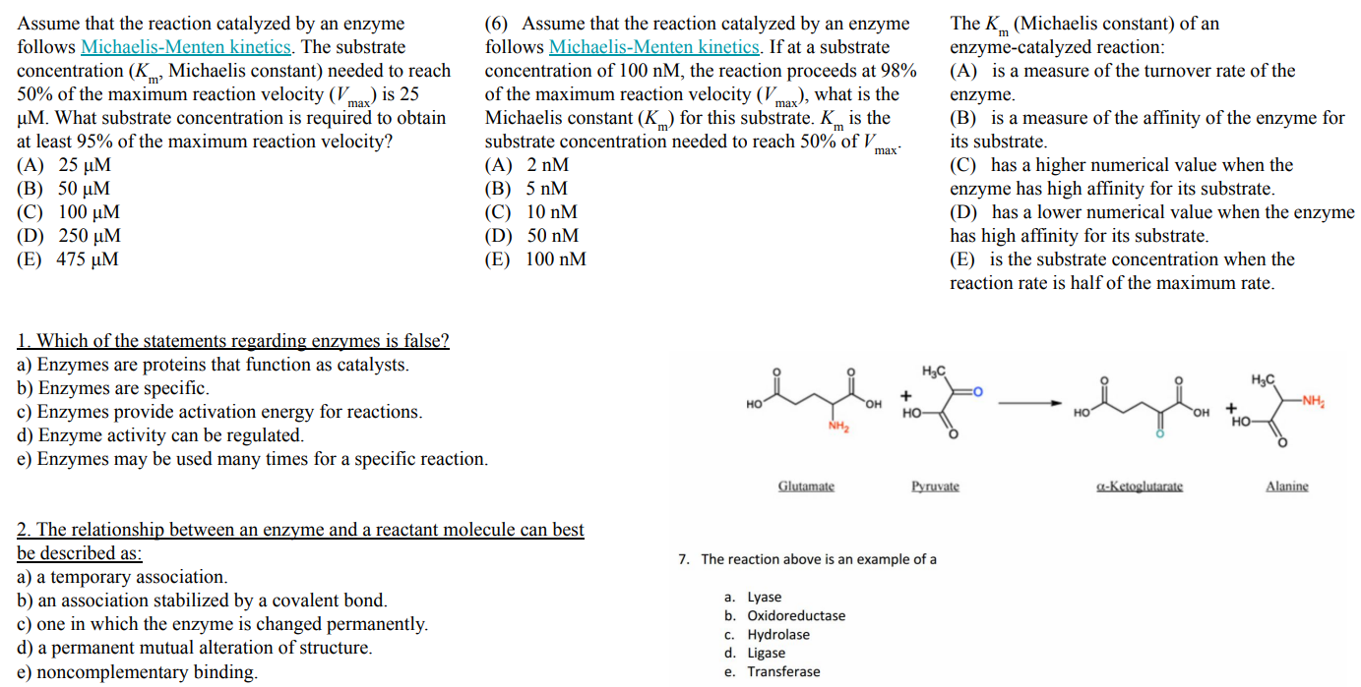

Slide 3
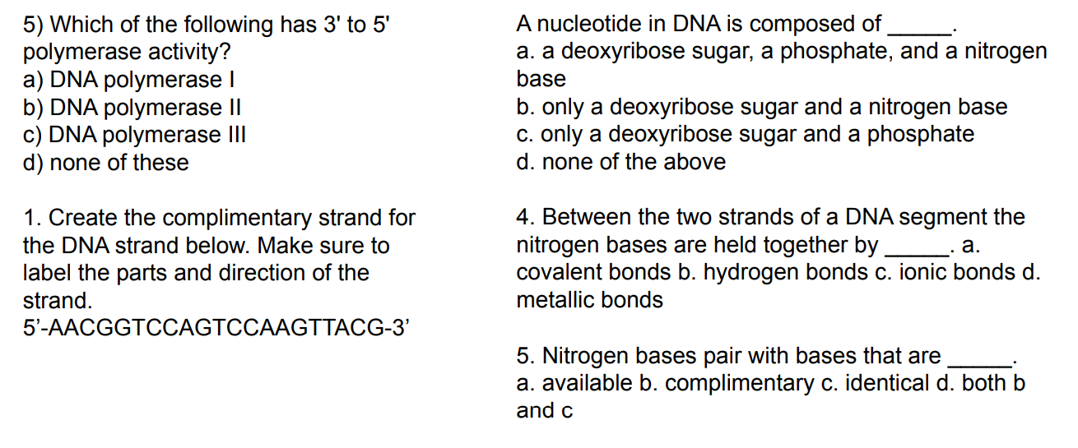
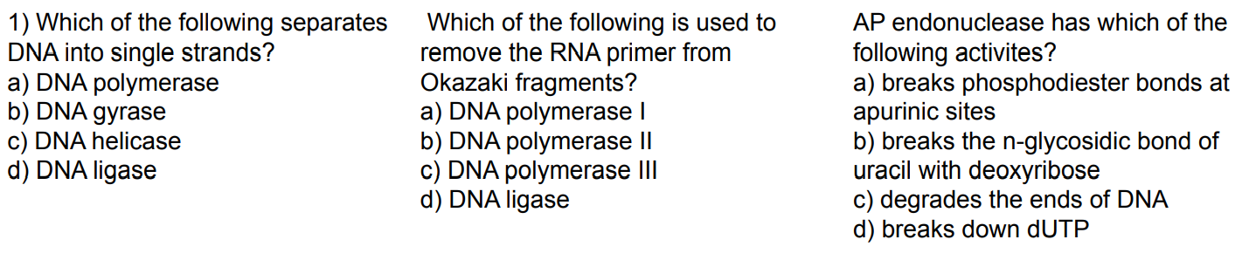

Slide 4
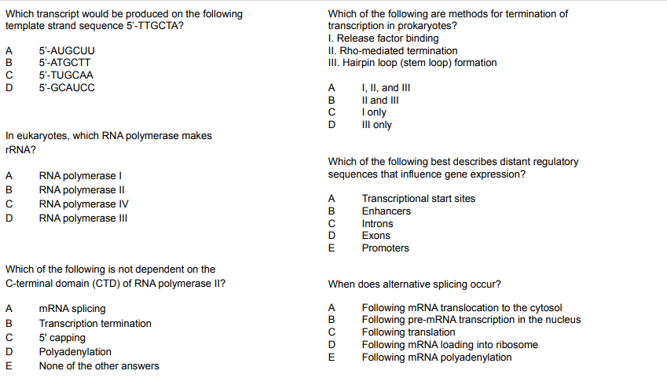

Slide 5
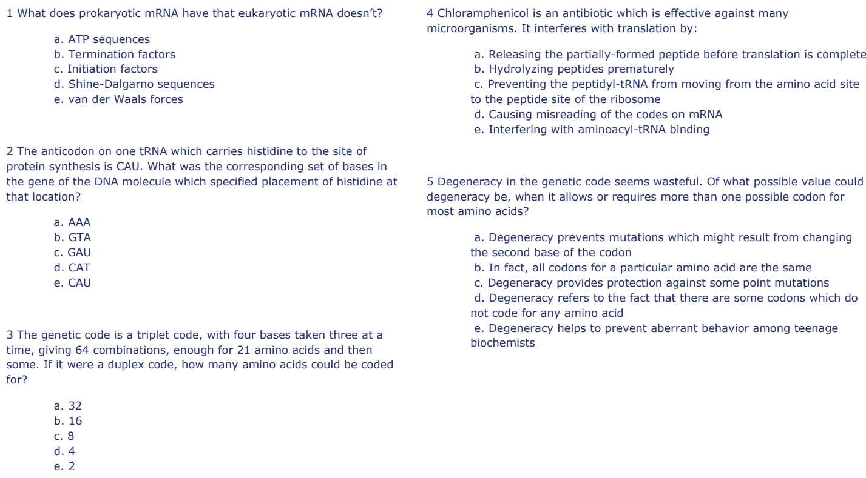

Slide 6
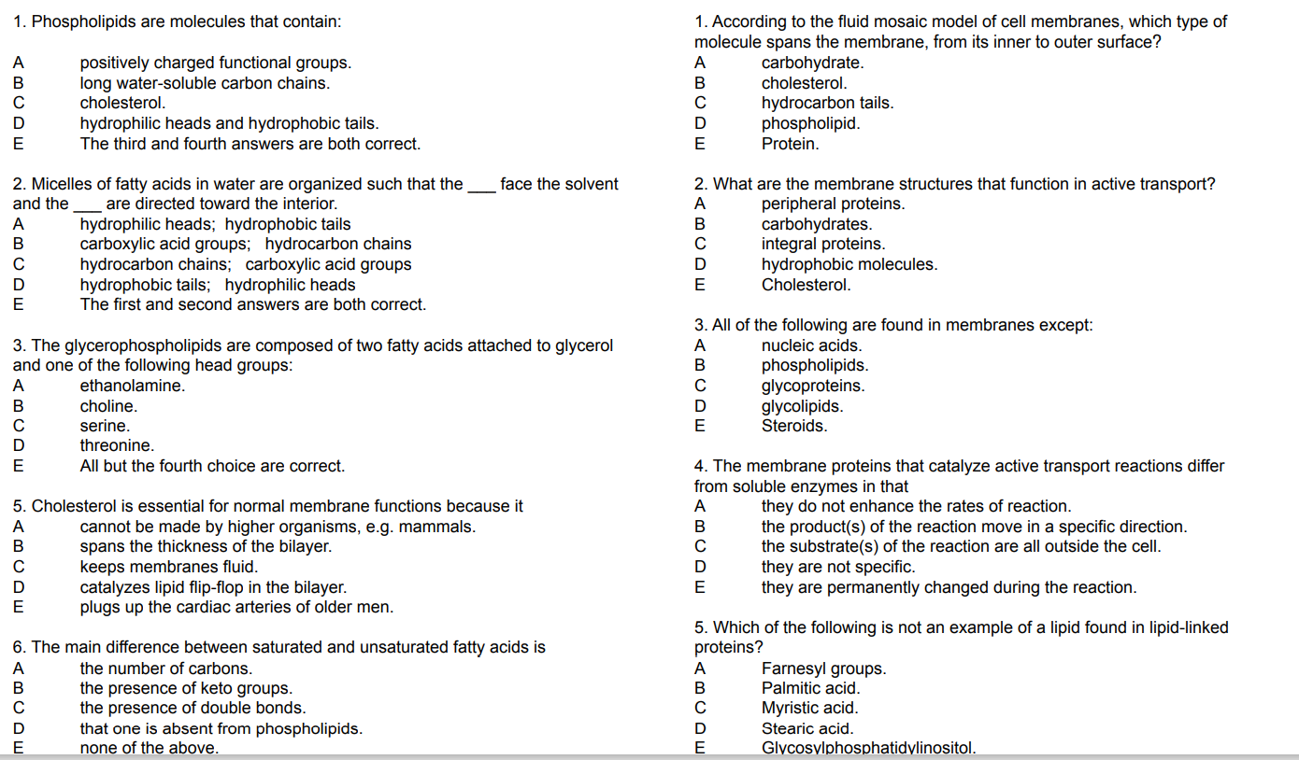

Slide 7
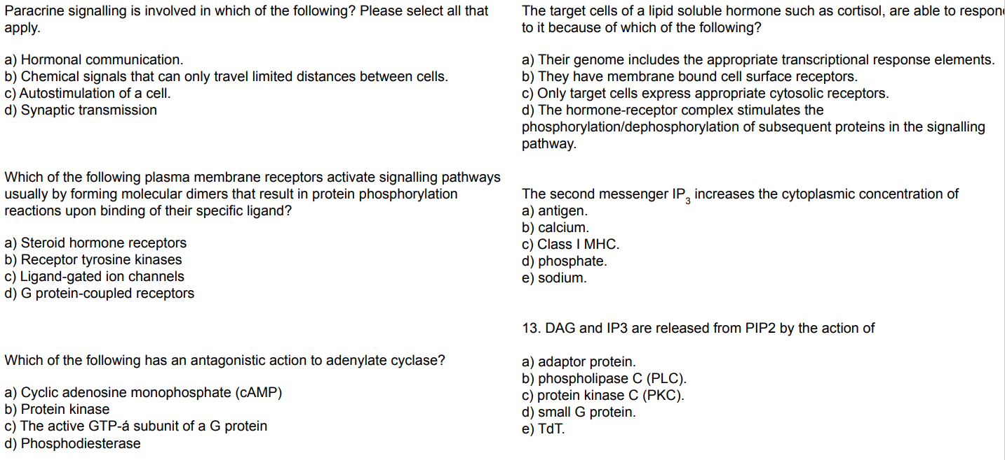

Slide 8
Question 1
Paracrine signalling is involved in which of the following? Please select all that apply.
a) Hormonal communication.
b) Chemical signals that can only travel limited distances between cells.
c) Autostimulation of a cell.
d) Synaptic transmission.
Question 2
Which of the following statements are true of the group of signalling molecules called eicosanoids? Please select all that apply.
a) Eicosanoids are derivatives of arachidonic acid.
b) Eicosanoids include prostaglandins, thromboxanes and leukotrienes.
c) Eicosanoids are usually autocrine signalling molecules.
d) Eicosanoids can be synthesized from fatty acids derived from membrane phospholipids.
Question 3
Which of the following plasma membrane receptors activate signalling pathways usually by forming molecular dimers that result in protein phosphorylation reactions upon binding of their specific ligand?
a) Steroid hormone receptors
b) Receptor tyrosine kinases
c) Ligand-gated ion channels
d) G protein-coupled receptors
Question 4
Which of the following has an antagonistic action to adenylate cyclase?
a) Cyclic adenosine monophosphate (cAMP)
b) Protein kinase
c) The active GTP-á subunit of a G protein
d) Phosphodiesterase
Question 5
Serine, threonine and tyrosine residues are all subjected to phosphorylation in various signal transduction pathways.
a) True
b) False

Slide 9
Question 1
Paracrine signalling is involved in which of the following? Please select all that apply.
cells.
Correct answer/s:
b) Chemical signals that can only travel limited distances between cells.
d) Synaptic transmission.
Feedback:
Paracrine signalling involves the use of chemical messengers that can normally travel only a limited distance from the cell where they are synthesized.
Question 2
Which of the following statements are true of the group of signalling molecules called eicosanoids? Please select all that apply.
Correct answer/s:
a) Eicosanoids are derivatives of arachidonic acid.
b) Eicosanoids include prostaglandins, thromboxanes and leukotrienes.
d) Eicosanoids can be synthesized from fatty acids derived from membrane phospholipids.
Feedback:
Eicosanoids include prostaglandins, thromboxanes and leukotrienes that generally effect their actions in a paracrine manner. They are synthesized from arachidonic acid using fatty acids obtained in the diet or from cellular sources such as membrane lipids.
Question 3
Which of the following plasma membrane receptors activate signalling pathways usually by forming molecular dimers that result in protein phosphorylation reactions upon binding of their specific ligand?
Correct answer/s:
b) Receptor tyrosine kinases
Feedback:
Binding of ligand alters the conformation of the receptor, allowing it to activate a G protein by GDP-GTP exchange and the subsequent release of the GTP-á subunit.
Question 4
Which of the following has an antagonistic action to adenylate cyclase?
Correct answer:
d) Phosphodiesterase
Feedback:
This enzyme catalyzes the hydrolysis of cAMP (formed by adenylate cyclase) to AMP.
Question 5
Serine, threonine and tyrosine residues are all subjected to phosphorylation in various signal transduction pathways.
Correct answer:
a) True
Feedback:
Serines, threonines and tyrosines residues in proteins are specific phosphorylated in various signal pathways such as those associated with adrenalin, insulin, glucagon and erythropoietin stimulation.

Slide 10
Question 6
The target cells of a lipid soluble hormone such as cortisol, are able to respond to it because of which of the following?
a) Their genome includes the appropriate transcriptional response elements.
b) They have membrane bound cell surface receptors.
c) Only target cells express appropriate cytosolic receptors.
d) The hormone-receptor complex stimulates the phosphorylation/dephosphorylation of subsequent proteins in the signalling pathway.
Question 7
Most organelles of a neuron are distributed throughout the cytoplasm.
a) True
b) False
Question 8
Neurotransmitters are released into the synapse at which of the following?
a) Presynaptic membrane
b) Postsynaptic membrane
c) Golgi apparatus
d) Axon hillock
Question 9
Which of the following apply to the nicotinic acetylcholine receptor? Please select all that apply.
a) Binding of acetylcholine to the receptor induces a conformational change that activates a G protein.
b) Binding of acetylcholine to the receptor induces a conformational change that opens a transmembrane pore allowing Na⁺ and Ca²⁺ to flow into the cell.
c) The nicotinic acetylcholine receptor is a pentamer consisting of five integral polypeptides.
d) Binding of acetylcholine to the receptor induces a conformational change that opens a transmembrane pore allowing Na⁺ and K⁺ to flow into the cell.
Question 10
Transducin is a typical trimeric G protein
a) True
b) False

Slide 11
Question 6
The target cells of a lipid soluble hormone such as cortisol, are able to respond to it because of which of the following?
Correct answer:
c) Only target cells express appropriate cytosolic receptors.
Feedback:
The hormone-receptor complex enters the nucleus and modulates the transcription of an altered protein complement.
Question 7
Most organelles of a neuron are distributed throughout the cytoplasm.
Correct answer:
b) False
Feedback:
Most organelles in a neuron are restricted to the cell body.
Question 8
Neurotransmitters are released into the synapse at which of the following?
Correct answer:
a) Presynaptic membrane
Feedback:
The axon hillock is that part of the neuron where action potentials are triggered.
Neurotransmitters released into the synapse when intracellular vesicles containing the fuse with the part of the plasma membrane of the neuron that forms the presynaptic membrane.
Question 9
Which of the following apply to the nicotinic acetylcholine receptor? Please select all that apply.
Correct answer/s:
c) The nicotinic acetylcholine receptor is a pentamer consisting of five integral polypeptides.
d) Binding of acetylcholine to the receptor induces a conformational change that opens a transmembrane pore allowing Na⁺ and K⁺ to flow into the cell.
Feedback:
The nicotinic acetylcholine receptor is a pentamer consisting of five integral polypeptides. Binding of acetylcholine to the receptor induces a conformational change that opens a transmembrane pore through the receptor allowing Na⁺ and K⁺ to flow into the cell.
Question 10
Transducin is a typical trimeric G protein
Correct answer:
a) True
Feedback:
Transducin resembles other trimeric G proteins in being a lipid anchored trimeric protein, with an á subunit capable of changing conformation in response to the binding of GDP or GTP.

Slide 12
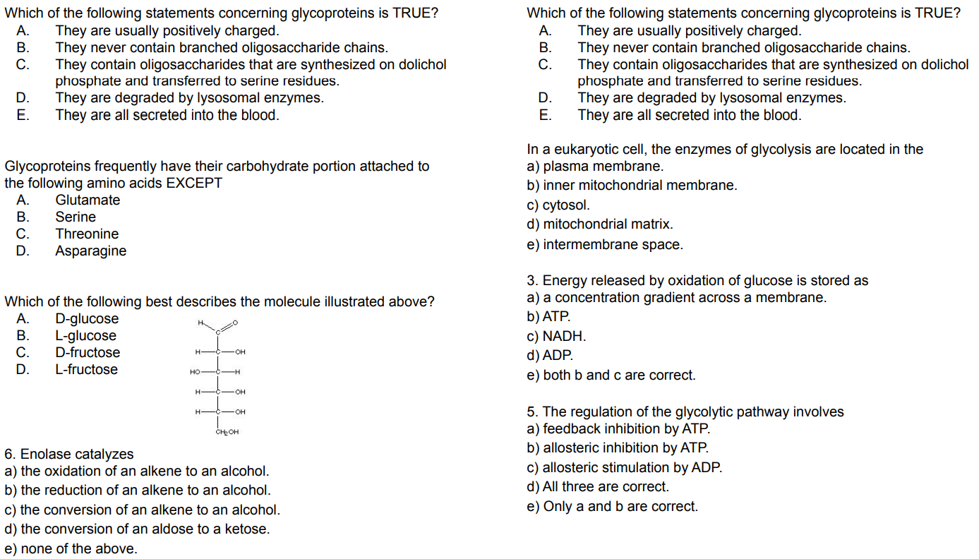
_

Slide 13
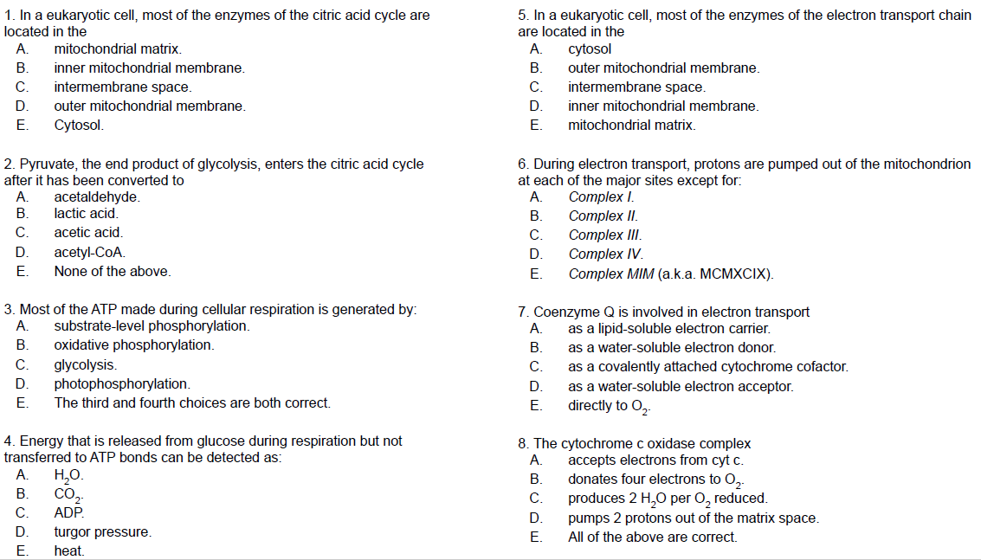

Slide 14
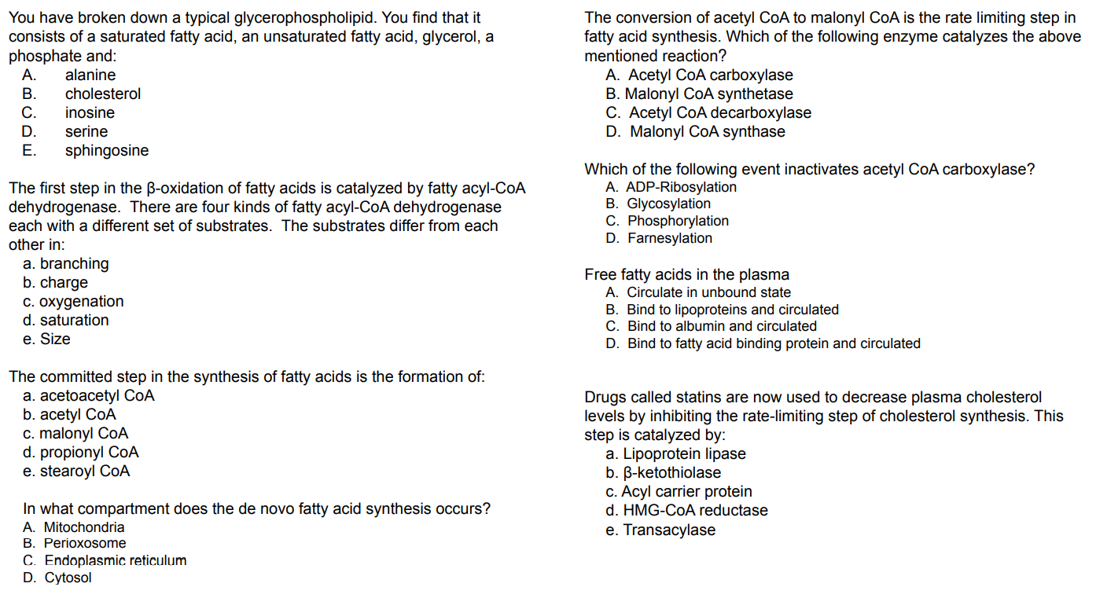

Slide 15
1) Free fatty acids in the plasma
a) Circulate in the unbound state
b) Bind to lipoproteins and circulated
c) Bind to albumin and circulated
d) Bind to a fatty acid-binding protein and circulated
2) In what compartment does the de novo fatty acid synthesis occur?
a) Mitochondria
b) Peroxisome
c) Endoplasmic reticulum
d) Cytosol
3) What is the precursor for fatty acid synthesis?
a) Acetyl CoA
b) Propionyl CoA
c) Succinyl CoA
d) Acetoacetyl CoA
4) The conversion of acetyl CoA to malonyl CoA is the rate-limiting step in the fatty acid synthesis. Which of the following enzyme catalyzes the above-mentioned reaction?
a) Acetyl CoA carboxylase
b) Malonyl CoA synthetase
c) Acetyl CoA decarboxylase
d) Malonyl CoA synthase
5) The acetyl CoA is produced in the mitochondria and must be transported into the cytosol for the synthesis of fatty acid. Which of the following is true regarding the transport of Acetyl CoA?
a) Acetyl CoA is diffused from the mitochondrial membrane
b) Acetyl CoA is transported by its specific transporter protein
c) Acetyl CoA is converted into pyruvate, enters into the cytosol and acetyl CoA is regenerated
d) Acetyl CoA is converted into citrate, enters into the cytosol and acetyl CoA is regenerated.
6) What is the allosteric regulator of acetyl CoA carboxylase?
a) Fatty acid
b) ATP
c) Citrate
d) Acetyl CoA
7) Which of the following event inactivates acetyl CoA carboxylase?
a) ADP-Ribosylation
b) Glycosylation
c) Phosphorylation
d) Farnesylation
8) Which of the following is not a positive regulator of acetyl CoA carboxylase?
a) Excess calories
b) Insulin
c) Citrate
d) Long-chain fatty acid
9) Which of the following enzyme statement is not true regarding fatty acid synthase?
a) Fatty acid synthase is a multifunctional enzyme
b) Fatty acid synthase is active as a dimer
c) Fatty acid synthase is activated by high-calorie food
d) Fatty acid synthase complex is inhibited by its phosphorylation
10) What form of energy is required for fatty acid biosynthesis?
a) ATP
b) NADH
c) NADPH
d) FADH2

Slide 16
11) What is the source of NADPH required for fatty acid synthesis?
a) Pentose phosphate pathway
b) Malic enzyme
c) Both
d) None
12) What is the fate of fatty acid entering the cells?a) Fatty acid diffuses into mitochondria for beta-oxidation
b) Fatty acid is converted into fatty acyl CoA (activated form)
c) Fatty acid is bound to albumin in the cytosol
d) None of the above
13)What is the role of L-carnitine in fatty acid metabolism?
a) Facilitate the transport of fatty acid from the cytosol to mitochondria
b) Serve as a cofactor for enzyme fatty acid synthase
c) Activator of acetyl CoA carboxylase
d) None of the above
14) Identify the correct sequential enzymatic step for fatty acid synthesis:
a) Delta-2-enoyl CoA Dehydrate, Acyl CoA Dehydrogenase, Hydroxy acyl dehydrogenase, Thiolase
b) Hydroxy acyl dehydrogenase, Acyl CoA Dehydrogenase, Delta-2-enoyl CoA Dehydrate, Thiolase
c) Thiolase, Acyl CoA Dehydrogenase, Delta-2-enoyl CoA Dehydrate, Hydroxy acyl dehydrogenase
d) Acyl CoA Dehydrogenase, delta-2-enoyl CoA Dehydrate, Hydroxy acyl dehydrogenase, Thiolase
15) The complete beta-oxidation of palmitoyl CoA yield
a) 8 molecules of Acetyl CoA and 16 NADH
b) 8 molecules of Acetyl CoA and 16 FADH2
c) 8 molecules of Acetyl CoA, 8 NADH, and 8 FADH
d) 8 molecules of Acetyl CoA and 16 NADPH
16) High rate of beta-oxidation in the liver leads to ketogenesis (ketone body synthesis).
Which of the following condition may result in ketogenesis?
a) Uncontrolled Type I diabetes
b) Pregnancy
c) Starvation
d) All of the above
17) Which of the following step is unique to the formation of ketone bodies?
a) Formation of Acetoacetyl CoA catalyzed by thiolase
b) Formation HMG CoA catalyzed by HMG CoA synthase
c) Splitting of HMG CoA to acetyl CoA and acetoacetate catalyzed by HMG CoA lyase
d) Reduction of acetoacetate to 3-hydroxybutyrate catalyzed by 3-hydroxybutyrate dehydrogenase
18) Identify the key regulators of the ketogenic pathway:
a) Acyl CoA/CoA ratio
b) NADH/NAD ratio
c) Insulin/Glucagon ratio
d) All of the above
19) Dicarboxylic aciduria is characterized by the excretion of C6–C10 ω-dicarboxylic acids and by nonketotic hypoglycemia.
Identify the defective enzyme from the following?
a) Long Chain Acyl CoA Dehydrogenase
b) Medium Chain Acyl CoA Dehydrogenase
c) Short Chain Acyl CoA Dehydrogenase
d) Very Long Chain Acyl CoA Dehydrogenase
20) Which of the following is the rate-limiting step of fatty acid oxidation and is also inhibited by malonyl CoA?
a) Thiokinase
b) Carnitine Palmitoyl transferase I
c) Acyl CoA Dehydrogenase
d) Thiolase

Slide 17
1-c) Bind to albumin and circulated
2-d) Cytosol
3-a) Acetyl CoA
4-a) Acetyl CoA carboxylase
5-d) Acetyl CoA is converted into citrate, enters into the cytosol and acetyl CoA is regenerated.
6-c) Citrate
7-c) Phosphorylation
8-d) Long-chain fatty acid
9-d) Fatty acid synthase complex is inhibited by its phosphorylation
10-c) NADPH
11-c) Both
12-b) Fatty acid is converted into fatty acyl CoA (activated form)
13-a) Facilitate the transport of fatty acid from the cytosol to mitochondria
14-d) Acyl CoA Dehydrogenase, delta-2-enoyl CoA Dehydrate, Hydroxy acyl dehydrogenase, Thiolase
15-c) 8 molecules of Acetyl CoA, 8 NADH, and 8 FADH
16-d) All of the above
17- Option c) and d)
18-d) All of the above
19-b) Medium Chain Acyl CoA Dehydrogenase
20-b) Carnitine Palmitoyl transferase I

Slide 18
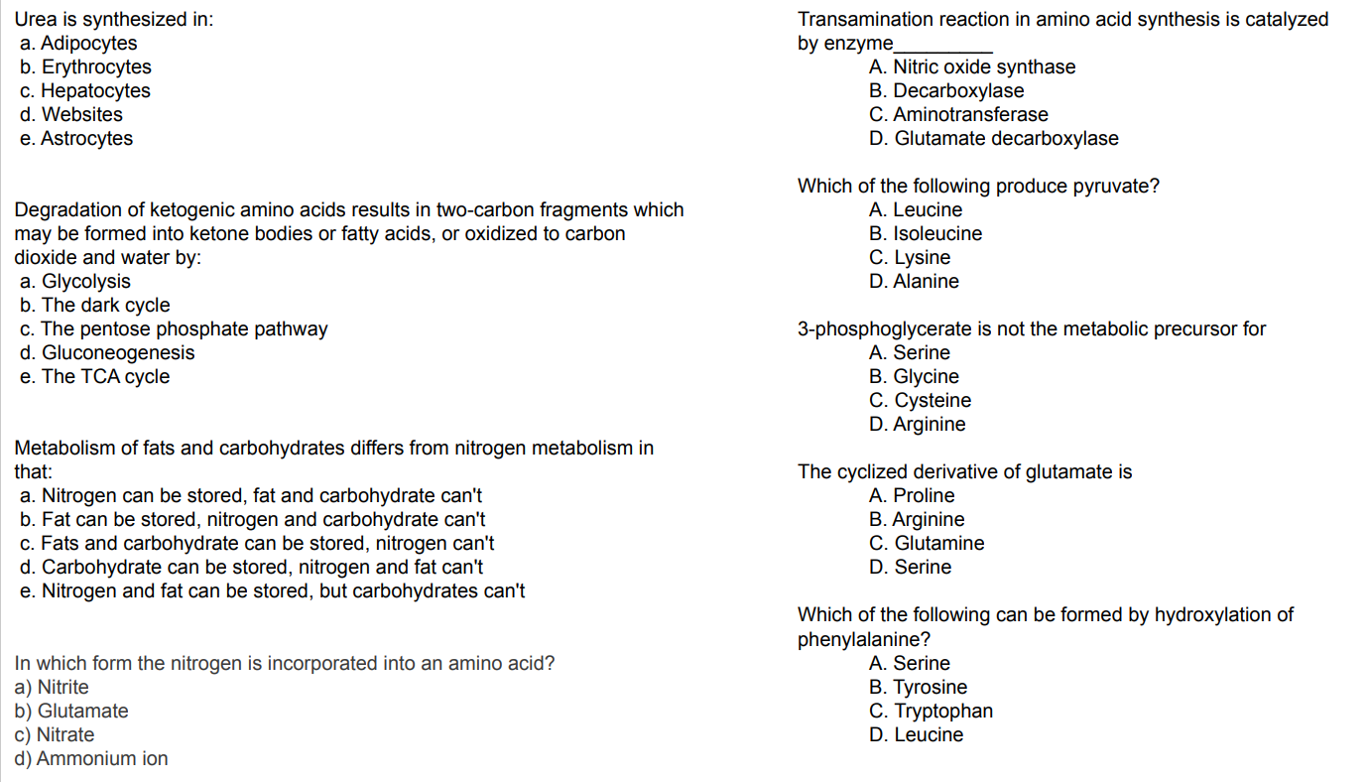

Slide 19


