Slide 1


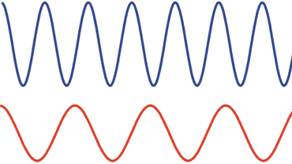
Magnetic Resonance Imaging
Spatially resolved reception
Gradient
ω1
ω2
x2
x1
Biomedical Magnetic Resonance: 5 Magnetic Resonance Imaging

Slide 2
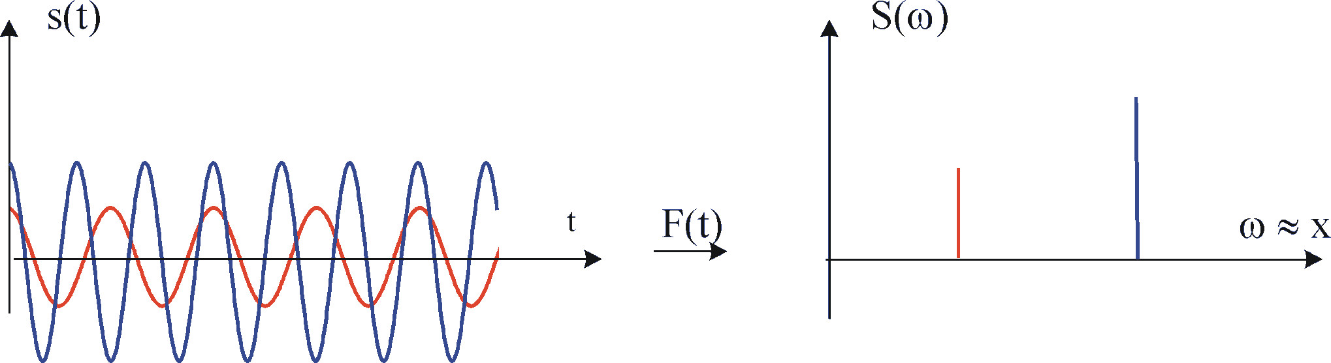
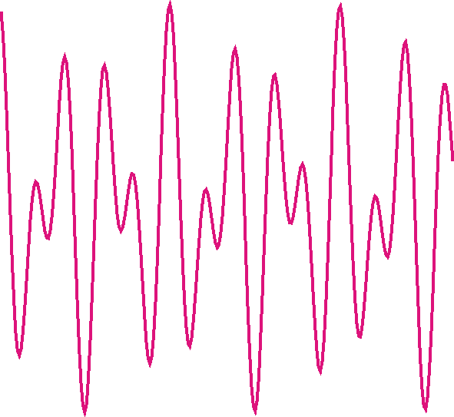
Magnetic Resonance Imaging
Spatially resolved reception
Spatial encoding: the Fourier Transform
Biomedical Magnetic Resonance: 5 Magnetic Resonance Imaging

Slide 3
Magnetic Resonance Imaging
Spatially resolved reception
RF excitation
z gradient
x gradient
MR signal
Gradient
ω1
ω2
FT
x2
x1
Biomedical Magnetic Resonance: 5 Magnetic Resonance Imaging

Slide 4
Magnetic Resonance Imaging
Spatially resolved reception
Back projection
x gradient
y gradient
Biomedical Magnetic Resonance: 5 Magnetic Resonance Imaging

Slide 5
Magnetic Resonance Imaging
Spatially resolved reception
Back projection
x gradient
y gradient
Biomedical Magnetic Resonance: 5 Magnetic Resonance Imaging

Slide 6
Magnetic Resonance Imaging
Spatially resolved reception
Back projection
x gradient
y gradient
Biomedical Magnetic Resonance: 5 Magnetic Resonance Imaging

Slide 7
Magnetic Resonance Imaging
Spatially resolved reception
Back projection
x gradient
y gradient
Biomedical Magnetic Resonance: 5 Magnetic Resonance Imaging

Slide 8
Magnetic Resonance Imaging
Spatially resolved reception
Back projection
x gradient
y gradient
Biomedical Magnetic Resonance: 5 Magnetic Resonance Imaging

Slide 9
Magnetic Resonance Imaging
Spatially resolved reception
Back projection
x gradient
y gradient
Biomedical Magnetic Resonance: 5 Magnetic Resonance Imaging

Slide 10
Magnetic Resonance Imaging
Spatially resolved reception
Back projection
x gradient
y gradient
Biomedical Magnetic Resonance: 5 Magnetic Resonance Imaging

Slide 11
Magnetic Resonance Imaging
Spatially resolved reception
Back projection
x gradient
y gradient
Biomedical Magnetic Resonance: 5 Magnetic Resonance Imaging

Slide 12
Magnetic Resonance Imaging
Spatially resolved reception
Back projection: imaging sequence
RF excitation
z gradient
x gradient
y gradient
Signal acquisition
Repeat n times along different angles
Biomedical Magnetic Resonance: 5 Magnetic Resonance Imaging

Slide 13
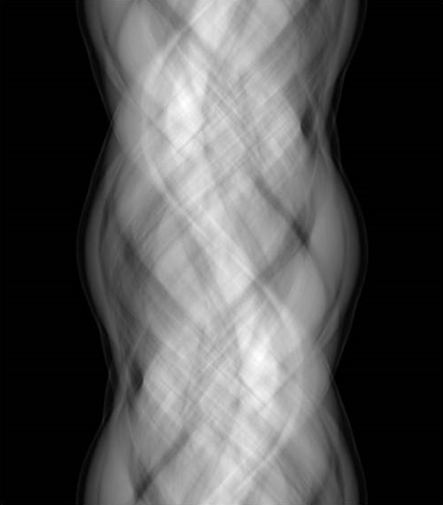
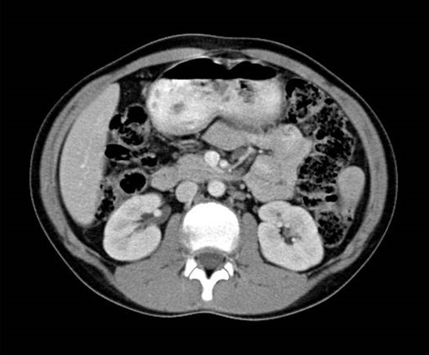
Magnetic Resonance Imaging
Spatially resolved reception
Back projection: imaging sequence
RF excitation
recon
z gradient
x gradient
y gradient
Signal acquisition
sinogram
FT
Biomedical Magnetic Resonance: 5 Magnetic Resonance Imaging

Slide 14
Magnetic Resonance Imaging
Imaging in k-space
For a point source (drop of water):
harmonic oscillation:
(continous linear phase change)
Frequency is a function of time:
Total signal:
Biomedical Magnetic Resonance: 5 Magnetic Resonance Imaging

Slide 15
Magnetic Resonance Imaging
Imaging in k-space
Total signal:
Inversion of the signal equation:
Biomedical Magnetic Resonance: 5 Magnetic Resonance Imaging

Slide 16
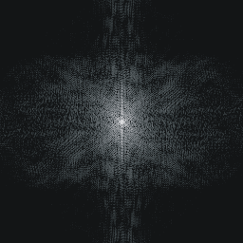
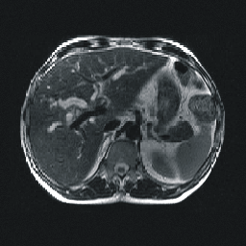
Magnetic Resonance Imaging
Imaging in k-space
k-space
image
2DFT
Biomedical Magnetic Resonance: 5 Magnetic Resonance Imaging

Slide 17
Magnetic Resonance Imaging
Properties of k-space
k_{y}
k_{x}
Biomedical Magnetic Resonance: 5 Magnetic Resonance Imaging

Slide 18
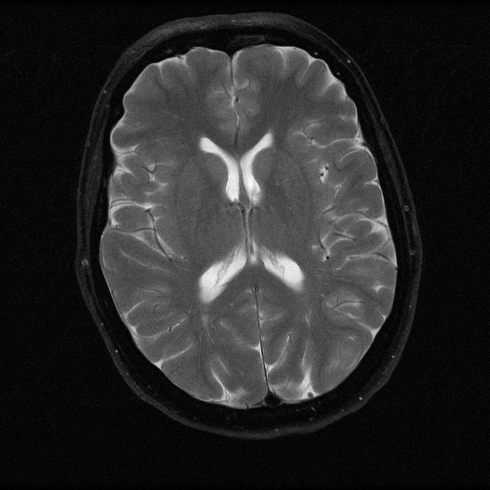

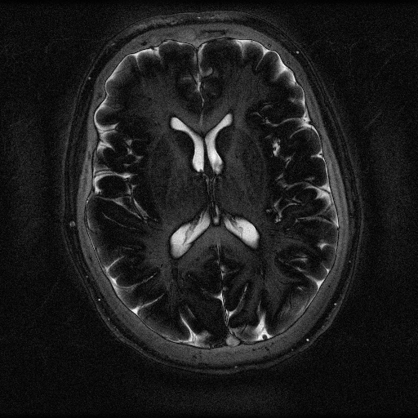
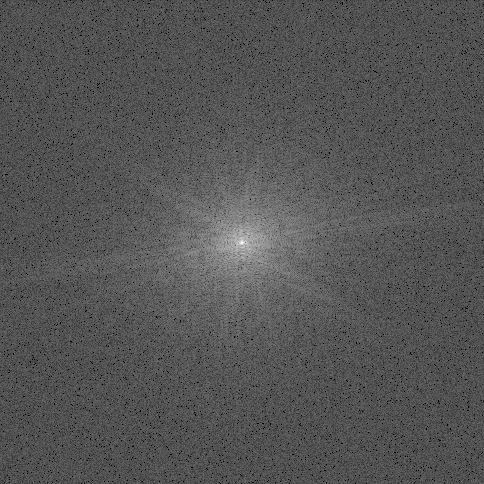


Magnetic Resonance Imaging
Properties of k-space
512 x 512
8 x 8
Biomedical Magnetic Resonance: 5 Magnetic Resonance Imaging

Slide 19

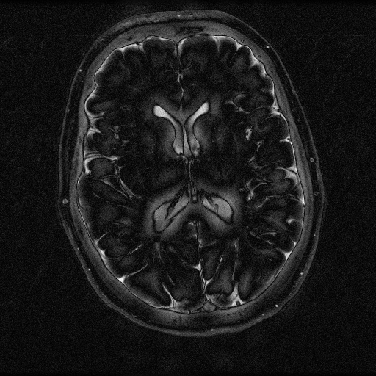


Magnetic Resonance Imaging
Properties of k-space
512 x 512
16 x 16
Biomedical Magnetic Resonance: 5 Magnetic Resonance Imaging

Slide 20

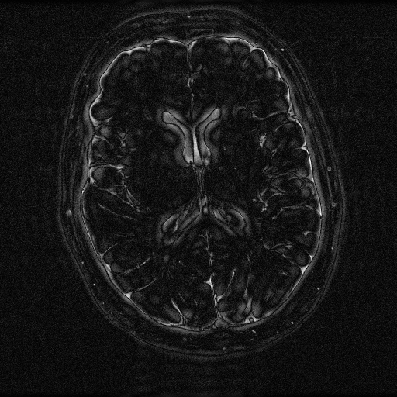

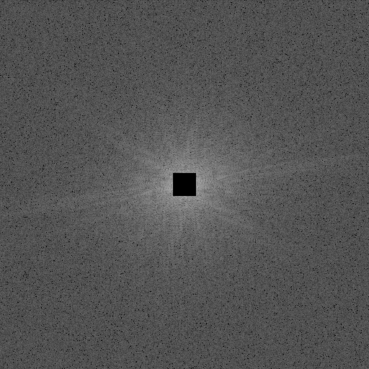
Magnetic Resonance Imaging
Properties of k-space
512 x 512
32 x 32
Biomedical Magnetic Resonance: 5 Magnetic Resonance Imaging

Slide 21

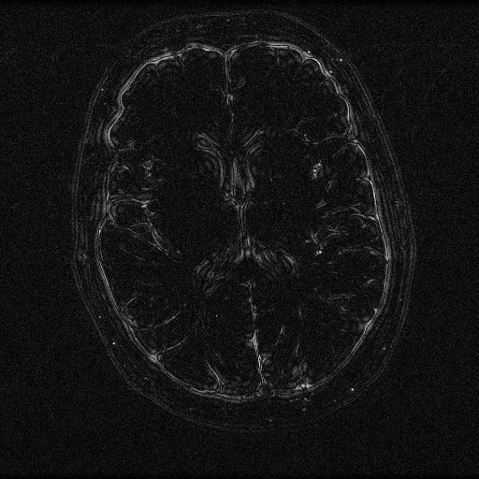
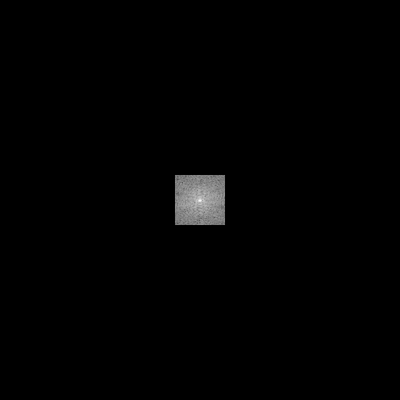
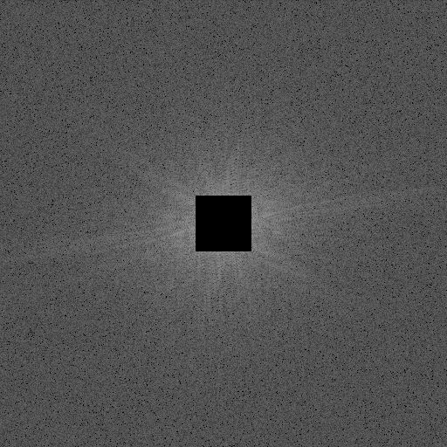
Magnetic Resonance Imaging
Properties of k-space
512 x 512
64 x 64
Biomedical Magnetic Resonance: 5 Magnetic Resonance Imaging

Slide 22

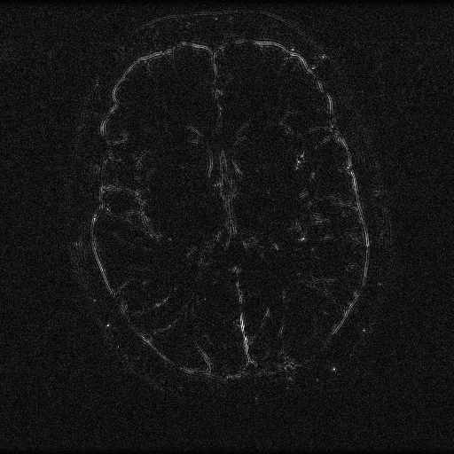
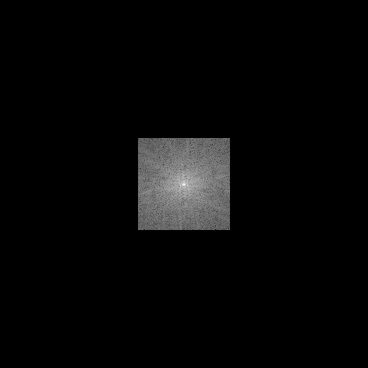
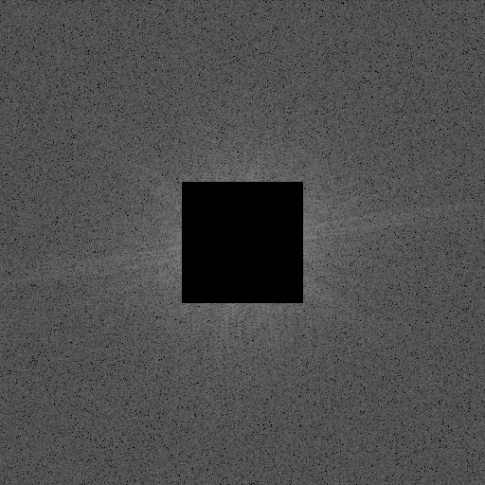
Magnetic Resonance Imaging
Properties of k-space
512 x 512
128 x 128
Biomedical Magnetic Resonance: 5 Magnetic Resonance Imaging

Slide 23
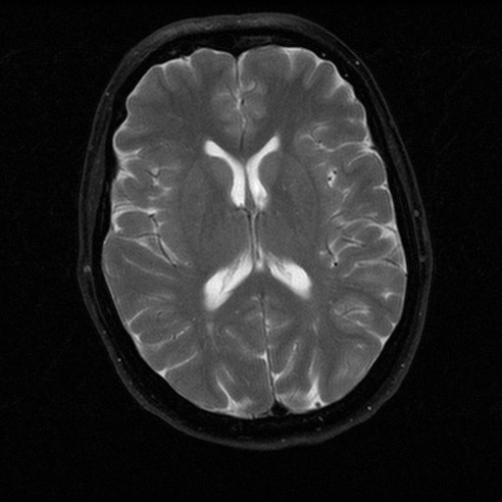
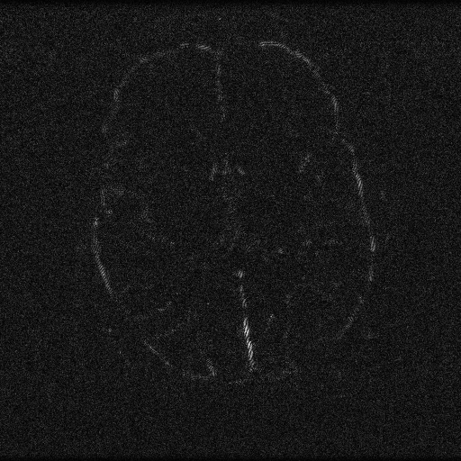
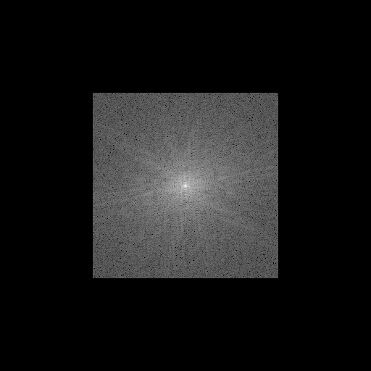

Magnetic Resonance Imaging
Properties of k-space
512 x 512
256 x 256
Biomedical Magnetic Resonance: 5 Magnetic Resonance Imaging

Slide 24
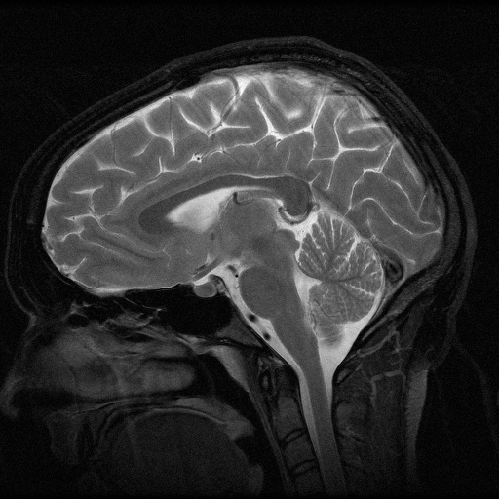
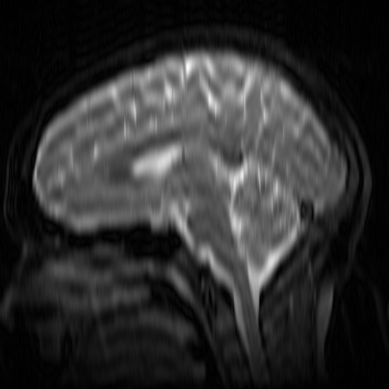
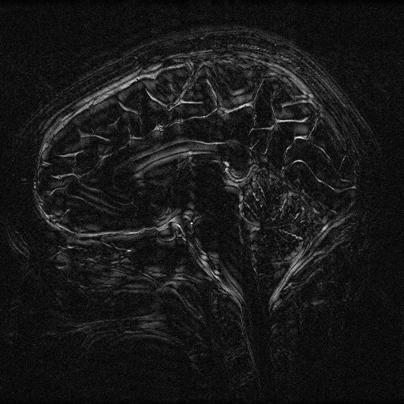
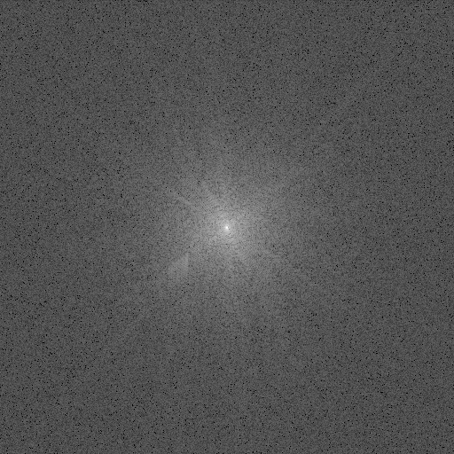

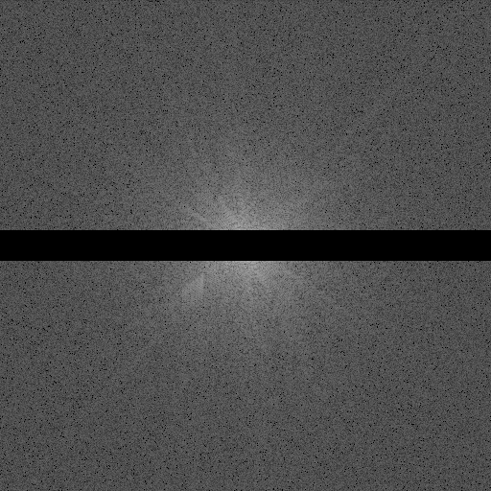
Magnetic Resonance Imaging
Properties of k-space
512 x 512
512 x 32
Biomedical Magnetic Resonance: 5 Magnetic Resonance Imaging

Slide 25
Magnetic Resonance Imaging
Properties of k-space
FOV in x-direction
FOV in y-direction
_{ky}
resolution in y-direction
_{kx}
resolution in x-direction
Biomedical Magnetic Resonance: 5 Magnetic Resonance Imaging

Slide 26
Magnetic Resonance Imaging
Imaging in k-space
k-space
RF excitation
z gradient
x gradient
y gradient
Signal acquisition
Biomedical Magnetic Resonance: 5 Magnetic Resonance Imaging

Slide 27
Magnetic Resonance Imaging
Imaging in k-space: gradient echo (GE) sequence
k-space
RF excitation
z gradient
x gradient
y gradient
Signal acquisition
Biomedical Magnetic Resonance: 5 Magnetic Resonance Imaging

Slide 28
Magnetic Resonance Imaging
Imaging in k-space: gradient echo (GE) sequence
k-space
RF excitation
z gradient
x gradient
y gradient
Signal acquisition
Biomedical Magnetic Resonance: 5 Magnetic Resonance Imaging

Slide 29
Magnetic Resonance Imaging
Imaging in k-space: gradient echo (GE) sequence
k-space
RF excitation
z gradient
x gradient
y gradient
Signal acquisition
Biomedical Magnetic Resonance: 5 Magnetic Resonance Imaging

Slide 30
Magnetic Resonance Imaging
Imaging in k-space: gradient echo (GE) sequence
k-space
RF excitation
z gradient
x gradient
y gradient
Signal acquisition
Biomedical Magnetic Resonance: 5 Magnetic Resonance Imaging

Slide 31
Magnetic Resonance Imaging
Imaging in k-space: gradient echo (GE) sequence
k-space
RF excitation
z gradient
x gradient
y gradient
Signal acquisition
Biomedical Magnetic Resonance: 5 Magnetic Resonance Imaging

Slide 32
Magnetic Resonance Imaging
Imaging in k-space: gradient echo (GE) sequence
k-space
RF excitation
z gradient
x gradient
y gradient
Signal acquisition
Biomedical Magnetic Resonance: 5 Magnetic Resonance Imaging

Slide 33
Magnetic Resonance Imaging
Imaging in k-space: gradient echo (GE) sequence
k-space
RF excitation
z gradient
x gradient
y gradient
Signal acquisition
Biomedical Magnetic Resonance: 5 Magnetic Resonance Imaging

Slide 34
Magnetic Resonance Imaging
Imaging in k-space: gradient echo (GE) sequence
k-space
RF excitation
z gradient
x gradient
y gradient
Signal acquisition
Biomedical Magnetic Resonance: 5 Magnetic Resonance Imaging

Slide 35
Magnetic Resonance Imaging
Imaging in k-space: gradient echo (GE) sequence (EPI)
k-space
RF excitation
z gradient
x gradient
y gradient
Signal acquisition
Biomedical Magnetic Resonance: 5 Magnetic Resonance Imaging

Slide 36
Magnetic Resonance Imaging
Imaging in k-space: gradient echo (GE) sequence (spiral EPI)
k-space
RF excitation
z gradient
x gradient
y gradient
Signal acquisition
Biomedical Magnetic Resonance: 5 Magnetic Resonance Imaging

Slide 37
Magnetic Resonance Imaging
Imaging in k-space: spin echo (SE) sequence
RF excitation
k-space
90°
z gradient
x gradient
y gradient
Signal acquisition
Biomedical Magnetic Resonance: 5 Magnetic Resonance Imaging

Slide 38
Magnetic Resonance Imaging
Imaging in k-space: spin echo (SE) sequence
RF excitation
180°
k-space
90°
z gradient
x gradient
y gradient
Signal acquisition
Biomedical Magnetic Resonance: 5 Magnetic Resonance Imaging

Slide 39
Magnetic Resonance Imaging
Imaging in k-space: spin echo (SE) sequence
RF excitation
180°
k-space
90°
z gradient
x gradient
y gradient
Signal acquisition
Biomedical Magnetic Resonance: 5 Magnetic Resonance Imaging

