Slide 1


PET/MR Imaging
Technical challenges, clinical and research applications
27.10.2017
Mario Amend
Werner Siemens Imaging Center,
Department of Preclinical Imaging and Radiopharmacy,
Eberhard Karls University Tuebingen, Germany
Department of Preclinical Imaging and Radiopharmacy

Slide 2
Outline
Technical challenges:
  the PET principle
  the MRI principle
  combining PET and MRI
Clinical applications:
  PET/MRI in cancer patients
  PET/MRI vs. PET/CT
  non-oncological applications
PET/MR research:
  functional and metabolic brain imaging
  future applications in the developing and diseased brain

Slide 3
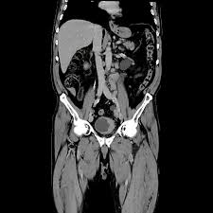
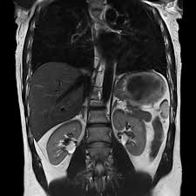
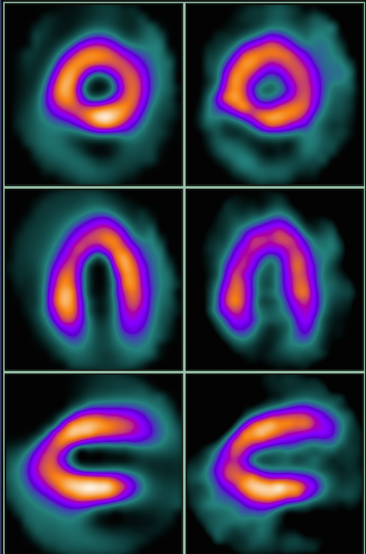
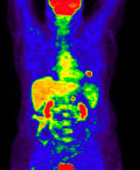
Dedicated Imaging Modalities
CT
MRI
SPECT
PET
Morphology
Morphology
(Function)
Function
Function

Slide 4
Why combine PET with MR?
What we get:
  MR: high resolution and soft tissue contrast
  PET: high sensitivity (pico molar) and variety of tracers
Additional benefits:
  No additional radiation dose by the MR (in contrast to PET/CT)
  Soft tissue contrast of MRI can be exploited
  Can be combined with advanced MR techniques such as fMRI, DWI, MRS
  Simultaneous imaging
    Time savings
    Multifunctional imaging (spatial and temporal correlation)
Similar to PET/CT:
  “Near perfect” registration of image data
  Anatomically guided interpretation of PET data
  Anatomic priors for reconstruction and data modeling

Slide 5
Challenges of PET/MR
Interference on PET:
  Static magnetic field
  Electromagnetic interference from RF and gradients
solved:
- new detector technology
- intelligent PET insert design
Notes:
5

Slide 6

Positron-Emission-Tomography Principle
Biomolecule with
Positron Emitter → Radiotracer
PET-Scanner
Detectors
Positron
path length
511 keV
γ-Quant
Electron
Positron
Positron-Electron
Annihilation
511 keV
γ-Quant
Coincidence DetectionΔt

Slide 7
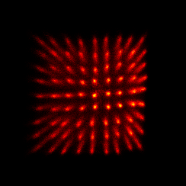
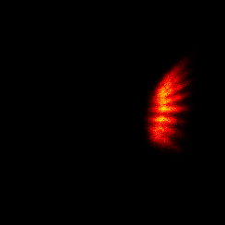
Photomultiplier-Tubes
light guide
scintillation
crystal
light (420nm)
Photocathode
Dynodes
γ (511 keV)
Anode
size ~ resolution
U_{PET}
photoelectron
secondary electrons
B=0
length ~ sensitivity
light (420nm)
N
S
γ (511 keV)
Anode
B≠0
Notes:
7
7

Slide 8
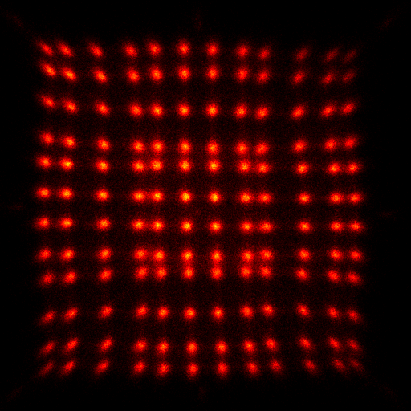
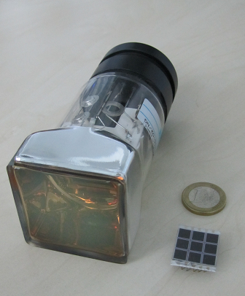
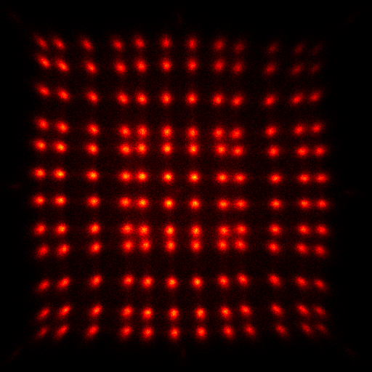
Avalanche-Photodiodes (APDs)
light guide
scintillation
crystal
light (420nm)
Cathode
γ (511 keV)
size ~ resolution
p-type
n-type
U_{PET}
B=0
length ~ sensitivity
N
light (420nm)
S
γ (511 keV)
PMT
APD
p-type
n-type
U_{PET}
B≠0
Notes:
8
8

Slide 9
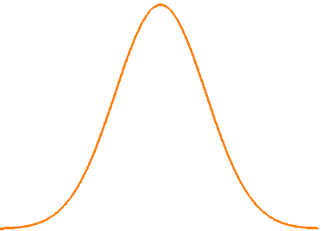
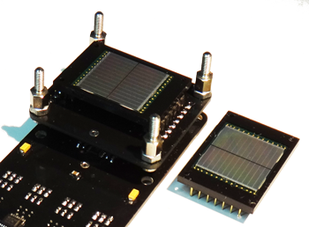
Trends in PET/MR Hardware
PET/MR Detectors:
  Geiger-mode avalanche photo diodes (GAPD, SiPMs) replacing avalanche photodiodes (APDs):
    GAPDs have a higher gain compared to APDs
    GAPDs have a faster rise time than APDs -> TOF-PET
D₁
D₂
A
M
Det. 1
Det. 2
ΔTOF=t₁-t₂
c*ΔTOF/2
(D₂-D₁)/2
  Optical Signal transfer
    Less interference, less shielding
    Possibly lower costs by new multiplexing schemes
  novel scintillator materials (organic scintillators) etc…
Notes:
9

Slide 10
Performance Characteristics
 | Philips Ingenuitiy PET/MR | GE PET/CT Discovery 690 (in Trimodality Setup) | GE Signa PET/MR | Siemens Biograph mMR
PET FOV axial (cm) | 18 | 15.7 | 25 | 25.8
PET FOV trans (cm) | 57.6 | 50-70 | 60 | 59.4
MRI or CT FOV trans (for att) | 45 | CT | 50 | 50
Average spatial resolution at 1 cm off center (mm FWHM) | 4.7 | 4.7 | 4.2 | 4.3
Average spatial resolution at 10 cm off center (mm FWHM) | 5.1 | 5.3 | 5.1 | 5.5
Timing resolution (ps) | 525 | 544 | 384 | 2930
Energy resolution (FWHM %) | 12 | 12.4 | 10.3 | 11.5
Sensitiviy (average 0 and 10 cm) (cps/kBq) | 7.1 | 7.5 | 22.9 | 14.4
Max NECR (kcps) at (kBq/mL) | 88.5 at 13.7 | 139.1 at 29.0 | 218 at 17.7 | 184 at 23.1
Scatter fraction at NECR peak (%) | 26 | 37 | 43.6 | 37.9
PMT
GAPD/Si-PMT
APD
Boellaard R. et al, Semin Nucl Med. 2015
Notes:
10

Slide 11
Challenges of PET/MR
Interference on PET:
  Static magnetic field
  Electromagnetic interference from RF and gradients
Interference on MR:
  Maintaining magnetic field homogeneity
  Electromagnetic radiation from the PET electronics
  Eddy currents
  Susceptibility artifacts
solved:
- new detector technology
- intelligent PET insert design
solved:
non magnetic materials
eddy current suppressing design
SNR, B0, B1, stability not impaired
Notes:
11

Slide 12
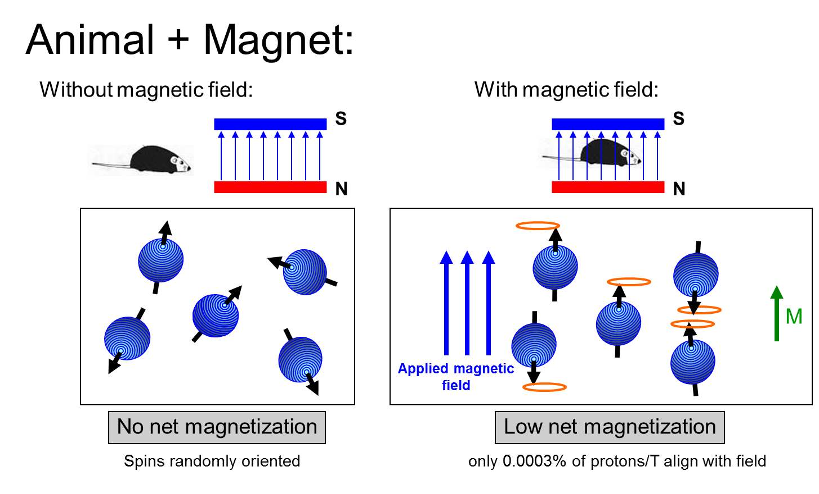
MRI principle
Notes:
12

Slide 13
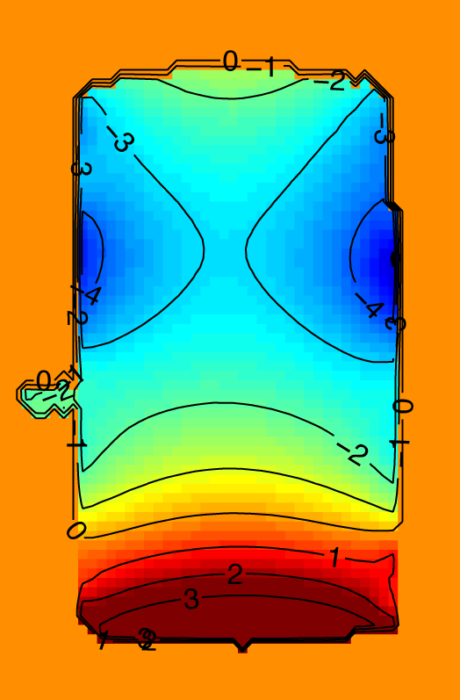

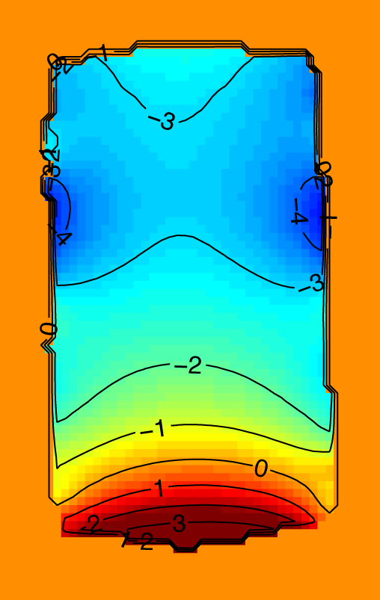
Homogeneity of the main magnetic field (B₀)
50 ml phantom, gre sequence with two echo times, phase images, phase unwrapping
without PET
µT
with PET
µT
25 mm
25 mm
Differences are smaller than 0.5 ppm (3.5 µT @ 7 T)
Specification of the MR: inhomogeneity < 1 ppm in 11 cm dsv
Spectroscopy: FWHM of Citrate-Signal 2.0 Hz -> 2.2 Hz
Notes:
13

Slide 14
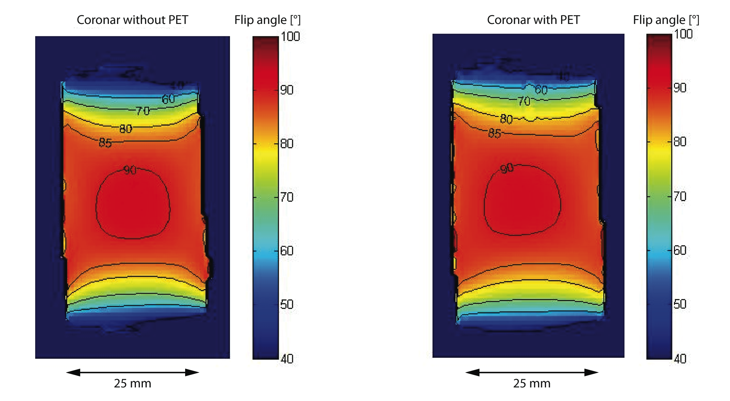
Homogeneity of the RF field (B₁)
50 ml phantom, B1 field mapping sequence (spin echo with two refocusing pulses),
Matlab data processing
Flip angle distribution is not influenced by the PET insert
Notes:
14

Slide 15
Challenges of PET/MR
Interference on PET:
  Static magnetic field
  Electromagnetic interference from RF and gradients
Interference on MR:
  Maintaining magnetic field homogeneity
  Electromagnetic radiation from the PET electronics
  Eddy currents
  Susceptibility artifacts
General challenges:
  Space
  Environmental factors (temperature, vibration…)
  Attenuation correction for PET data
  Optimized workflows (clinical applications)
solved:
- new detector technology
- intelligent PET insert design
solved:
non magnetic materials
eddy current suppressing design
SNR, B0, B1, stability not impaired
partially solved:
reduced bore size
MR based AC in progress
workflow suggestions
Notes:
15

Slide 16
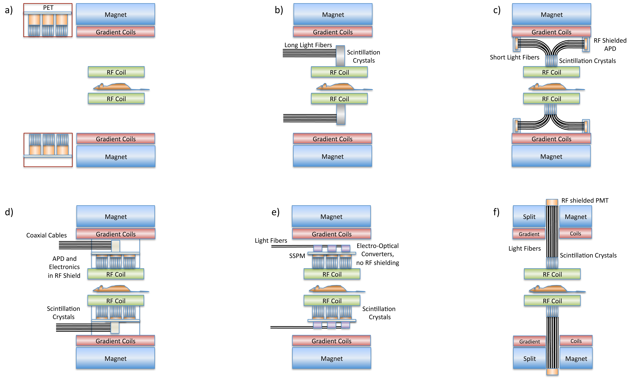
PET/MR System Configurations
Philips
King’s College London, West Virginia Univ.
UC Davis, Caltech
Tuebingen, Siemens, HyperImage Project
Stanford, GE
Cambridge University
Wehrl HF et al. TCRT 2010
Notes:
16

Slide 17
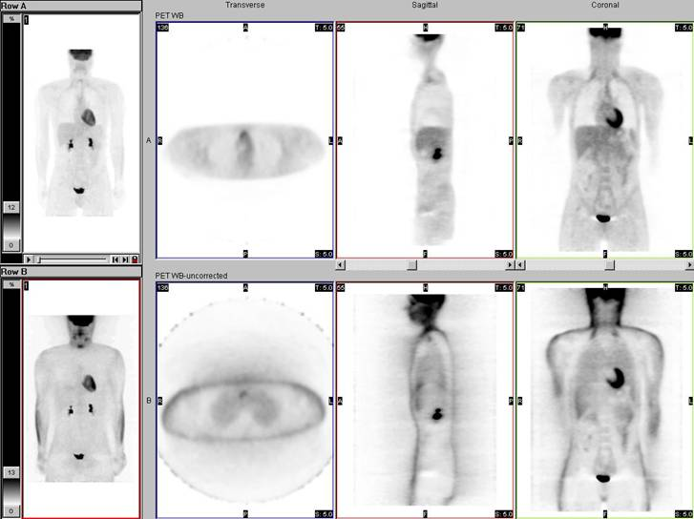
PET Attenuation
Notes:
17
Attenuation is the loss of detection of true coincidence events because of their absorption in the body or due to their scattering out of the detector field of view. Attenuation problems are greater with PET imaging compared to traditional nuclear medicine SPECT imaging. Even though the photons are of greater energy than those used in SPECT imaging, in PET imaging two photons must escape the patient simultaneously to be detected as a true event and the mean photon path distance from emission to detection is greater with a PET camera than with a SPECT camera. The loss of true coincidence event detection due to attenuation in PET imaging can range between 50 to 95%, especially great in a larger person.
Loss of counts due to attenuation increases image noise, image artifacts, and image distortion. Without attenuation correction, significant artifacts which may occur on whole-body PET scans include: (1) prominent activity at body surface edges due to relative lack of attenuation at the surfaces compared to deeper structures, (2) distorted appearance of areas of intense activity (e.g. urinary bladder) due to variable degrees of attenuation in different directions of activity originating from these areas, and (3) diffuse, relatively increased activity in tissues of relatively low attenuation (e.g. lungs).Therefore, attenuation correction of data is necessary for accurate qualitative (i.e. visually normal, increased, or decreased) and quantitative (i.e. standardized uptake values or SUVs) measurements of FDG activity.
In PET/CT x-rays from a CT scan are used to construct an attenuation map of density differences throughout the body that can then be used to correct for the absorption of the photons emitted from FDG decay. Attenuation is much more likely in the center of the body and therefore non-attenuation-corrected images will show diffusely lower level activity deep in the body compared to the skin surface. The attenuation correction process essentially “adds counts back” into areas that are more attenuated due to their being deeper or being surrounded by relatively dense structures. Similarly, it essentially “subtracts counts” from areas that are attenuated much less than all other tissues (e.g. lungs and body surfaces). Both attenuation-corrected and non-attenuation-corrected data sets are provided for review and both should be examined by the interpreter. Reviewing both data sets sometimes allows confirmation of an abnormality or confirmation of the benignity of a process which might have been incorrectly assessed based on review of one set alone.
Activity within tissue closely approximated to very high density material in the body may appear falsely low in intensity on attenuation-corrected data. For example, in correcting for attenuation by metallic density orthopedic hardware the computer may essentially “subtract” counts from the area immediately adjacent to the hardware which could at times include “subtraction” of true counts originating from an abnormality such as a lymph node. Close inspection of the CT data and non-attenuation-corrected PET data should permit accurate detection (or at least confirm suspicion) of the abnormal activity within the lymph node in that example.
Activity within tissue closely approximated to very high density material in the body may appear falsely high in intensity on attenuation-corrected data. For example, in correcting for attenuation by metallic density orthopedic hardware the computer may essentially “add” counts into tissues immediately adjacent to the hardware which could at times result in the false appearance of increased activity within tissue (e.g. a lymph node) closely approximated to the hardware. Close inspection of the CT data and the non-attenuation-corrected PET data should confirm that the apparent increase in activity within the lymph node in that example was artifactual, related to the attenuation correction process. However, artifacts of activity related to the attenuation correction process can result in equivocal findings even after close inspection of all of the data.
Some lesions located near the surface of the body, such as skin lesions, are more obvious on non-attenuation-corrected data because of the generalized “subtraction” of counts from the surface related to absence of attenuation there compared to deeper structures. On close review, uptake in these lesions will usually be visible on the attenuation-corrected data as well.

Slide 18
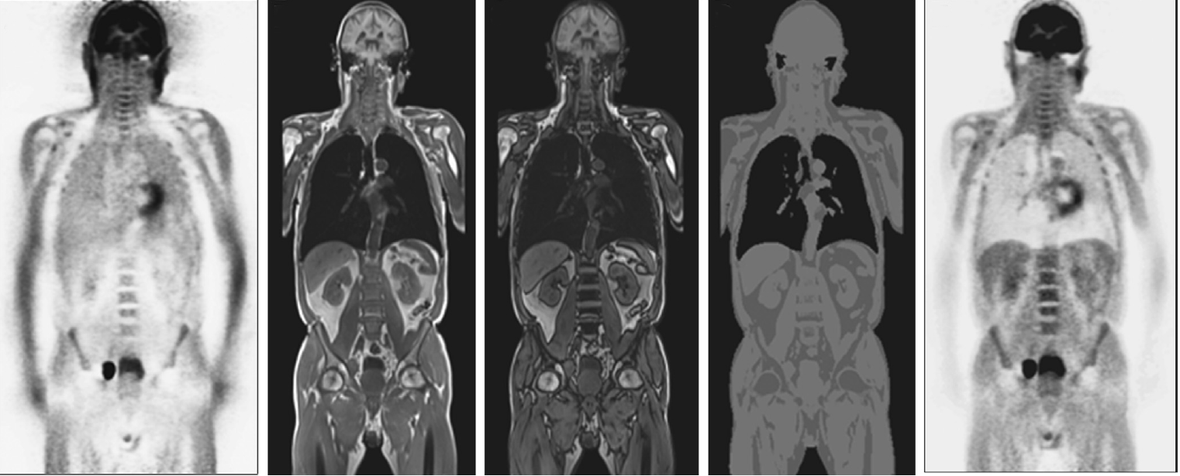
PET/MR Attenuation correction
Current state:
  Dixon MR sequence (fat / water separation) for AC
    no bone identification (e.g. soft tissue values)
    possible quantification errors (e.g. lesions close to bone)
  Atlas based approaches
    Prior knowledge about patients needed (data base)
    Problematic when patient anatomy deviates from average patient cases
  Ultra short (UTE) and zero echo time (ZTE) sequences
    Can identify bone
    Currently problematic in abdominal areas (small FOV…)
PET (no AC)
MR-Dixon (water-fat images)
Segmented MR
PET (with AC)
adapted from Boellaard R. et al, Semin Nucl Med. 2015
Notes:
18

Slide 19
PET/MR Workflows – must haves for clinical routine
Evolving Defined PET/MRI protocols need to be developed and validated which go beyond adding two imaging modalities
Standardized magnetic-resoncance-based attenuation correction (MRAC) of PET data
Avoiding lengthy overall examinations (patient comfort, image qualitiy)
Partial MRI (focused on a specific area or organ of interest), or whole-body MRI
“minimum necessary” protocols with maximum diagnostic outcome
Notes:
19

Slide 20
Outline
Technical challenges:
  the PET principle
  the MRI principle
  how to combine PET and MRI
Clinical applications:
  PET/MRI in pediatric lymphoma patients
  PET/MRI vs. PET/CT
  non-oncologic applications
Translational PET/MR research:
  functional and metabolic brain imaging
  future applications in the developing and diseased brain

Slide 21
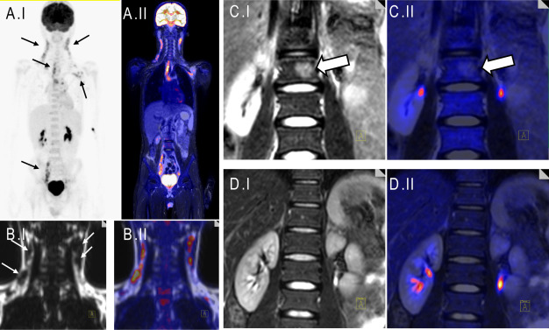
Oncological [¹⁸F]FDG-PET/MRI
15-year-old boy with Hodgkin Lymphoma – initial staging
S. Gatidis et al, Eur J Radiol (2017)

Slide 22
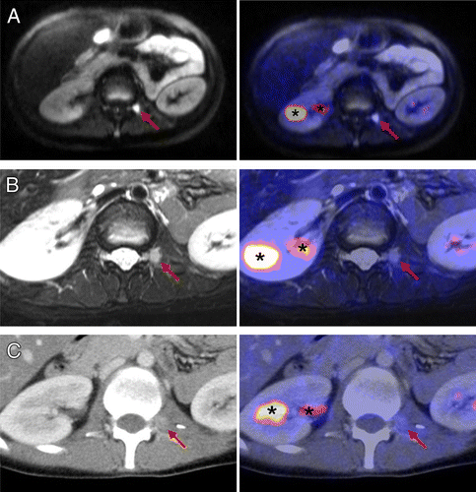
PET/MR vs. PET/CT
17-year-old female patient with hepatocellular carcinoma
[¹⁸F]-FDG-PET images clearly negative for paravertebral metastasis
DWI shows a suspicious lesion (A)
The lesion is hardly visible with CT (C)
J.F. Schäfer et al, Radiology (2014)

Slide 23
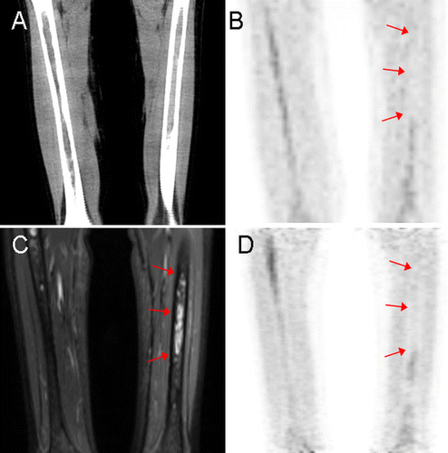
PET/MR vs. PET/CT
11-year-old female patient with neuroblastoma
Coronal STIR image shows bone marrow infiltration (C)
Lesion not visible in the CT image (A)
[¹⁸]F-FDG-PET shows in both modalities relatively decreased FDG uptake (B,D)
J.F. Schäfer et al, Radiology (2014)
Notes:
Images depict bone marrow infiltration.(C) Coronal STIR image shows bone marrow infiltration not visible in the CT image (A).
FDG-PET shows in both modalities relatively decreased FDG uptake in the involved area compared with the adjacent physiological activated bone marrow.
Neuroblastom stellt sich im FDG PET nicht wirklich dar.

Slide 24
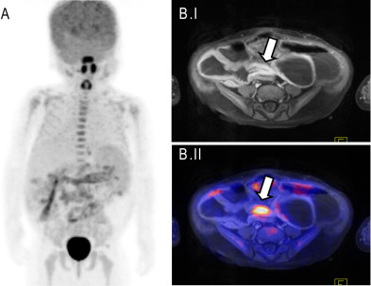
Non-oncologic applications
3-year-old boy with Crohn´s-like disease
[¹⁸]F-FDG PET (A) reveals multifocal intestinal inflammation
MRI shows segmental stenosis and marked contrast enhancement of the intestinal wall (B)
S. Gatidis et al, Eur J Radiol (2017)
Notes:
This young patient with a genetic immune dysregulation syndrome and known Crohn´s-like disease presented with recurrent fever without a clear clinical correlate. FDG-PET was performed to screen for possible foci of inflammation and to asses the current state of bowel inflammation.

Slide 25
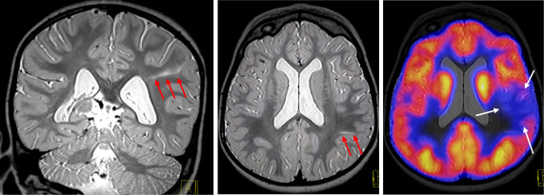
Non-oncologic applications
2-year-old girl with focal cortical dysplasia
MRI shows hyperintensities of the left postcentral gyrus
[¹⁸]F-FDG-PET reveals asymetric hypometabolism
S. Gatidis et al, Eur J Radiol (2017)
Notes:
This toddler presented with recurring clonic and assymetric tonic seizures. Combined FDG-PET/MRI was performed in order to identify possible epileptogenic foci. Using PET/MRI, this assessment could be performed in a single examination with a single sedation avoiding a second sedation using seperated PET/MRI examinations.

Slide 26
Outline
Technical challenges:
  the PET principle
  the MRI principle
  how to combine PET and MRI
Clinical applications in children:
  PET/MRI in pediatric lymphoma patients
  PET/MRI vs. PET/CT
  non-oncologic applications
PET/MR research:
  functional and metabolic brain imaging
  future applications in the developing and diseased brain

Slide 27
Windows to the Brain and Metabolism
anatomy, atrophy, relaxometry, diffusion, connectivity, magnetization transfer, permeability
PET/MR
blood flow / perfusion
MRI
blood / tissue oxygenation
glucose consumption
MRS/CSI
amino/nucleic acid metabolism
neurotransmitter metabolism
PET
receptor density
cell labeling
tissue pH
metabolite/drug concentration
correlate, cross calibrate, monitor on different stages
PET/MR correlation evolved from function with anatomy to function with function
Wehrl HF et al. Eur J Nucl Med Mol Imaging 2009
Notes:
27

Slide 28
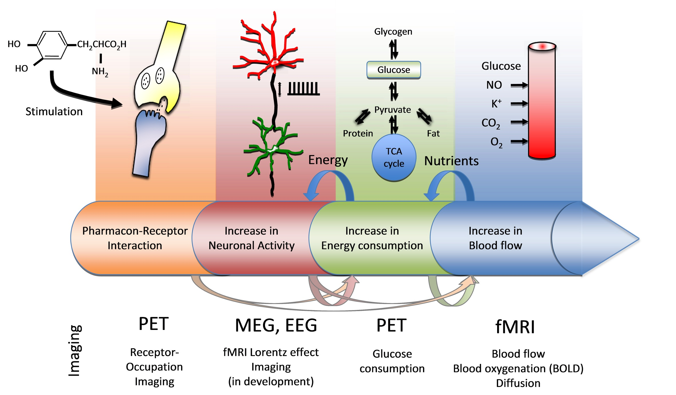
Cascade of brain activation
Wehrl HF et al. J Nucl Med. 2014
Notes:
28

Slide 29
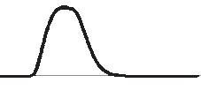
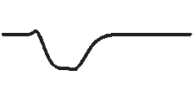


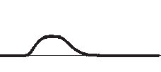
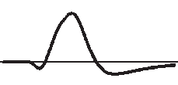
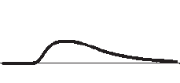
fMRI: The BOLD Effect
The BOLD signal has a high intrinsic complexity
CBF
≈5-50%
OEF
≈-(2-10%)
Stimulus
neuronal activity
CMRO₂
≈0-20%
BOLD
CBV
≈1-2%
≈20%
Inspired by Buxton R. B., Introduction to fMRI, 2002 and 2009

Slide 30
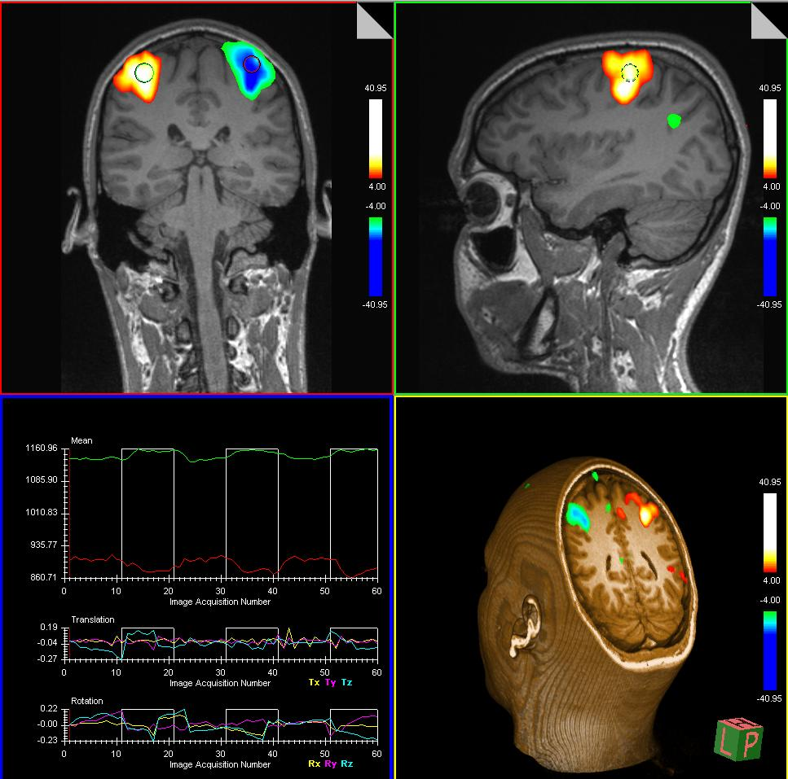
fMRI: BOLD-Effect in humans
Nowadays it is a “routine” tool in human studies
Results of a finger tapping experiment

Slide 31
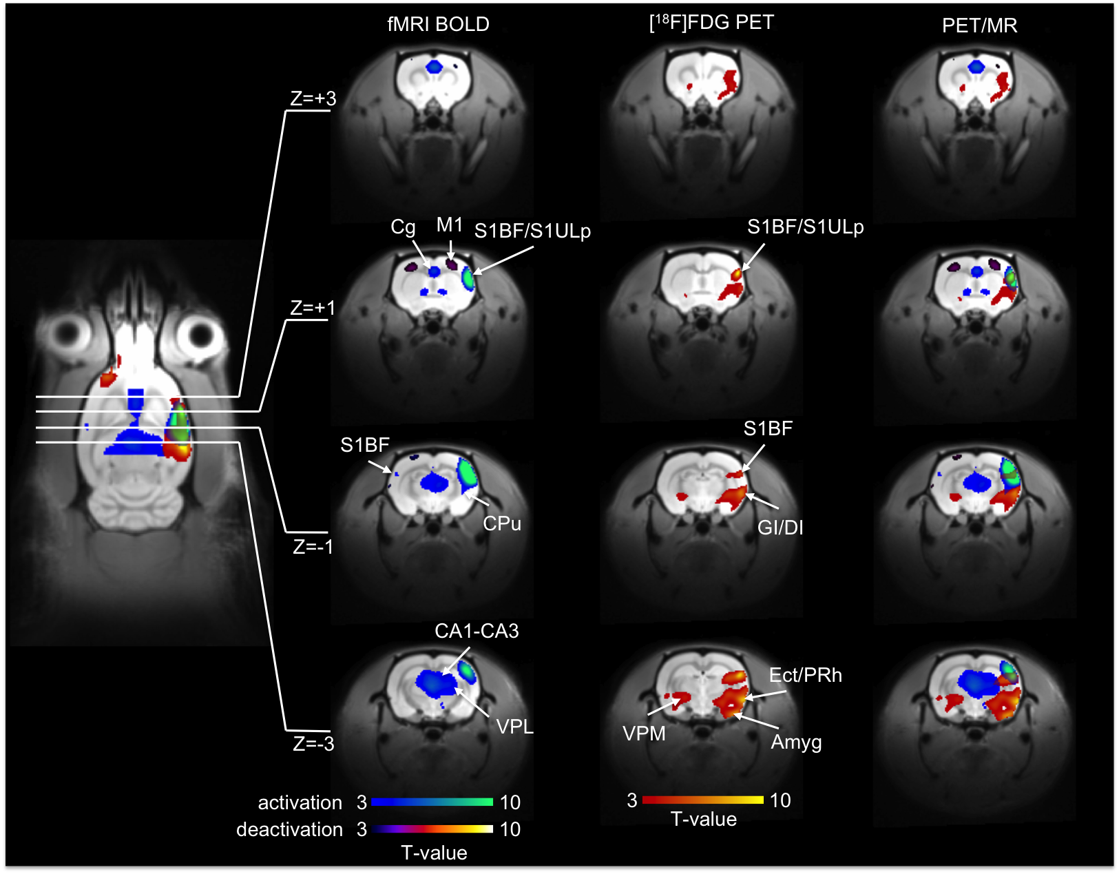
Results: Stimulation – statistical analysis
Wehrl HF et al. Nature Med. 2013
Notes:
31

Slide 32
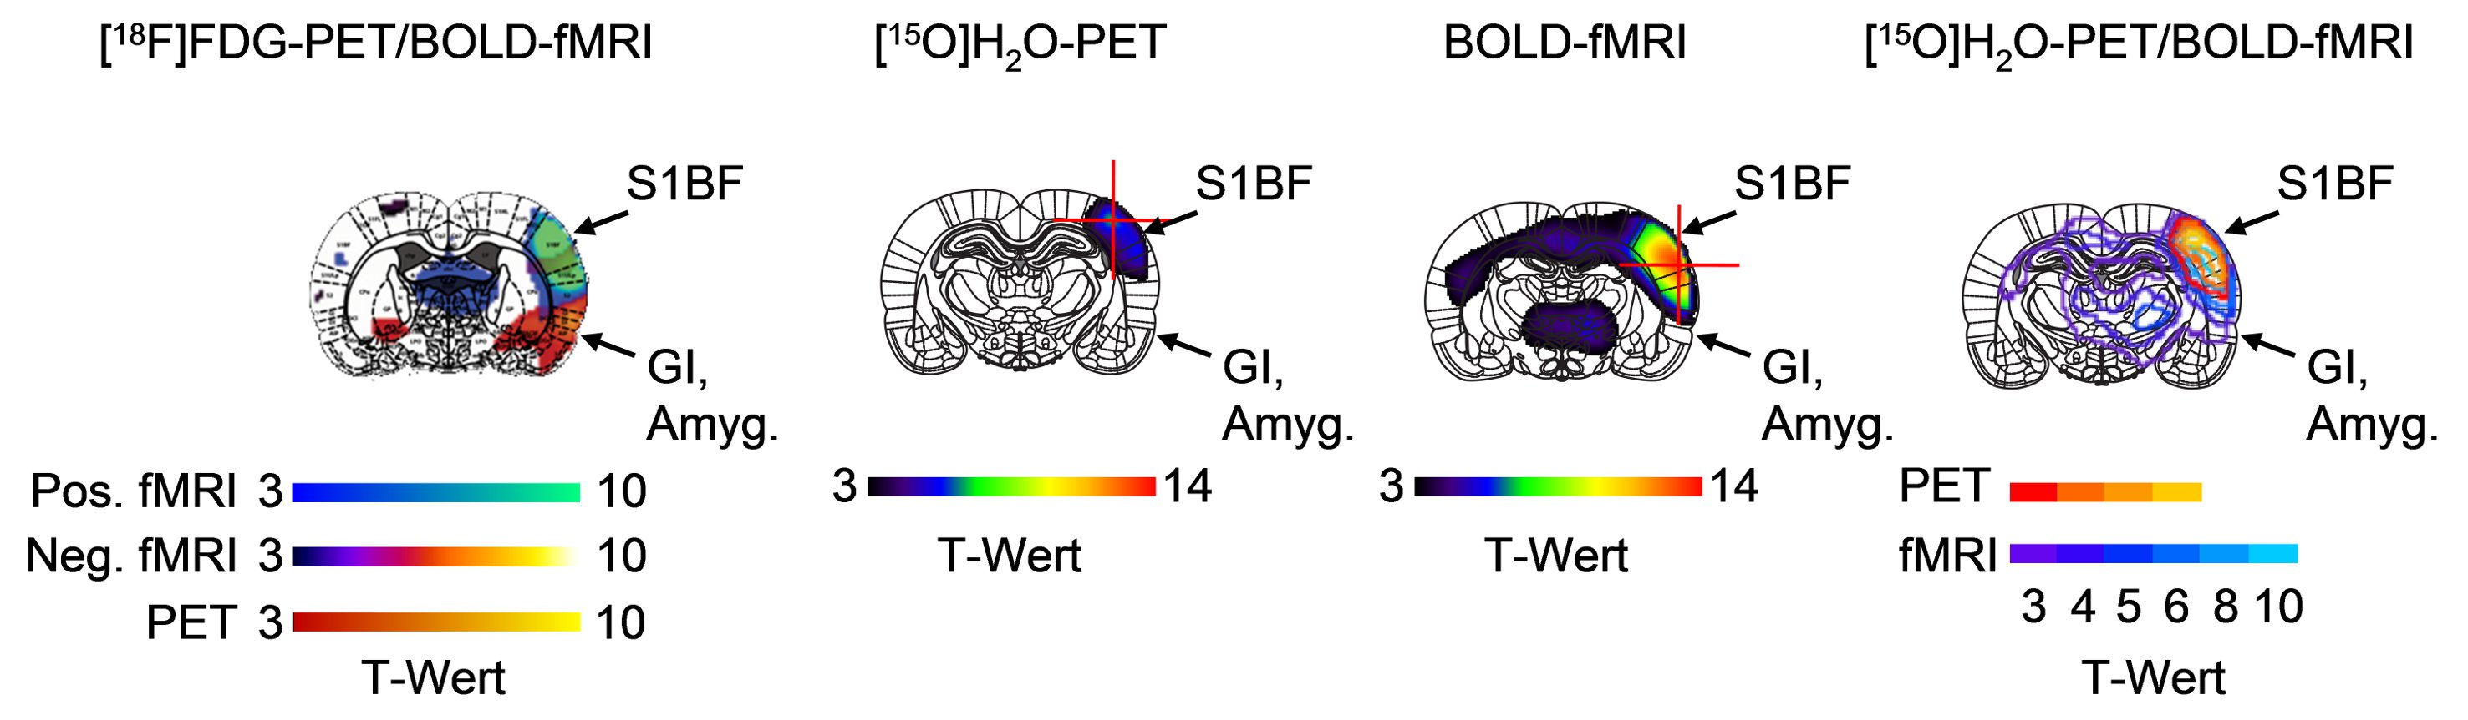
[¹⁸F]FDG and [¹⁵O]H₂O-PET vs. BOLD-fMRI
T-value
T-value
T-value
T-value
[¹⁸F]FDG vs. BOLD (n = 8):
distance S1BF: 2.7 ± 0.7 mm
different regions
Wehrl HF et al. Nature Med. 2013
[¹⁵O]H₂O vs. BOLD (n = 8):
distance S1BF: 2.5 ± 1.4 mm
same regions
Wehrl HF et al. NeuroImage 2014
Notes:
32

Slide 33
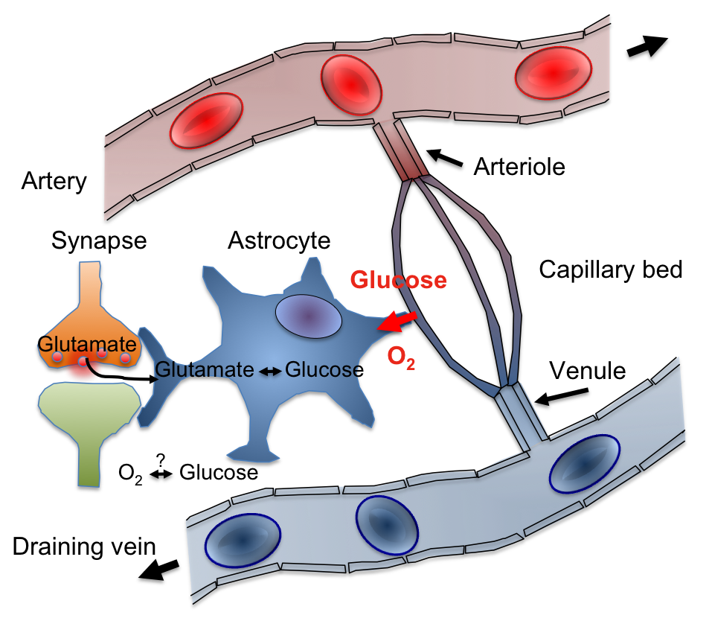
Possible Origins of Mismatch PET vs. fMRI
[¹⁵O]H₂O-PET
[¹⁸F]FDG-PET
fMRI
Wehrl HF et al. NeuroImage 2014
Notes:
33

Slide 34
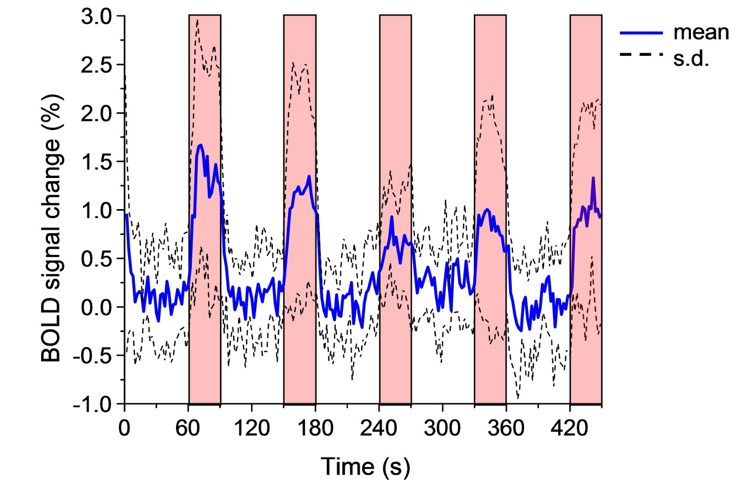
Functional Connectivity
Example: fMRI Blood Oxygen Level Dependent Imaging (BOLD) signal in the rat brain
Stimulation
blocks
Are these fluctuations just noise? → Resting State / Connectivity

Slide 35
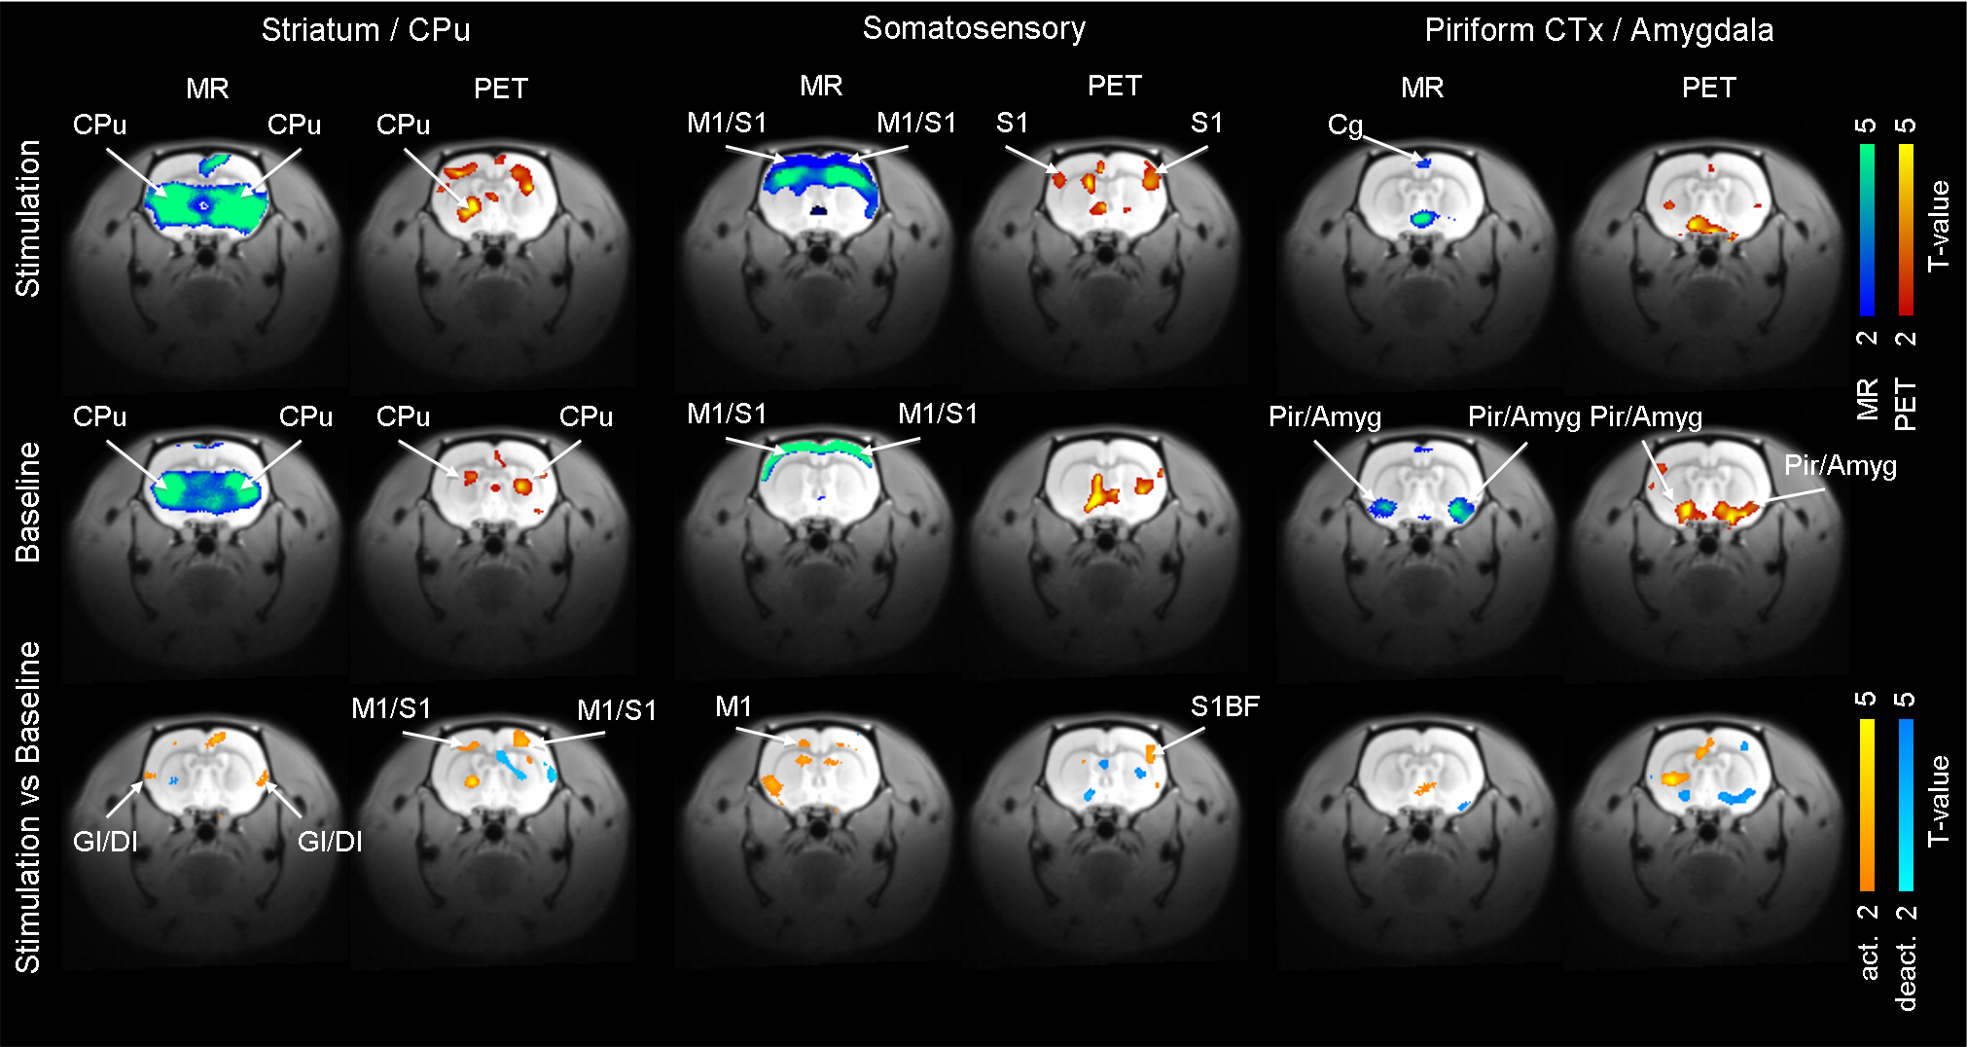
Can we get connectivity info from PET?
7 T small animal PET/MRI
[¹⁸F]FDG-PET, dynamic data (1 h), 8 rats (Lewis, male), isoflurane anesthesia studied
PET/MR functional connectivity (fc) using Independent component analysis (ICA) discovered
9 meaningful networks in BOLD-fMRI and 7 Networks in PET
Connectivity information is also coded in metabolic information
Now such “Networks” have also been found in humans (Aiello et al. Front.
Neurosci 2016)
Wehrl HF et al. Nature Med. 2013
Notes:
35

Slide 36
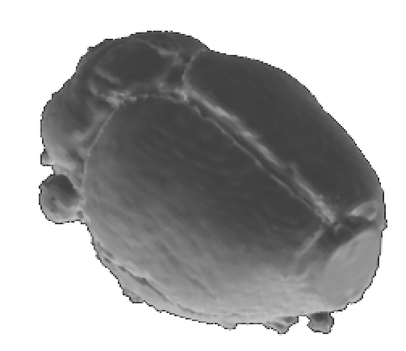
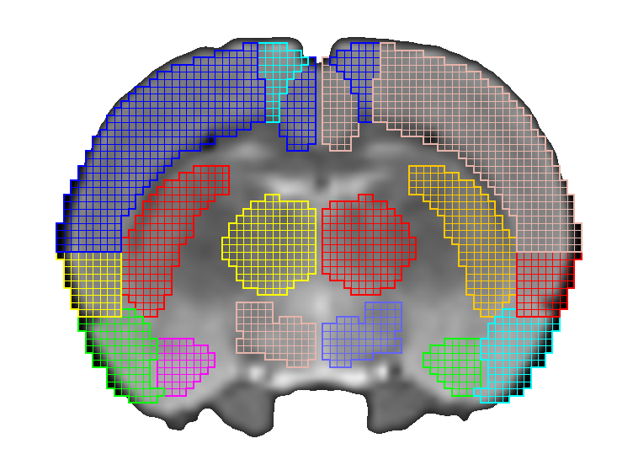
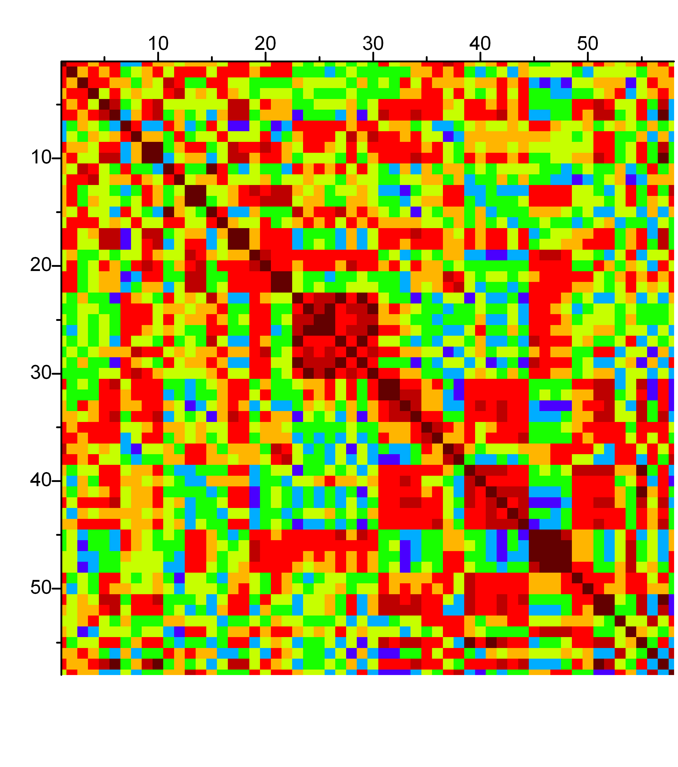
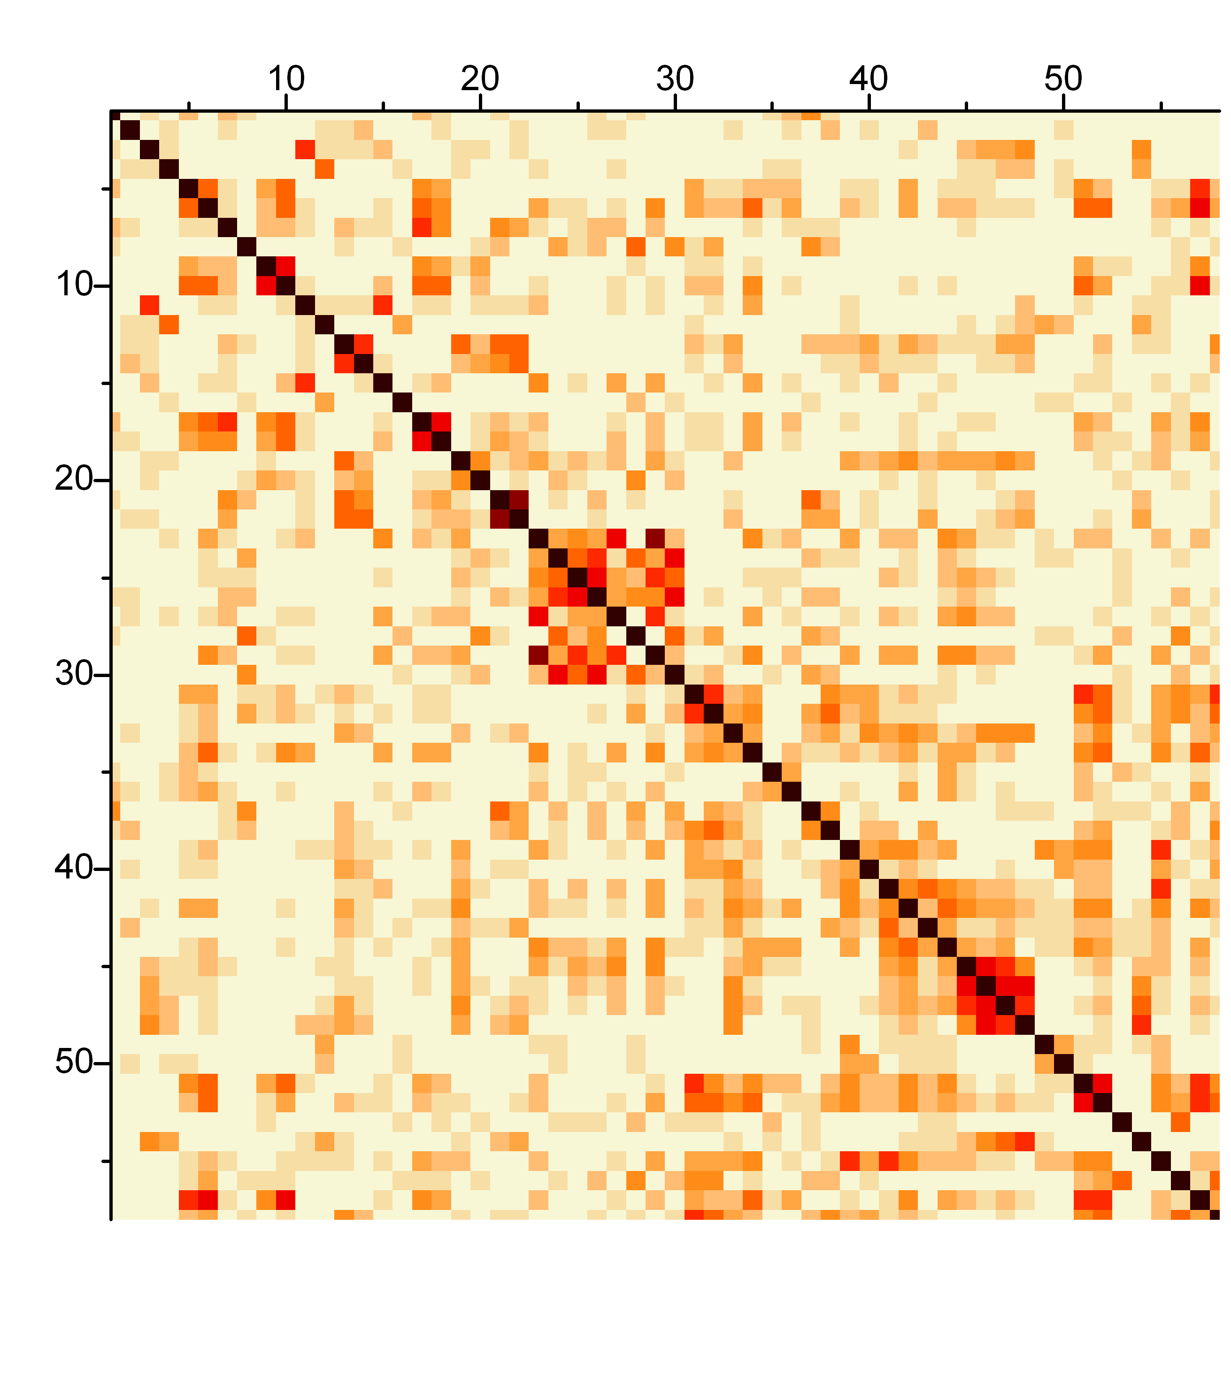
Graph theory based PET data analysis
MR and PET Data
Selection of Regions / Nodes
Signal in Nodes
Positive Correlation
Negative Correlation
R=0.8
R=- 0.7
Brain regions
Uptake Region B
Uptake Region B
Correlation Matrix
Signal in Nodes
Node A
Uptake Region A
Uptake Region A
Node B
No Correlation
Measurements
R=0
Data of individual Animals
or
Data over timepoints
Selection
Network
Connection
Uptake Region B
Uptake Region A
Nodes
Line thickness as a
measure of connection strength
Notes:
36

Slide 37
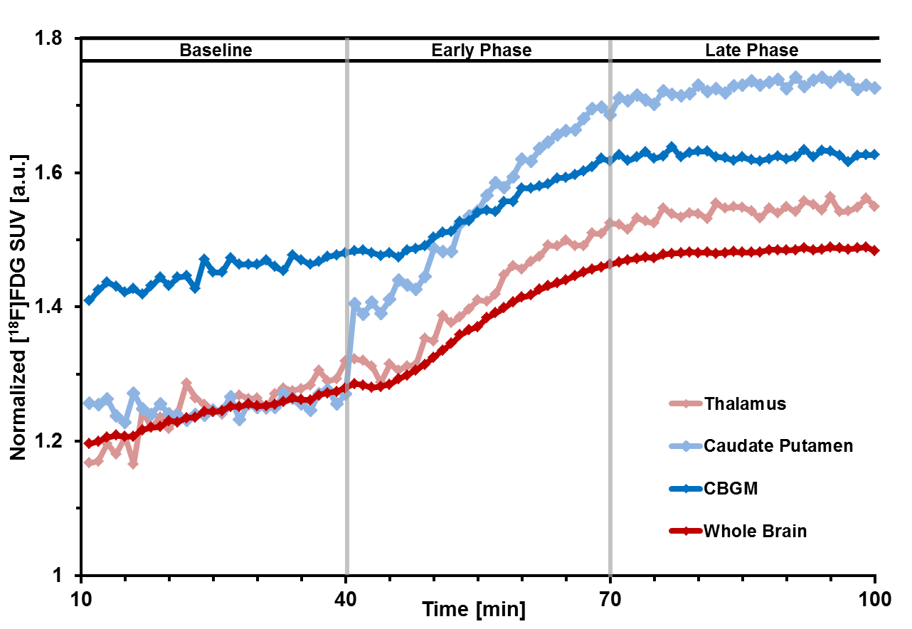
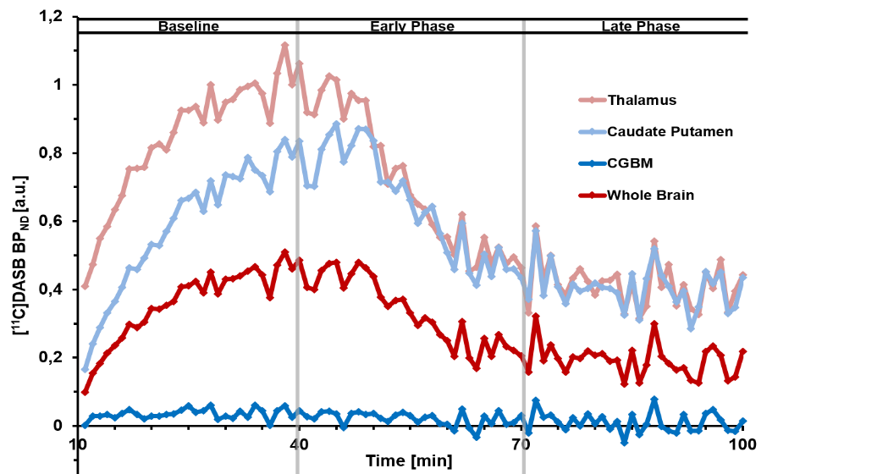
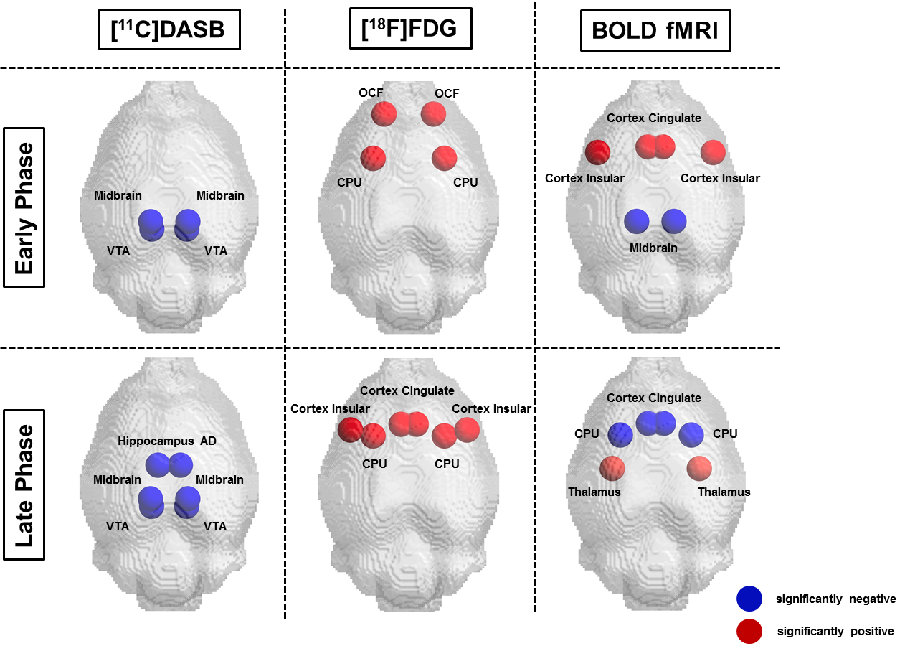
MDMA Drug challenge: [¹⁸F]FDG and [¹¹C]DASB-PET vs. fMRI
[¹⁸F]FDG: “glucose metabolism”
[¹¹C]DASB: “serotonin transporter“
PET
MDMA
PCA
Amend, Wehrl, et al.
Notes:
37
Investigation of brain function and metabolism in vivo is mainly performed by imaging techniques such as PET and fMRI. Hereby, fMRI relies on the BOLD effect, which is kind of complex interplay of blood flow, blood volume and oxygen consumption in the brain. In contrast PET uses radiolabeled metabolites or receptors. So both techniques utilize different biochemical and physiological markers, which might result in a different data outcome.
Brain activation is characterized by a whole cascade of biochemical and physiological processes that can be investigated by multimodal imaging.

Slide 38
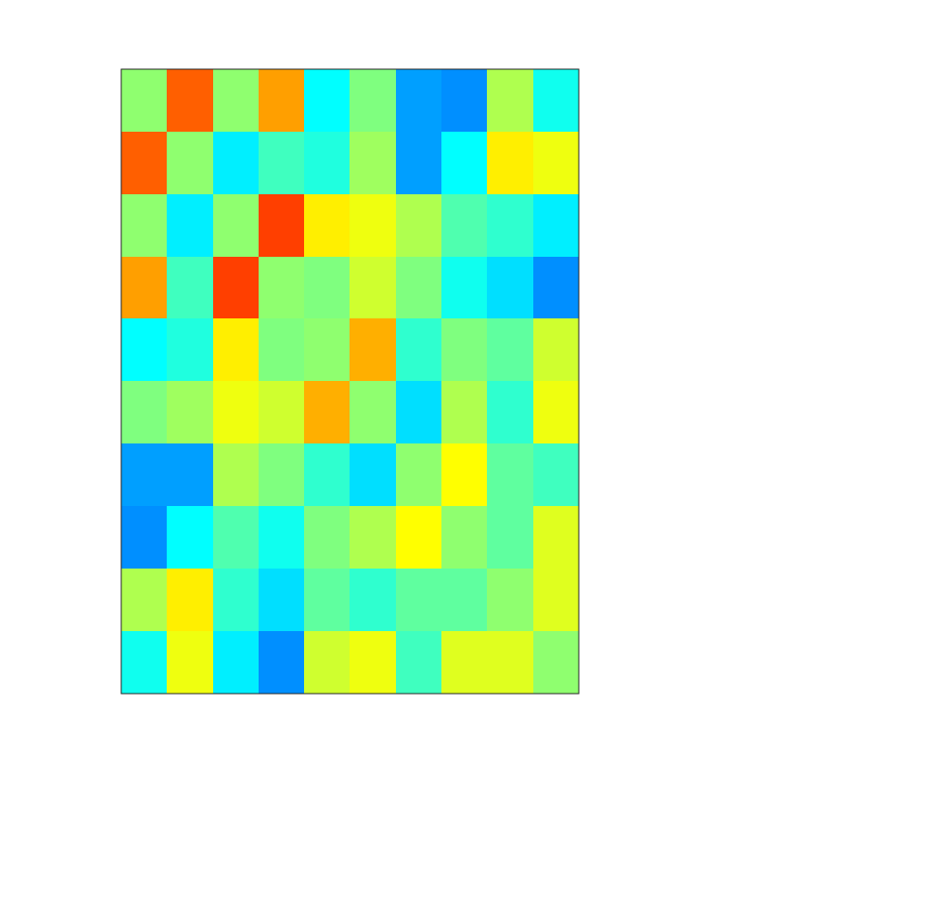
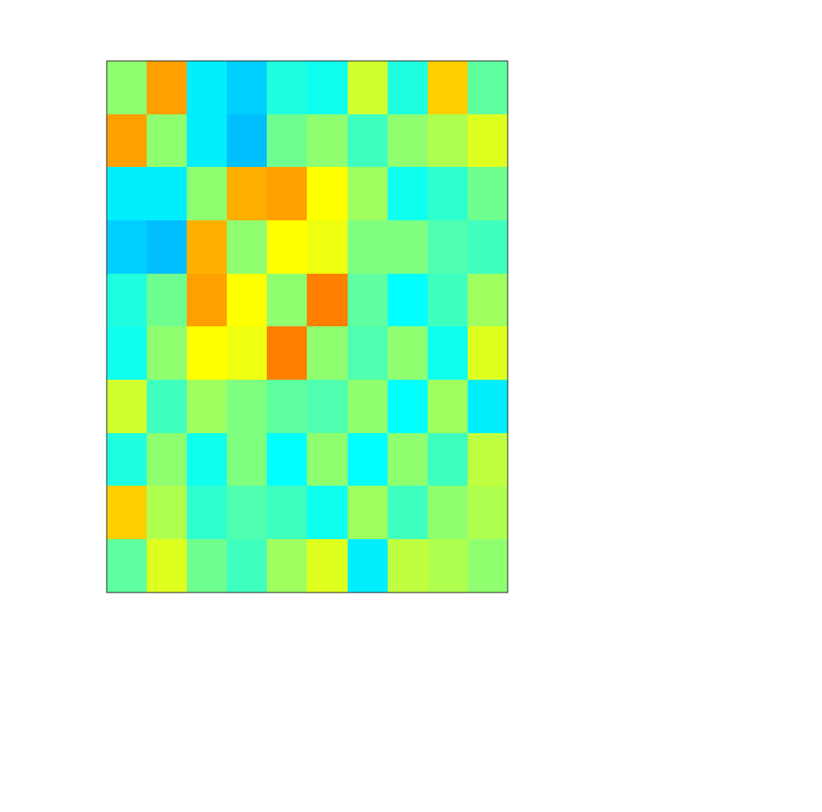
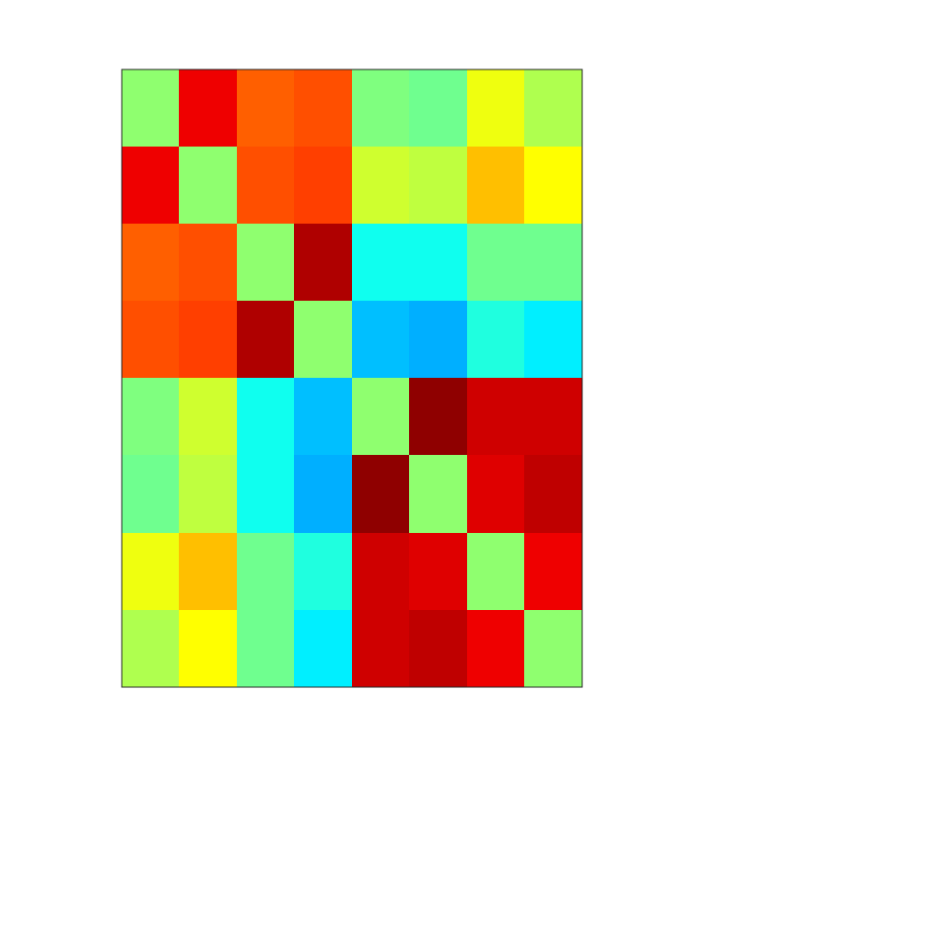
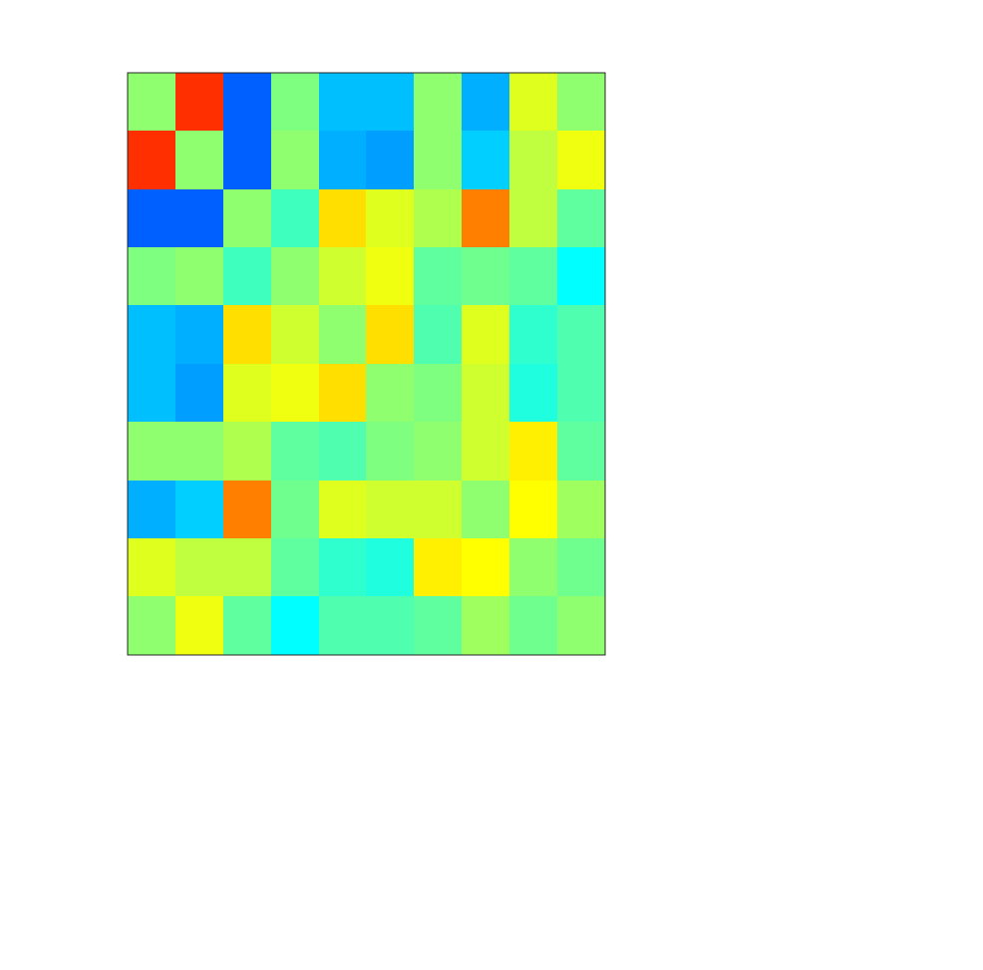
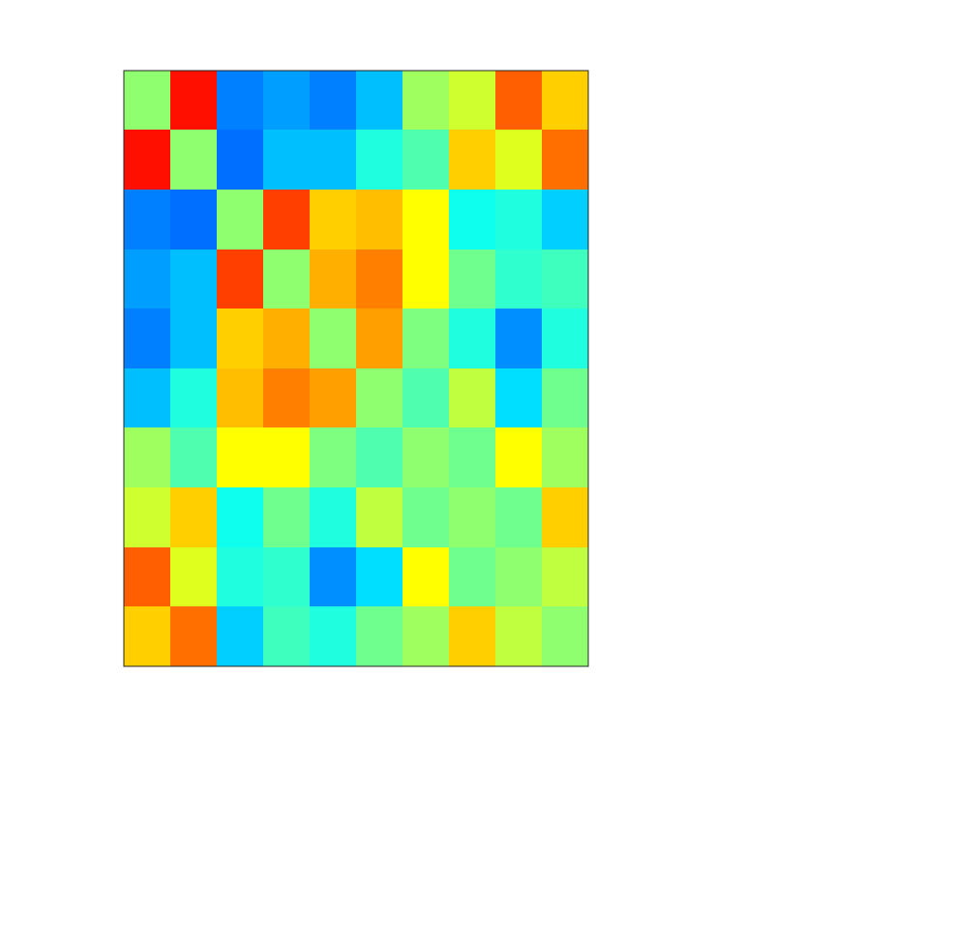
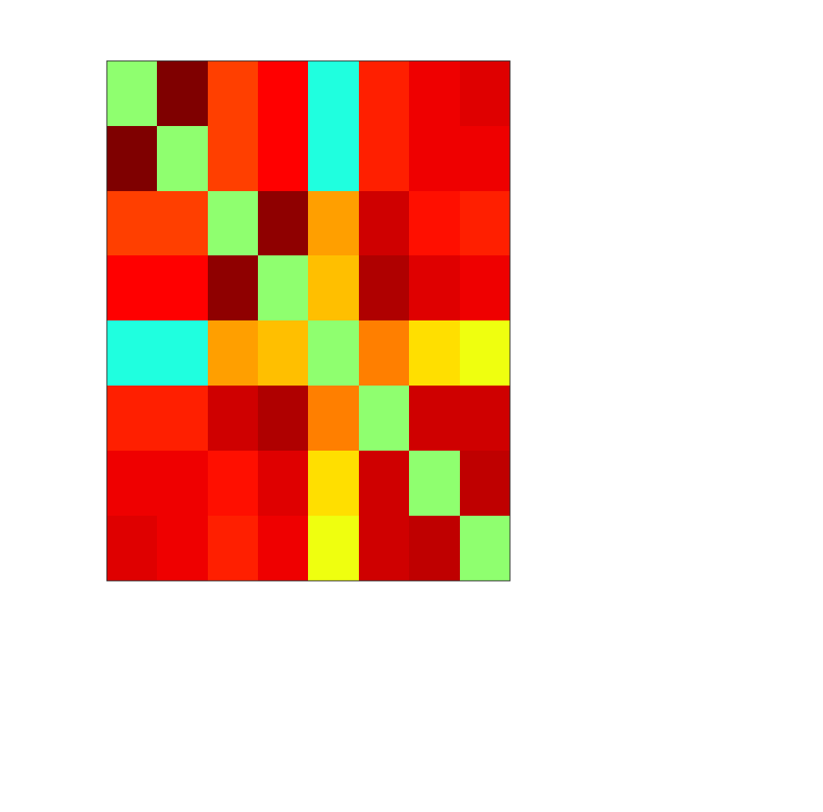
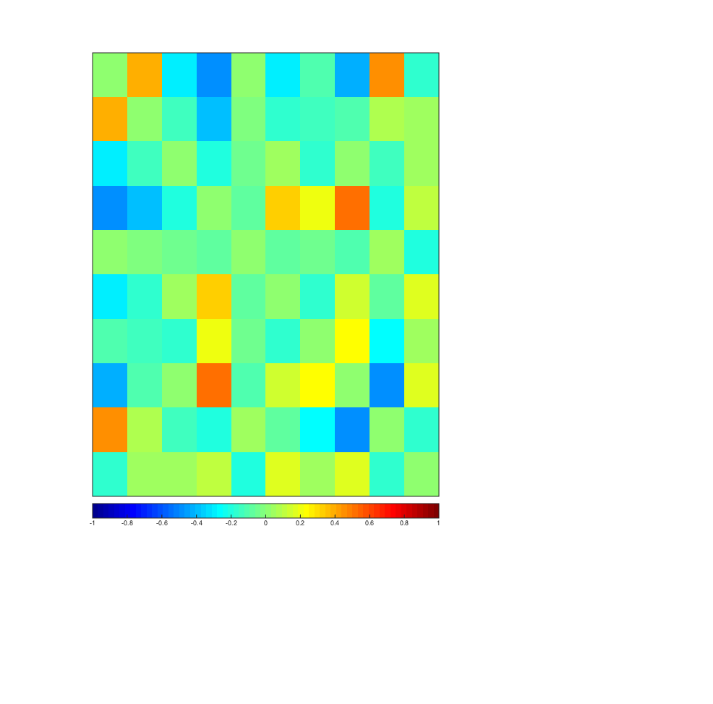
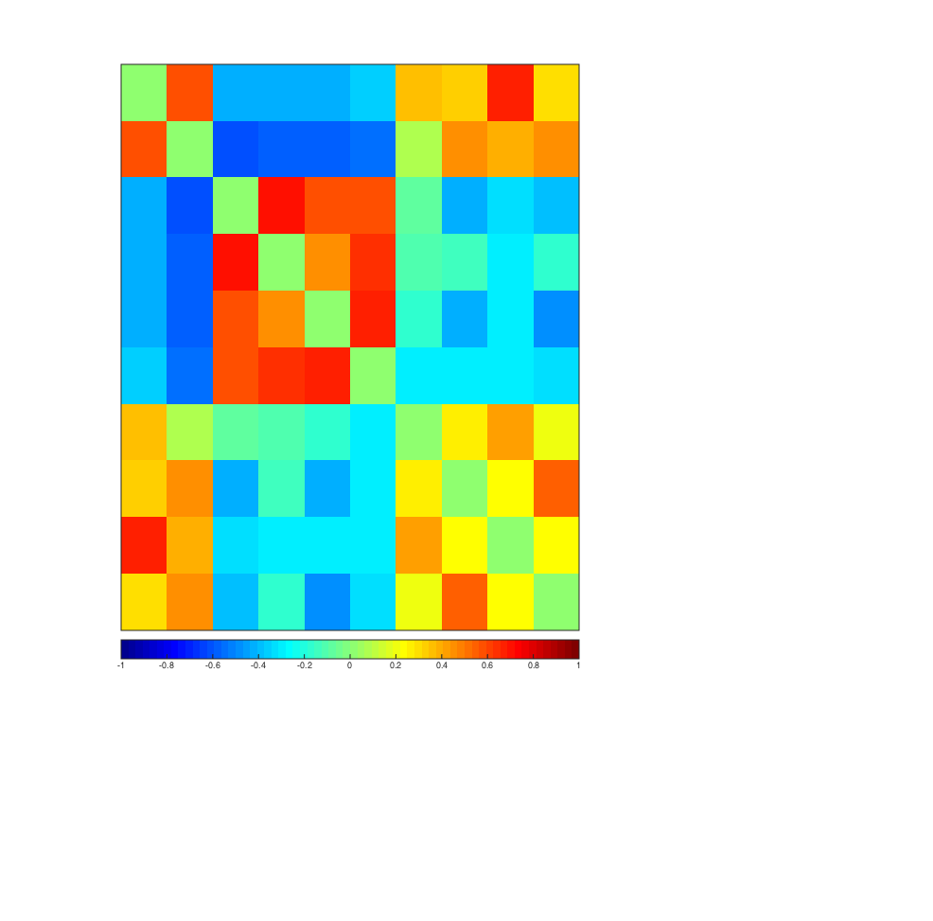

Multimodal Comparison – “Emotional Network”
[¹¹C]DASB
[¹⁸F]FDG
BOLD fMRI
1
1
1
Amygdala
2
2
2
Cortex Cingulate
Baseline
3
3
4
4
3
Hippocampus AD
5
5
4
Hippocampus P
1
2
3
4
5
1
2
3
4
5
1
2
3
4
1
1
1
Amygdala
2
2
2
Cortex Cingulate
Early Phase
3
3
Hippocampus AD
4
4
3
5
5
4
Hippocampus P
1
2
3
4
5
1
2
3
4
5
1
2
3
4
1
1
1
Amygdala
2
2
2
Cortex Cingulate
Late Phase
3
3
Hippocampus AD
4
4
3
5
5
4
Hippocampus P
-1
0
1
-1
0
1
-1
0
1
Amend, Wehrl, et al.
Notes:
38
“Emotional Network” changes from baseline to early and late phase after MDMA administration. In DASB no major changes are observed. However in FDG and fMRI correlation between the specific emotional brain areas are changes (positively as well as negatively).

Slide 39











Metabolic Connectivity across species and tracers
[¹⁸F]FDG
[¹⁵O]H₂O
[¹¹C]DASB
BOLD-fMRI
Humans
Rats
Cooperation Partners:
LMU Munich (Bartenstein, Mille)
Vienna (Lanzenberger)
Newark (Biswal)
Tuebingen (Wehrl, la Fougère)
Mice

Slide 40


Clinical applications of metabolic connectivity
Patient vs. healthy control data:
  PCA
  PD (n=15) vs. healthy and AD (n=40) vs. healthy ([¹⁸F]FDG-PET)
  z-Scores were used to describe “expression”
Metabolic Signatures of different diseases (PD, AD)
Characteristic networks that change with disease progression and treatment
Initial data looks very promising however more follow up studies needed
Translation into broad clinical use needed, by robust and automatic procedures
DMN like
PD
AD
Control
Group 1
PD related network
expression
DMN like network
expression
Control
Group 2
Control
DMN like network
expression
DMN like network
expression
PD
Group
Ctrl
early PD
PD MCI
Spetsieris P. G. et al. PNAS 2015
Notes:
40

Slide 41

Applications in the developing brain?
Impairment of FC between language regions in former early preterms
M. Wilke et al, Hum Brain Mapp. (2014)
Overall strength of connectivity between STL language regions was significantly stronger in TD participants
Correlation with metabolic or molecular information derived from PET data could yield promising results

Slide 42
Conclusions: PET/MR Imaging
Challenges:
  majority of challenges are solved
  correct data interpretation
Opportunities:
  reduction of total radiation dose compared to PET/CT
  reduction of sedation compared to sequential measurements
  complementary functional information (e.g. DWI vs. [¹⁸F]FDG)
  new study protocols (low dose PET)
Future:
  excellent translational research tool
  more correlations (e.g. functional, metabolic and molecular information)
  clinical translation requires robust implementations (acquisition, analysis etc.)
Notes:
42

Slide 43
Organisational matters
Lecture fMRI: 12/04/17 08:30 a.m. – 10:00 a.m.
Practical course:
12/04/17 10:00 a.m. – 01:00 p.m.
12/06/17 09:30 a.m. – 12:30 p.m.
Seminar topics:
Functional brain network alterations in mouse models of neurodegenerative diseases
2. Small animal PET/MRI
3. Imaging BOLD responses in the somatosensory cortex of the rat
Notes:
43

Slide 44







Acknowledgement
Universität Tübingen
Bernd Pichler
Hans Wehrl
Christian la Fougere
Konstantin Nikolaou
MPI für Biologische Kybernetik, Tübingen
Rolf Pohmann
New Jersey Instute of Technology, Newark, USA
Bharat Biswal
Suril Gohel
National Cerebral and Cardiovascular Center, Osaka, Japan
Hidehiro Iida
Jun-ichiro Enmi
Osaka University, Osaka, Japan
Yun Hatazawa
Tadashi Watabe
Stanford University, USA
Gary Glover
DFG Emmy Noether Programm
WE 5795/2-1
BMBF: „Neurophysiologische Basis der Gehirnkonnektivität“ DLR 01GQ1415
Werner Siemens-Foundation
IZKF Research Group:
Functional and Metabolic Brain Imaging (FMBI), fortüne: 2209-0-0, 2409-0-0
JSPS: PE 15015
Notes:
44

