Slide 1
Image Reconstruction
Jonathan Disselhorst, PhD
Jonathan.Disselhorst@med.uni-tuebingen.de

Slide 2
Downloads
http://jonathan.disselhorst.eu/imageanalysis
(case sensitive)

Slide 3
Overview
Forward and back projection
Reconstruction types
Filtered Back Projection
  Filtering
Ordered Subsets Expectation Maximization
  Iterations
  Subsets
MATLAB

Slide 4
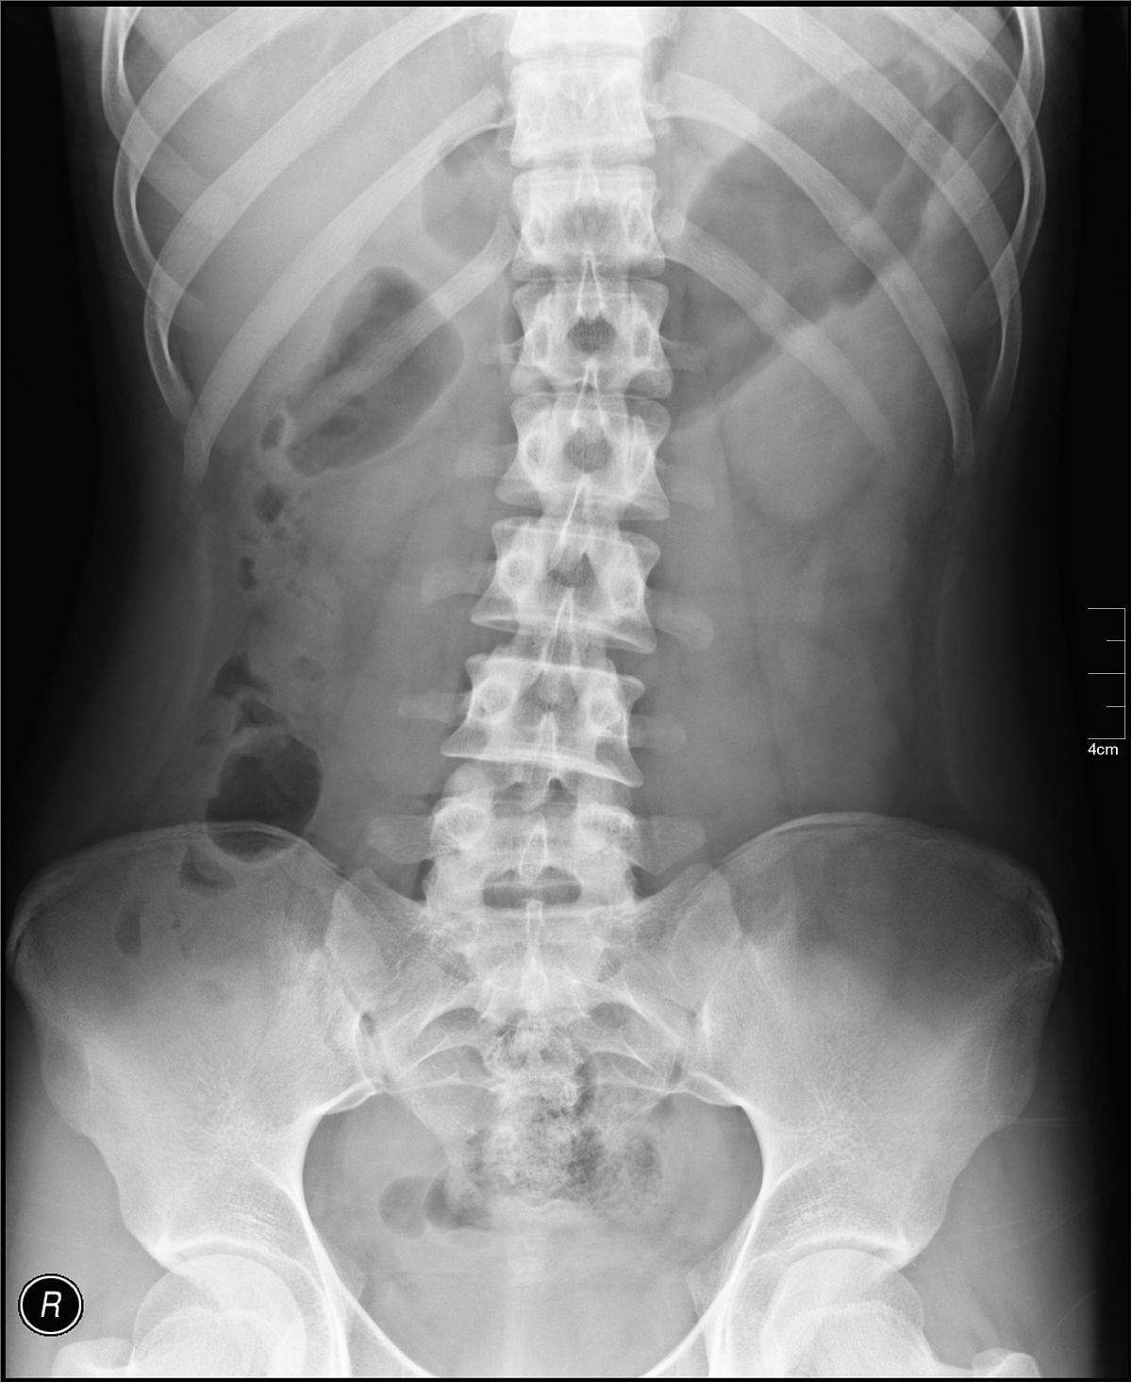
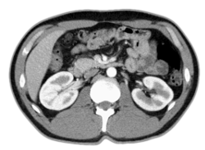
Forward Projection

Slide 5
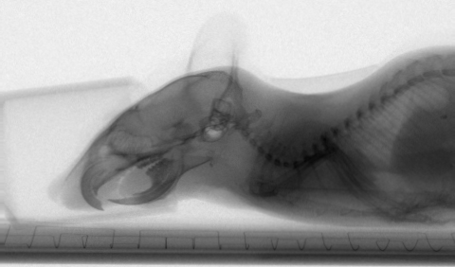
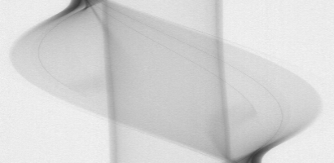
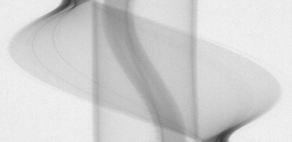
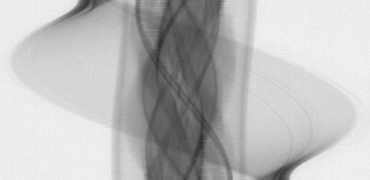
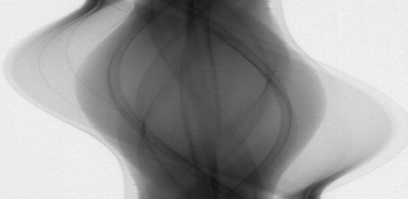
Forward Projection
1 projection,
1 angle
Sinogram of
1 slice
over 180º

Slide 6

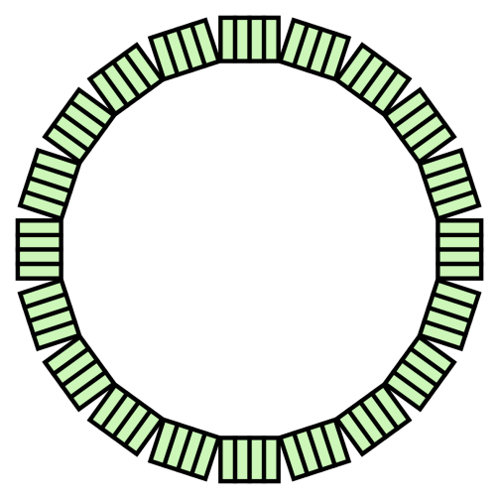
Forward Projection

Slide 7
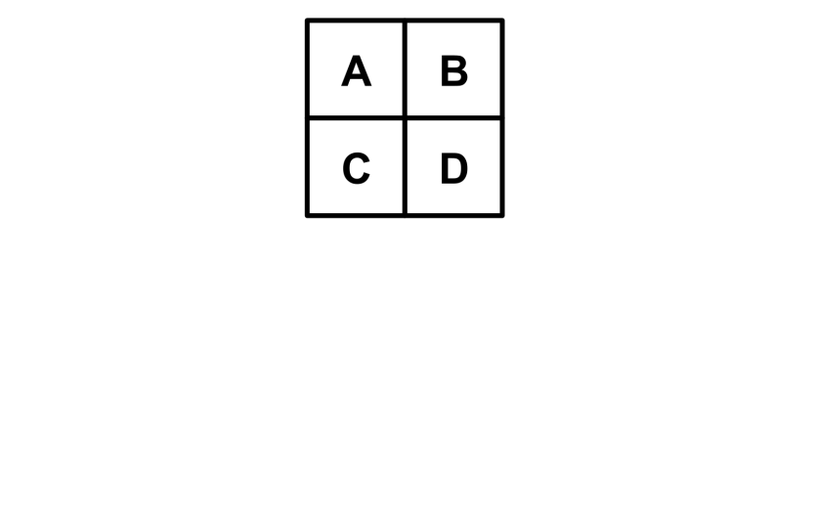
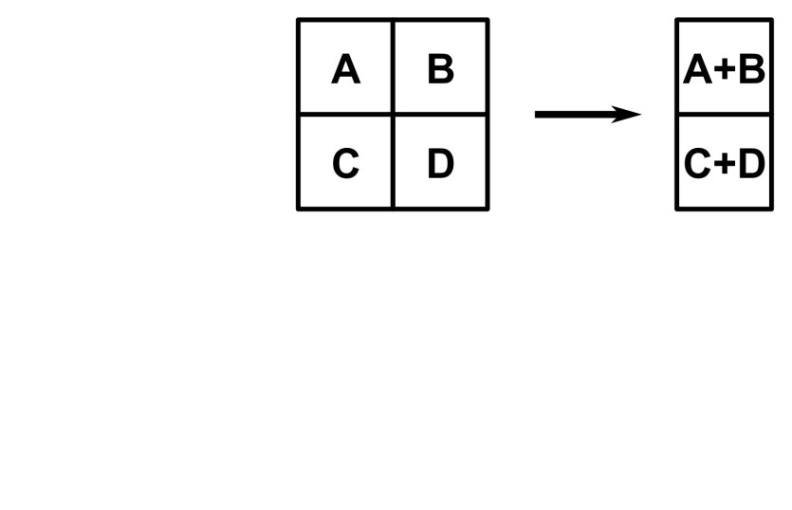
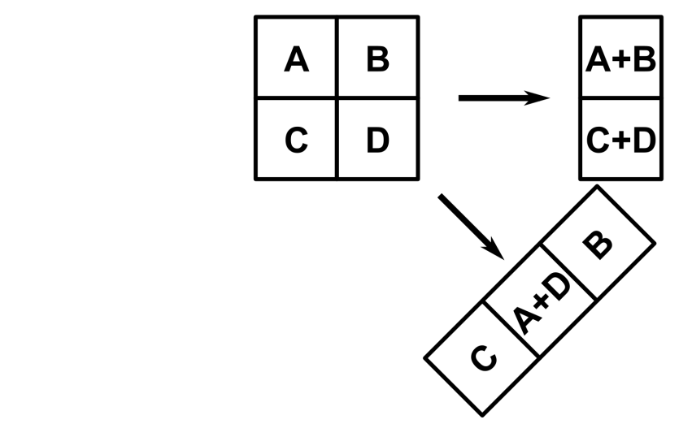
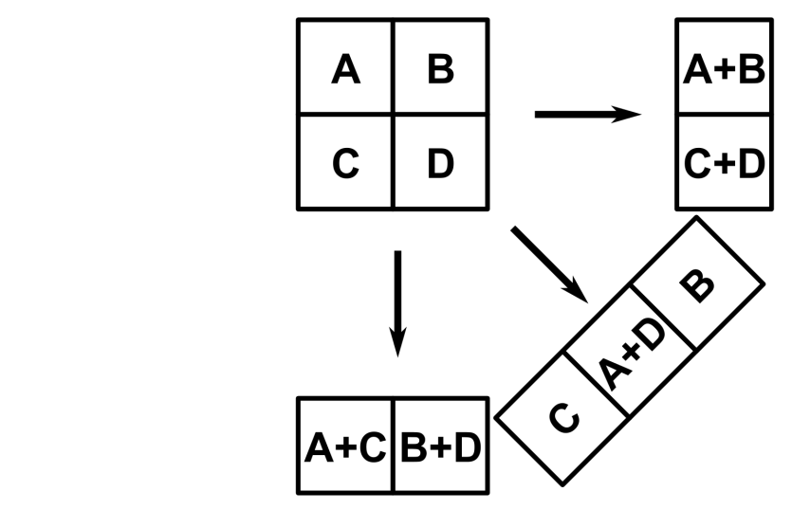
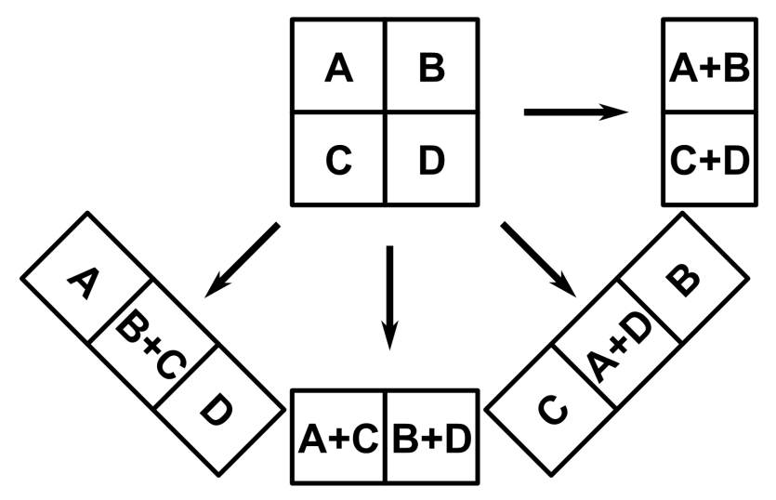
Forward Projection

Slide 8

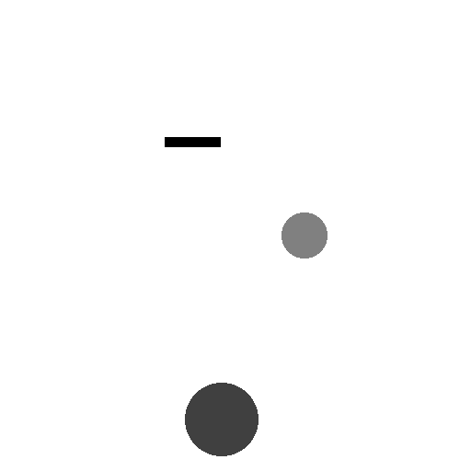

Forward Projection
Image
Sinogram

Slide 9
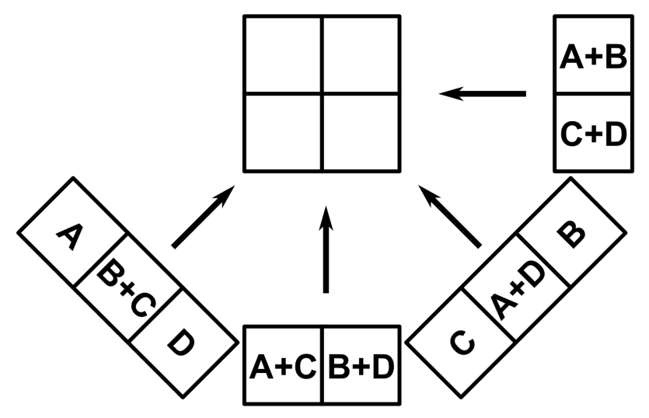
Back Projection
A+B+
A+D+
A+C+
A
A+B+
B+
B+D+
B+C
C+D+
C+
A+C+
B+C
C+D+
A+D+
B+D+
D

Slide 10
Back Projection
Subtract projection sum (A+B+C+D) from all pixels
Divide by number of projections − 1
A
B
A+B+
A+D+
A+C+
A
A+B+
B+
B+D+
B+C
C
D
C+D+
C+
A+C+
B+C
C+D+
A+D+
B+D+
D

Slide 11

Back Projection
Reconstructed Image
(unfiltered back projection)
Sinogram

Slide 12
Back Projection
With normal back projection, the image looks very blurry!
Blurred with an (1/r) function.

Slide 13
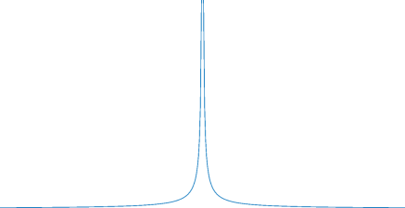

1/r
Image of a point (source)
Profile
original
Unfiltered backprojection

Slide 14
Back Projection
With normal back projection, the image looks very blurry!
Blurred with an (1/r) function.
Could be corrected with a deconvolution, but we don’t want to do this…
$$f^{′}\left(x,y\right)=f\left(x,y\right)⨂\frac{1}{r} \text{ (}⨂\text{ : }\text{convolution}\text{)}$$

Slide 15
Reconstruction types
Image Reconstruction
Analytical
e.g., FBP
Iterative
Algebraic
e.g., ART
Statistical
e.g., OSEM

Slide 16
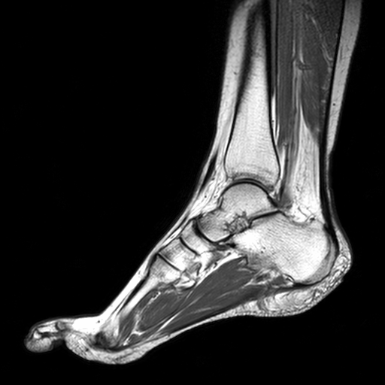
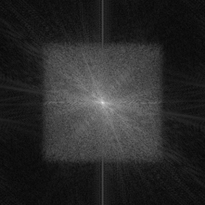
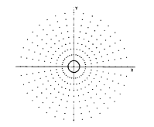
Fourier Transform
→ Discrete Fourier transform →
← Inverse discrete Fourier transform ←
Discrete form of the Fourier transform (DFT)
Often implemented as the fast Fourier transform (FFT)
High frequency
Low frequency

Slide 17
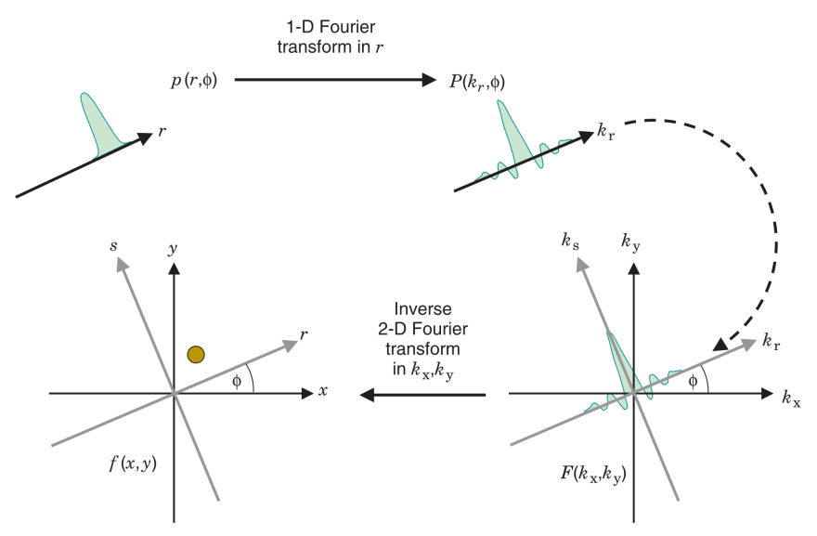
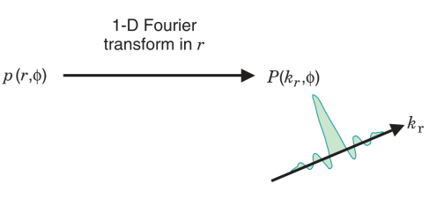
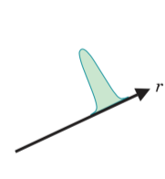
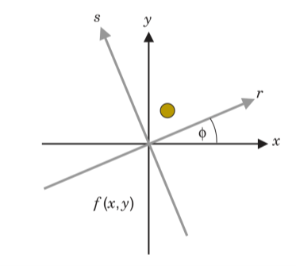
Central Slice Theorem
Can be used for reconstruction.
Reconstruct image by applying the inverse Fourier transform
However, converting the polar frequency space to Cartesian coordinates is slow and can lead to artifacts when inter-polation is not done properly.
Cherry et al. Physics in Nuclear Medicine
Notes:
The central slice theorem is an important concept in image reconstruction.
Projection p(r,ϕ) is a one-dimensional projection of the 2D image f(x,y) at projection angle ϕ.
Fourier spectrum F(kx,ky) is the Fourier transform of image f(x,y).
The theorem states that the 1D Fourier transform of p [called P(kr,ϕ)], is equal to a line through F at the same angle ϕ.

Slide 18
Filtered Back Projection
Take 1D FFT of each projection
Perform filtering in frequency domain
(does not require interpolation or coordinate conversion:
therefore it is accurate and fast)
Take 1D inverse FFT
Standard back projection

Slide 19
Filters
What would be a good filter?
H
k
High frequency
Low frequency
Ramp filter (a.k.a. Ram-Lak)

Slide 20
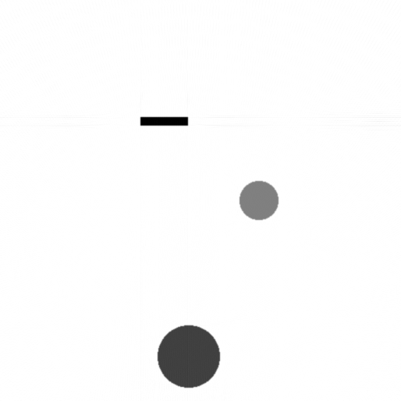
Filters
Back projection
Filtered back projection
(Ramp filter)

Slide 21
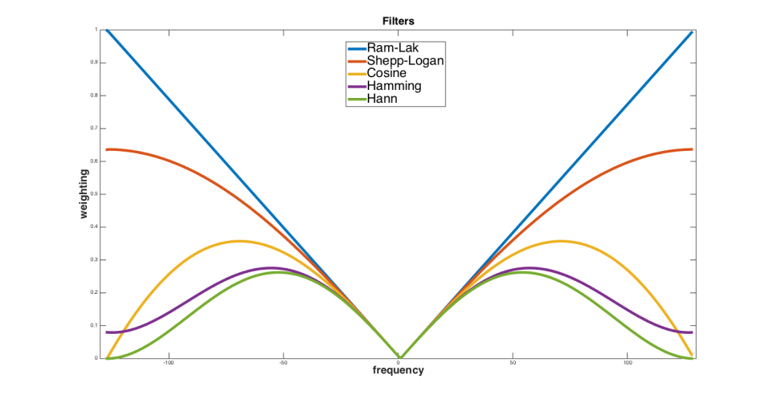
Filters
Low frequencies:
Always filtered out
Image courtesy of Chih-Chieh Liu

Slide 22
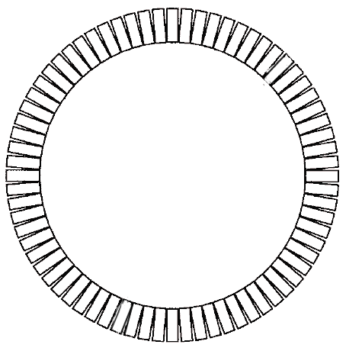
FBP vs. Reality
Imprecise detectors
Imperfect geometry
…
Number of projections
Noise

Slide 23
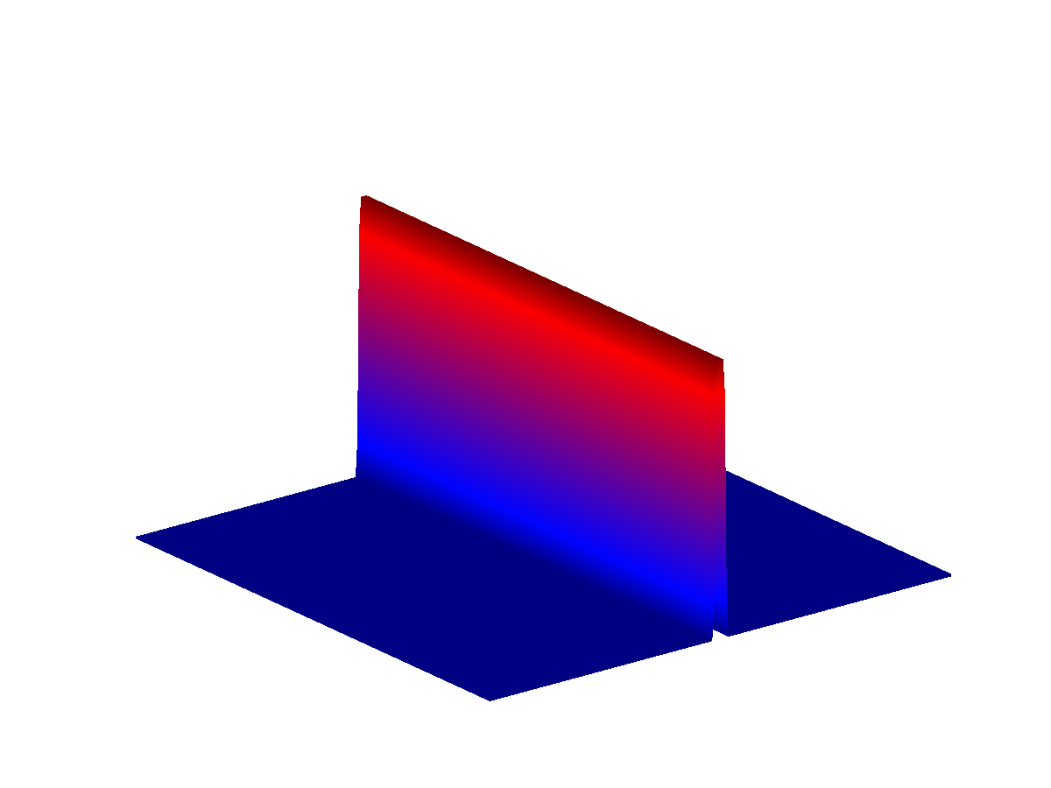
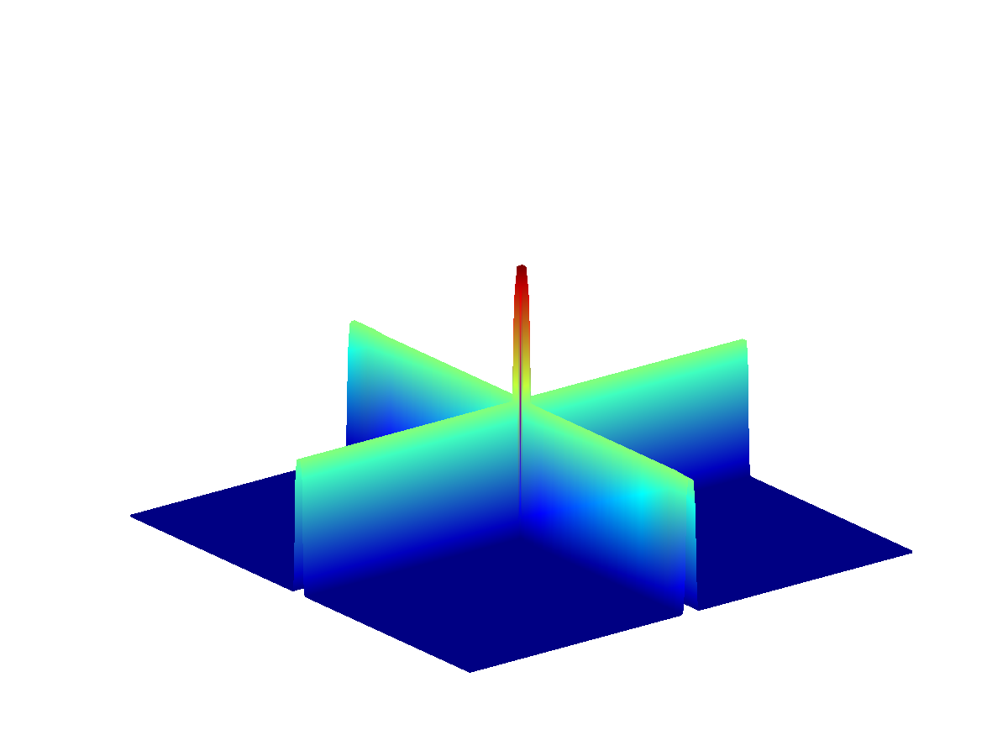
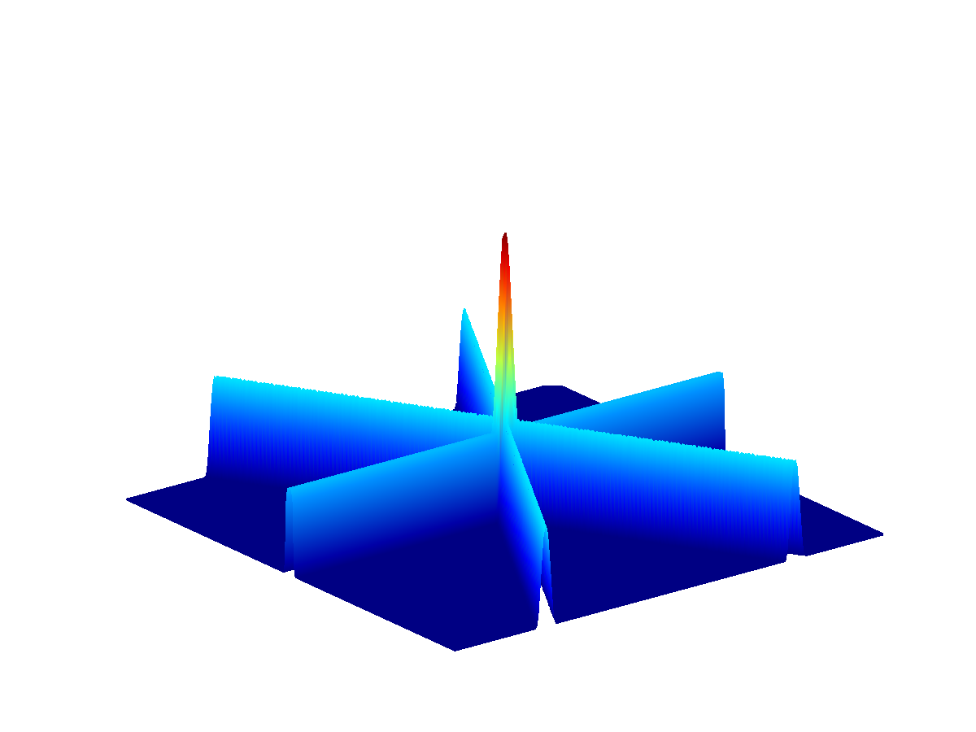
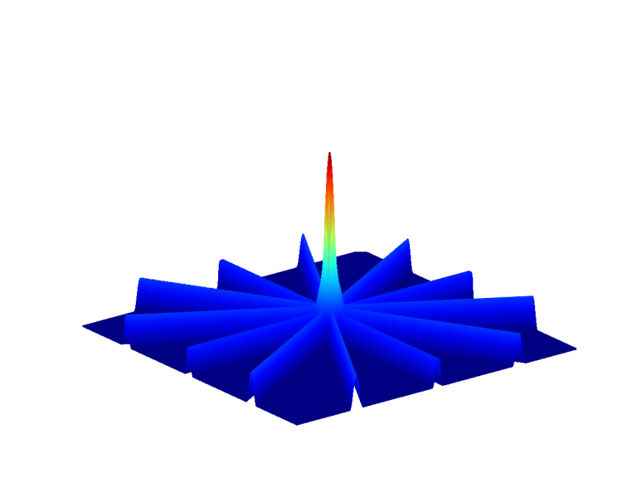
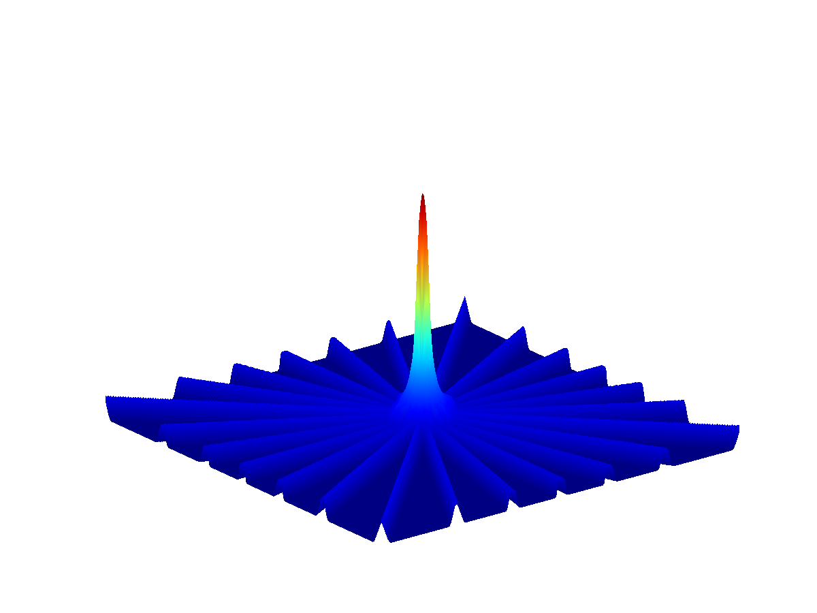



















Number of Projections
Point source measurement reconstructed from 1 projection.
Point source measurement reconstructed from 2 projections.
Point source measurement reconstructed from 3 projections.
Point source measurement reconstructed from 6 projections.
Point source measurement reconstructed from 12 projections.
Point source measurement reconstructed from 24 projections.
Point source measurement reconstructed from 48 projections.
Point source measurement reconstructed from 96 projections.
Filtered
Unfiltered

Slide 24
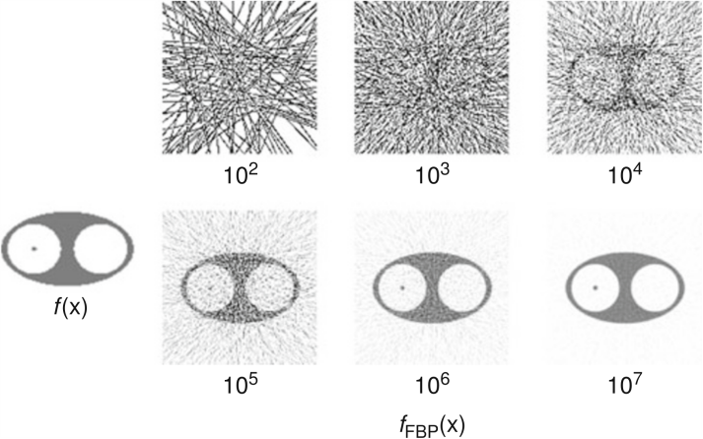
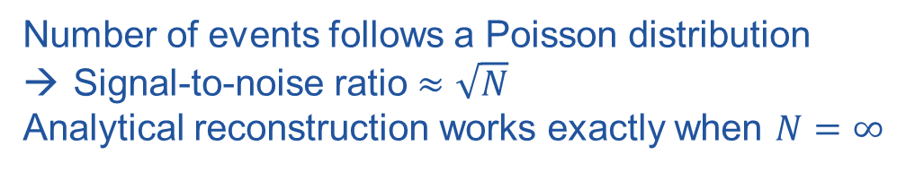
Noise
Image courtesy of
Milan Zvolský (DESY)
Number of events follows a Poisson distribution
Signal-to-noise ratio $≈\sqrt{N}$
Analytical reconstruction works exactly when $N=∞$

Slide 25
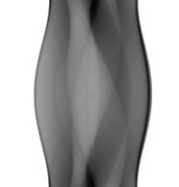
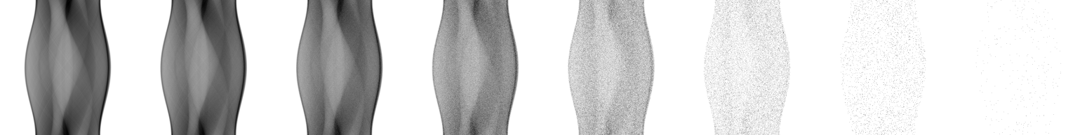
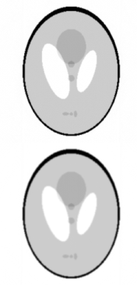
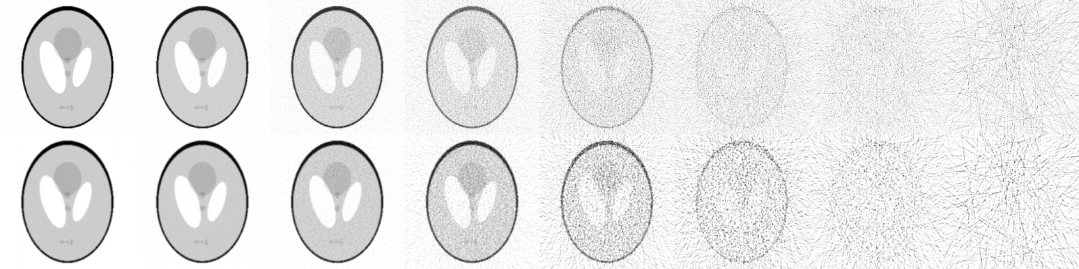
Noise
Sinogram
Ramp filter
Hann filter

Slide 26
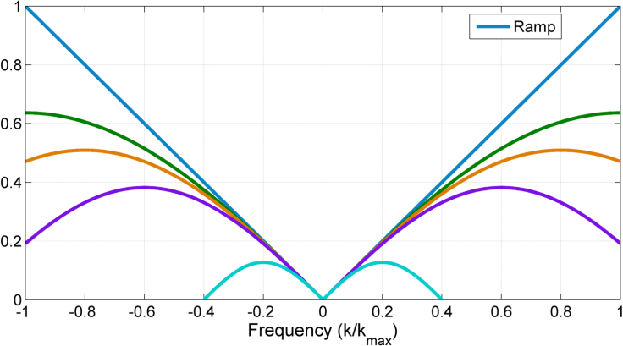
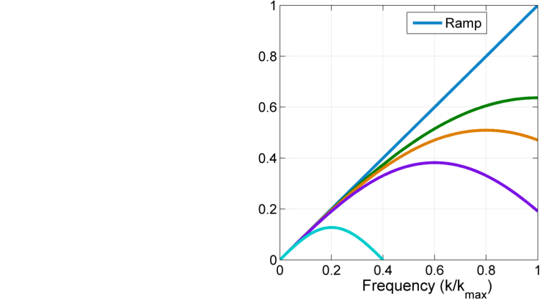
Noise
Shepp-Logan filters with different cut-off frequencies.
Cherry et al.

Slide 27
Artifacts
Effect of linear sampling of the profile on image quality.
Undersampling leads to blurring and image artifacts.
Cherry et al.

Slide 28
Artifacts
Effect of angular sampling on image quality.
Undersampling leads to image artifacts.
Cherry et al.

Slide 29
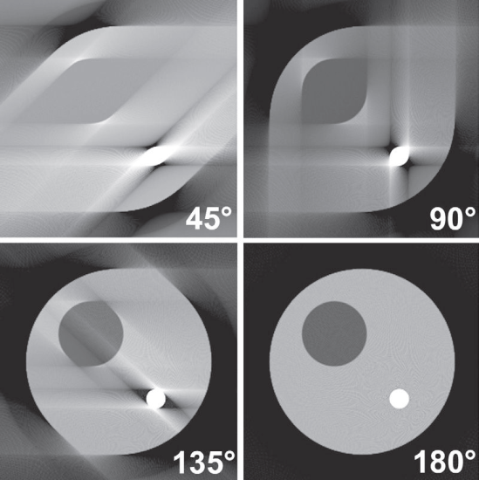
Artifacts
Effect of angular sampling range on image quality.
Sampling over an interval of less than 180 degrees leads to image artifacts.
Cherry et al.

Slide 30
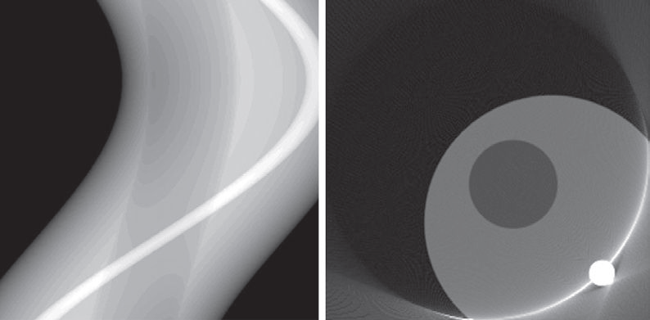
Artifacts
Cherry et al.
Projections do not cover the entire object.

Slide 31
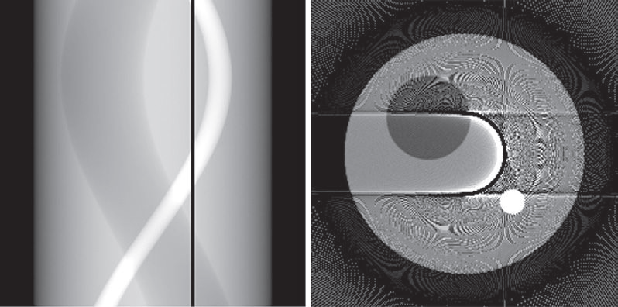
Artifacts
Cherry et al.
Missing projection element, e.g., as a result from a broken detector.

Slide 32
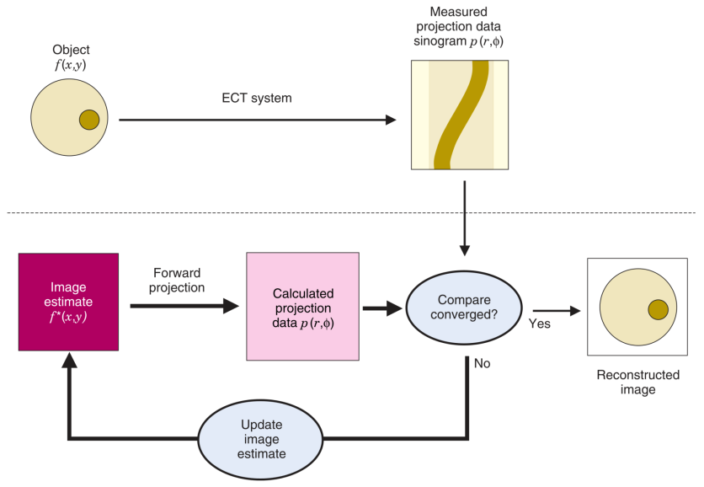
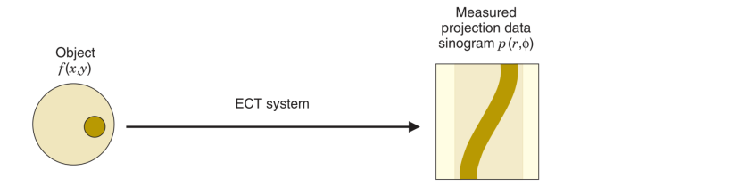
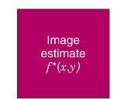
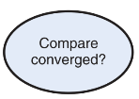
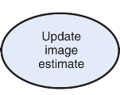
Iterative Reconstruction
The measurement,
Forward projection
Cost function
Cherry et al. Physics in Nuclear Medicine
Update function

Slide 33
Iterative Reconstruction
Aspects that may be considered during iterative reconstruction:
Statistical noise
Prior information (about the system, the object, …)
Non-negativity constraint
Cherry et al. Physics in Nuclear Medicine

Slide 34
Iterative Reconstruction
Major advantages:
Less sensitive to noise
Potentially more accurate
Major disadvantages
Computationally intensive
Cherry et al. Physics in Nuclear Medicine

Slide 35
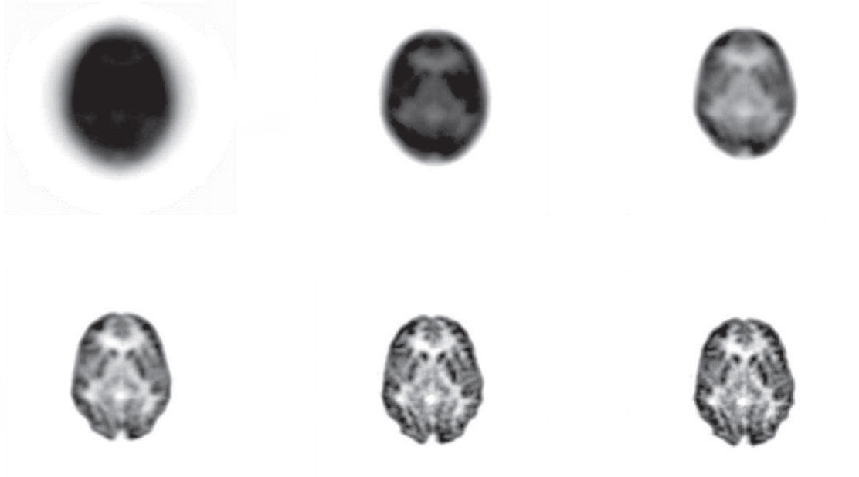
Iterative Reconstruction
Iteration 1
Iteration 3
Iteration 5
Cherry et al. Physics in Nuclear Medicine
Iteration 10
Iteration 20
Iteration 30

Slide 36
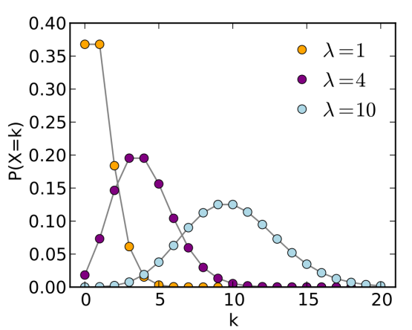
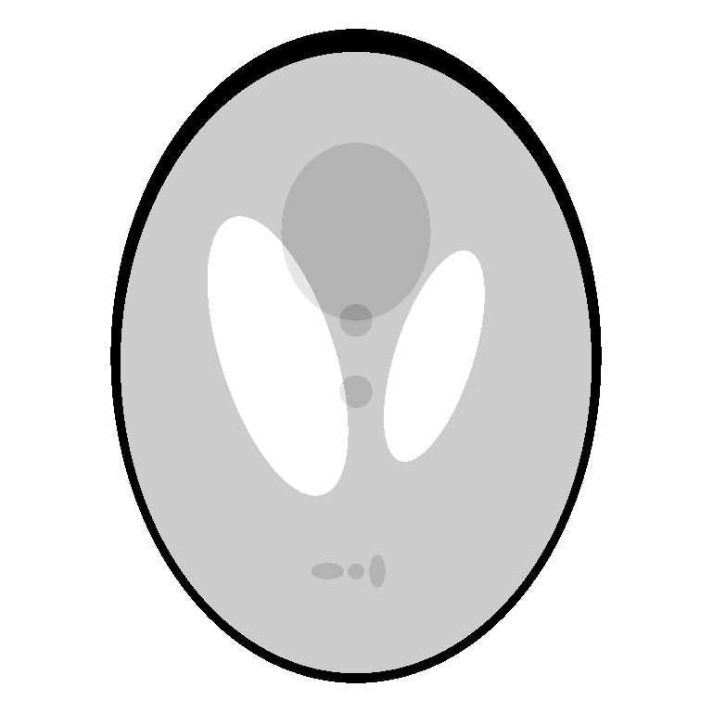

Iterative Reconstruction
Components in iterative reconstruction:
Image model
System model
Data model
Model of physical effects that govern the system, e.g.,
Geometry
Depth of interation
Scattering in detector
Dead time
Randoms
Photon acollinearity
Positron range
Data model:
Describes the statistical relationship between the measured data and the expected value of the measurement.
Photon detection is Poisson distributed* →
*no longer after correction for randoms, scatter, attenuation, etc…

Slide 37
Iterative Reconstruction
Components in iterative reconstruction:
Image model
System model
Data model
Cost function
Algorithm
An algorithm is required to optimize the cost function, to find the best image estimate. Commonly used:
Expectation Maximization (EM)
Most commonly used for iterative reconstruction: Maximum Likelihood.
In general: the likelihood that observed data matches with a certain model.

Slide 38
Iterative Reconstruction, Noise
Ideal
Noisy
Smoothing
Wernick and Aarsvold. Emission Tomography: The fundamentals of PET and SPECT.

Slide 39
Ordered Subsets EM (OSEM)
Ordered Subsets Expectation Maximization (OSEM)*
Faster than MLEM
Uses subsets of the entire data for each image update.
Each iteration has sub-iterations for each subset
The back projection only uses projections from one subset
* Hudson and Larkin. IEEE Trans Med Imaging. 1994

Slide 40



OSEM
OSEM with one subset = MLEM
Rule of thumb: Speed increase of OSEM is roughly the number of subsets.
Caution: comes at the expense of higher image variance
Alessio and Kinahan, PET Image Reconstruction. 2006

Slide 41


FBP vs. OSEM
FBP vs. OSEM
FBP vs. OSEM
Alessio and Kinahan, PET Image Reconstruction. 2006

Slide 42




Fan-Beam & Cone-Beam
Fan-beam
Feldkamp algorithm
Cone-beam
Cherry et al.

Slide 43

3D – PET
Single Slice Rebinning – Fourier Rebinning – 3D reconstruction
Cherry et al.

Slide 44
MATLAB
IM = phantom;
sino = radon(IM);
FBP = iradon(sino);
CT = fanbeam(IM,183);
CTrecon = ifanbeam(CT,183);
sinon = imnoise(sino/1E12,'poisson');
FBPn = iradon(sinoN);
183 is the distance from CT source to the center of rotation. Can be changed.
1E12 is a scale factor to adjust the noise, increase to increase the noise. Also ‘Poisson’ can be changed to change noise distribution.

Slide 45
Questions!
Downloads
http://jonathan.disselhorst.eu/imageanalysis
(case sensitive)

Slide 46


Books

