Slide 1
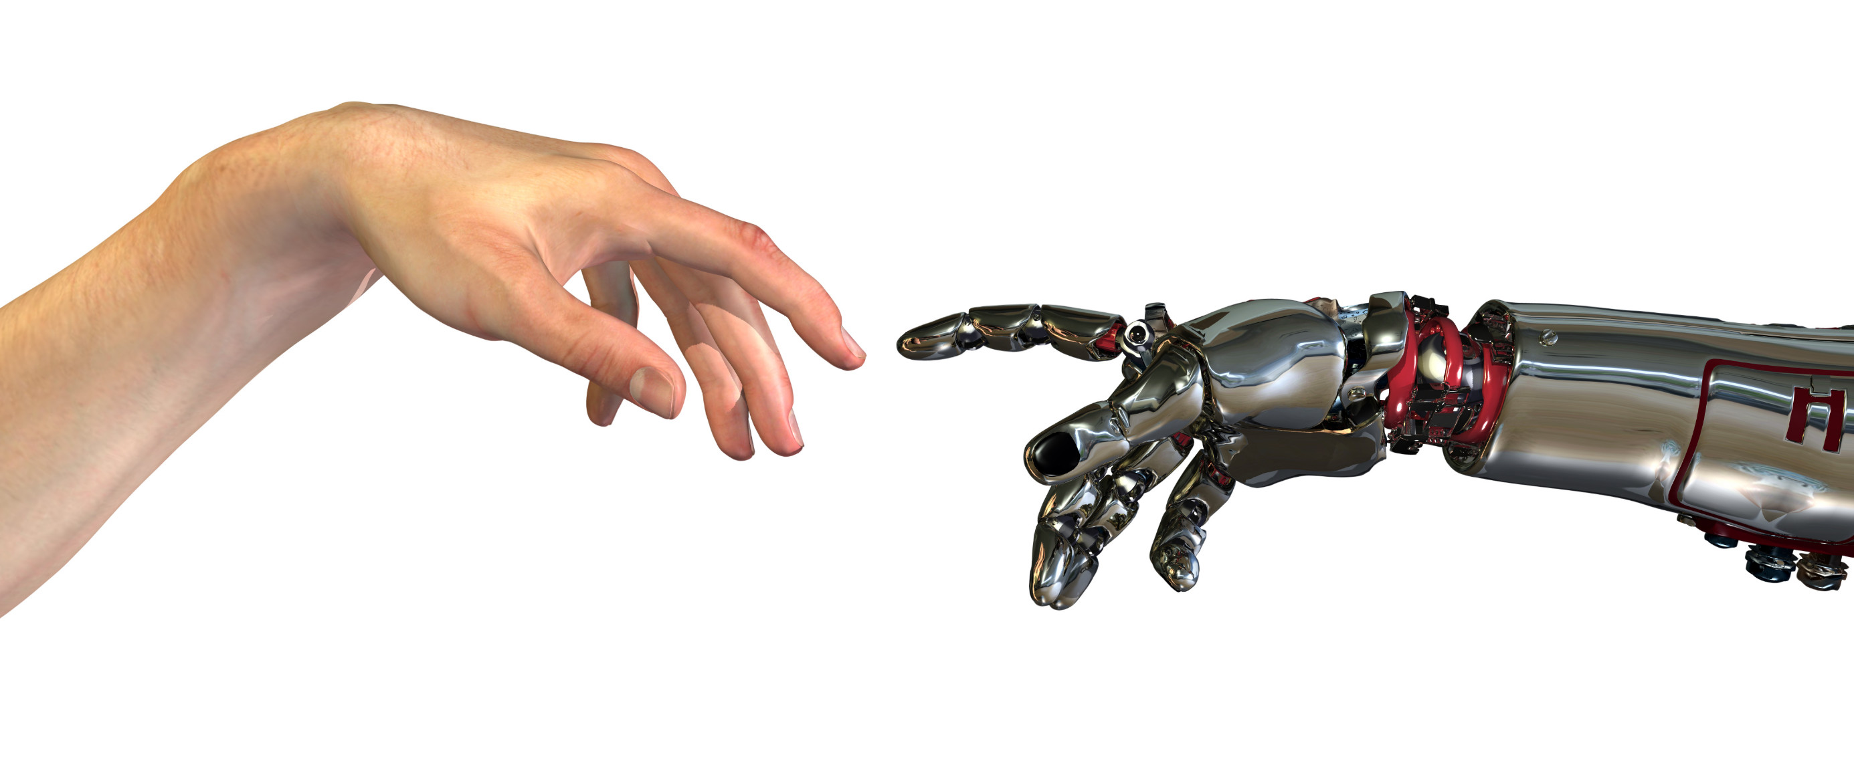
Medical robot systems
Dept. of Urology
Niklas Harland

Slide 2
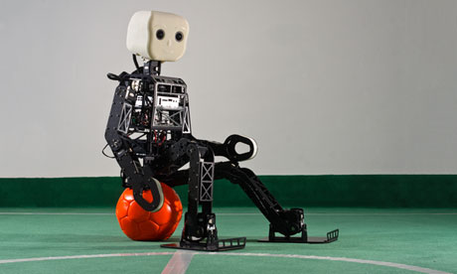

Slide 3
Objectives
Overview of robotic surgery
Describe evolution of robotic surgery
Review oncological and clinical outcomes
Videos of robotic procedures

Slide 4
Robotic Surgery
“…Developed to overcome the limitations of minimally invasive surgery and to enhance the capability of open surgery… “

Slide 5
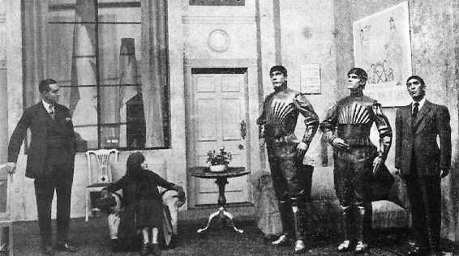
History – Robot
The term “Robot " was coined by the Czech playright Karel Capek in 1921 in his play Rossom's Universal Robots.
In 1985 a ROBOT, the PUMA 560, was used to place a needle for a brain biopsy using CT guidance.
Robots were first introduced in 1987 with the first laparoscopic surgery.

Slide 6
Chronological Events
1998, Reconnection of fallopian tubes using ZEUS.
1999, heart bypass using ZEUS.
2001, first remote cholecystectomy.
2008, First robotic pediatric neurogenic bladder reconstruction.
2009, first all-robotic-assisted kidney transplant.
2010, first robotic operation at the femoral vasculature

Slide 7
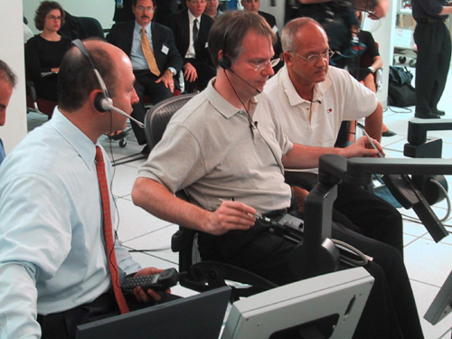
Chronological Events
First Remote Cholecystectomy.
Dr. Jacques Marescaux and Dr. Michel Gagner
New York, September 2001.

Slide 8
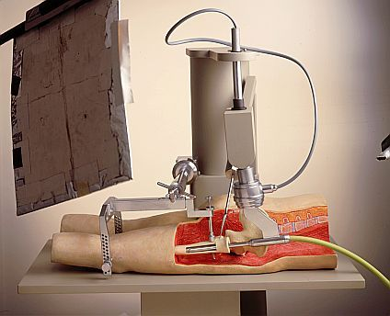
History of Robotic Surgery
In 1992, The ROBODOC
The ROBODOC Clinical Trial: Total Hip Arthroplasty.

Slide 9
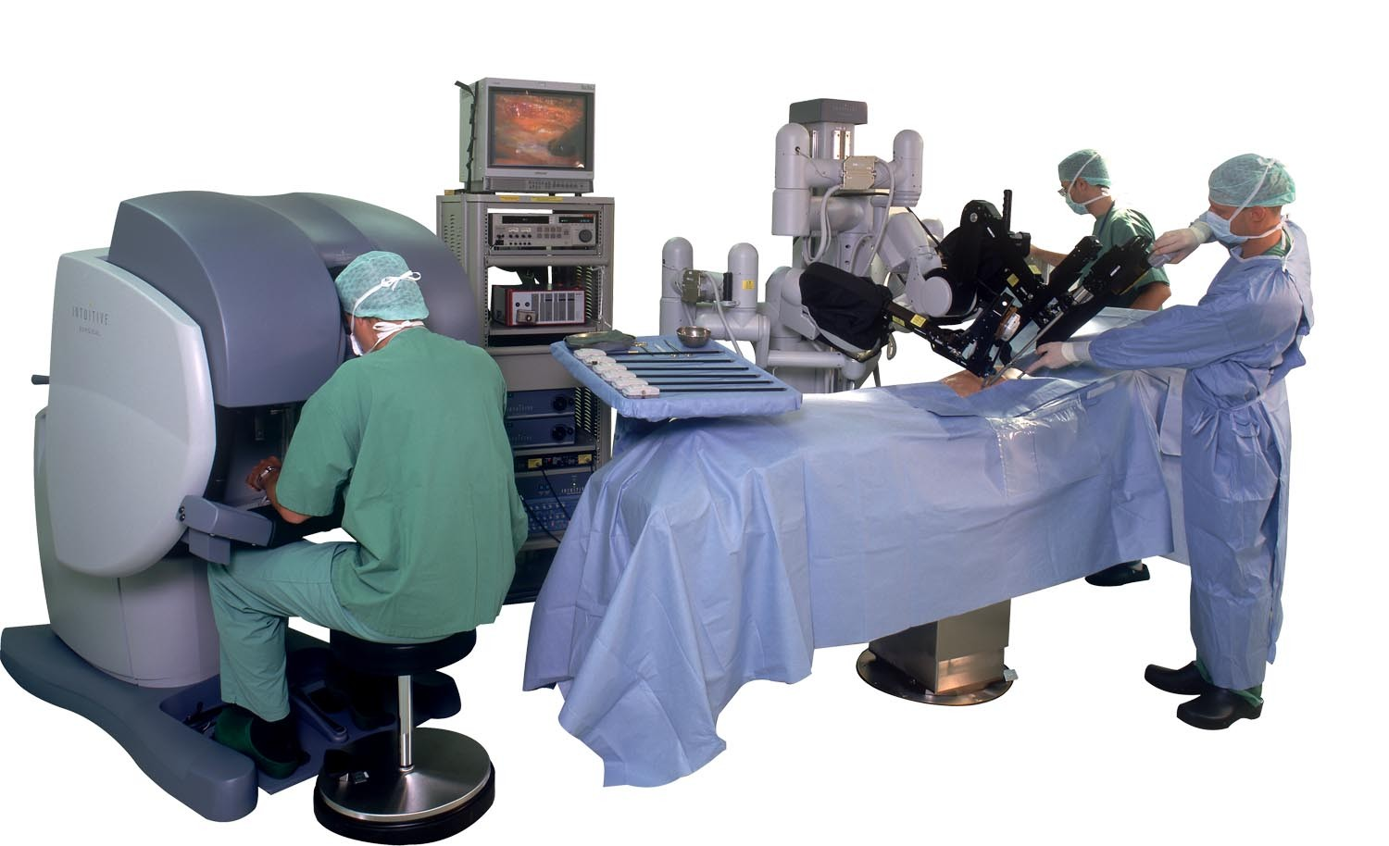
History of Robotic Surgery
In 2000, The da Vinci Surgical System
The da Vinci and ZEUS System

Slide 10
“Targeted at the heart, but hit the prostate”
1980s prototype - Stanford Research Institute, funded by US Army, to perform battlefield surgery remotely by a surgeon in the safe rear

Slide 11

“Targeted at the heart, but hit the prostate”

Slide 12
“Targeted at the heart, but hit the prostate”
1980s prototype - Stanford Research Institute, funded by US Army, to perform battlefield surgery remotely by a surgeon in the safe rear
2000 - FDA approved in human operations
End of 2006, 559, end of 2017 4,400 DaVinci robots have been installed worldwide
Until this year 5,000,000 DaVinci procedures performed worldwide
  Robotic Radical prostatectomy in US
    2001 < 1%
    2006 > 40%
    2018 > 90%

Slide 13

Laparoscopy vs Robotics

Slide 14
Laparoscopic Surgery
first laparoscopic cholecystectomy in 1985 but rejected by the German Surgical Society
Mouret performed the first laparoscopic cholecystectomy in 1987
Perissat demonstrated the technique of laparoscopic cholecystectomy at the Society of American Gastrointestinal Surgeons Meeting in Louisville in 1989
Spread rapidly all over the world

Slide 15
Laparoscopic Surgery Advantages
Decreased pain
Shorter hospital stay
Rapid return to work
Smaller scars
Less infection
Less bleeding

Slide 16
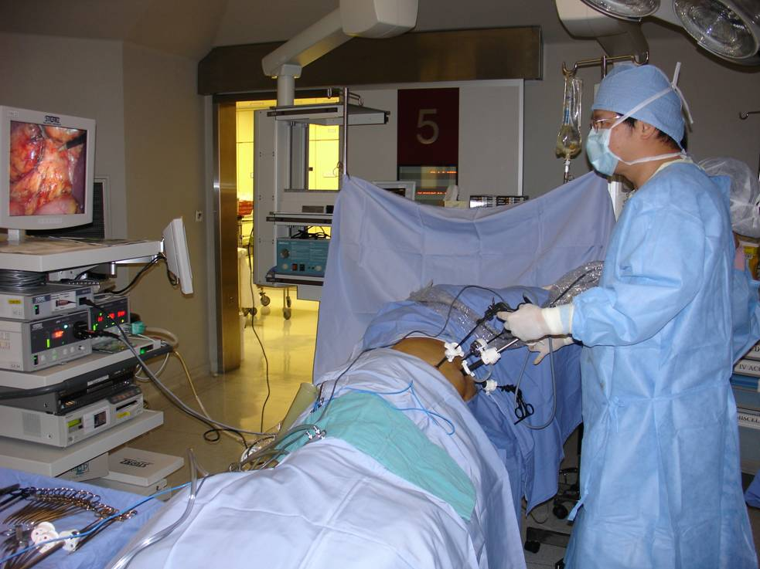
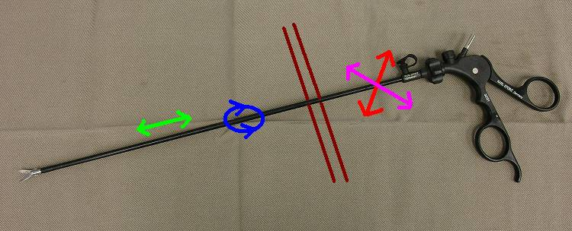
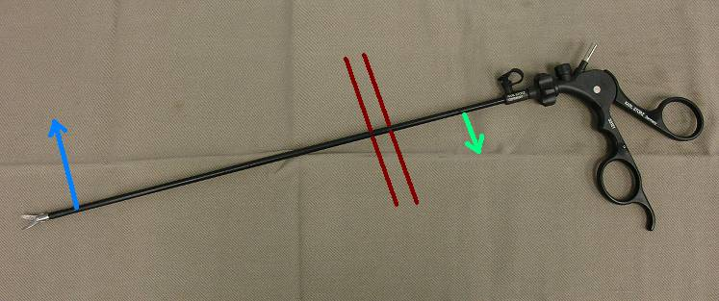
Laparoscopic Surgery Disadvantages
Two dimensional view
Dexterity of instruments within the abdominal space
Fixed instruments tips with 4 degree of freedom
Possible misalignment of hands

Slide 17
Decrease Dexterity
To escape from the difficulties in suturing and knots tying
Clip
Haemolock
Stapler
Endoloop
Extracorporeal knot tying
Ligasure
Harmonic scalpel
Argon beam coagulator

Slide 18
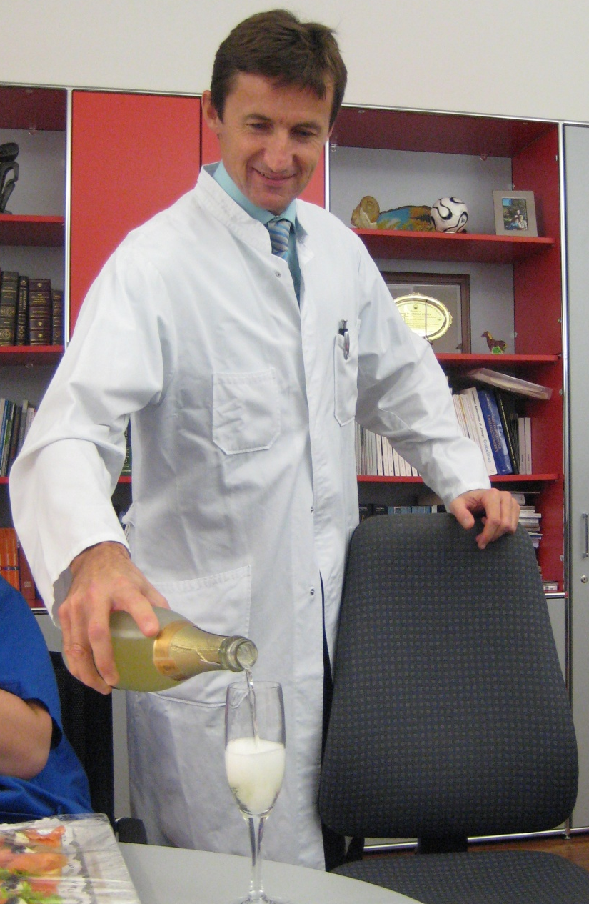

Da Vinci Surgical System
Master-slave system – the surgeon directly initiates all the movements of the robotic instruments in real time
Robotic radical prostatectomy – robotic assisted laparoscopic radical prostatectomy
retain the advantages of minimally invasive surgery
overcome the drawbacks of conventional laparoscopic surgery

Slide 19
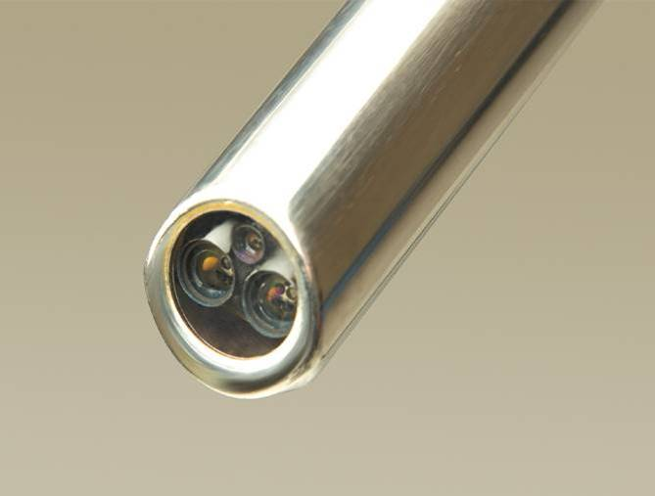
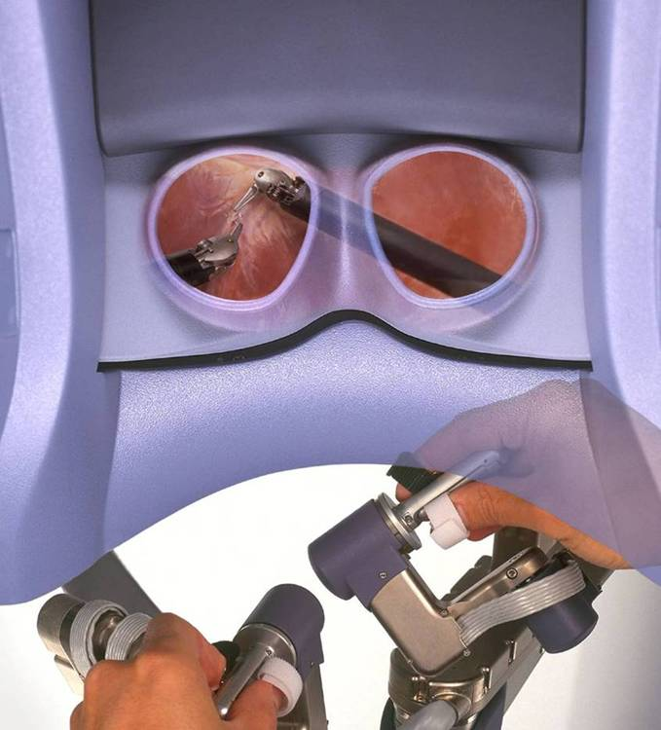
Da Vinci Surgical System
Double lenses laparoscope
3D, high definition, binocular view
10-15X magnification

Slide 20
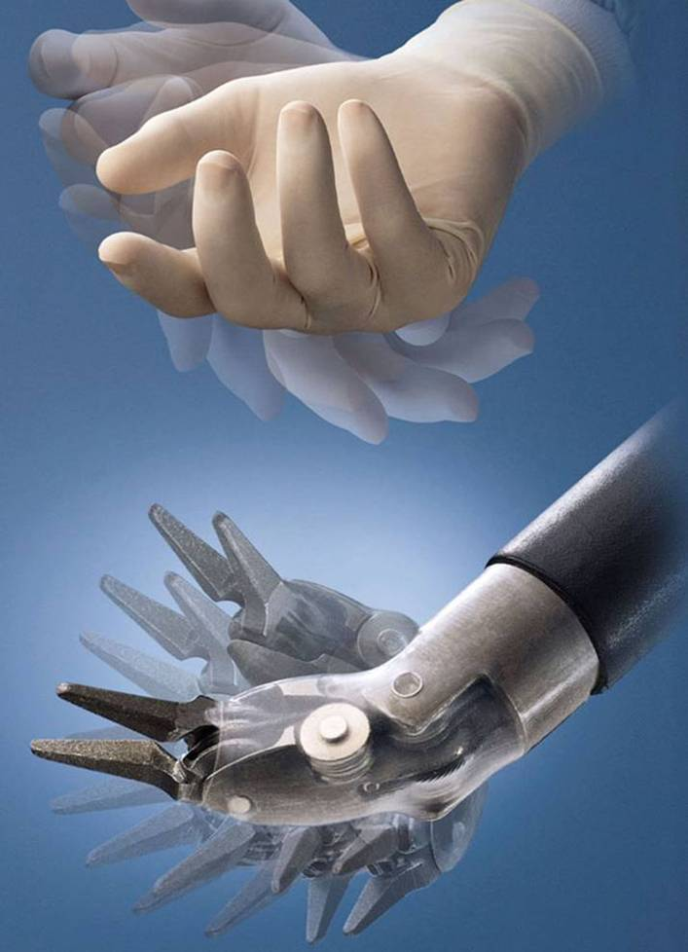
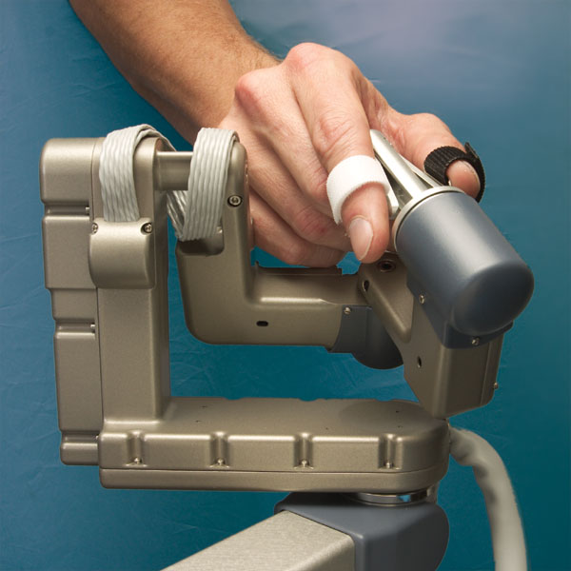
Da Vinci Surgical System
Endowrist instruments have 6 degrees of freedom
Filtering off hand tremor
Scaling down movements 1-5X

Slide 21
The daVinci Principle

Slide 22
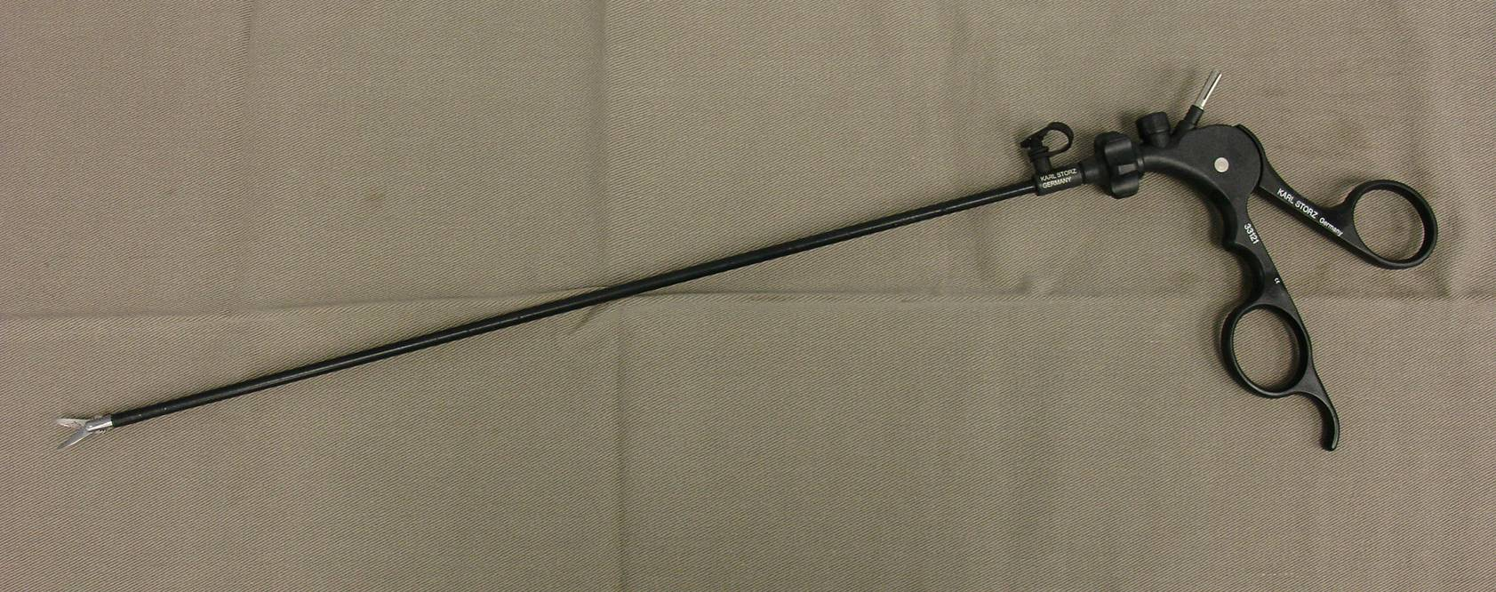
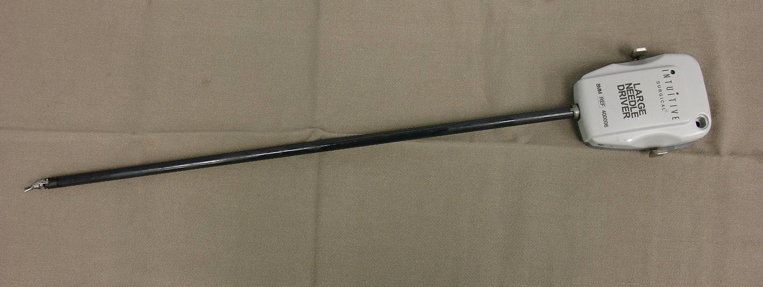
Instruments

Slide 23

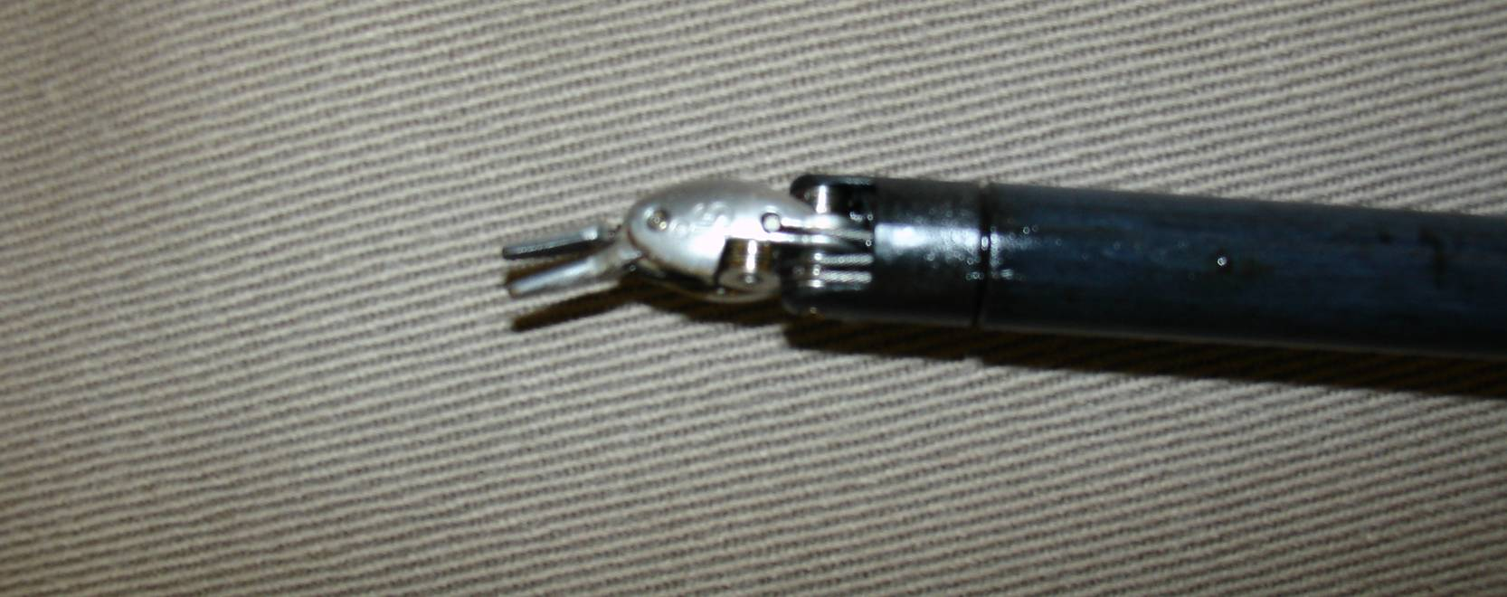
Instruments

Slide 24
Instruments

Slide 25

Short learning curve & better results ?
Surgeons with experience in open techniques but no laparoscopic experience, the results of after performing 8 - 12 robotic radical prostatectomy were comparable to those of skilled laparoscopists who had performed more than 100 laparoscopic radical prostatectomy
T Ahlering J Urol 2003
Robotic vs Open
  Improved cancer control
  Increased continence
  Enhanced sexual potency
  V Patel J Endourol 2005
  T Ahlering ART 2006
  M Menom UCNA 2004

Slide 26

daVinci vs. laparoscopy

Slide 27
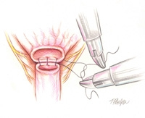
Challenges of Laparoscopic Prostatectomy
Prostate located in fixed confines of pelvis
Laparoscopic instruments limited in articulated movements
Approximation of bladder-urethral anastomosis difficult to suture
Learning Curve over 300 cases !

Slide 28
Disadvantages of daVinci Robot
Expensive
  € 1.5 million cost for machine
  € 150,000 annual maintenance contract
  Disposable instruments € 1500/case
  Hospital reimbursement same DRG
Increased staff training/competance
Increased OR set-up/turnover time

Slide 29
Robotic Disbelievers
“Lack of clear data”
  Randomized-controlled-trial without improvement of erectile dysfunction or continence
“Loss of tactile feedback”
  Haptic feedback: visual resistance
“Legal”
  Time lag between surgeons commands and action could harm patient
  Loss of power in an electrical failure
  Robotics does not replace human intelligence, skill and experience

Slide 30
Robotic Disbelievers

Slide 31
laparoscopic, robotic & radical prostatectomy
Variable open laparoscopic robotic
(reference value) (odd ratio) (odd ratio)
Operating time 163 mins 1.51 0.91
Blood loss 910 ml 0.42 0.10
Positive margin 23% 1 1
Complication 15% 0.67 0.33
Catheter time 15.8 days 0.5 0.44
Hospital >24 hours 100% 0.35 0.07
Postop pain score 7 0.45 0.45
(0-10)
Mean time to continence 160 days 1 0.28
Mean time to erection 440 days NA 0.4
Mean time to intercourse >700 days NA 0.5
Detectable PSA 15% 1 0.5
M Menom UCNA 2004

Slide 32
Margin Positivity
Series % Positive margins
Soloway (Open) 28 %
Lepor (Open) 26 %
Guillonneau (Laparoscopic) 14 %
Abbou (Laparoscopic) 20%
Rassweiler (Laparoscopic) 24 %
Turk (Laparoscopic) 26 %
Bollens (Laparoscopic) 22 %
Sulser (Laparoscopic) 18%
Menon (Robotic) 26%
Ahlering (Robotic) 17%
Lee (Robotic) 21%

Slide 33
Continence Data
Surgeon 3 mo 6 mo 12 mo
Walsh (Open) 54 % 80% 93%
Abbou (Laparoscopic) 58% 69% 78%
Guillonneau (Laparoscopic) N/A N/A 85 %
Rassweiler (Laparoscopic) 54% 74% 97%
Menon (Robotic) N/A 96% N/A
Ahlering (Robotic) 76% 91% 94%
Lee (Robotic) 60% 82% N/A

Slide 34
Potency Data
Author Capable of Intercourse
Walsh (age 60 to 67) (Open) 75%
Catalona (60’s/70’s) (Open) 60% / 47%
Guillonneau (Laparoscopic) 66% overall
Abbou (Laparoscopic) 54%
Turk (Laparoscopic) 59%
Menon (Robotic) 64%
Ahlering (Robotic) 65%
Lee (Robotic) Too early

Slide 35
The Future
What‘s next?
2018 Senhance
-with haptic feedback
2019 Hugo (Medtronic)
2020 Verb (Alphabet + Johnson & Johnson)
- plans to integrate artificial intelligence
- image recognition

Slide 36

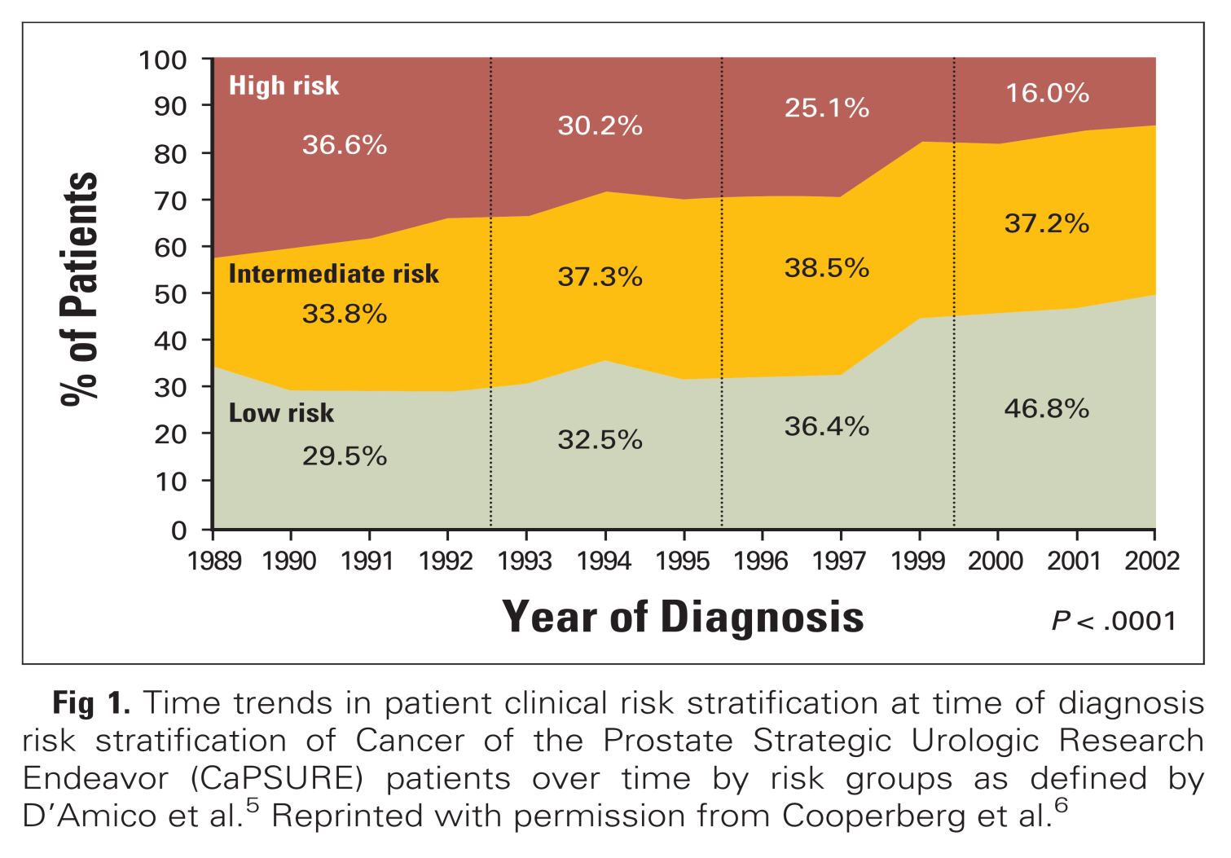
Prostate Cancer - Realiy

Slide 37

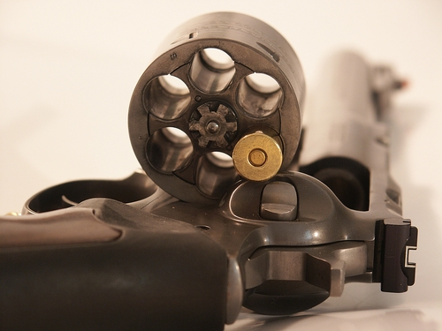
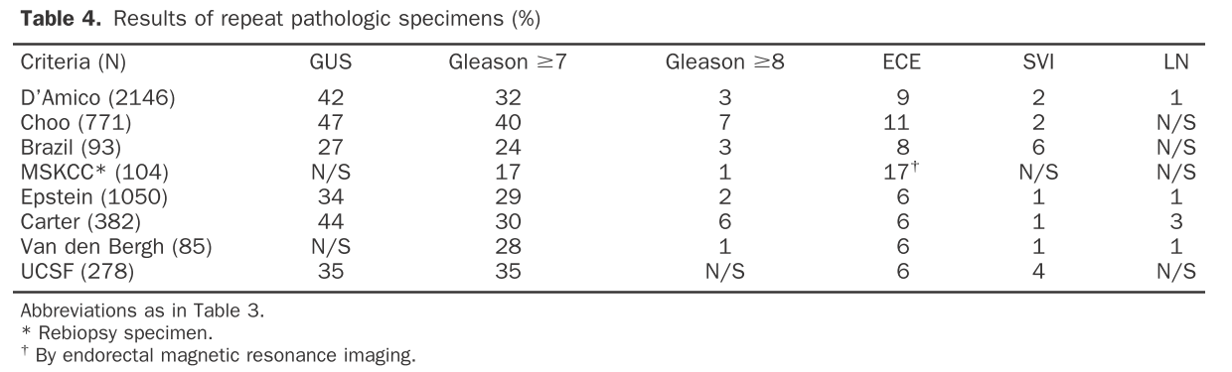
…More than 2000 unique patients met the criteria for the D’Amico low-risk group. Of these, 42% had a higher Gleason score ... 32% of these patients had a total Gleason score of ≥7, with 3% having a total Gleason score of 8.

Slide 38
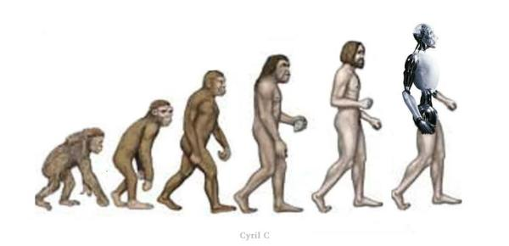
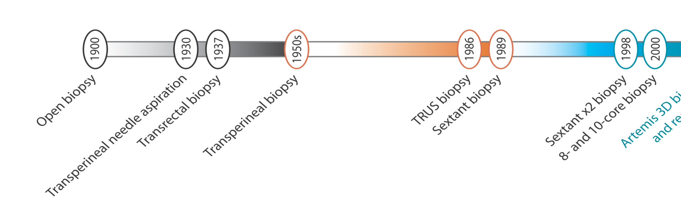
Prostate Biopsy

Slide 39
Robotic Prostate Biopsy

Slide 40
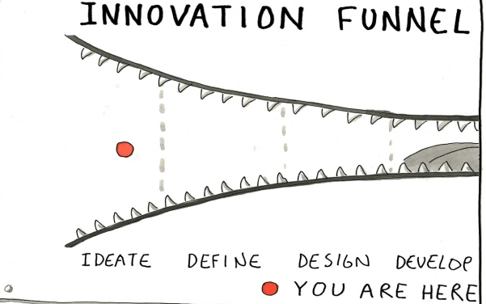


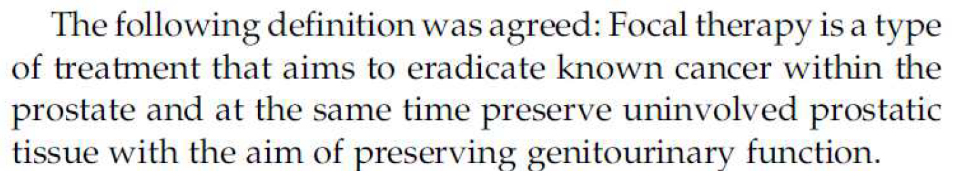

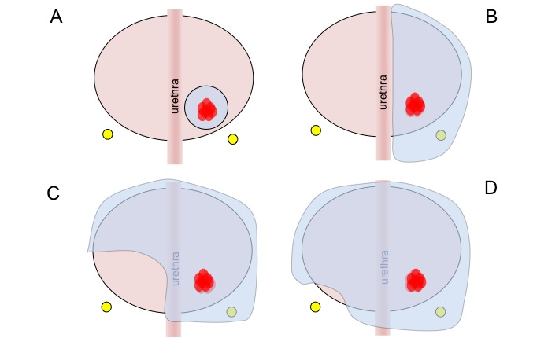
Focal Therapy

Slide 41
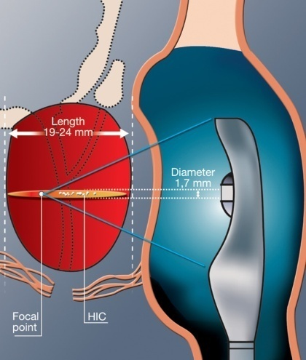
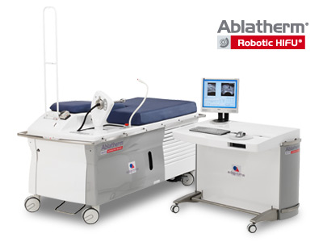
HIFU-Therapy ?
High Intensity Focus US
  focused US / parabolic transducer
  Generates heat >80°C and coagulative necrosis
  Cavitation and mechanical tissue disruption occurs
  Real time feedback of thermal effects
Ablaterm (EDAP-TMS, France)
Imaging/therapeutic transducers in one probe
Uses a special bed
„Robotic HIFU“
ExAblate 2100P
MRI guided HIFU
Real time temperature feedback

Slide 42

Robotic Focal – HIFU

Slide 43
Robotic Surgery Application
Urology
Gynecology
Gastrointestinal Surgery
Otolaryngology—Head & Neck Surgery
Cardiothoracic Surgery
Cardiology and Electrophysiology
Neurosurgery
Orthopedic
Pediatrics

Slide 44


Conclusions & Future
Robotic surgery:
  POTENTIALLY improving clinical outcomes
  BENEFITS justify the increased EXPENSE?
Future?
  All complex laparoscopic surgery will be done by robots
  All laparoscopic surgery will be done by robots
  smaller robot, flexible laparoscope and instruments
  Partiall autonomy?
  Telesurgery

Slide 45


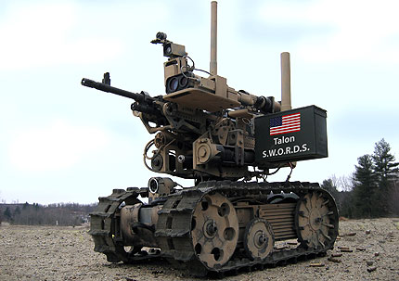
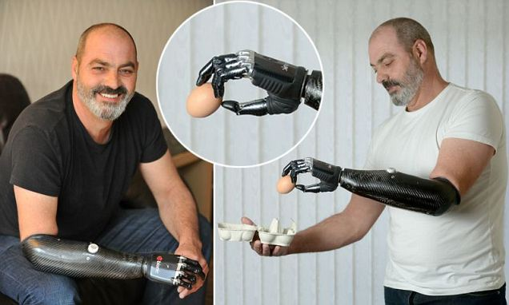
THANK YOU !
Niklas.harland@med.uni-tuebingen.de

