Slide 1
Pacemaker and ICD therapy
Scriptum
PD Dr. med. Iris Müller

Slide 2
Medical Indications for Pacemaker Therapy
high degree atrioventricular block (AV-block II° Mobitz and III°)
symptomatic AV-Block I°
sick sinus syndrome with symptoms such as syncopes
severe heart failure with complete left bundle brunch block (cardiac resynchronization, CRT)
SA-Block III with pauses > 6 seconds
pre-automatic pauses > 6 seconds
no pacemaker should be implanted in asymptomatic bradycardia in sinus rhythm

Slide 3
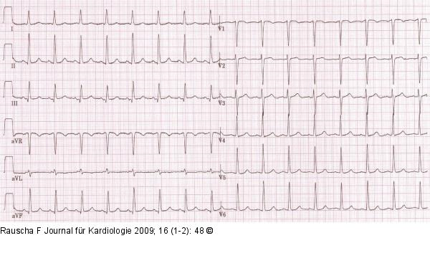
Sinus Rhythm

Slide 4
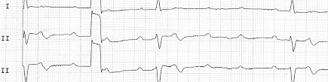
AV-Block III

Slide 5
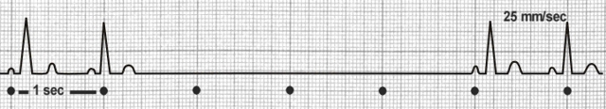
SA-Block III

Slide 6
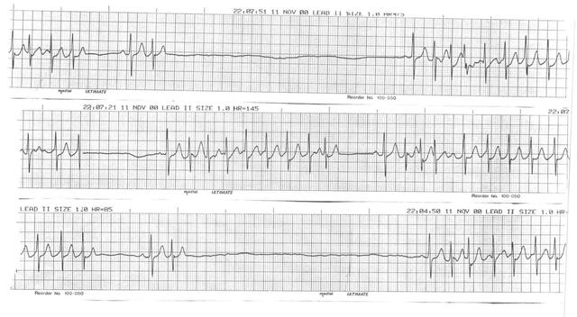
Brady-Tachy-Syndrome

Slide 7
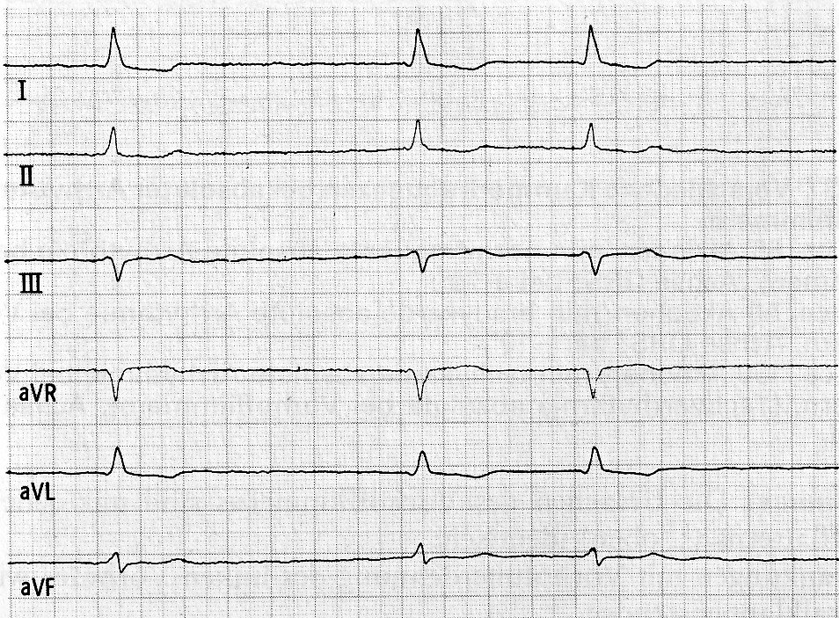
Bradycard Atrial Fibrillation

Slide 8
Implantable Cardioverter Defibrillators (ICD´s)
are implanted since 1980 in patients with cardiac diseases
are recommended for patients with severely impaired left ventricular function (EF < 35 %) with chronic heart failure due to coronary artery disease or dilative cardiomyopathy
are indicated in patients, who were successfully reanimated during sudden cardiac death, as it may appear in chronic ischemic cardiomyopathy or dilative cardiomyopathy due to ventricular fibrillation or ventricular tachykardia
should not be implanted in patients directly after acute myocardial infarction, but in case of a severly reduced ventricular function 2 to 3 months after the acute myocardial infarction an ICD should be implanted to protect patients from sudden cardiac death
are mostly implanted from the left side of the patient via the left Vena subclavia due to a better shock field between ICD and the heart

Slide 9
ICD Indications
Primary prophylaxis
coronary artery disease
dilatative cardiomyopathy
rare causes of reduced LV-function
Sekundary prophylaxis
after survived cardiac arrest
after sustained ventricular tachycardias
after syncope of presumably ventricular tachycardia

Slide 10
ICD-Therapy:
Patients with CAD, without sufficient revascularization, and reduced LV-function
AVID ICD vs. Amiodarone reduction of mortality with
n= 1016 ICD of 31%
The Antiarrhythmics Versus Implantable Defibrillators (AVID) Investigators. A
comparison of antiarrhythmic-drud therapy with implantable defibrillators in
patients resuscitated fromnear-fatel ventricular arrhythmias.
N Engl J Med 1997; 337: 1576-1583
MADITT II ICD vs. conventional therapy reduction of mortality with
n= 1232 ICD of 30%
Moss AJ, Zareba W, Hall WJ et al. Prophylactic implantation of a defibrillator in
patients with myocardial infarction and reduced ejection fraction.
N Engl J Med 2002; 346: 877-883

Slide 11
Implantation of pacemakers or implantable cardioverter defibrillators (ICD´s)
mostly in local anaesthesia
performed by a cardiac surgeon and/or cardiologist
may include one, two or three leads, depending on the implanted system (one chamber system, two chamber system, three chamber system or CRT system)
pacemaker leads are implanted in the right ventricle, right atrium and in posterolateral coronary veins of the coronary sinus to reach the lateral wall of the left ventricle, depending on the implanted system
are performed regardless from age or gender, as long as the patient ist in good physical condition and will live longer than at least one year

Slide 12
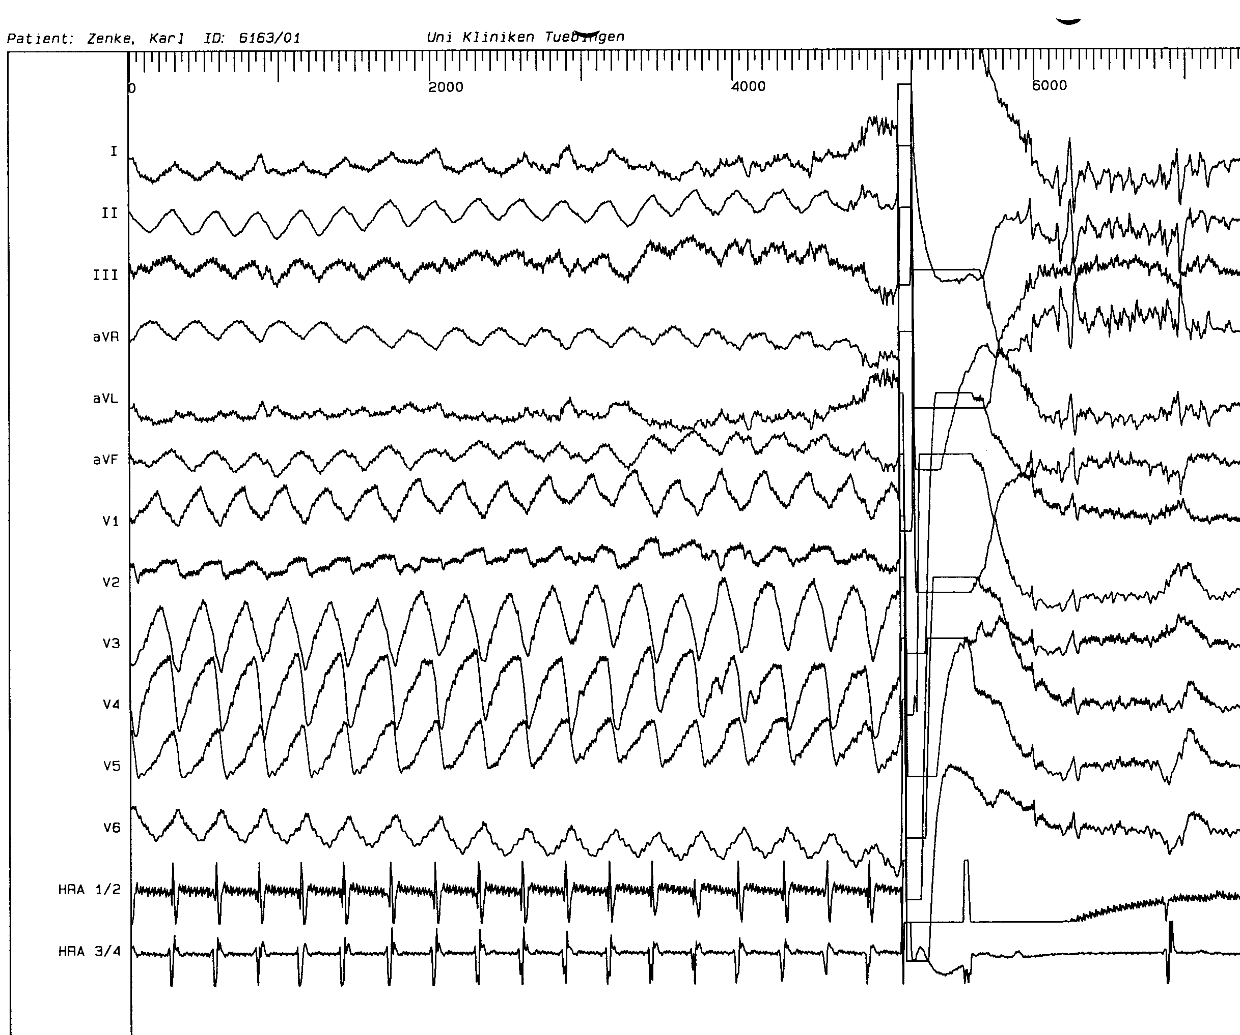
Implantable Cardioverter-Defibrillator-System (ICD)
„Primary goal of ICD-therapy is reduction of mortality due to
sudden cardiac death. Cardiac arrest is supposed to be terminated
through automatic detection und termination of hemodynamic
relevant ventricular tachycardias.“
Mitteilungen der Deutschen Gesellschaft
für Kardiologie-Herz-und Kreislaufforschung
Leitlinien zur Implantation von Defibrillatoren
Z Kardiol 89:126-135 (2000)

Slide 13
Pacemaker leads
are coated with silicone
are nowadays bipolar, in patients with older pacemaker models leads can also be unipolar
are connected to the pacemaker device via the header and fixed with screws
can be disconnected from the pacemaker device by liberating fixation screws
are implanted via the big thoracic veins, such as Vena subclavia and Vena cava superior
20% of the implanted leads develop defects in the first 10 years after implantation independent from the producer

Slide 14
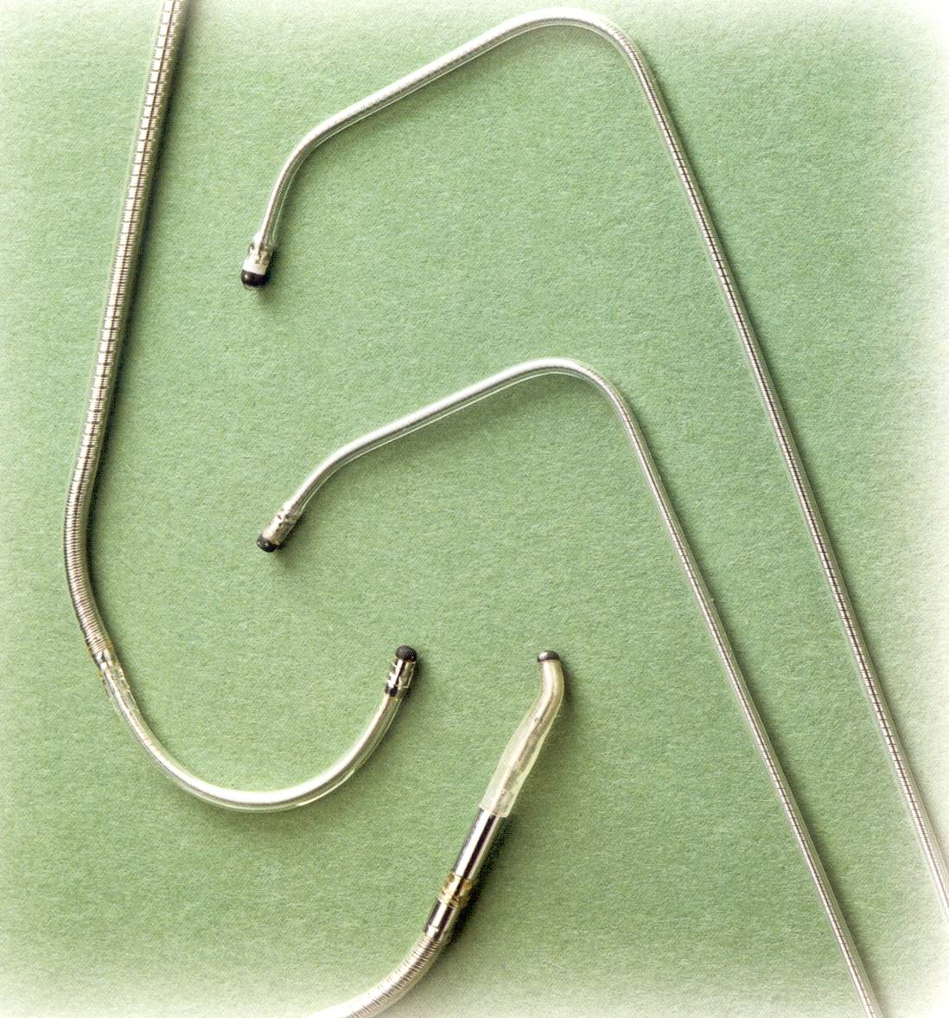
Leads for coronary veins

Slide 15
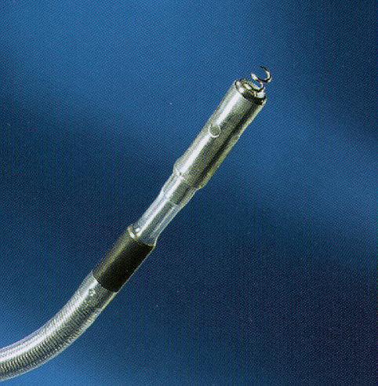
Lead with active fixation for the right ventricle and right atrium

Slide 16
ICD leads
are coated with silicone
are always bipolar and contain one or two shock coils
are connected to the ICD device via the header and fixed with screws
can be disconnected from the ICD device by liberating fixation screws
are implanted via the big thoracic veins, such as Vena subclavia and Vena cava superior
20% of the implanted leads develop defects in the first 10 years after implantation independent from the producer

Slide 17
Pacemaker and ICD Batteries
batteries of pacemakers last about 5 to 10 years
ICD batteries last about 3 to 8 years
pacemakers contain one battery
ICD´s contain two batteries, as they have to create higher voltages for cardiac defibrillation
cannot be charged from the outside by the cardiologist or the patient; they have to be exchanged by surgery every 3 to 10 years, once their voltage reaches to low amounts

Slide 18
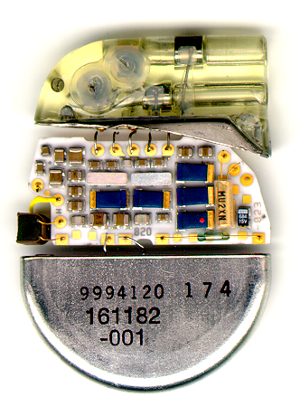
Anatomy of a pacemaker
Impedances
Atrial Connection Tube
Connector Block
Ventricular Connection Tube
Defibrillation - Protector
Condensator
Hybrid
Quarz Crystal
Reed-Switch
Telemetry
Battery

Slide 19
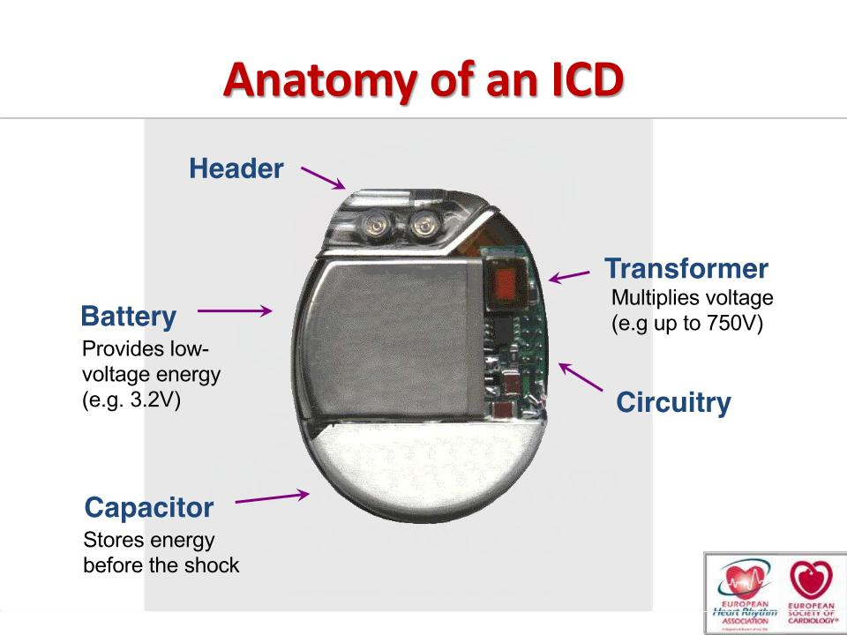

Slide 20
Cardiac resynchronization therapy (CRT)
synchronizes the systolic contraction of the lateral wall of the left ventricle, of the lateral wall of the right ventricle, and of the interventricular septum
may improve the left ventricular ejection fraction (EF) by 5 to 20%
is indicated in patients with severely impaired left ventricular function (EF < 35%), NYHA class II-IV, complete left bundle branch block and a QRS complex duration > 130 ms
is well evaluated by several prospective randomized clinical trials regarding its positive effects in patients with chronic heart failure
is recommended in men and women with chronic heart failure, but women often show a higher benefit from CRT

Slide 21
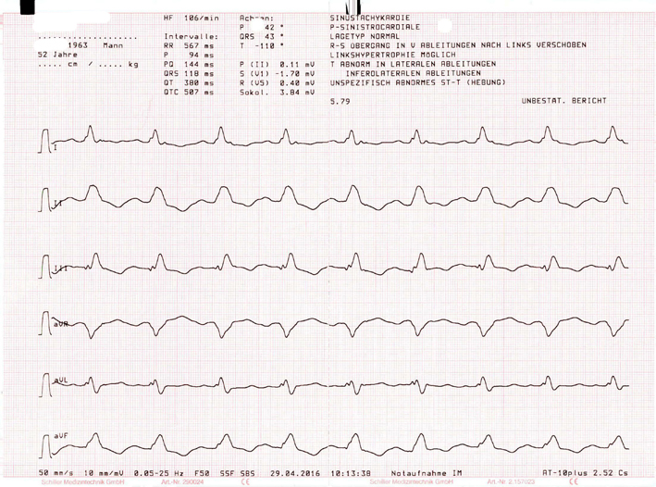
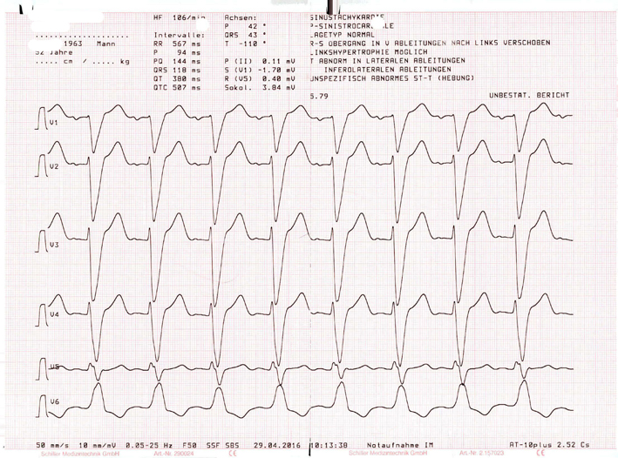
Left bundle branch block

Slide 22
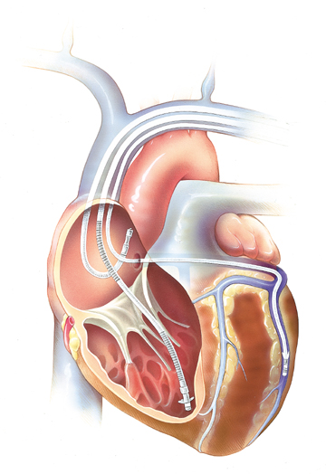
Three chamber system (CRT-Pacemaker)

Slide 23
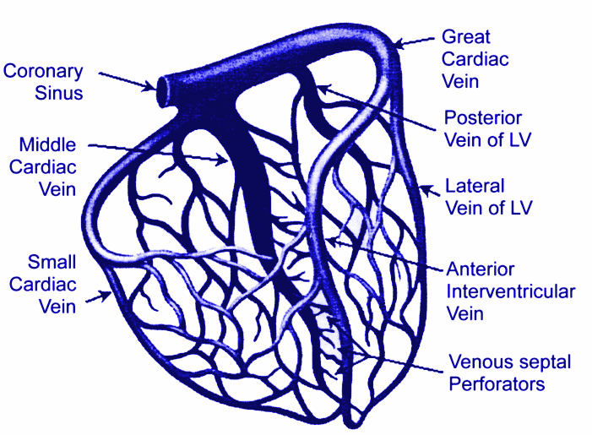
Coronary Veins

Slide 24
Ventricular Resynchronization (CRT)
Sinus Node
AV Node
Left Bundle Branch
Stimulation Therapy

