Slide 1
Correction Methods
Jonathan Disselhorst, PhD
Jonathan.Disselhorst@med.uni-tuebingen.de

Slide 2
PET Corrections Overview
Normalization
Random
Dead time
Attenuation
Scatter
Motion
…

Slide 3
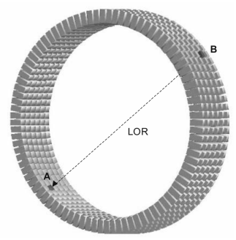
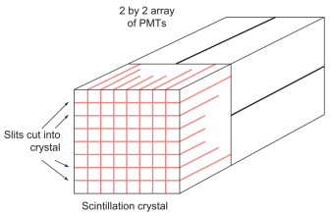
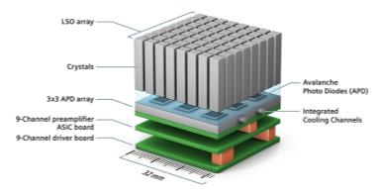
PET: Normalization
Lines of Response (LOR) in a PET scanner have a different sensitivity. These variations have to be removed prior to reconstruction.
Causes: Variations in detector efficiency, geometric effects, solid angle, time synchronization, ….
Bailey et al.
Bushberg et al.
Siemens Healthineers

Slide 4
PET: Normalization
Uniformly illuminate all LORs with a positron source (usually ⁶⁸Ge)
Normalization coefficients are assumed proportional to the inverse of the counts for each LOR
Long acquisition times required (several hours)
Sources require uniform activity distribution

Slide 5
PET: Normalization
Measured sinogram
Normalization
Corrected sinogram

Slide 6
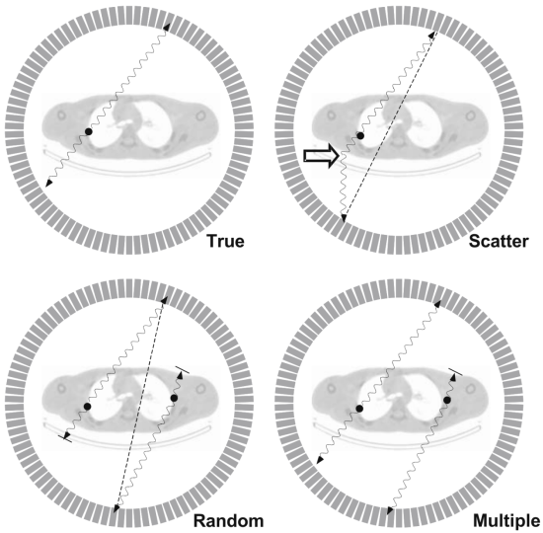
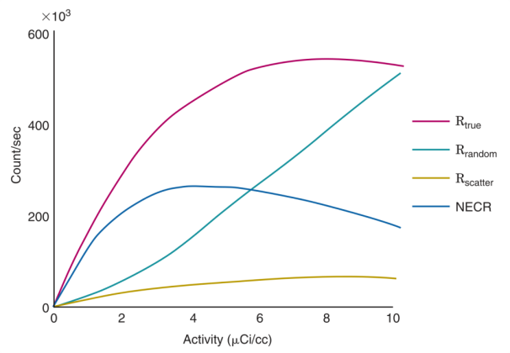
PET: Randoms
Bailey et al.
Cherry et al.

Slide 7
PET: Randoms
Randoms occur because of the finite time window; two uncorrelated events can be detected.
When left uncorrected, randoms add a uniform background to the entire image
Several options to estimate the number of randoms:
  Using a delayed time window
  From singles
  Fitting of the tail of the sinogram
  (sometimes together with scatter correction, details to follow)
delay
time window
delayed window
1st event
coincidence
time
random

Slide 8
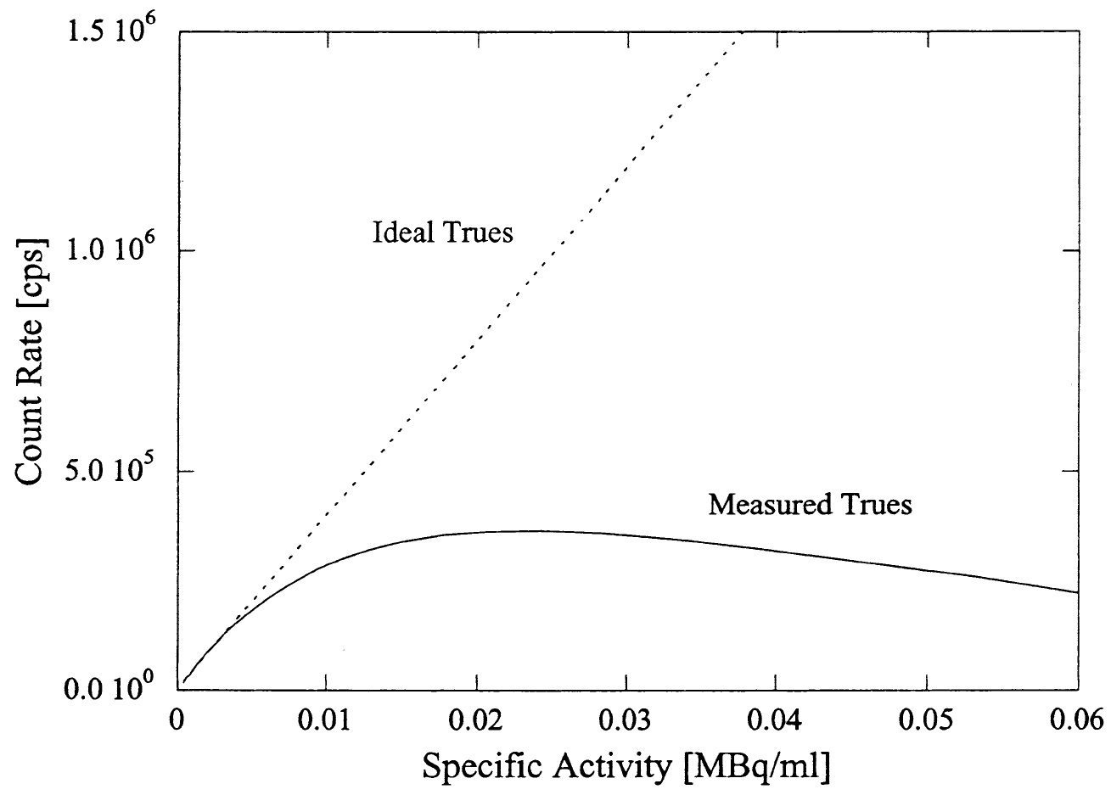
PET: Dead time
Phelps, Cherry, Dahlbom. 2006

Slide 9
PET: Dead time
Also electronics dead-time, a time during which the detector has to ‘reset’, and dead time resulting from coincidence processing
Ignoring dead time can lead to a significant underestimation of activity, especially at high activity levels, e.g., in ¹⁵O studies.

Slide 10
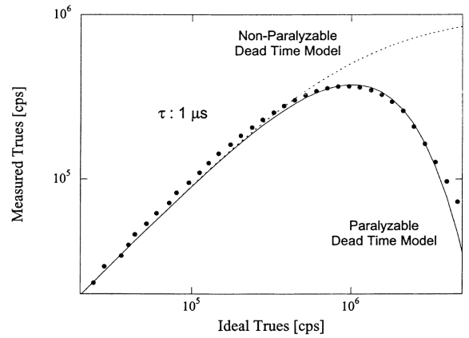
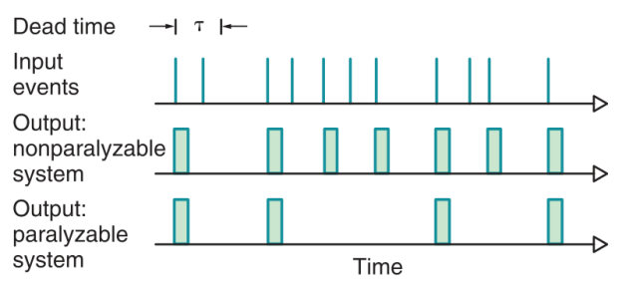
Paralyzable and non-paralyzable
Non-paralyzable detector: an event occurring during the dead time of the detector is lost.
Paralyzable detector: an event occurring during the dead time is not only lost, but also restarts the dead time.
Cherry, Sorenson, Phelps. 2003
Phelps, Cherry, Dahlbom. 2006

Slide 11
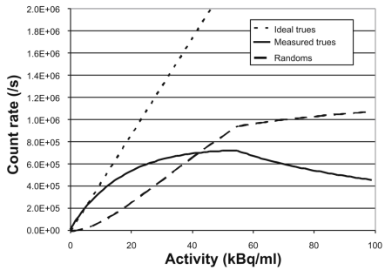
PET: Dead time
To measure dead time: Measure a source with a fast decaying nuclide, e.g., ¹⁸F.
Extrapolate the count rate at low activity (where dead time losses are small)
and determine the dead time at high activity.
Simplest solution to correction: make a lookup table with such a measurement, and correct future scans for dead time with it. → This does not account for spatial variations etc. So better is to incorporate the system architecture and model the dead time more accurately.
Bailey et al.
(the dip at ± 55 kBq/mL is caused by bandwidth limitations of the coincidence circuitry.)

Slide 12
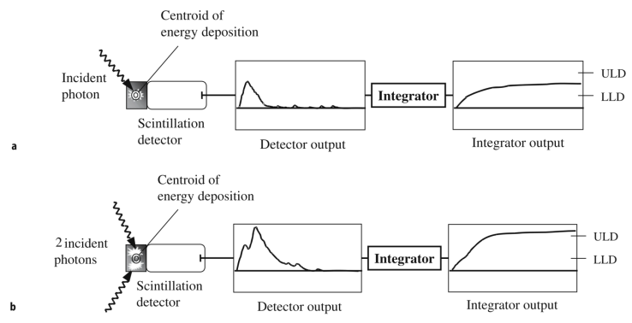
PET: Dead time
Pulse pileup, two or more photons hit the detector during the integration time. They are either discarded because their combined energy is too high, or observed with an incorrect position and energy
Bailey et al.

Slide 13
PET: Scatter
Bailey et al.

Slide 14
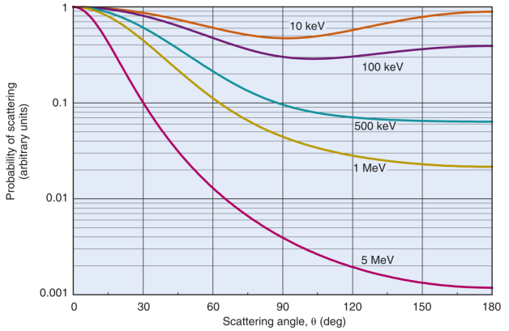
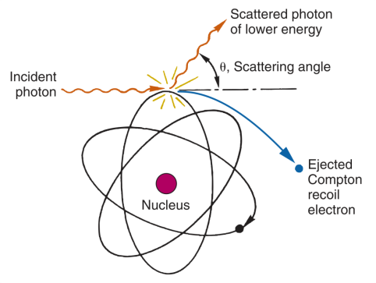
PET: Scatter
Cherry et al.

Slide 15
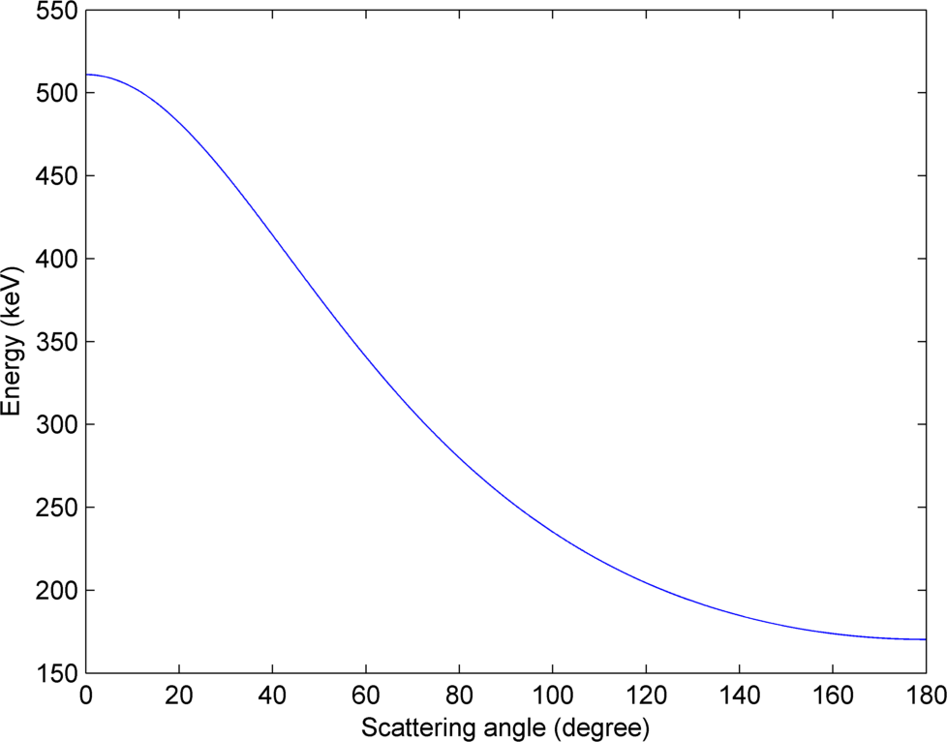
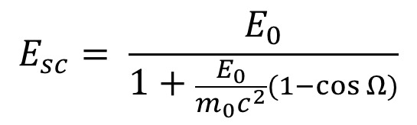
PET: Scatter
Typical lower energy
windows for PET: 350 keV
$$E_{sc}= \frac{E_{0}}{1+\frac{E_{0}}{m_{0}c^{2}}(1−\cos{Ω)}}$$
E_{sc}: Energy of scattered photon
E₀: Start energy of photon (0.511 MeV)
M₀c²: Resting energy of electron before scattering (0.511 MeV)
Ω: Angle of scattering

Slide 16
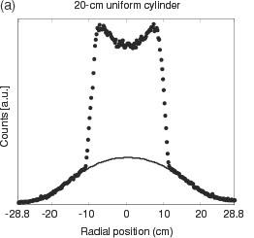
PET: Scatter
Scattered events increase the background;
contrast and resolution decrease
There are different methods to correct for scatter
Two properties of scattered LORs:
LORs measured outside the object can only originate from scattered events (after random correction)
The scatter distribution contains mainly low frequency components
One method:
The tails outside the object in the sinogram space can be fitted and then subtracted.
Disadvantages:
  Smooth function is not always appropriate.
  Does not work if the object is too big (i.e., there are no tails to fit)
Accorsi et al. Phys Med Biol 2004

Slide 17
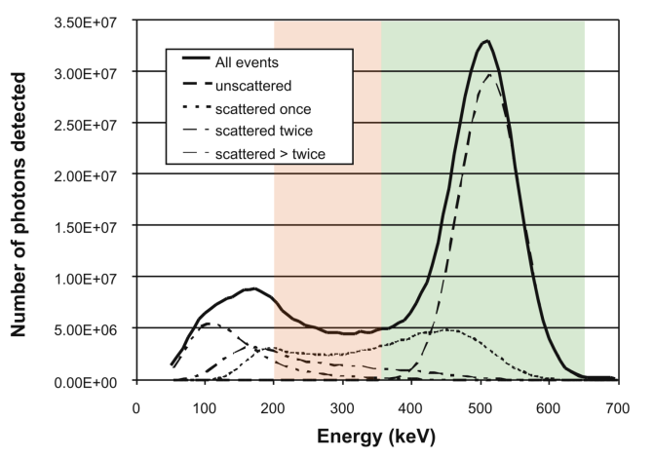
PET: Scatter
Scattered window technique: Measure coincidences in multiple energy windows,
to estimate the scatter fraction. Not very successful in PET, but used in SPECT.
Adapted from Bailey et al.

Slide 18
PET: Scatter
Scatter can be estimated using an emission image together with a transmission image.
Modeling photon interaction physics in combination with the two images, the distribution of scattered events can be estimated.
The scattered radiation can then be subtracted, and a new reconstruction can be performed.
Disadvantages:
  Only works when all activity is contained in the FOV
  Computationally intensive

Slide 19
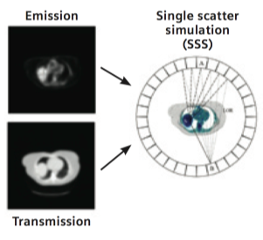
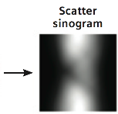
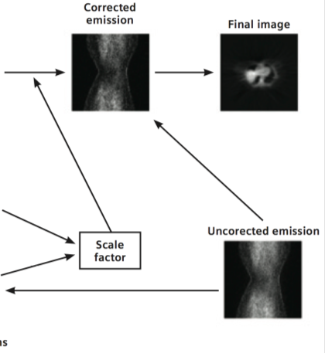
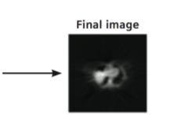
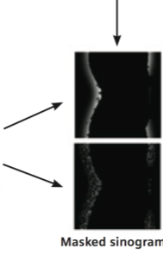
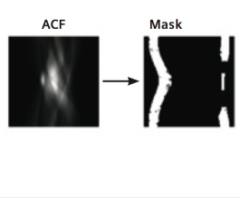
PET: Scatter
Attenuation Correction
Factors (ACF)

Slide 20
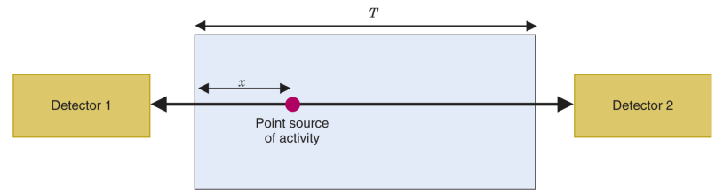



PET: Attenuation
$$P_{det1}= e^{−μx}$$
$$P_{det2}= e^{−μ(T−x)}$$
The probability that both photons reach the detectors, depends on the total amount of attenuation along the line of response.
$$P_{coinc}=P_{det1}{×P}_{det2}=e^{−μT}$$
With μ the linear attenuation coefficient (LAC). For non-uniform material, different LACs need to be taken into account.

Slide 21
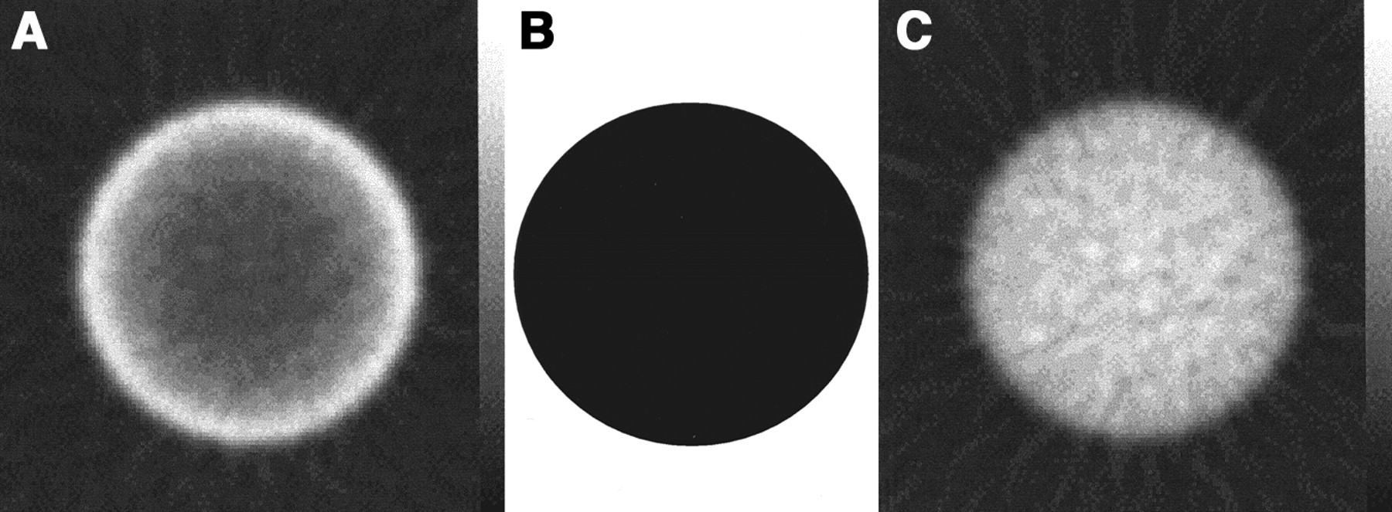
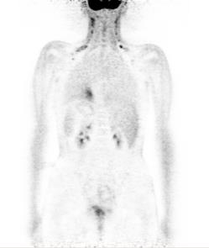
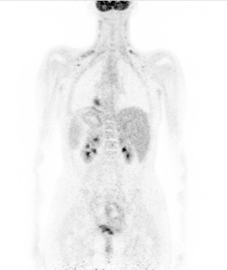
PET: Attenuation
Uncorrected images show:
Activity underestimation
Non-uniformity
High lesion-to-background ratio → similar detection rate
w/o AC
att. map
with AC
← Without AC
With AC →
Zaidi & Hasegawa 2003

Slide 22
PET: Attenuation
Different methods to determine the attenuation, e.g.,
  Measured AC:
    Using a transmission source
    Using CT data in combined PET/CT systems
  Obtain in combination with MRI:
    Segmentation of MR data
    Atlas and machine-learning based methods
  Reconstruction of attenuation maps for PET emission data.

Slide 23
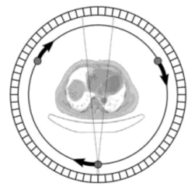
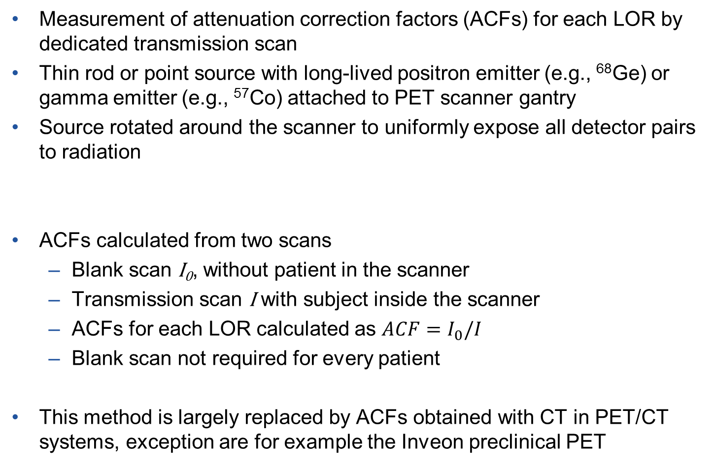
PET: Attenuation (TX)
Measurement of attenuation correction factors (ACFs) for each LOR by dedicated transmission scan
Thin rod or point source with long-lived positron emitter (e.g., ⁶⁸Ge) or gamma emitter (e.g., ⁵⁷Co) attached to PET scanner gantry
Source rotated around the scanner to uniformly expose all detector pairs to radiation
ACFs calculated from two scans
  Blank scan I₀, without patient in the scanner
  Transmission scan I with subject inside the scanner
  ACFs for each LOR calculated as $ACF=I_{0}/I$
  Blank scan not required for every patient
This method is largely replaced by ACFs obtained with CT in PET/CT systems, exception are for example the Inveon preclinical PET

Slide 24
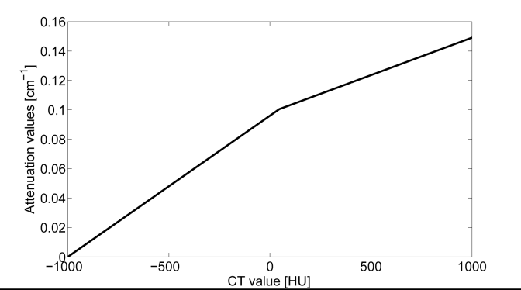
PET: Attenuation (CTAC)
In combined PET/CT systems, the CT scan can be used to create an attenuation map
Required: conversion from CT photon energy of 40–140 keV to PET photon energy of 511 keV
Simple solution for biological tissues: piecewise linear mapping of CT Hounsfield units to 511 keV linear attenuation coefficients
Example linear mapping from 120 keV CT

Slide 25
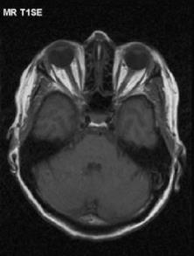
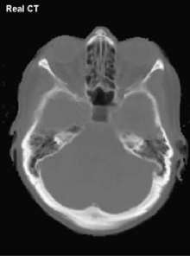
PET: Attenuation (MRAC)
For PET/MR systems, an MR-based attenuation correction (MRAC) is required
MR information is related to proton density of the tissue, but not to x-ray attenuation → MRAC is more challenging than CT-based AC.
One specific problem: differentiation of the high density bones in standard MR sequences
MRI
CT

Slide 26
PET: Attenuation (MRAC)
Segment MR data into discrete tissue classes
Assign uniform LACs to each tissue class
Representative method from Biograph mMR system:
  MR sequence with fat-water separation results in 4 images: in-phase, opposed phase, fat, water
  Segmentation into 4 classes: air, lungs, fat, soft tissue
  Segmentation with fixed MR intensity thresholds
  Lung detection by connected component analysis
  Fast, comparable results to CT-based AC on most lesions
  High attenuating bone tissue ignored

Slide 27
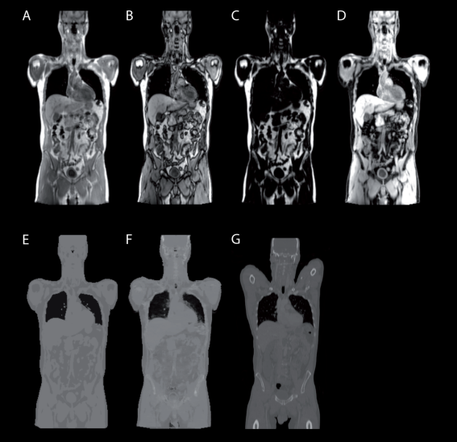
PET: Attenuation (MRAC)
MR sequence with fat-water separation results in 4 images: in-phase, opposed phase, fat, water
Segmentation into 4 classes: air, lungs, fat, soft tissue
No bone!

Slide 28
PET: Attenuation (MRAC, Atlas/ML)
Different methods are needed to predict attenuation coefficients on a continuous scale
  Machine learning-based: learn a mapping of MR data to attenuation coefficients
  Atlas-based: Register (deform) CT or PET transmission template to patient MR image
Allows prediction of dense bone tissue from standard MR sequences
Bone tissue prediction necessary for head region: most LORs affected by cranial bone attenuation

Slide 29
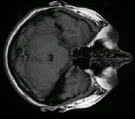
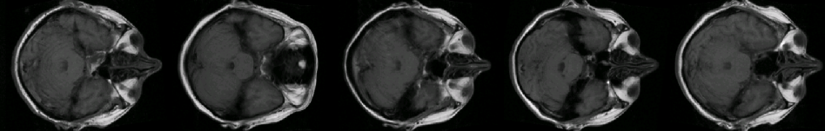
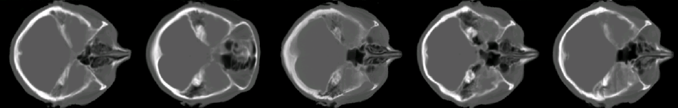
PET: Attenuation (MRAC, Atlas/ML)
Patient MRI
Find patches in the database that are most similar
Lookup corresponding attenuation value
Database of co-registered MRI and CT data

Slide 30
PET: Attenuation (EM)
PET sinograms contain information about tissue attenuation
Basic idea: if the PET emission image would be known exactly, there would be only one attenuation map that would fit
However, problem not solvable without additional information, as the emission image is not known exactly
Additional information:
  Time-of-flight information from time-of-flight PET systems
  Anatomical knowledge from MR data
Currently in early research stage

Slide 31
PET: Motion
Patient motion affects image quality if not corrected
  Respiratory motion particularly problematic
  Breath-hold acquisition not possible for PET scans (acquisition takes multiple minutes)
Correction strategies
  Gating: use only PET data acquired at the same breathing phase
  Track motion (e.g., with MRI) and use acquired deformation fields to correct listmode or sinogram data

Slide 32
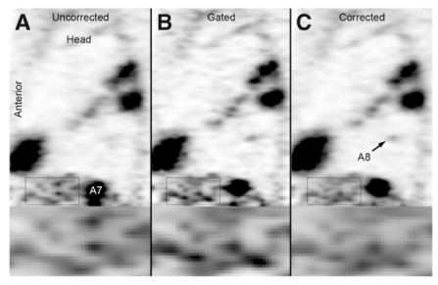
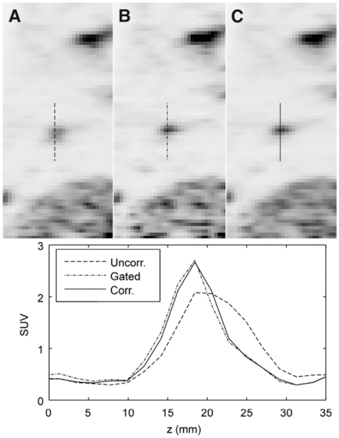
PET: Motion
Effect of motion on a lesion:
A: uncorrected
B: corrected with gating
C: MR-based motion correction

Slide 33
Questions?
Further Reading / References
The Essential Physics of Medical Imaging
Bushberg, Seibert, Leidholdt et al. Publisher: LWW
Positron Emission Tomography – Basic Sciences
Bailey, Townsend, Valk, Maisey. Publisher: Springer
Physics in Nuclear Medicine
Cherry, Sorenson, Phelps. Publisher: Saunders

