Slide 1
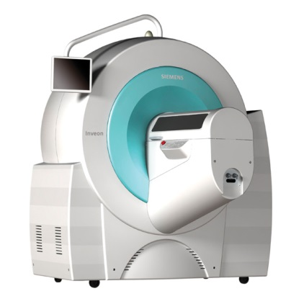
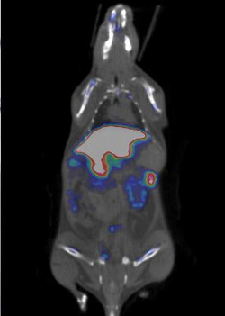
SPECT
Dr. Julia Mannheim
julia.mannheim@med.uni-tuebingen.de

Slide 2
Overview SPECT
general principle
collimation
single vs. multi-pinhole collimation
data acquisition and signal processing
SPECT in comparison to PET

Slide 3
SPECT principle
Forms of Nuclear Imaging
SPECT
PET
Courtesy: Dr. Simon Cherry, UC Davis

Slide 4
Gamma Radiation
e.g. ^{99m}Tc ⁹⁹Tc + γ
a nucleus in an excited state decays to ground state
electron capture: the nucleus consists of too many protons
and cannot emit a positron → captures an electron
e.g. ¹¹¹In ¹¹¹Cd + γ
beta decay: emission of γ
e.g. ⁶⁷Cu ⁶⁷Zn + e⁻ + γ
Gamma-Ray

Slide 5
Projection Imaging
Mouse injected with radiotracer
Mouse injected with radiotracer
Mouse injected with radiotracer
Position-sensitive scintillation detector
Position-sensitive scintillation detector
Position-sensitive scintillation detector
Position-sensitive scintillation detector
Projection image
Projection image
Projection image
Courtesy: Dr. Simon Cherry, UC Davis

Slide 6
Projection Imaging
Mouse injected with radiotracer
Position-sensitive scintillation detector with slit collimator
(Slit collimator)
Projection image
Courtesy: Dr. Simon Cherry, UC Davis

Slide 7
Collimation
Collimation = direction of motion become aligned
→ production of parallel γ -rays
Material of collimator:
  Tungsten, lead

Slide 8
Pinhole collimation
Parallel-hole collimator
One-to-one Projection
Large FOV
Pinhole collimator
Magnification of object
Smaller FOV
Increased resolution
Object
Object
Collimator
Magnification
Detector

Slide 9
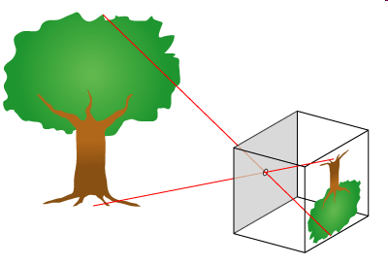
Pinhole collimation
use pinhole to obtain projection
magnification possible due to distance variation
Object
Object
Magnification

Slide 10
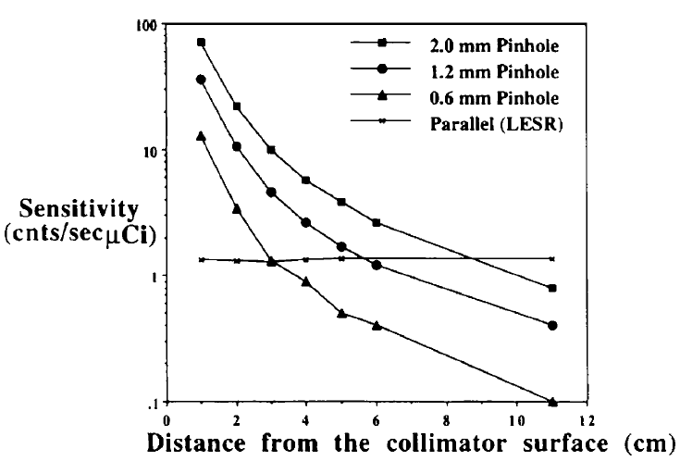
Pinhole collimation
Courtesy: Siemens
Notes:
10

Slide 11
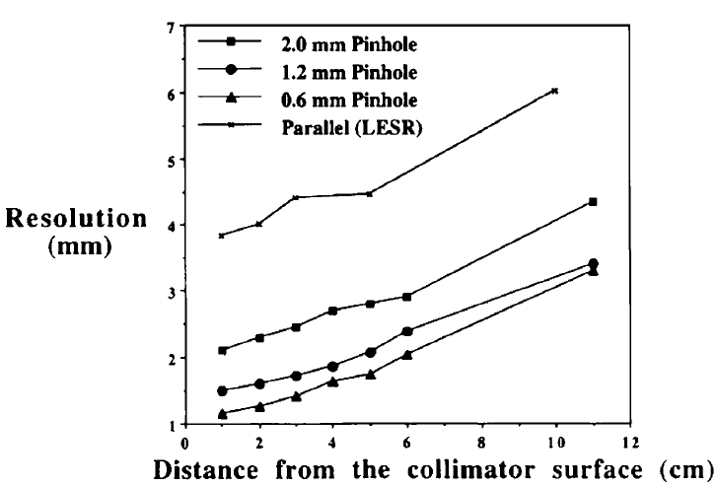
Pinhole collimation
Courtesy: Siemens
Notes:
11

Slide 12
Multipinhole collimation
higher sensitivity
faster acquisition
lower dose
more efficient use of detector
no reduction of resolution
larger FOV
Object

Slide 13
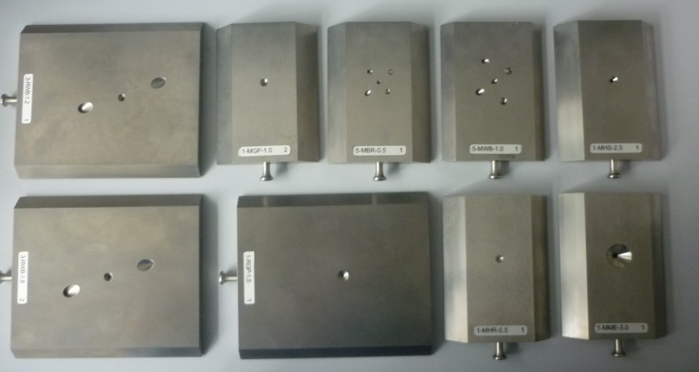
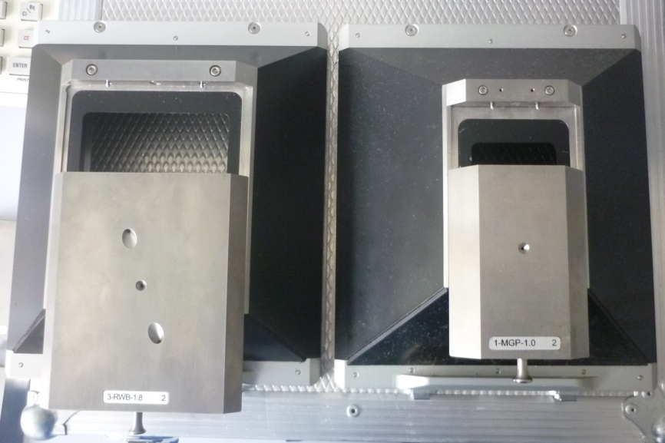
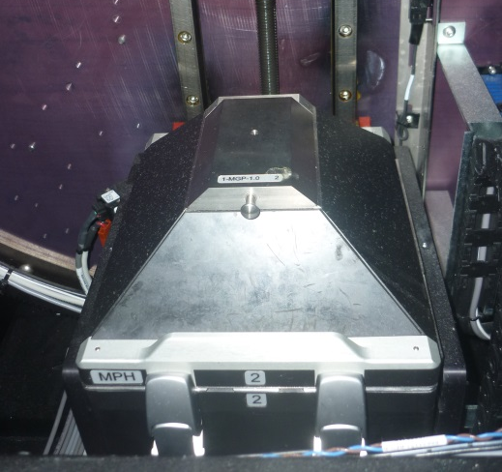
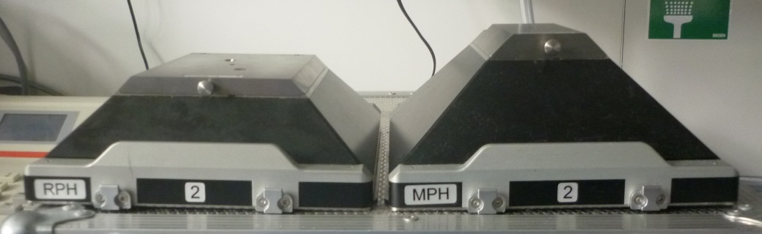
Inveon Collimators
Rat Mouse
Rat Mouse

Slide 14
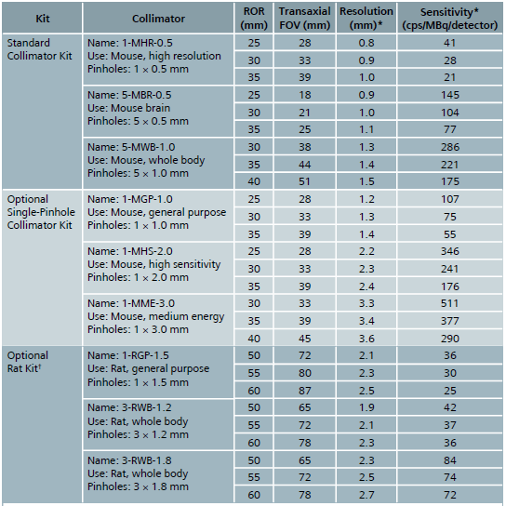

Inveon Collimators
radius of rotation (ROR)
Courtesy: Siemens

Slide 15
Data Acquisition
Rotate imaging system to collect projection views around the object
Use reconstruction algorithms to determine 3D distribution of radiotracer
Multiple pinholes often used to improve sensitivity

Slide 16
Data Acquisition
acquisition
projection 1
projection 2
.
.
.
.
.
projection xy
time

Slide 17
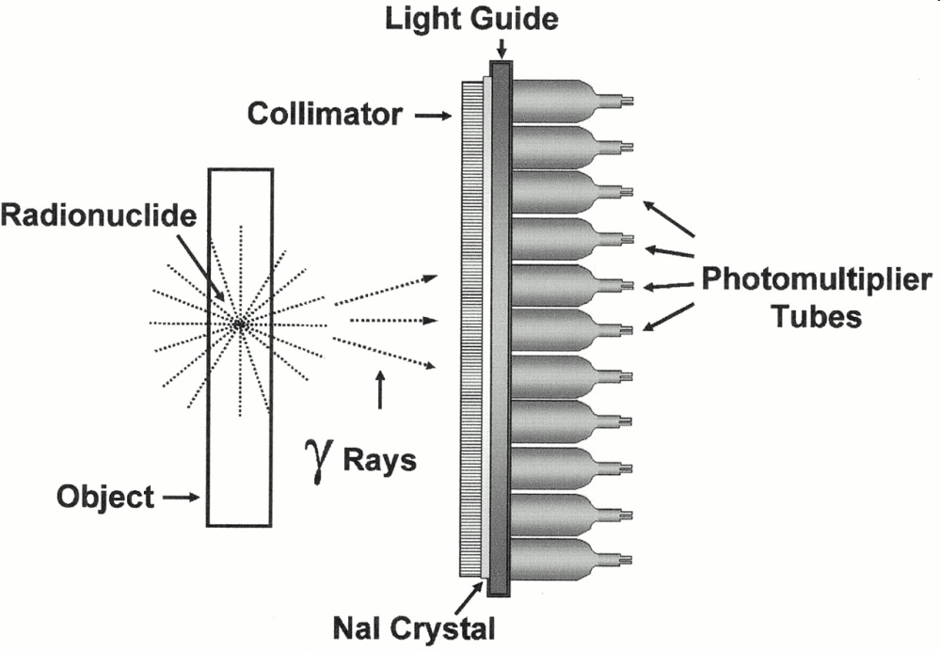
Detector
absorption of γ-rays in scintillation crystals → light release
transformation of light into electrons at photocathode of photomultiplier
amplification of electronic signal in photomultiplier
position-encoding electronics
2.2 mm x 2.2 mm crystals scanning area 150 mm x 150 mm
3x3 array position sensitive pmt
Electronic
Photomultiplier
Courtesy: Siemens

Slide 18
Data Acquisition & Processing
List mode data
Image
projection 1
projection 2
.
.
.
.
projection xy
projection 1
projection 2
projection XY
Time
Histogram
Recon
Projections
Considerations:
Different pinhole configurations allow for choice of different sensitivity and image resolution
More pinholes, lower resolution → higher sensitivity

Slide 19
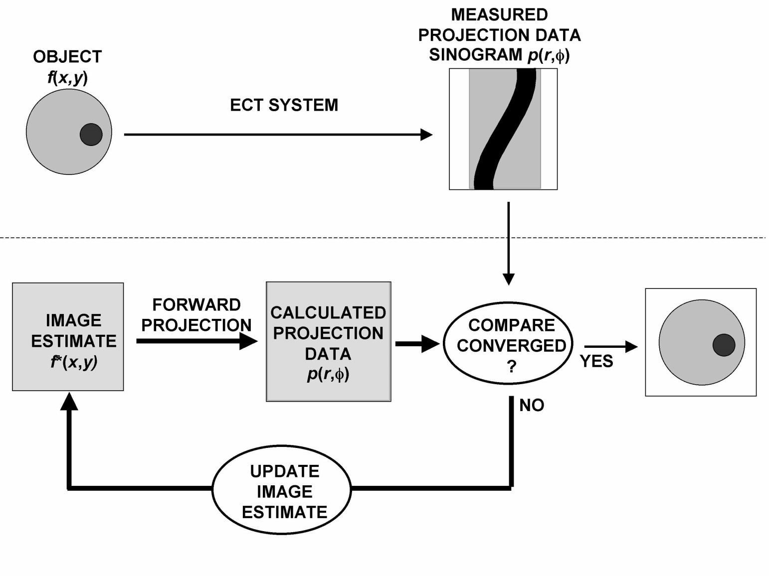
Iterative Reconstruction
Image courtesy of S.R. Cherry, University of California

Slide 20
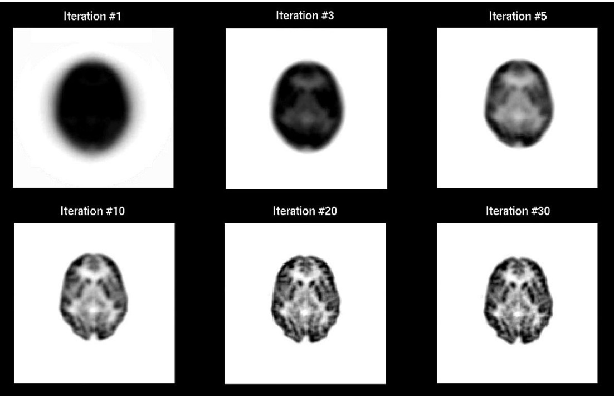
Iterative Reconstruction
Image courtesy of S.R. Cherry, University of California

Slide 21
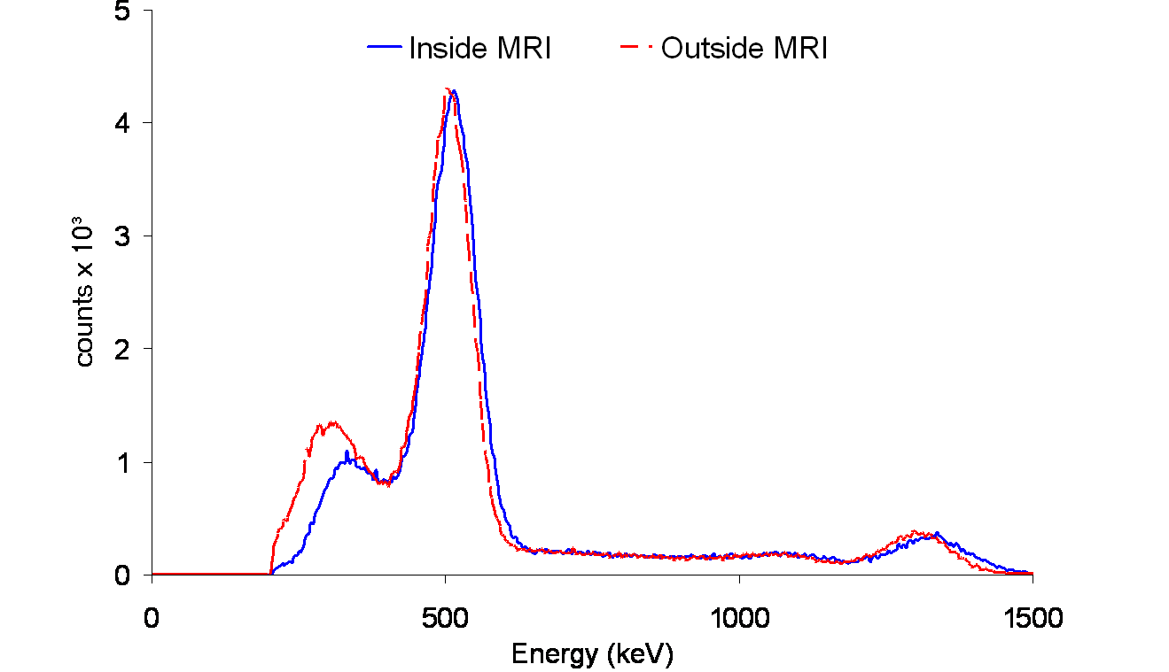
Energy discrimination
Different SPECT Isotopes can have one or more discrete lines of energy emission (~30-300 keV suitable for the Inveon system)
Post acquisition energy discrimination is performed
Detector needs to be calibrated for each isotope!!
Potential use of multiple isotopes
Energy
Window
0
140
200
300

Slide 22
SPECT isotopes
isotope | photopeak [keV] | suggested energy window [keV] | half life
⁵⁷Co | 122 | 110 – 134 | 271.74 d
⁶⁷Ga | 93 | 84 – 102 | 3.3 d
¹²³I | 159 | 143 – 175 | 13.2 h
¹²⁵I | 35 | 25 – 45 | 59.4 d
¹¹¹In | 171 | 154 – 188 | 2.8 d
¹⁷⁷Lu | 208 | 187 – 229 | 6.73 d
^{99m}Tc | 140 | 126 – 154 | 6 h
²⁰¹Tl | 70 | 63 - 77 | 12.23 d

Slide 23
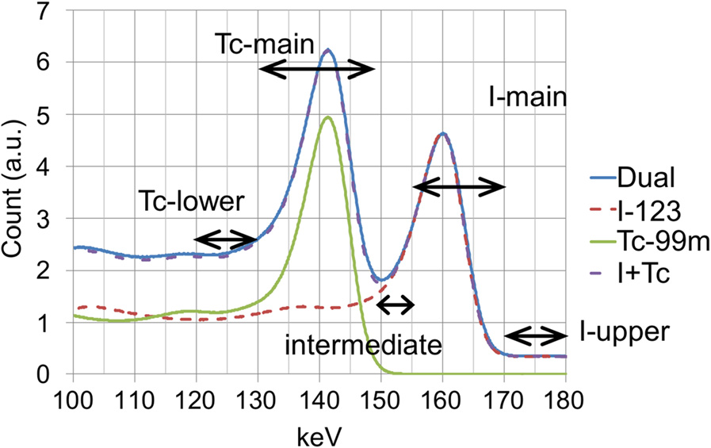
Multi-isotope SPECT
Multi-isotope imaging, e.g., ^{99m}Tc (peak 140 keV) & ¹²³I (peak 159 keV)
energy
window 1
126-154 keV
energy
window 2
143-175 keV
Adapted from Takeuchi, W. et al. EJNMMI Phys. 2016;3:10

Slide 24
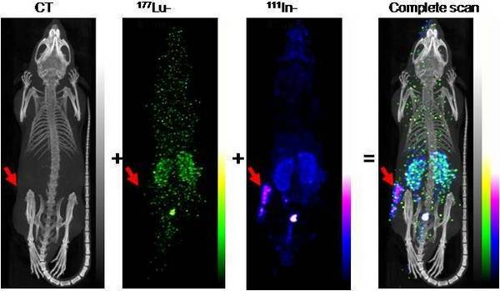
Multi-isotope SPECT
Courtesy: Siemens

Slide 25
PET vs. SPECT
 | PET | SPECT
spatial resolution | crystal thickness scintillation material depth of interaction reconstruction parameters … | pinhole diameter scintillation material radius of rotation reconstruction parameters …
sensitivity | crystal length axial FOV size … | pinhole diameter number of pinholes radius of rotation …

Slide 26
PET vs. SPECT
Spatial resolution
  PET: 1.5 mm CFOV
  SPECT: 0.8 mm, 25 mm ROR, 1MHR-0.5
  1.2 mm, 25 mm ROR, 1MGP-1.0
        1.3 mm, 30 mm ROR, 5MWB-1.0
  depending on pinhole choice → PET worse spatial resolution compared to SPECT
Sensitivity
  PET: 7.2% at CFOV (energy window: 350-650 keV,
        timing window: 3.432 ns)
  SPECT: 0.0107%, 25 mm ROR, 1MGP-1.0
        0.0286%, 30 mm ROR, 5MWB-1.0
  PET better sensitivity than SPECT
values represent the Inveon system

