Slide 1
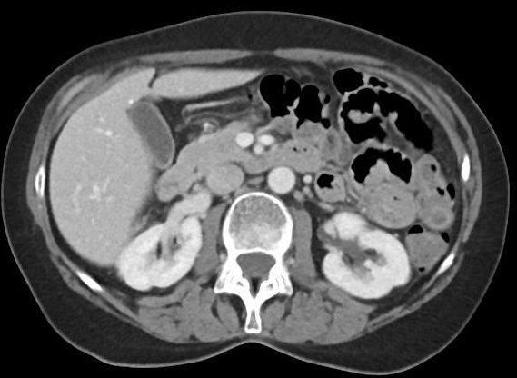
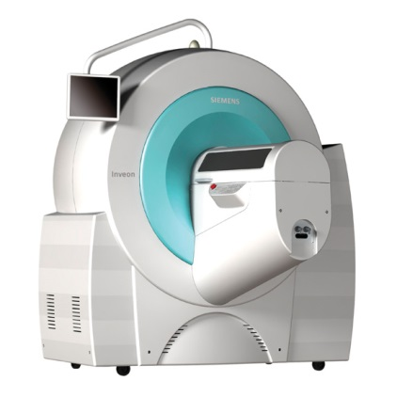
CT
Jonathan Disselhorst, PhD
Jonathan.Disselhorst@med.uni-tuebingen.de

Slide 2
Overview
X-rays and interaction
Detectors and scanners

Slide 3
X-Ray Production

Slide 4
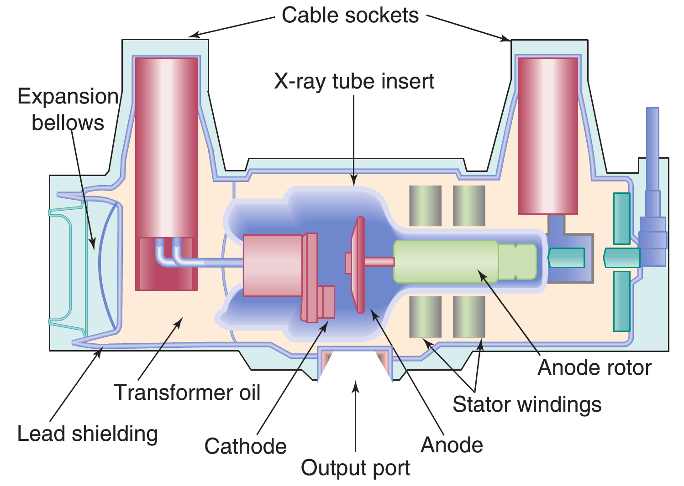
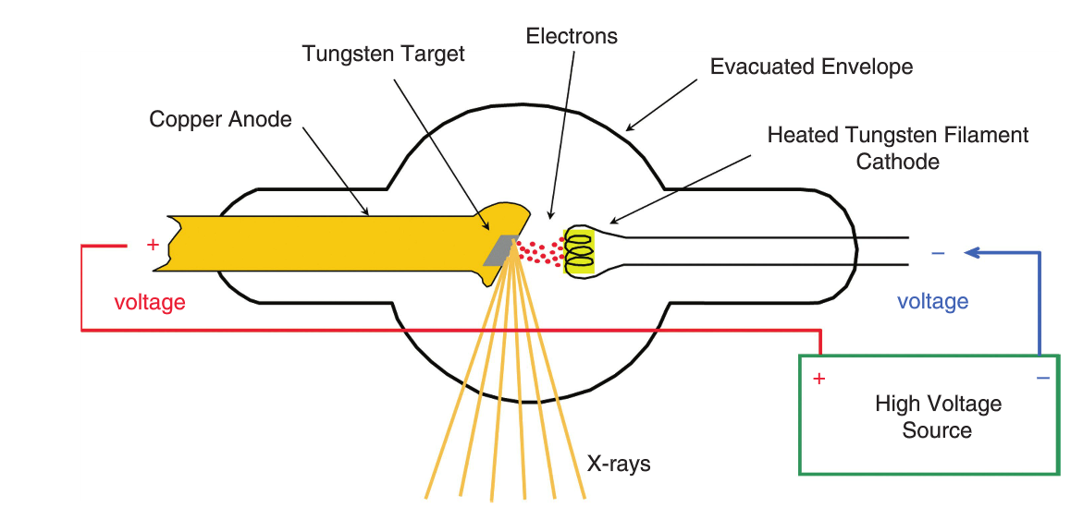
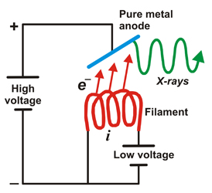
Production of X-Rays
Bushberg et al. The Essential Physics of Medical Imaging
Spanish National Research Council [CSIC] (http://www.xtal.iqfr.csic.es/)

Slide 5
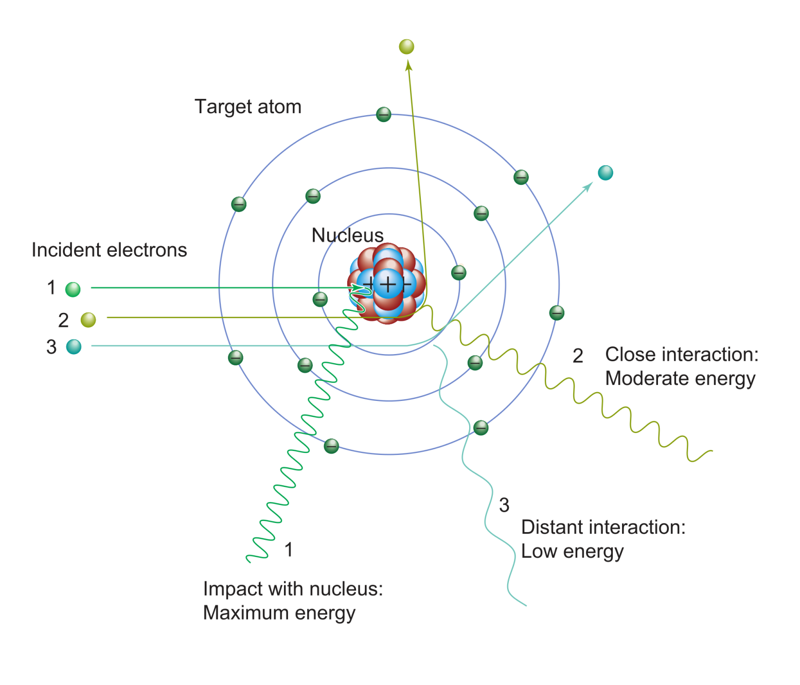
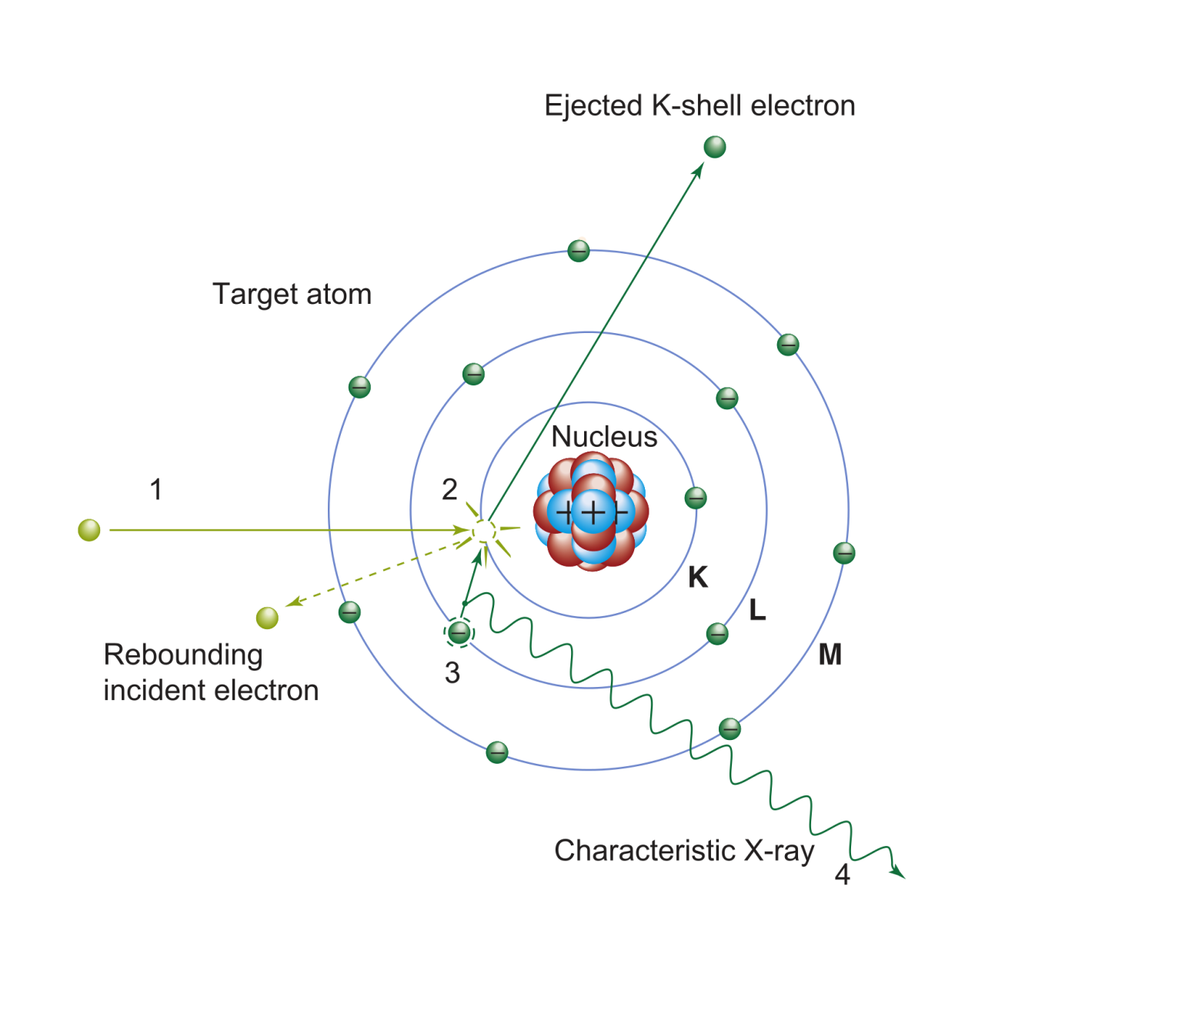
Production of X-Rays
Bremsstrahlung
Characteristic Radiation
Bushberg et al. The Essential Physics of Medical Imaging

Slide 6
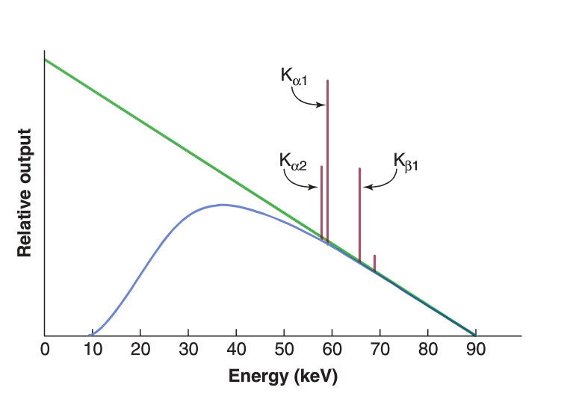
X-Ray Spectrum
Unfiltered
Bremsstrahlung
Characteristic
Radiation Spikes
(Tungsten)
Maximal Photon
Energy (90 keV)
Filtered Bremsstrahlung
Spectrum
Adapted from Bushberg et al. The Essential Physics of Medical Imaging

Slide 7
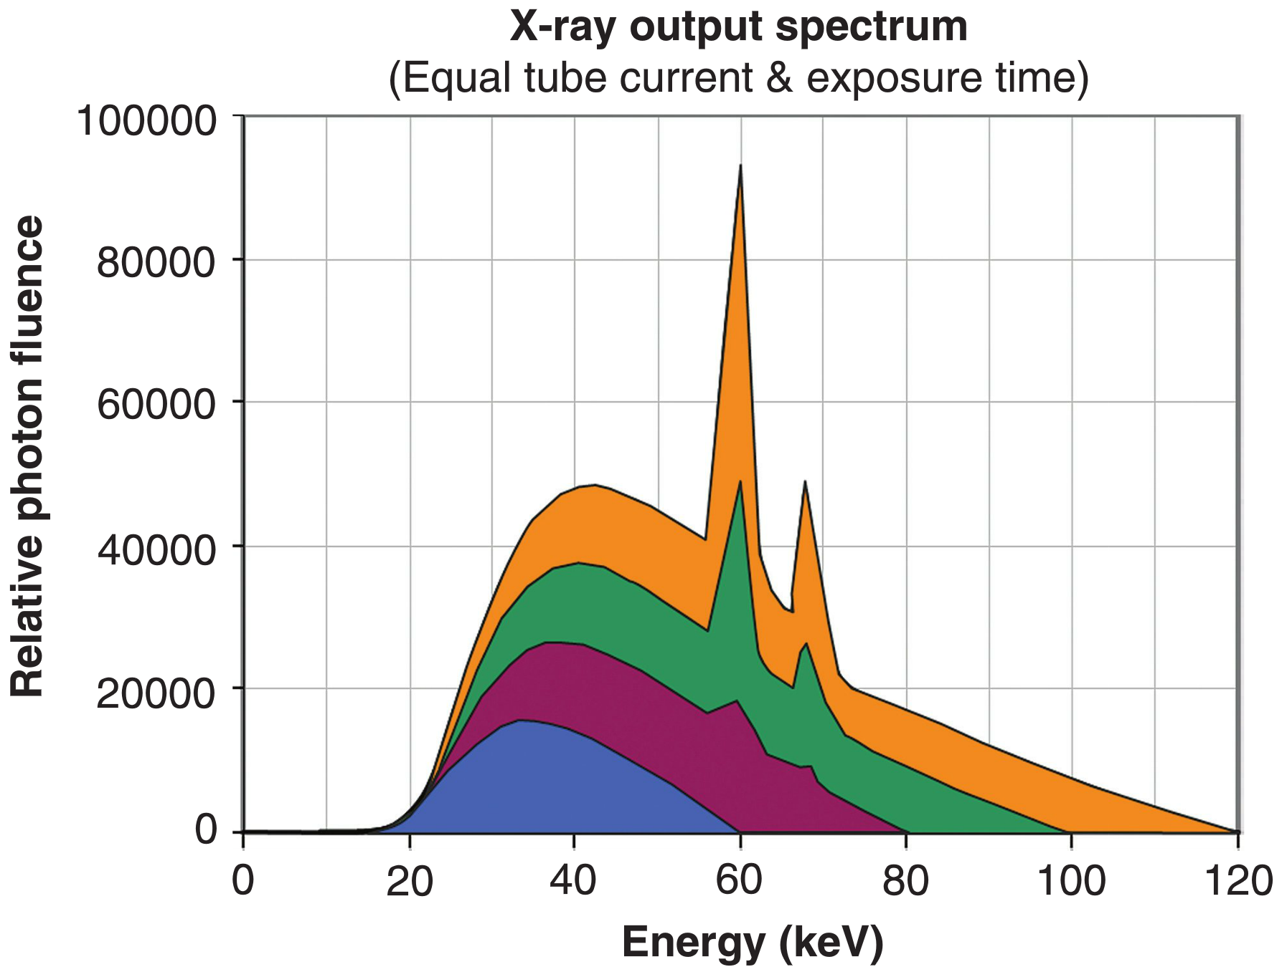
X-Ray Spectrum: Different kVp
kVp:
Peak Tube Voltage [kilo-Volts]
mAs:
Tube current [milli-Ampere]
multiplied by
Exposure time [seconds]
Bushberg et al. The Essential Physics of Medical Imaging

Slide 8
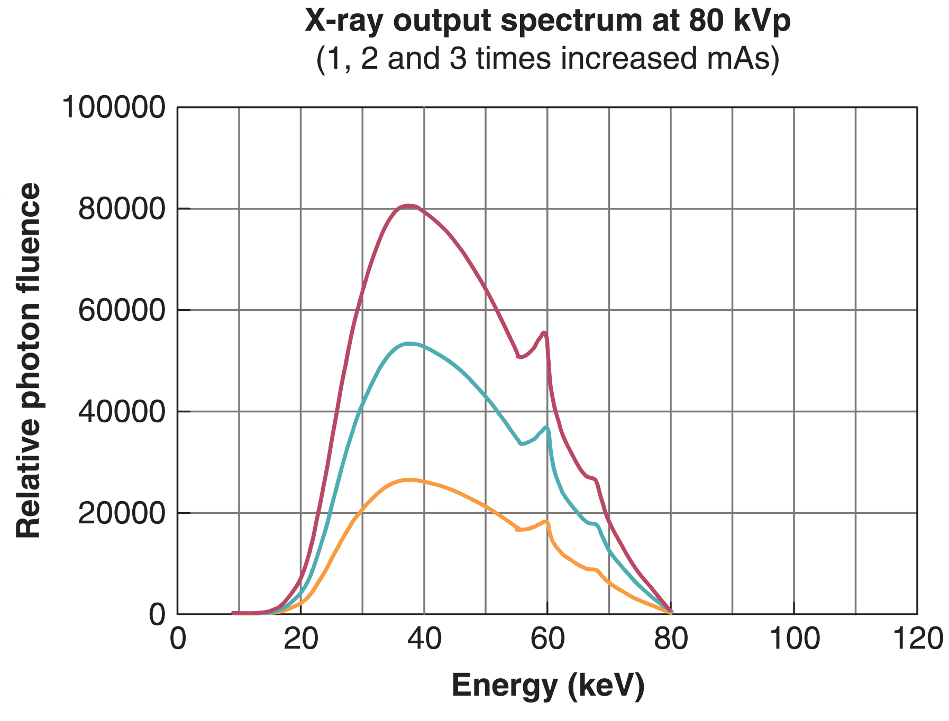
X-Ray Spectrum: Different mAs
kVp:
Peak Tube Voltage [kilo-Volts]
mAs:
Tube current [milli-Ampere]
multiplied by
Exposure time [seconds]
Bushberg et al. The Essential Physics of Medical Imaging

Slide 9
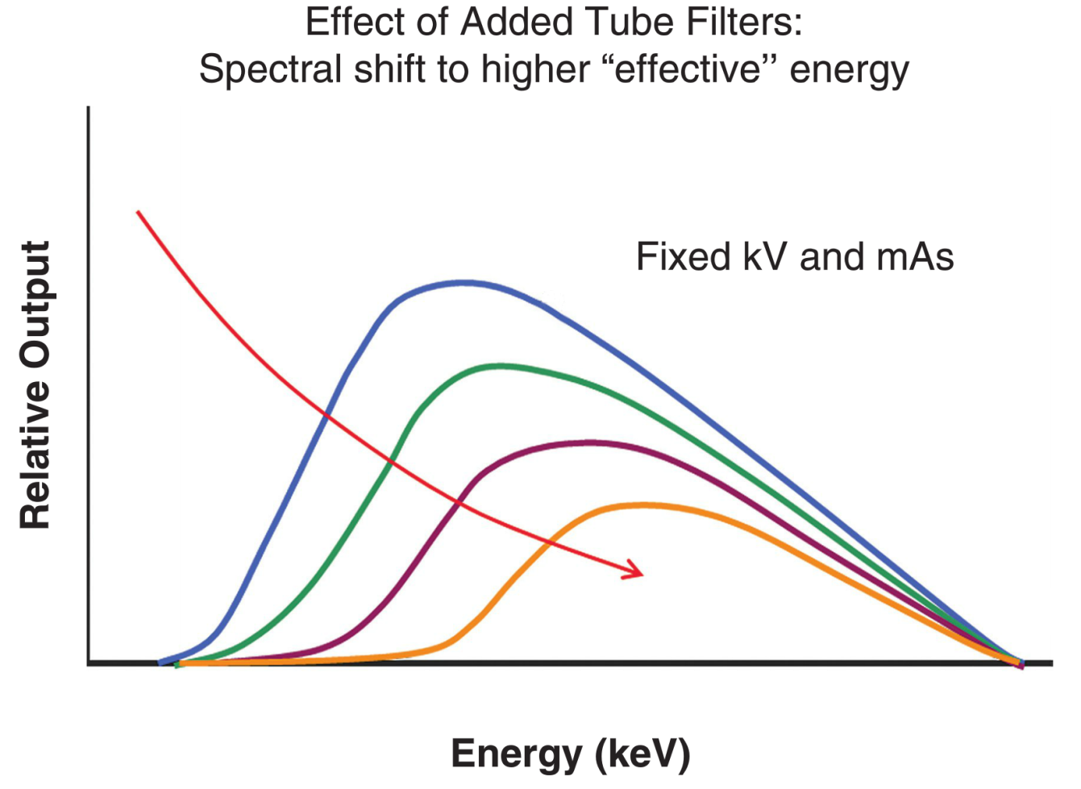
X-Ray Spectrum: Filtering
“Beam Hardening”
kVp:
Peak Tube Voltage [kilo-Volts]
mAs:
Tube current [milli-Ampere]
multiplied by
Exposure time [seconds]
Bushberg et al. The Essential Physics of Medical Imaging

Slide 10
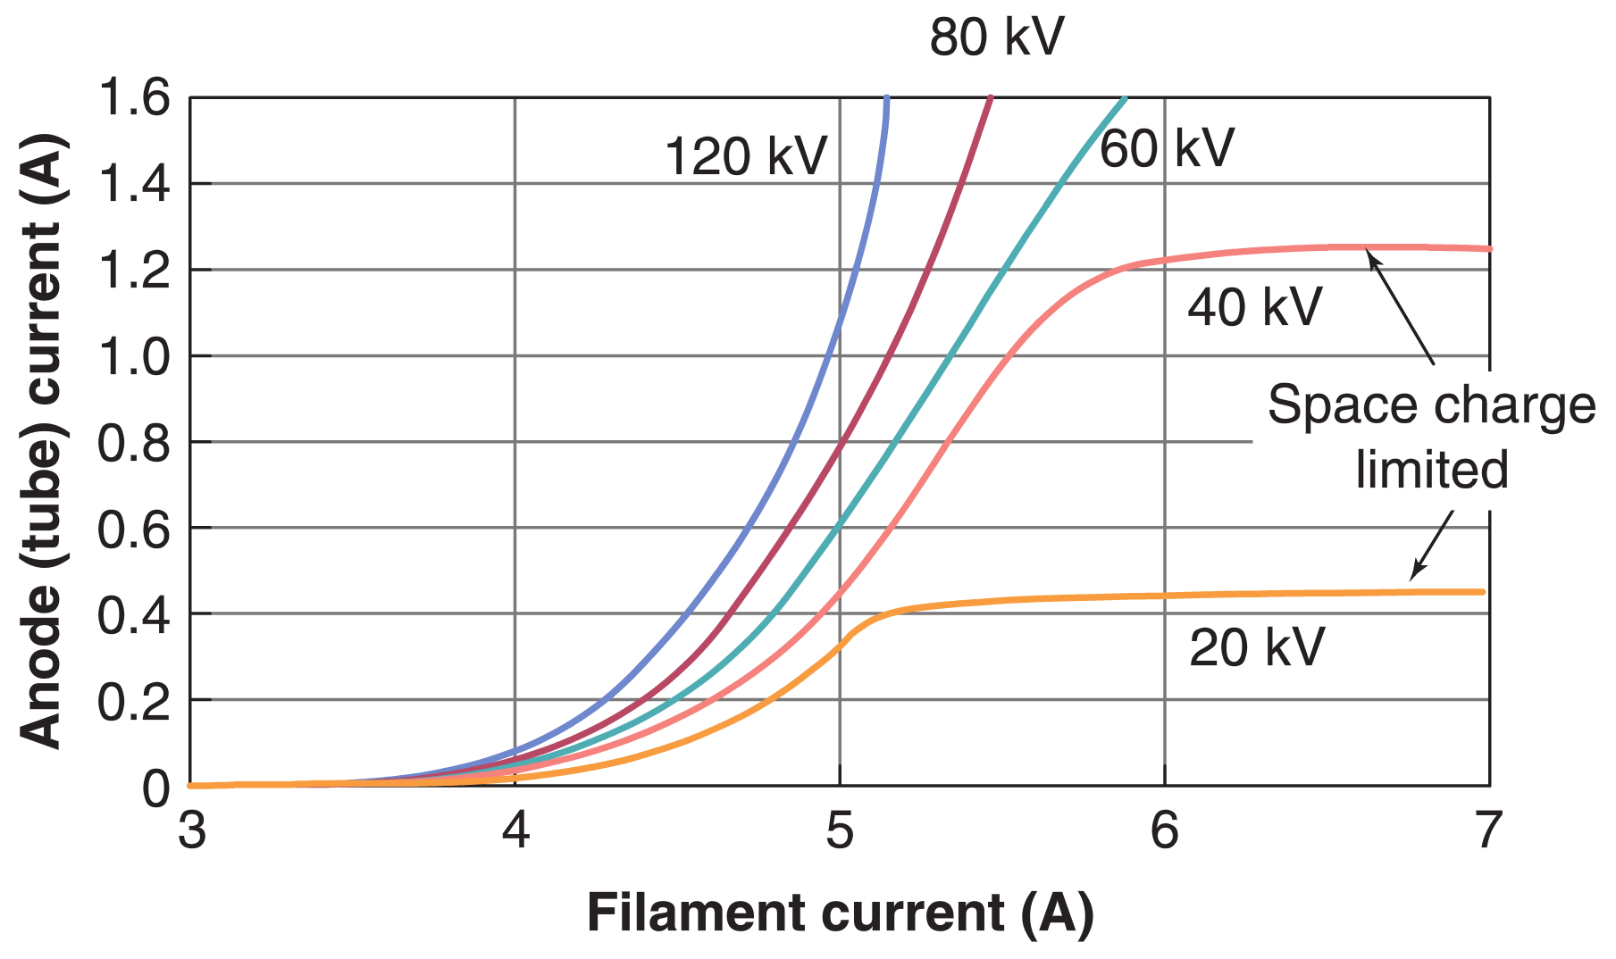
Current
Tube current ≠ Filament current
Tube voltage ≠ Filament voltage
Bushberg et al. The Essential Physics of Medical Imaging
Spanish National Research Council [CSIC] (http://www.xtal.iqfr.csic.es/)
Notes:
The tube voltage is around 80 kilovolt, the filament voltage is approximately 10V
The tube current depends on the filament current, but also on the tube voltage

Slide 11
X-Ray Interaction

Slide 12
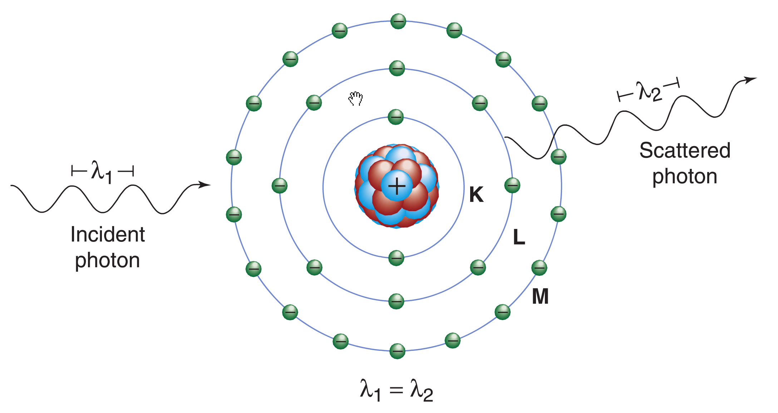
Rayleigh Scattering
Dominant form of elastic scattering of X-rays in medical imaging.
At low energies.
Bushberg et al. The Essential Physics of Medical Imaging

Slide 13
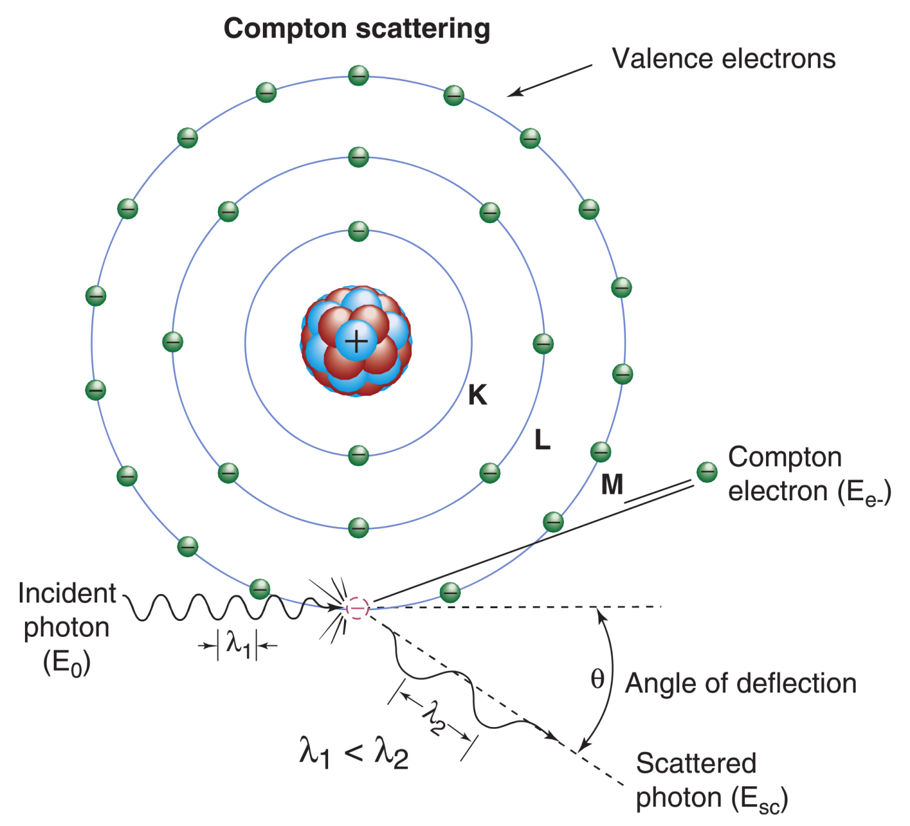
Compton Scattering
Dominant interaction in soft tissue in medical imaging.
Inelastic scattering.
Bushberg et al. The Essential Physics of Medical Imaging

Slide 14
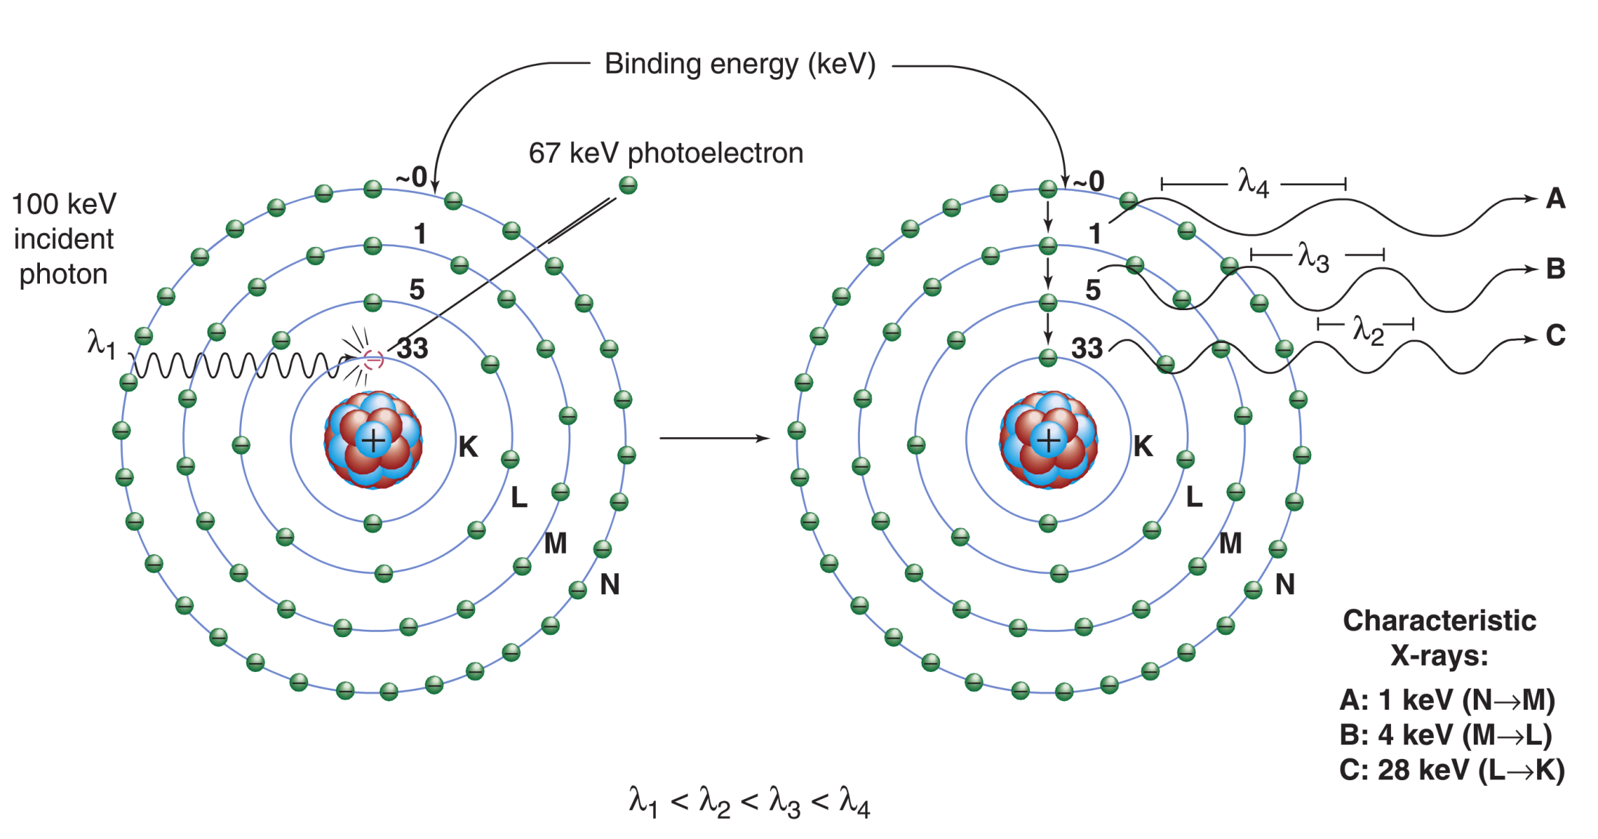
Photoelectric Effect
Can occur when the energy of the photon ≥ binding energy of the electron
Instead of characteristic X-rays (shown here), Auger electrons could be emitted (not shown).
The probability of characteristic X-rays decreases with lower atomic number (Z). The probability is not very high in tissue (Z_{eff} = 7).
Bushberg et al. The Essential Physics of Medical Imaging

Slide 15
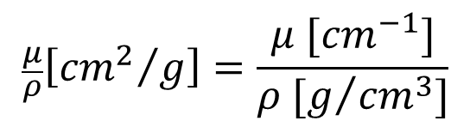
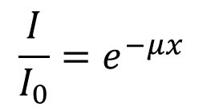
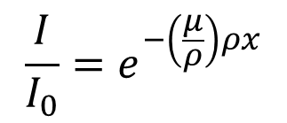
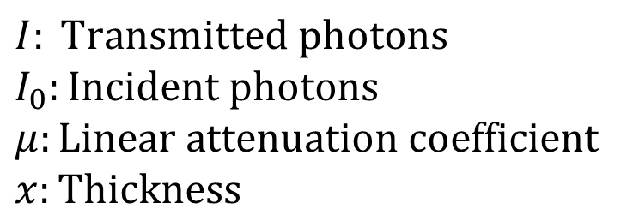
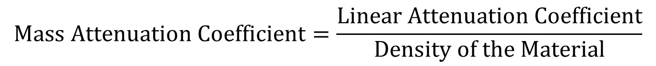
Attenuation
$$I: \text{Transmitted} \text{photons}$$
$$I_{0}:\text{Incident} \text{photons}$$
$$μ:\text{Linear} \text{attenuation} \text{coefficient}$$
$$x:\text{Thickness}$$
$$\frac{I}{I_{0}}=e^{−μx}$$
The Mass Attenuation Coefficient is independent of density
$$\text{Mass} \text{Attenuation} \text{Coefficient}=\frac{\text{Linear} \text{Attenuation} \text{Coefficient}}{\text{Density} \text{of} \text{the} \text{Material}}$$
$$\frac{μ}{ρ}\left[{{cm}^{2}}/g\right]=\frac{μ [{cm}^{−1}]}{ρ [g/{{cm}^{3}]}}$$
$$\frac{I}{I_{0}}=e^{−\left(\frac{μ}{ρ}\right)ρx}$$

Slide 16
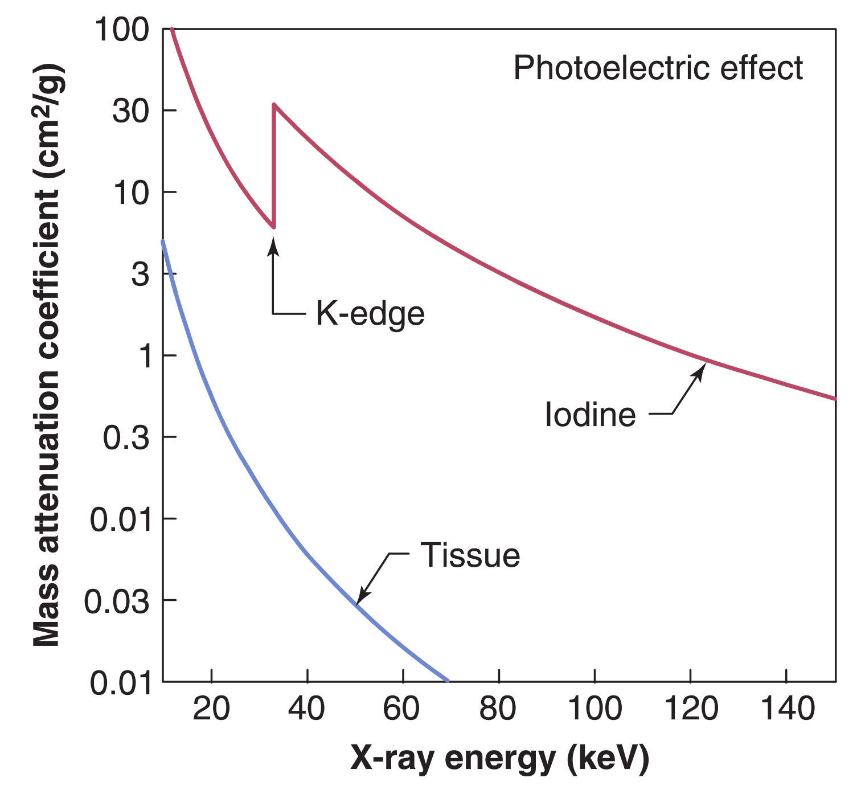
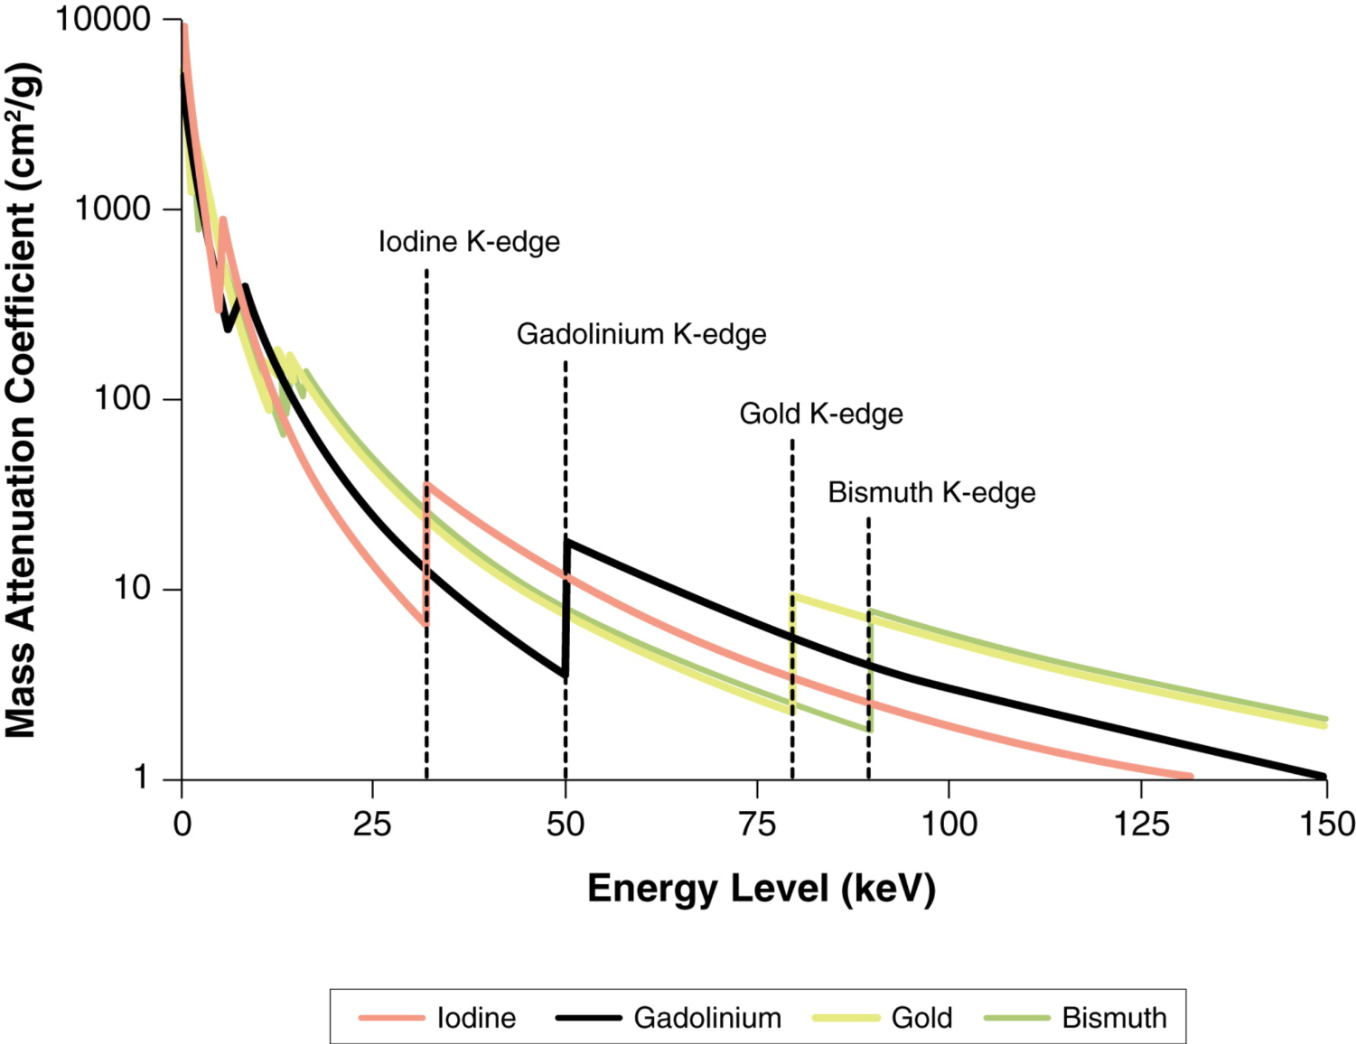
Photoelectric Effect
Bushberg et al. The Essential Physics of Medical Imaging
J Am Coll Cardiol Img. 2015;8(6):710-723. doi:10.1016/j.jcmg.2015.03.005

Slide 17
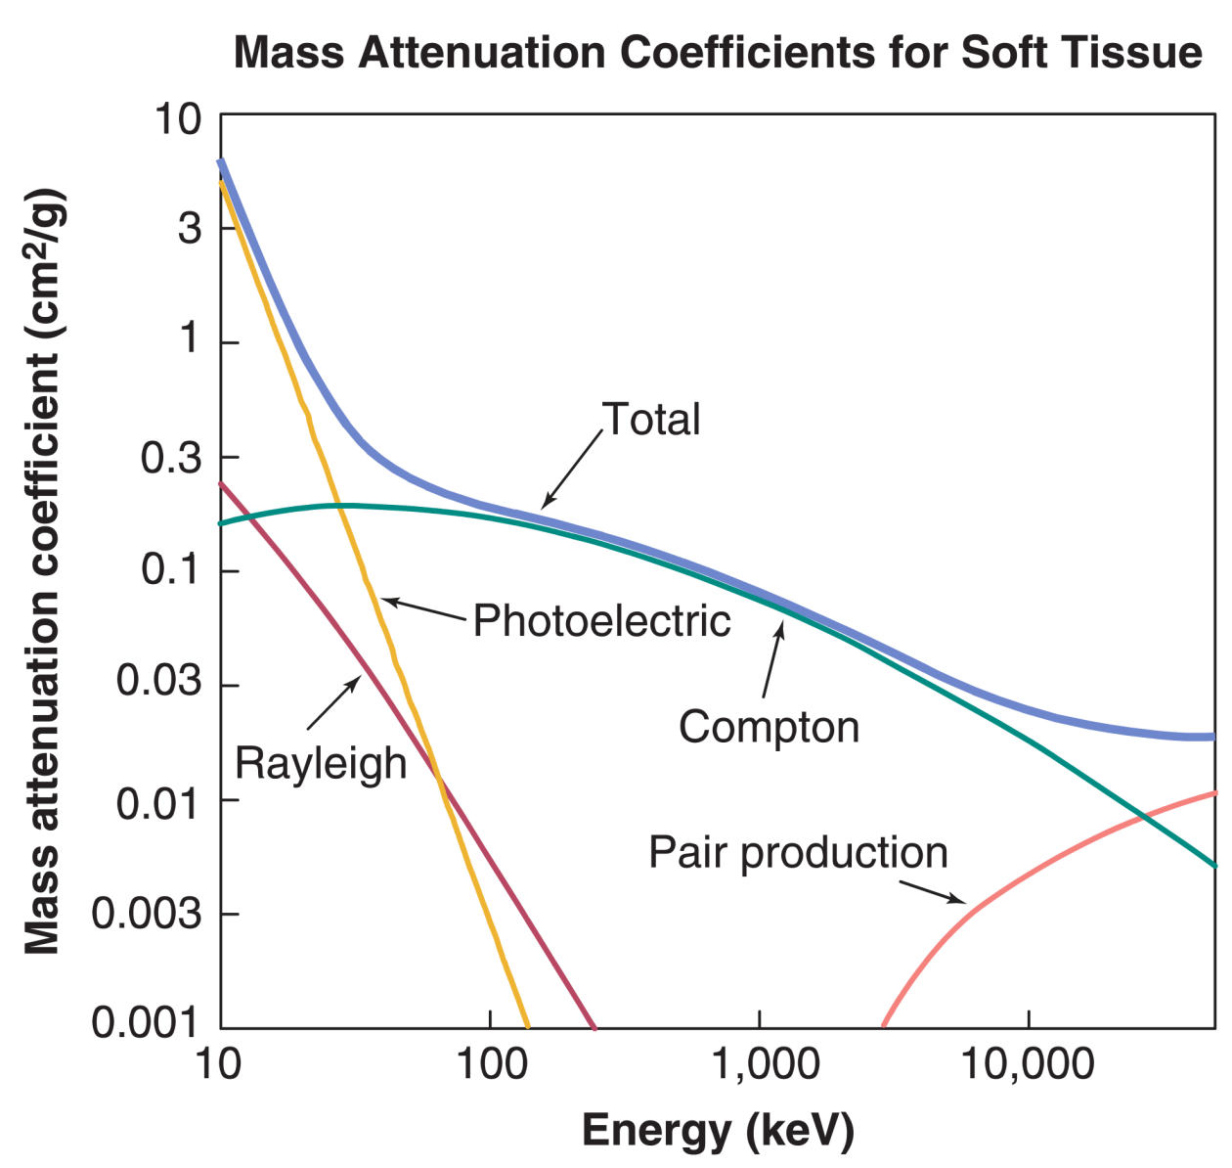
Mass Attenuation Coefficients
Radiology ~20-80 keV
Nuclear Medicine ~80-511 keV
Adapted from Bushberg et al. The Essential Physics of Medical Imaging

Slide 18
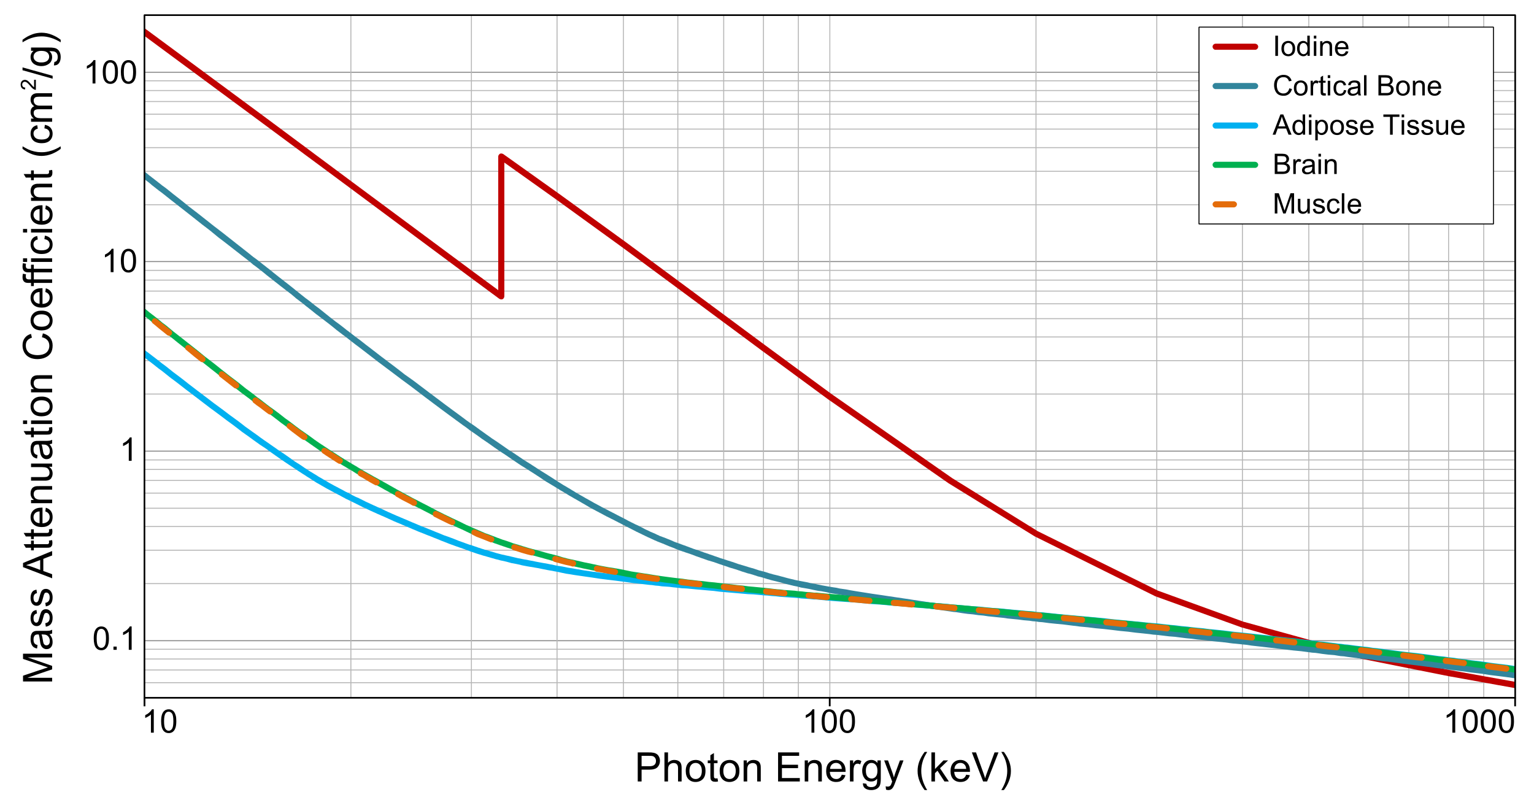
Attenuation in Tissue
K-edge (33 keV)
Data from the US National Institute of Standards and Technology (NIST)
http://physics.nist.gov/PhysRefData/XrayMassCoef

Slide 19
X-Ray Detection

Slide 20
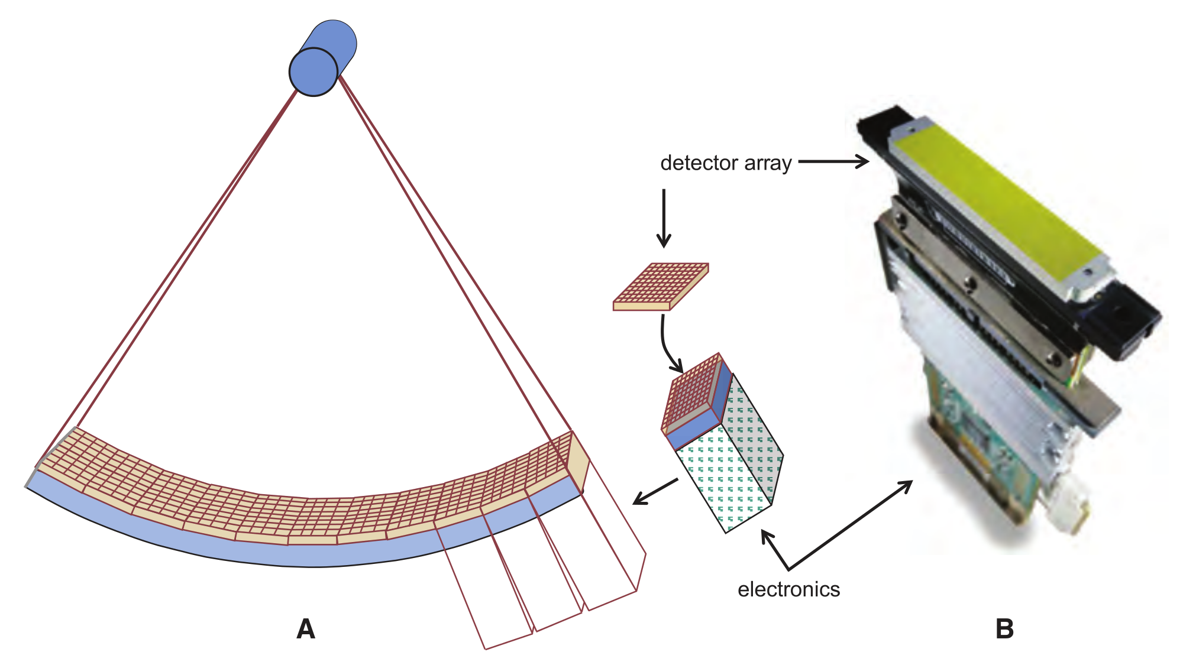
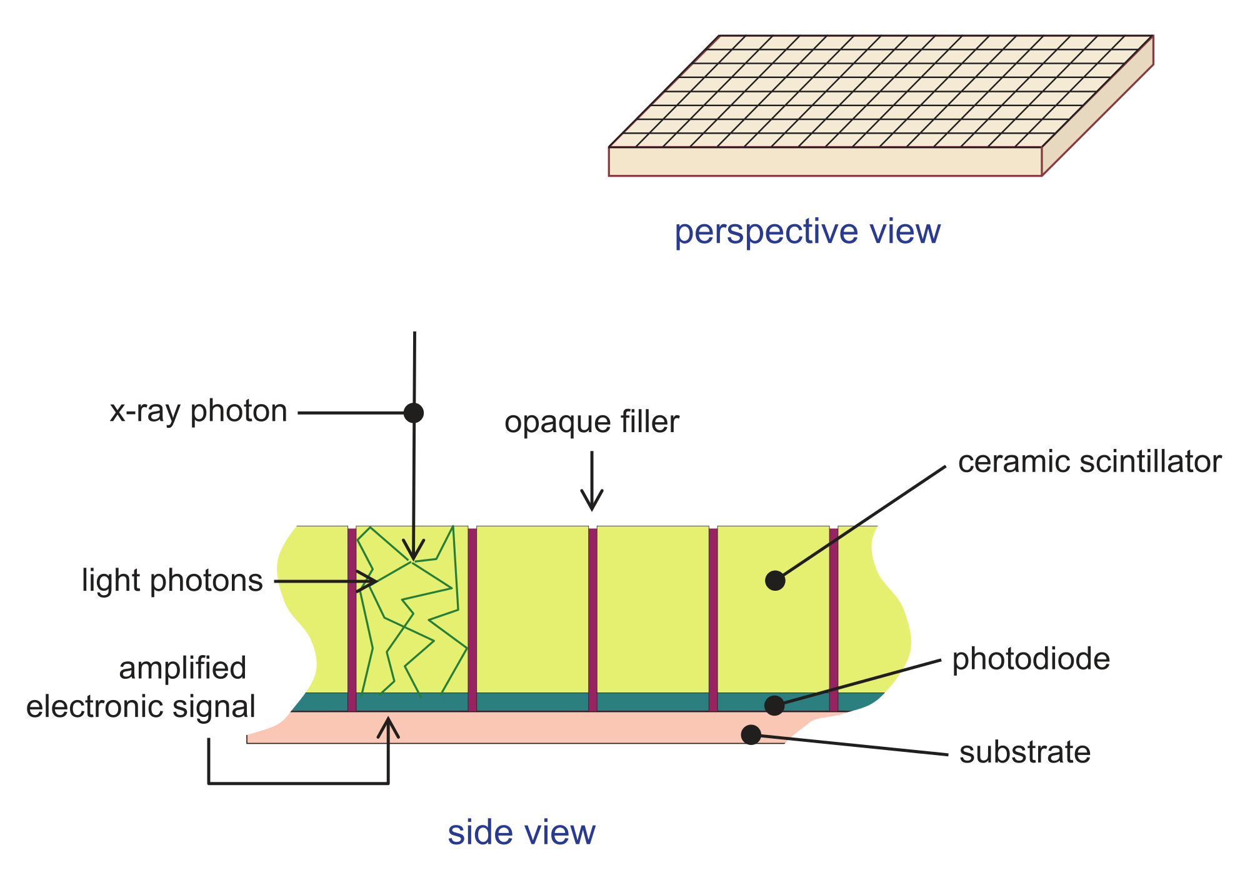
Detector

Slide 21
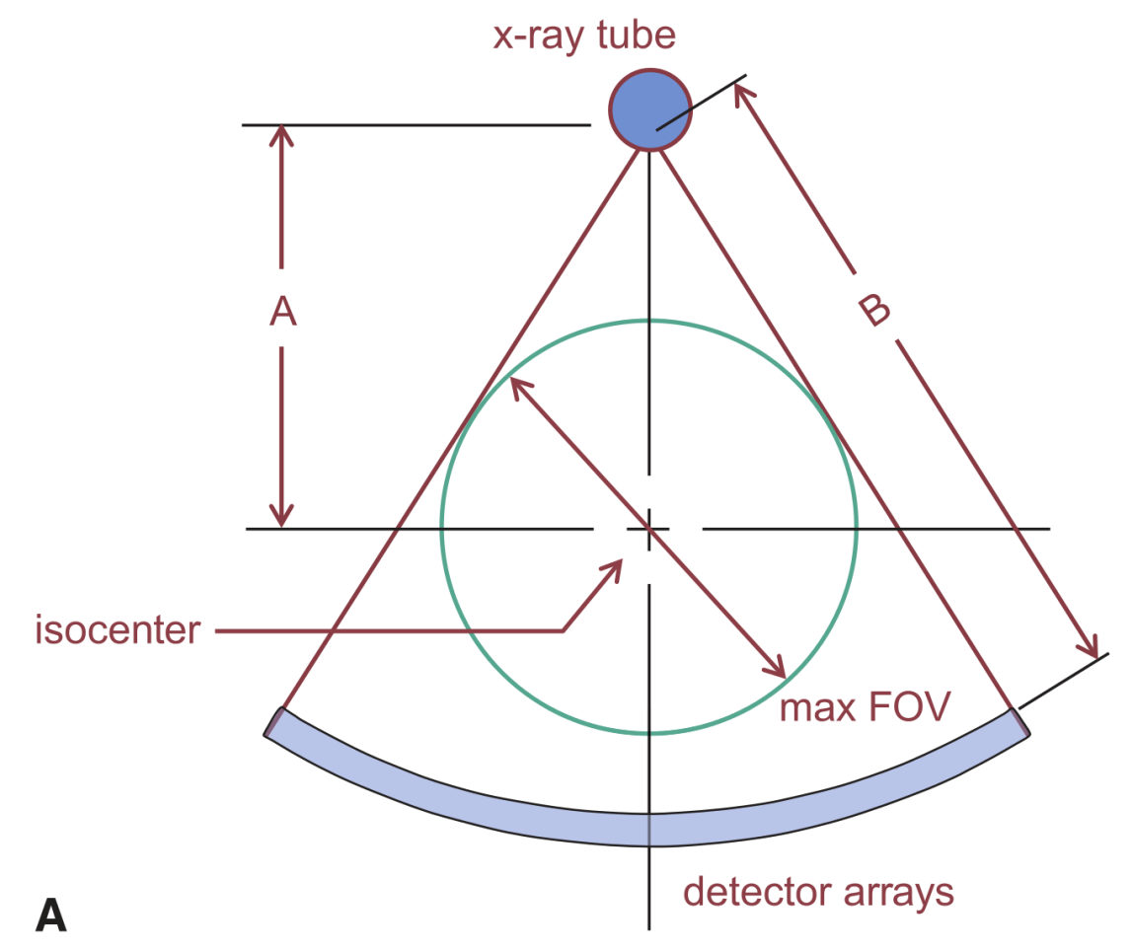
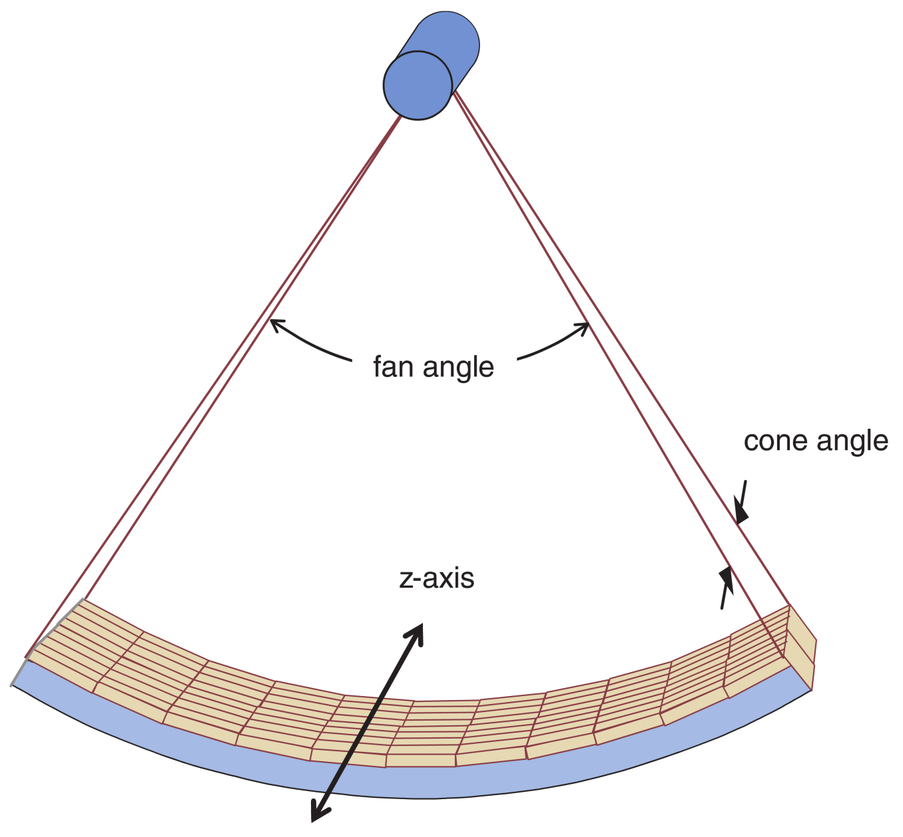
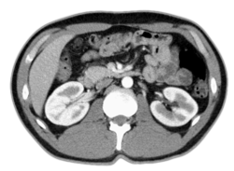
Fan- / Cone beam
Bushberg et al. The Essential Physics of Medical Imaging

Slide 22
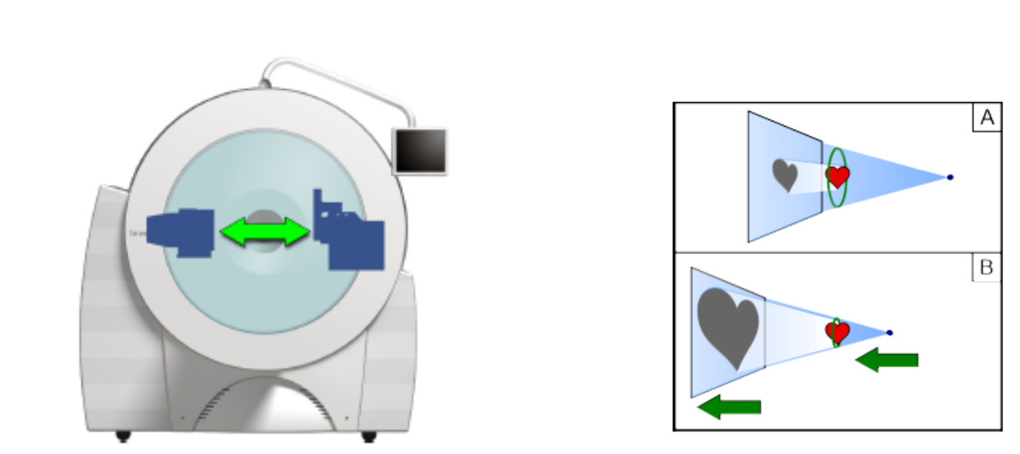

Siemens Inveon CT
Source
Detector

Slide 23
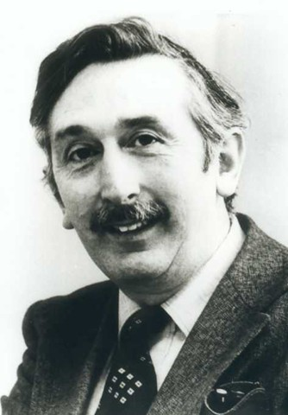
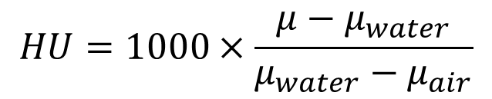
Hounsfield Units
Distilled water at standard pressure and temperature is defined as 0 HU
Air is defined as −1000 HU
In a voxel with average linear attenuation coefficient μ, the HU value is:
$$HU=1000×\frac{μ−μ_{water}}{μ_{water}−μ_{air}}$$
Godfrey Hounsfield

Slide 24
Typical HUs
Substance | HU
Air | −1000
Lung | −500
Fat | −100 to −50
Water | 0
CSF | 15
Kidney | 30
Blood | +30 to +45
Muscle | +10 to +40
Grey matter | +37 to +45
White matter | +20 to +30
Liver | +40 to +60
Soft Tissue, Contrast | +100 to +300
Bone | +700 (cancellous bone) to +3000 (cortical bone)

