Slide 1


Small animal fMRI
Biochemical and physiological background, technical needs and applications
12/04/2017
Werner Siemens Imaging Center,
Department of Preclinical Imaging and Radiopharmacy,
Eberhard Karls University Tuebingen, Germany
Department of Preclinical Imaging and Radiopharmacy

Slide 2
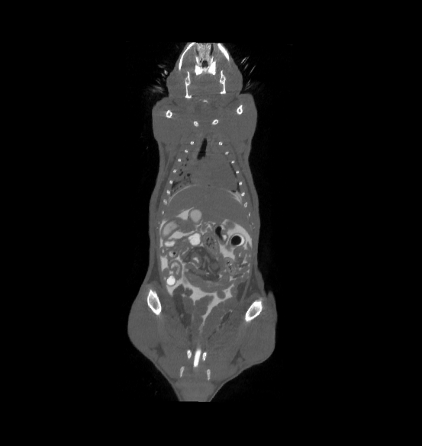
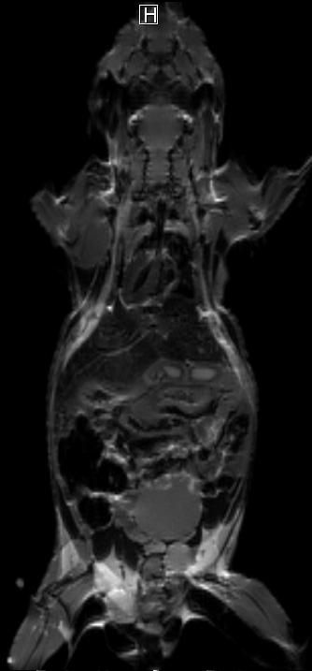
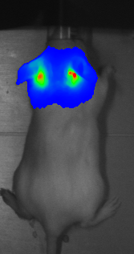
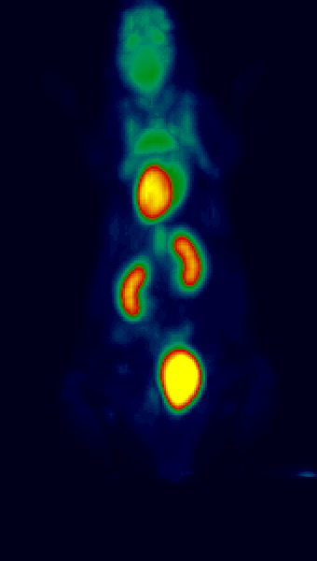
Dedicated Imaging Modalities
Optical
Imaging
CT
MRI
PET
Morphology
Morphology
(Function)
Function
Function

Slide 3
Imaging the brain
EEG, MEG, PET, MRI, CT
anatomy, atrophy, relaxometry, diffusion, connectivity, magnetization transfer, permeability
blood flow / perfusion
blood / tissue oxygenation
glucose consumption
amino/nucleic acid metabolism
fMRI
neurotransmitter metabolism
receptor density
cell labeling
tissue pH
metabolite/drug concentration
Notes:
3

Slide 4
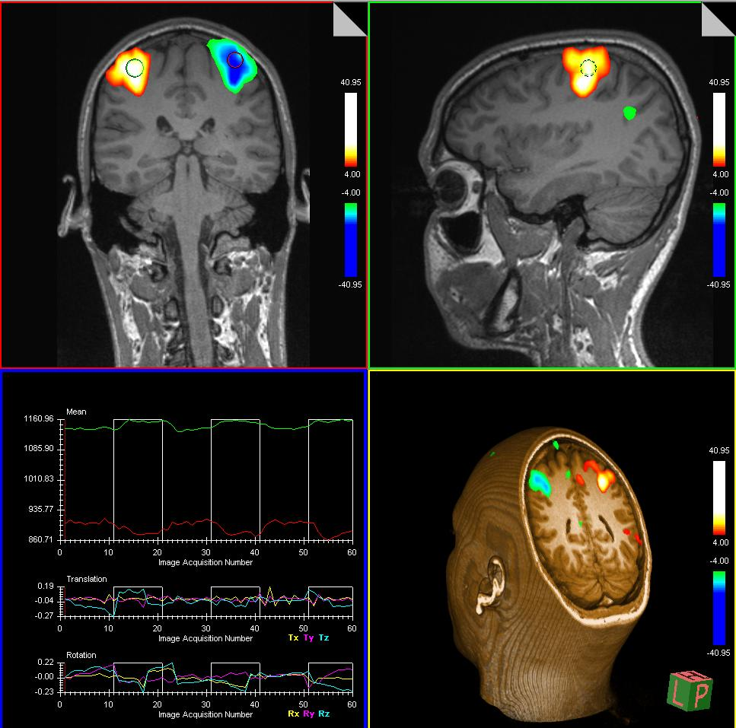
fMRI - what we commonly expect
Nowadays it is a “routine” tool in human studies
Results of a finger tapping experiment

Slide 5
Outline
Biochemical background:
  hemoglobin
  BOLD contrast
  hemodynamic response function
Technical needs:
  dedicated MR-sequences
  data preprocessing
Application:
  causes of neuronal activity changes
  fMRI data processing and presentation
  anesthesia options

Slide 6
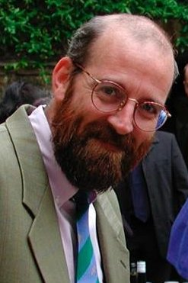
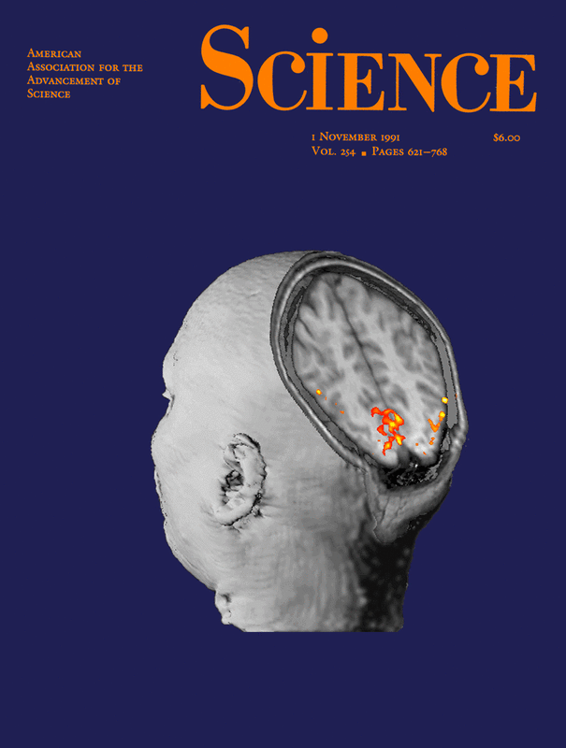
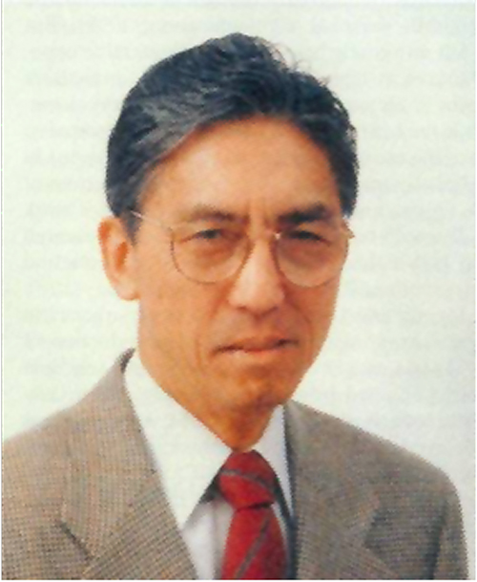
History in the making
John (Jack) Belliveau
1959-2014
Cover of November 1991 Science with an artist's rendition of the landmark paper by Belliveau et al demonstrating activation of the visual cortex using MRI.
Seiji Ogawa,
pioneer of BOLD fMRI, c. 1990

Slide 7
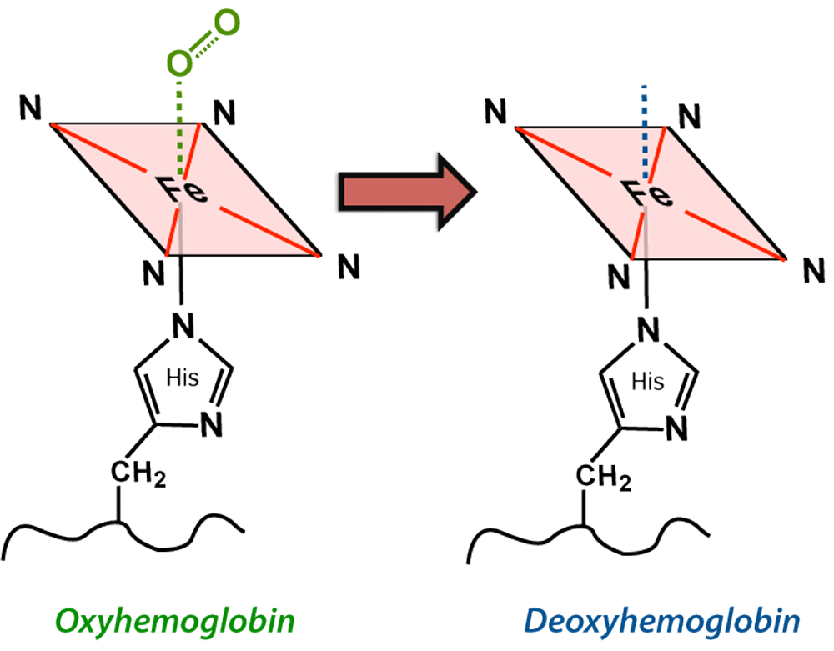
Hemoglobine
Oxygen transport in the blood via four heme groups
Heme changes upon oxygen binding:
Absorption (VIS/NIR)
Magnetic susceptibility:
Oxygenated blood: diamagnetic χ -0.3 ppm
Deoxygenated blood: paramagnetic χ 1.6 ppm
Deoxyhemoglobin is strongly paramagnetic due to 4 unpaired electrons at each iron center
Notes:
7

Slide 8
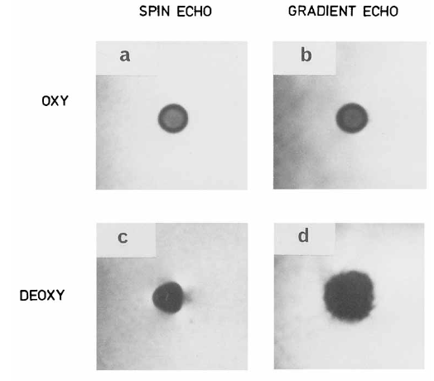
The BOLD effect
Why? Display functional areas in the brain during some stimulation/task
Function: BOLD (blood-oxygenation-level dependent) contrast
Spin Echo Gradient Echo Gradient Echo
Oxy
100% Oxygen
Deoxygenated blood shows stronger local signal “distortion” than oxygenated blood
Deoxy
normal air
Ogawa et al. MRM 1990
Notes:
Positron Range depends on maximum positron energy and describes an average distance which the positron travels in the body before it hits an electron an anhihilates.

Slide 9
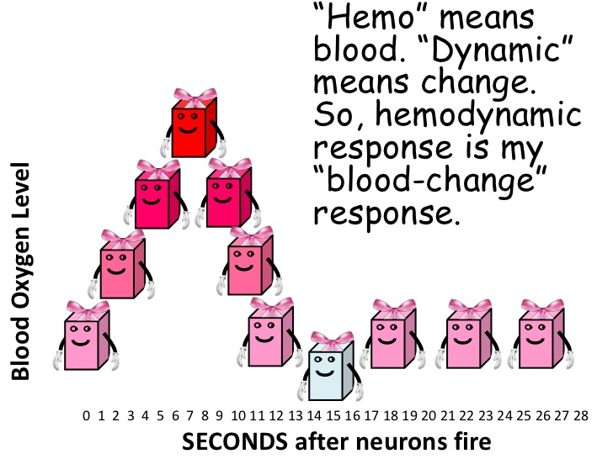
Hemodynamic response HRF
Hemo = blood
Dynamic = change
→ Hemodynamic response =
‘‘blood-change‘‘ response

Slide 10
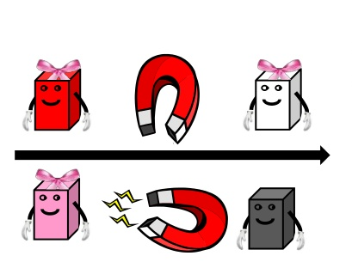
HRF signal change
But, instead of showing pictures
in red, pink and blue, the MRI
creates black and white images
Differences in magnetisation
are shown in shades of light and dark

Slide 11
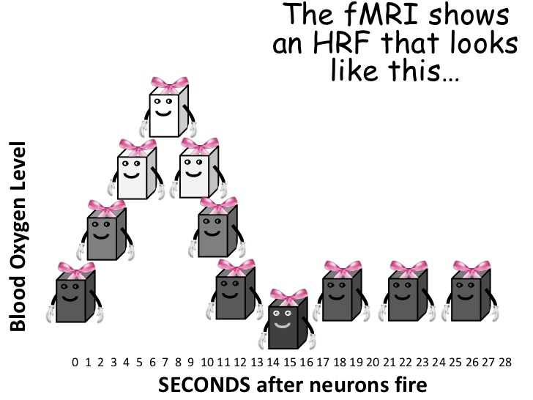
HRF signal change
The fMRI shows a HRF dependent
signal change that looks like this…

Slide 12
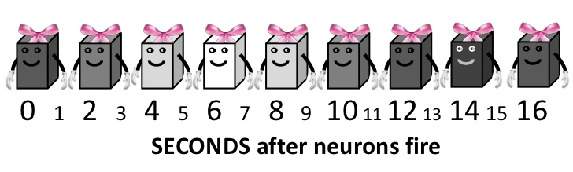
HRF signal change
…because the signal intensity tells us the blood oxygen level
we really do not need a vertical axis:
we can just use one line…

Slide 13
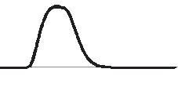
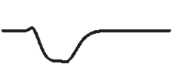
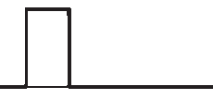
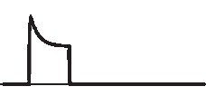
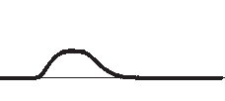
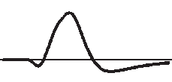
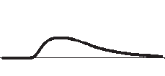
Hemodynamic response
CBF
≈5-50%
OEF
≈-(2-10%)
Stimulus
neuronal activity
CMRO₂
≈0-20%
BOLD
CBV
≈1-2%
≈20%

Slide 14
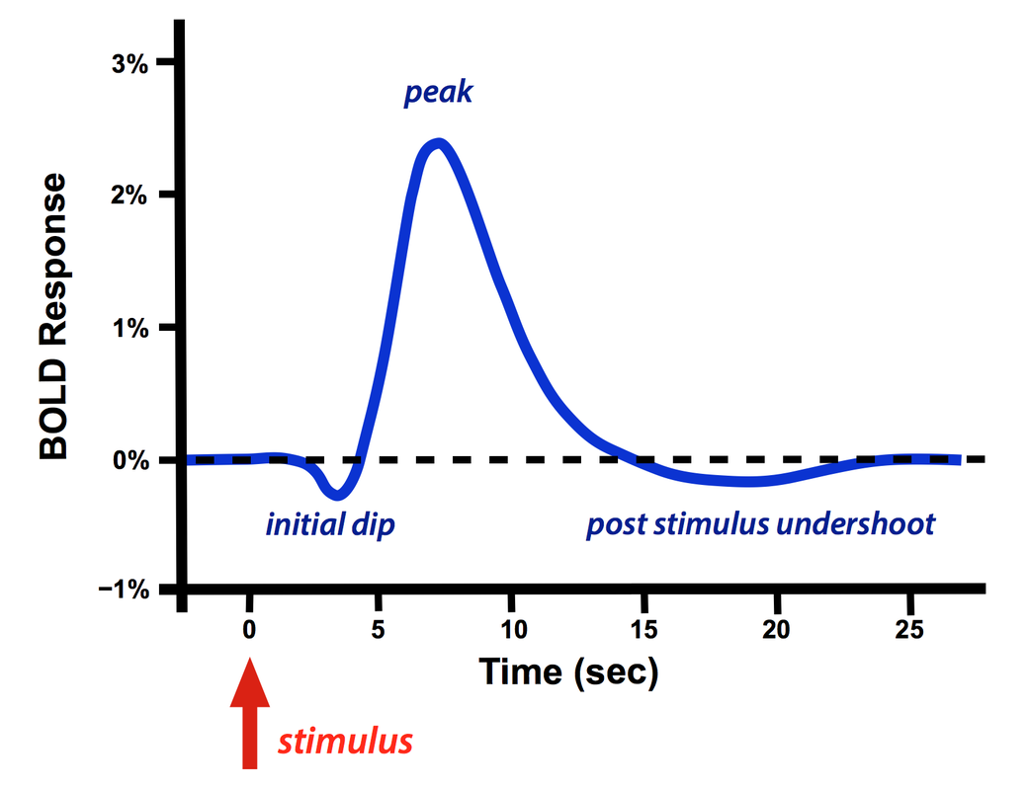
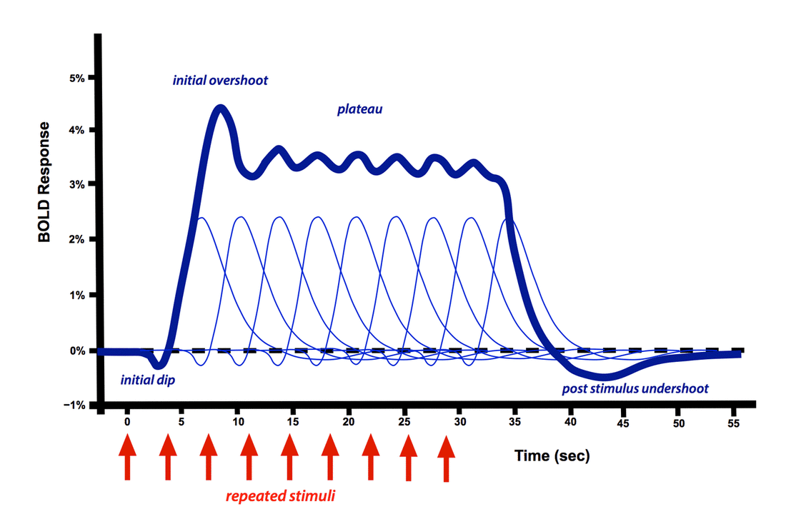
Hemodynamic response function HRF
Initial dip: a) early increased OE
b) early increase of CBV
Peak: massive CBF increase
Post stimulus undershoot: a) slow arterial CBV normalisation,
b) resetting of neurons for their resting state

Slide 15
Outline
Biochemical background:
  hemoglobine
  BOLD contrast
  hemodynamic response function
Technical needs:
  dedicated MR-sequences
  data preprocessing
Application:
  causes of neuronal activity changes
  fMRI data processing and presentation
  anesthesia options

Slide 16
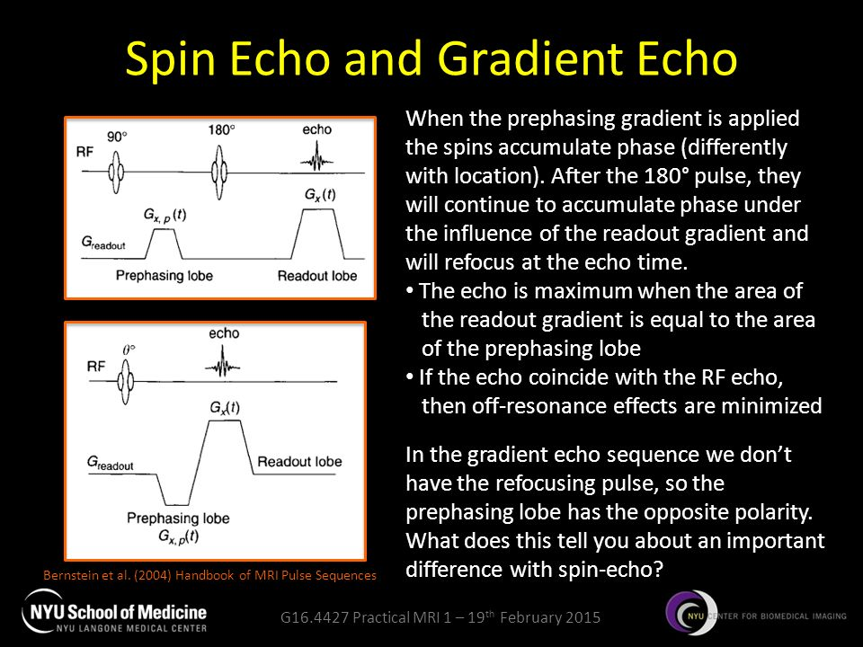
MR Sequences
Spin Echo
T2 weighted
signal generated by 2 RF-pulses
compensates for field inhomogeneities
Gradient Echo
T2* weighted
Signal generated by 1 RF-pulse +
gradient reversal
fast signal acquisition due to short TE and TR
very sensitive for static field shifts
Notes:
16

Slide 17
Spin Echo vs. Gradient Echo
Spin Echo: sharp contrast – low signal intensity
Gradient Echo: distorted contrast – strong signal
Notes:
17

Slide 18
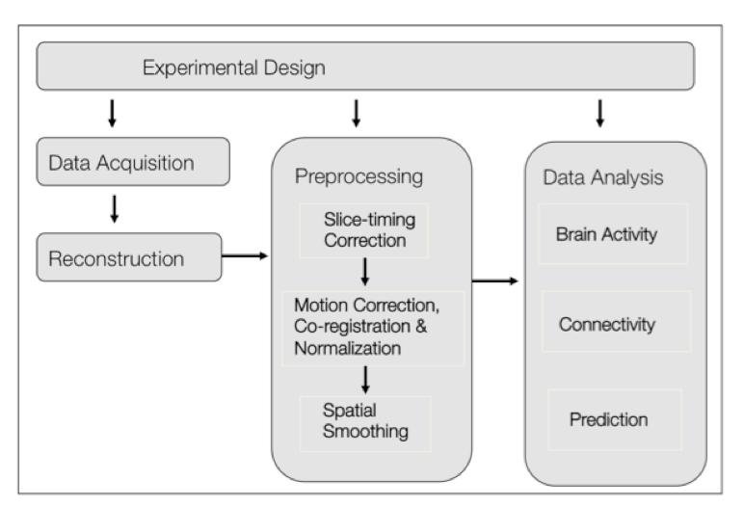
Preprocessing steps
Notes:
18

Slide 19
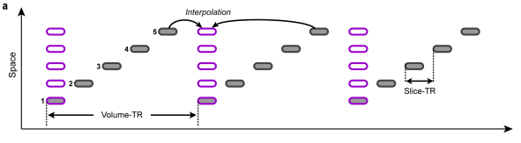
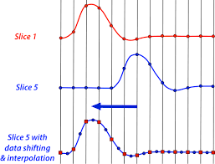
Slice-timing correction STC
- STC improves statistical power
- STC is most important when the speed of
acquisition is lower
- STC works by interpolating between images
(directly or by Fourier transforms)
Notes:
19

Slide 20
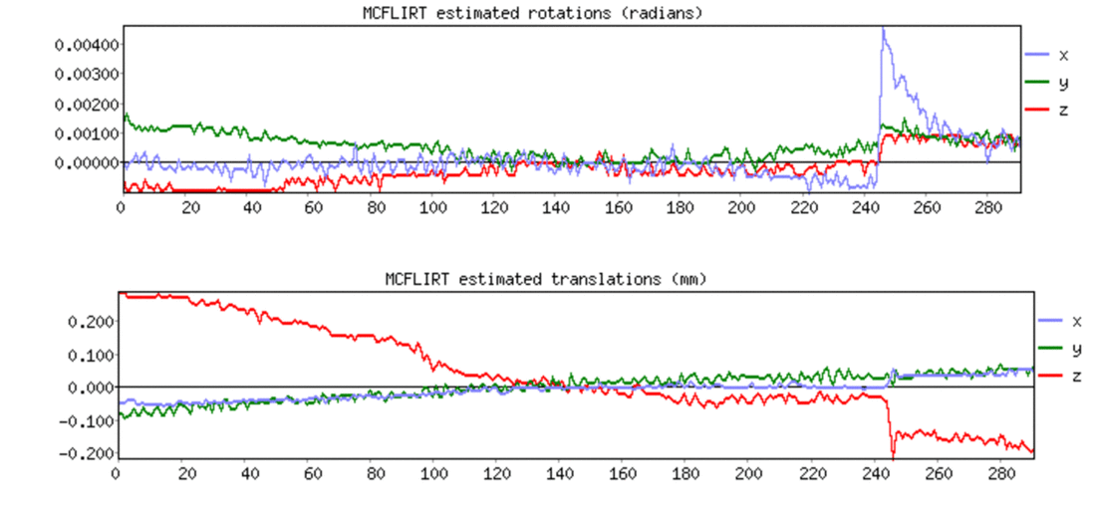
Motion correction
Head motion is probably the most severe problem in fMRI
MC incorporates the estimation of the movement based on
a reference volume
The realignment is applied by rigid body transformation (pitch, roll, yaw)
Notes:
20

Slide 21
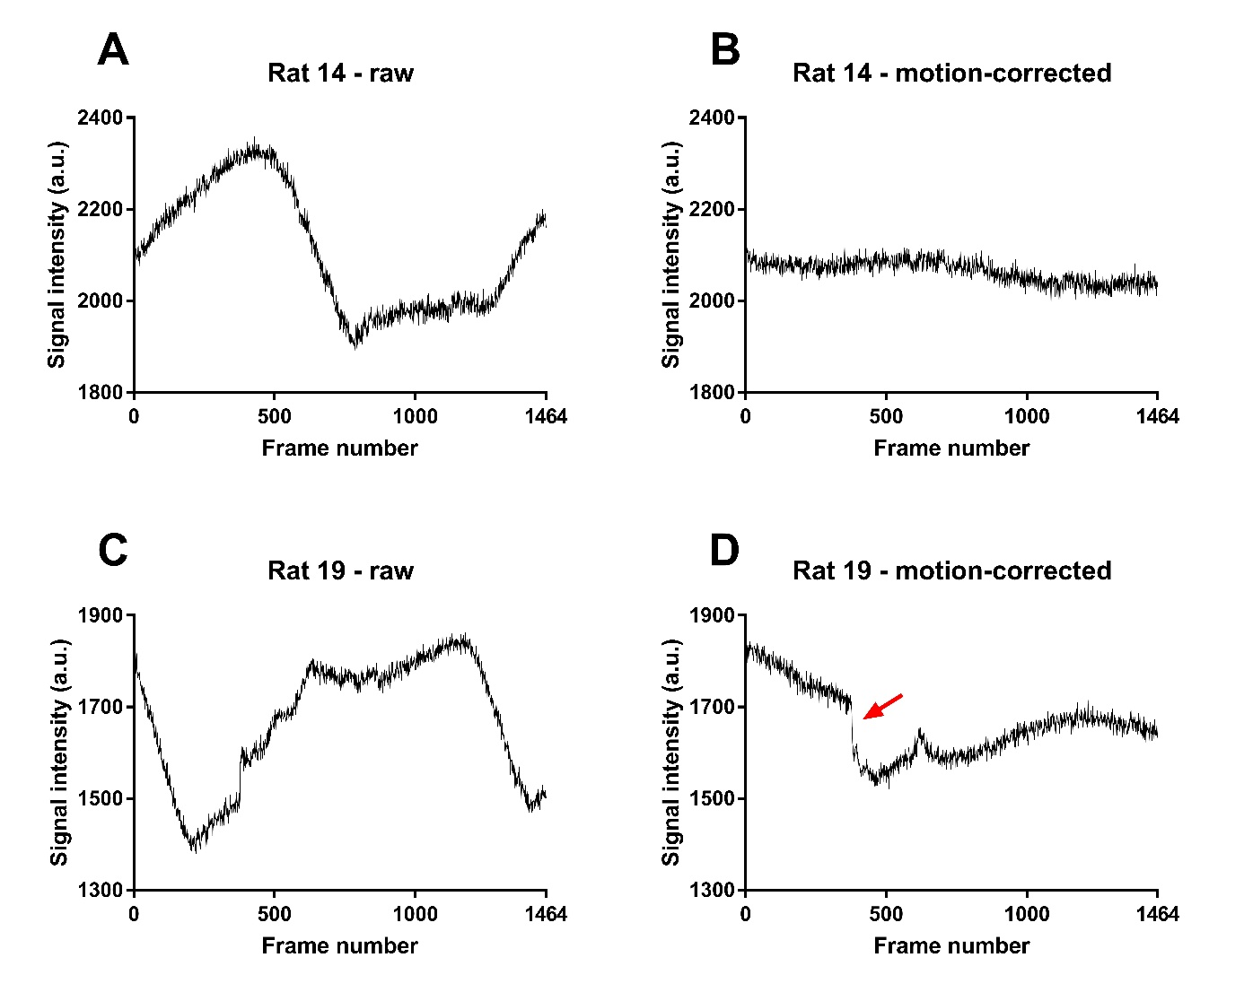
Motion correction - example
→ data set of Rat14 can be used for analysis
→ data set of Rat19 needs to be excluded
Notes:
21

Slide 22
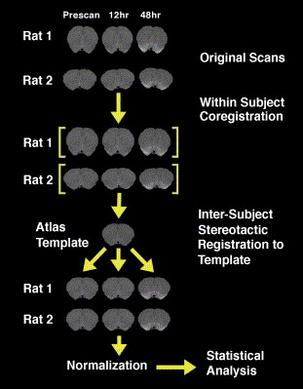
Coregistration
→ Within subject alignment
→ Inter-subject alignment
Due to small volumes of the rodent brain
manual pre-coregistration and visual
inspection is mandatory
Notes:
22

Slide 23
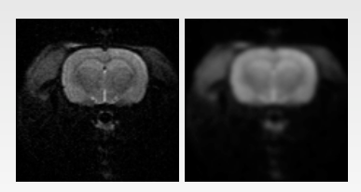
Spatial smoothing
→ Data points are averaged with their neighbours
→ effect of low pass filtering (high frequencies of the signal are removed)
FWHM for rats typically 1.0 – 2.0 mm
before
after
Notes:
23

Slide 24
Spatial smoothing
Benefits
Improvement of signal to noise ratio (SNR) → increased sensitivity
Improving validity of the statistical tests by making the error distribution more normal
Drawbacks
Reduction of spatial resolution
Edge artifacts
Merging of close activation peaks
Extinction of small meaningful activations (attenuation below significance threshold)
Mislocalization of activation peaks
before
after
Notes:
24

Slide 25
Outline
Biochemical background:
  hemoglobine
  BOLD contrast
  hemodynamic response function
Technical needs:
  dedicated MR-sequences
  data preprocessing
Application:
  causes of neuronal activity changes
  fMRI data processing and presentation
  anesthesia options

Slide 26
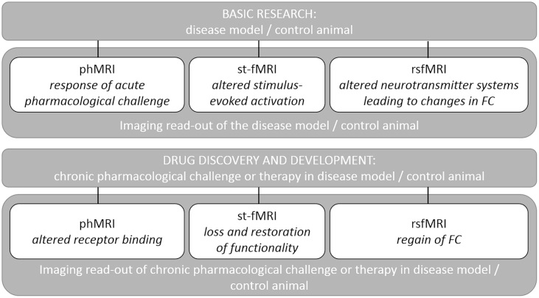
Application overview
Notes:
26

Slide 27
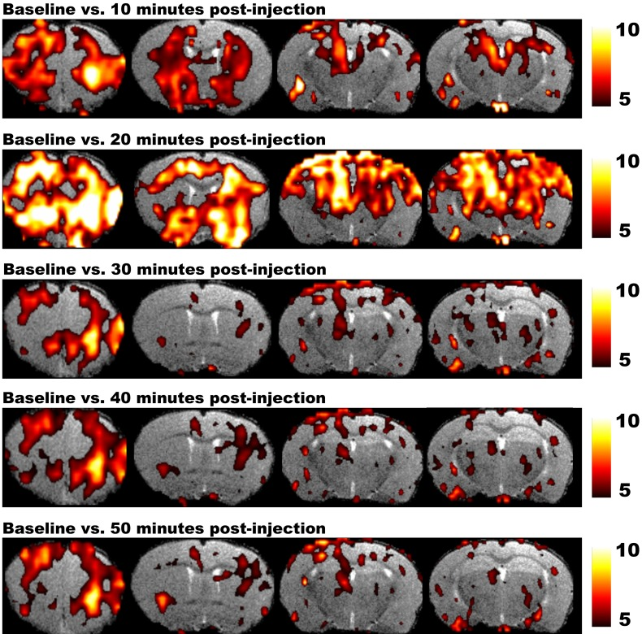
phMRI
Voxel wise t-Testing
Notes:
27

Slide 28
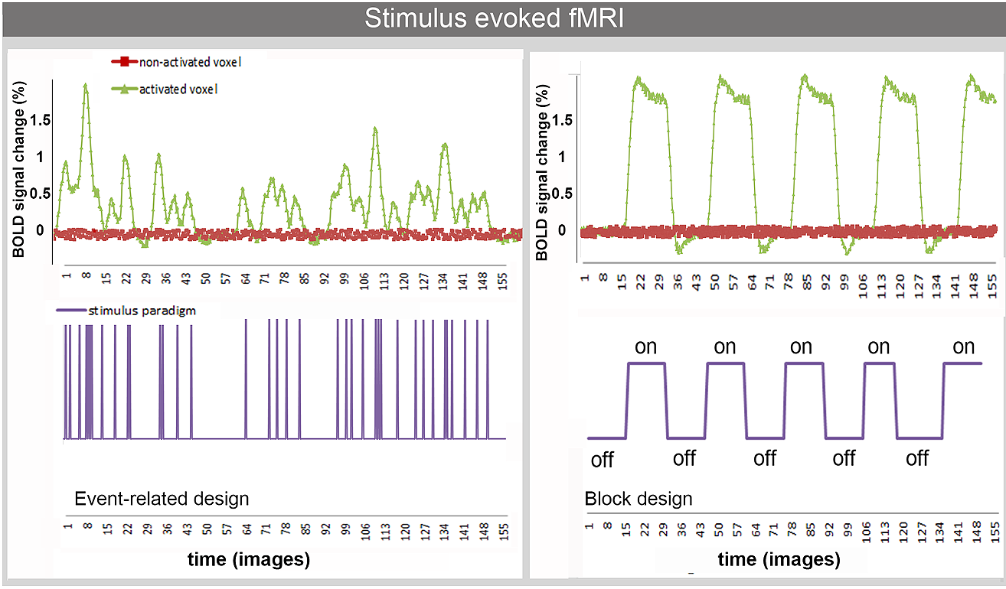
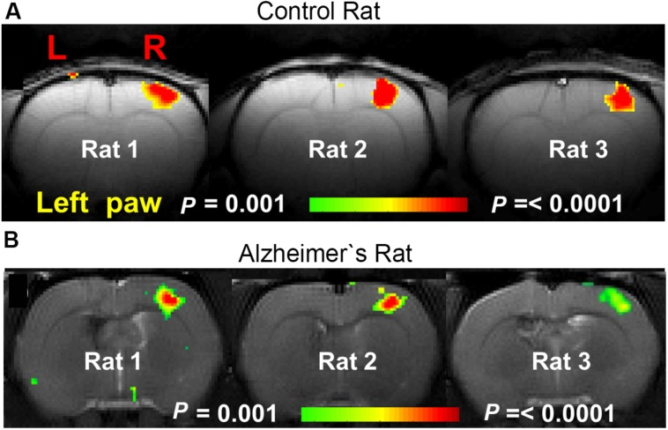
st-fMRI
Voxel wise t-Testing
Notes:
28

Slide 29
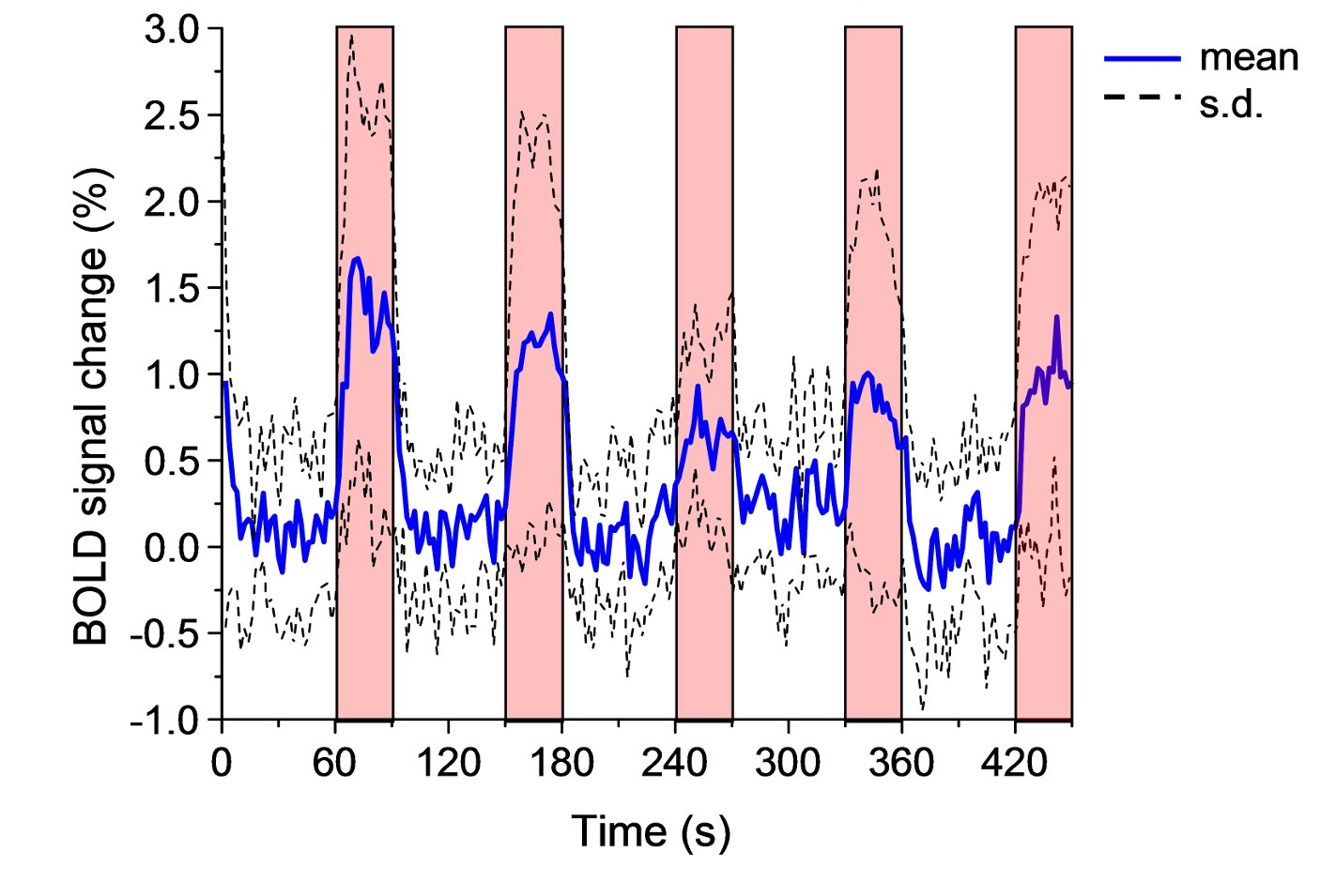
rs-fMRI
Stimulation
blocks
Are these fluctuations just noise? → Resting State / Connectivity

Slide 30
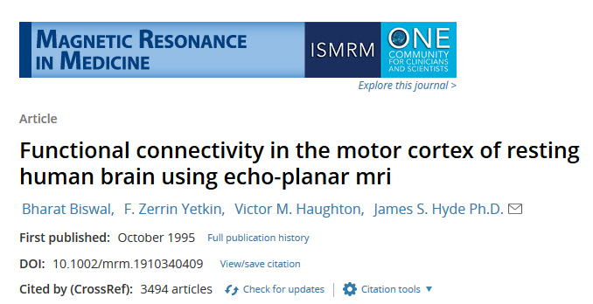
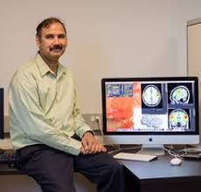
rs-fMRI
Prof. Bharat Biswal, NJIT

Slide 31
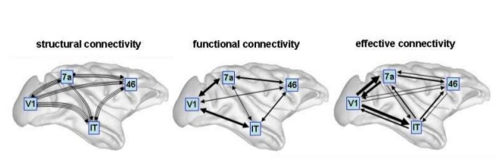
Brain connectivity
Axonal connections | Statistical dependencies between time series | Directed influences between regions
Methods: DTI, fiber-tracking | Methods: fMRI, PET, EEG, MEG | Methods: fMRI, PET, EEG, MEG

Slide 32
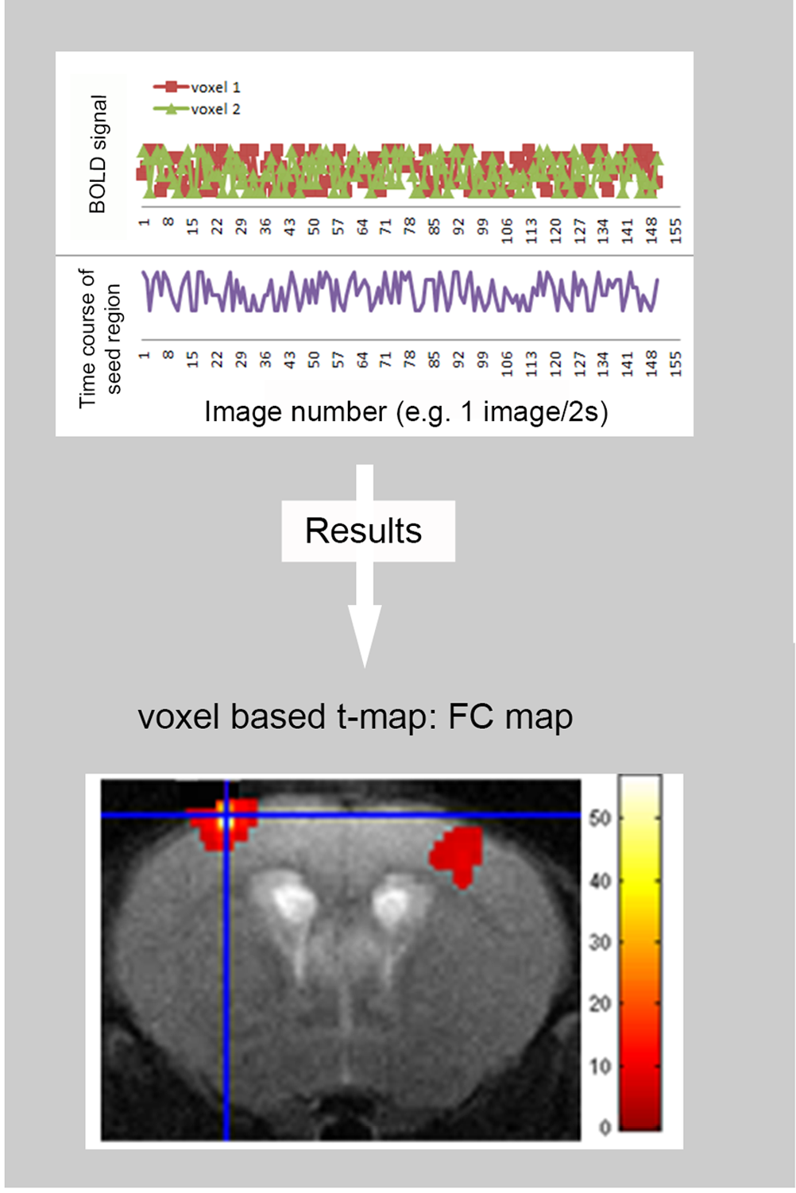
Seed-based Analysis
extracts BOLD time-series data from a “seed” - a priorly selected voxel or ROI
assesses the correlation between the averaged BOLD signal of the seed and the time course of all other brain voxels
→ ideal if a specific target region exists
Notes:
32

Slide 33
Independent Component Analysis (ICA)
- decomposing something complex into simpler components
- useful for searching a set of underlying sources of resting-state signals that are maximally independent of each other which can explain the resting-state patterns
→ decompose the entire spatial-temporal map
into spatial and temporal components
→ ideal for exploratory analysis
Notes:
33

Slide 34
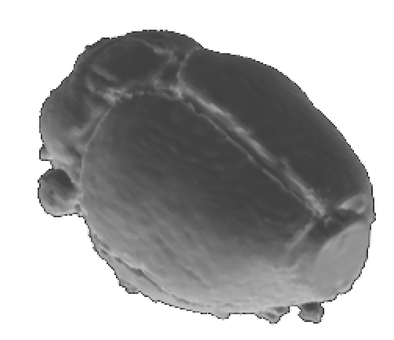
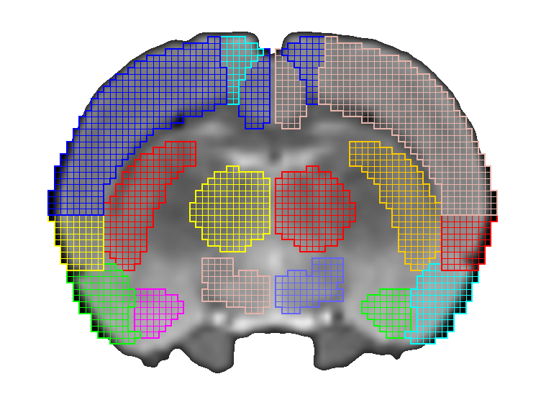
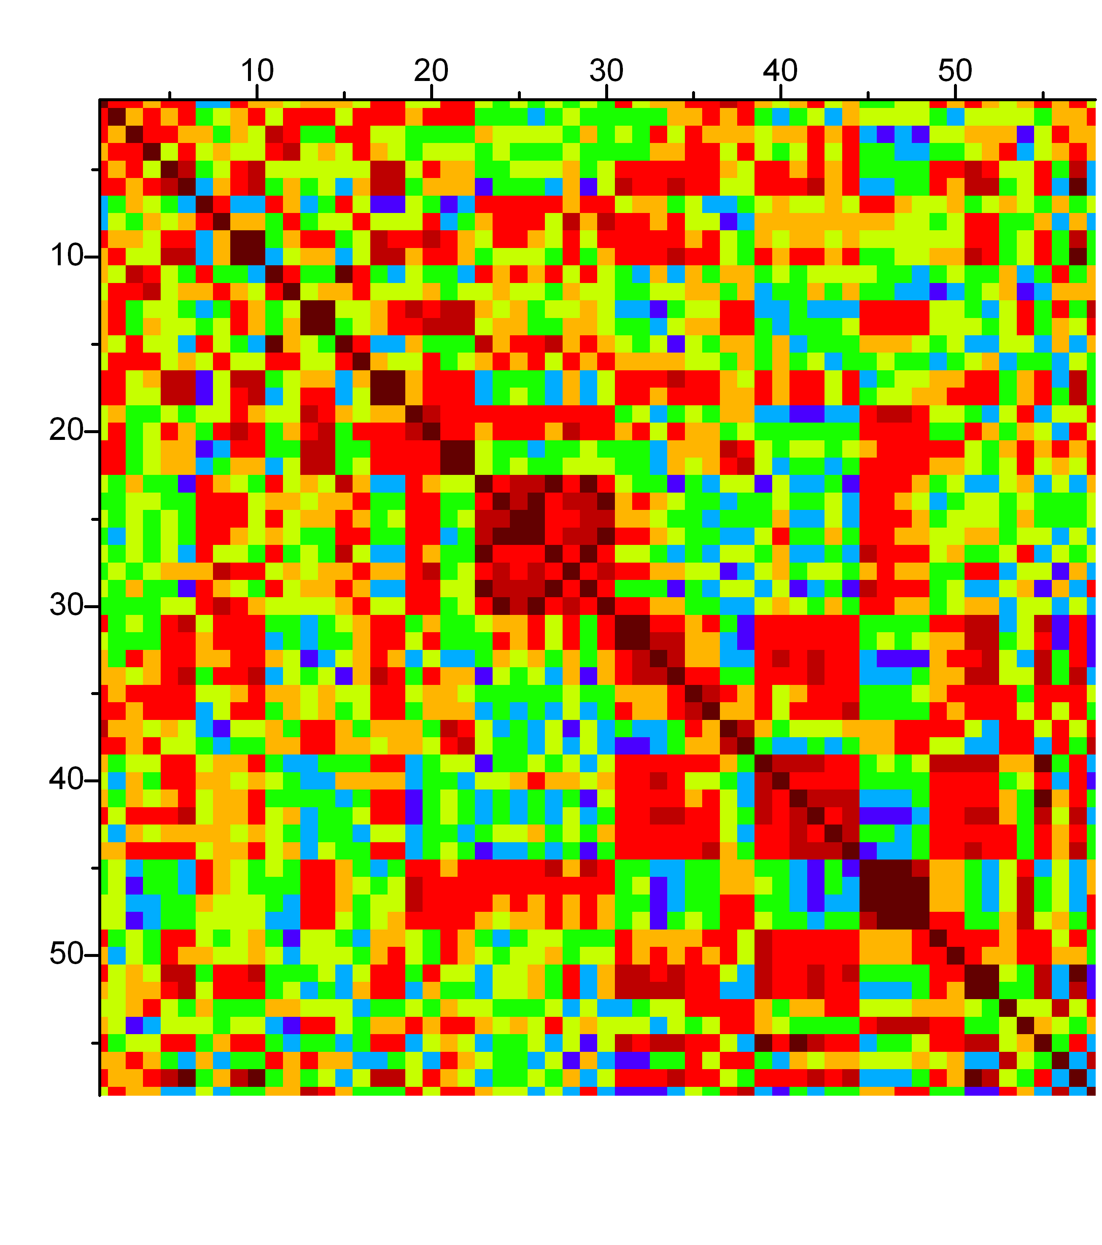
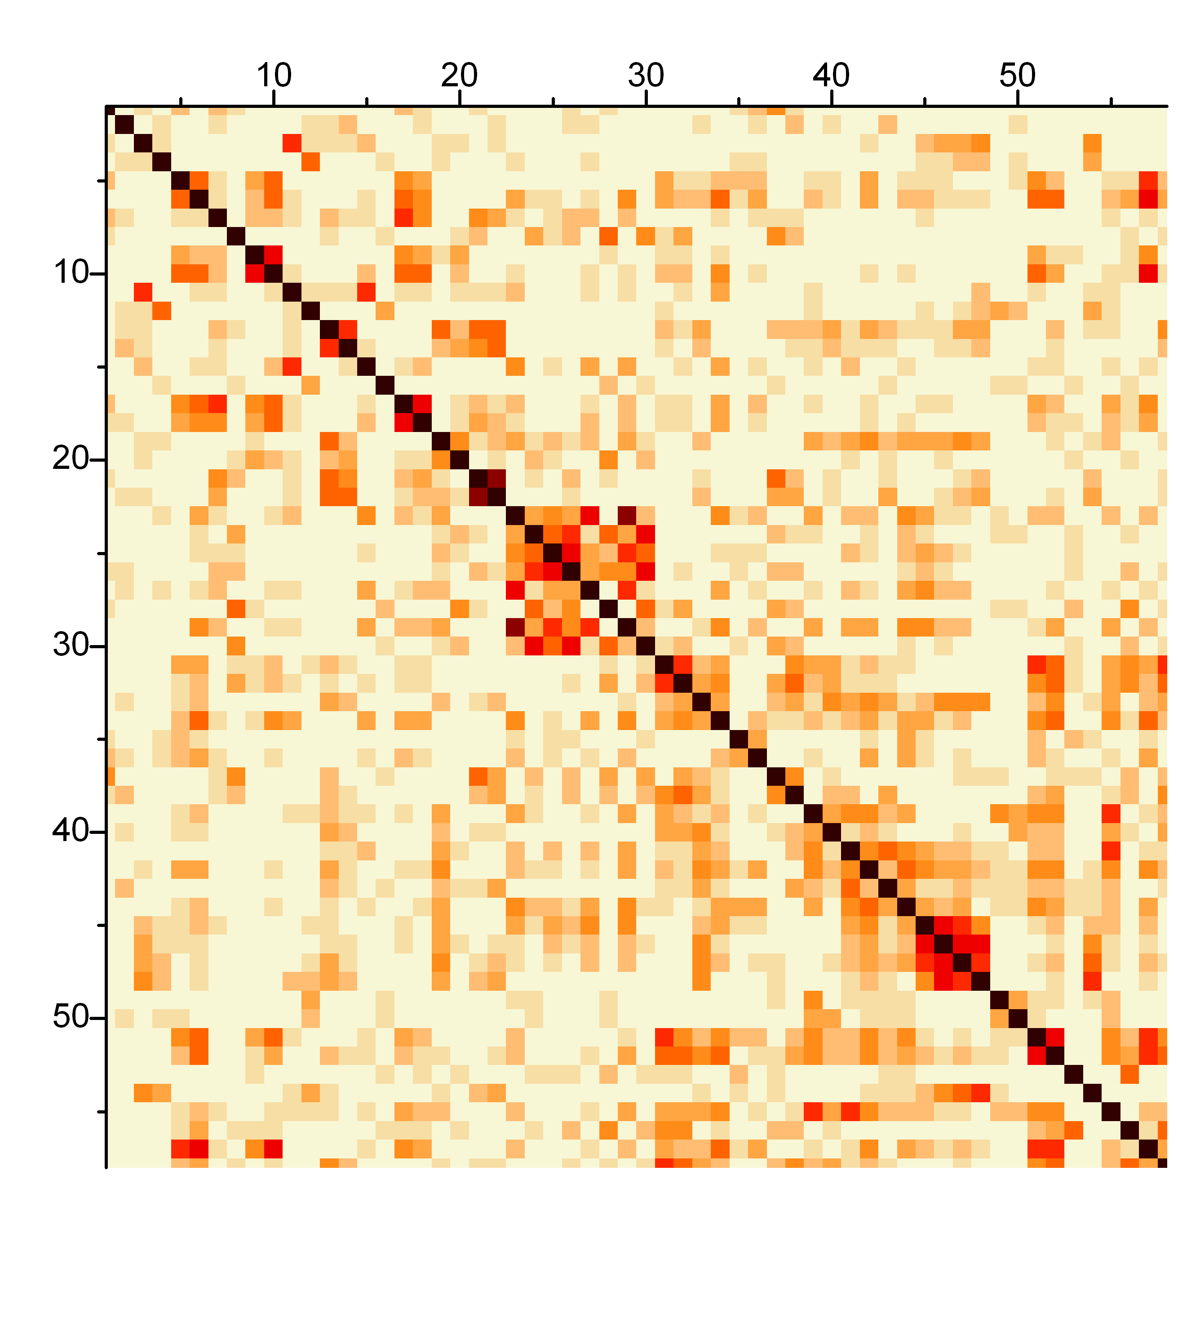
Graph theory based PET data analysis
MR and PET Data
Selection of Regions / Nodes
Signal in Nodes
Positive Correlation
Negative Correlation
R=0.8
R=- 0.7
Brain regions
Uptake Region B
Uptake Region B
Correlation Matrix
Signal in Nodes
Node A
Uptake Region A
Uptake Region A
Node B
No Correlation
Measurements
R=0
Data of individual Animals
or
Data over timepoints
Selection
Network
Connection
Uptake Region B
Uptake Region A
Nodes
Line thickness as a
measure of connection strength
Notes:
34

Slide 35
Pros and cons of rs-fMRI
Pros:
Easy to acquire
Ideal for short measurements
One single measuremnet allows to study different functional networks in the brain
Ideal for exploratory analysis
(Potentially) helfpful as clinical diagnostic tool (e.g. epilepsy, neurodeg.)
Cons:
Source of the spontaneous 0.1 Hz oscillations in BOLD signal debatable (a more general fMRI problem)
Data outcome depends on experimental design (anesthesia, genetic background, treatment)
Only correlations, no causal relationships
Notes:
35

Slide 36
The holy grail - anesthesia
→ minimize stress and prevent motion artifacts
But: cerebral hemodynamic response shows anesthesia-specific modulations
alpha-chloralose:
GABA-A agonist
gold standard for fMRI (minor cardiovascular effects)
minimal supression of neuronal activation
Medetomidine:
α2 agonist
sedation rather deep anesthesia
induces cerebral vasoconstriction
Isoflurane:
GABA-A receptor
Vasodilation in a dose dependent manner
Propofol and urethane:
- enhance GABAergic transmission
Combination
Notes:
36

Slide 37
Take home messages: small animal fMRI
Biochemical / physiological background:
  differences in oxygenated / deoxygenated hemoglobin causes signal changes
  HRF characterizes the BOLD effect
Technical aspects:
  BOLD produces time-dependent T2 and T2* alterations
  gradient echo (GRE) vs. spin echo (SE) sequences
  raw data sets need several preprocessing steps
Applications:
  ph-fMRI for pharmacological interventions
  st-fMRI for task / stimulus induced brain activation
  rs-fMRI to study brain connectivity (connectomics)
  choice of anesthesia is key to success
Notes:
37

